Slide 1


Broadcast Variable
Data Engineering Studies

Slide 2
Broadcast Variable
Used for improve the performance Spark
Avoids data shuffle
Reduces network I/O operations
Read-only shared variables that are cached and available on all nodes in a cluster.
Joining – when one of the tables is small. Small table is cached in all the nodes.
Small table is sent to the worker nodes though the driver
Data Engineering Studies

Slide 3
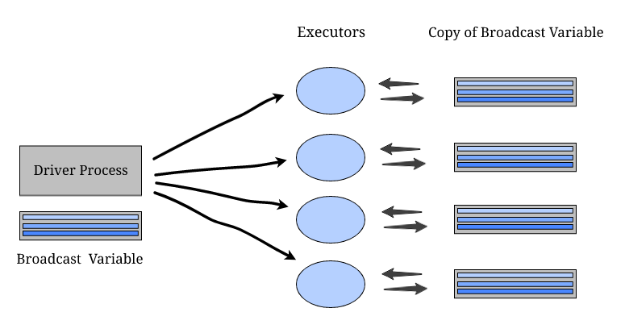


Broadcast Variable
Data Engineering Studies

Slide 4
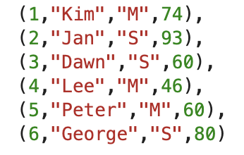
Broadcast Variable
Data Engineering Studies

Slide 5




Broadcast Variable
Data Engineering Studies

Slide 6
Broadcast Variable
Data Engineering Studies

Slide 7
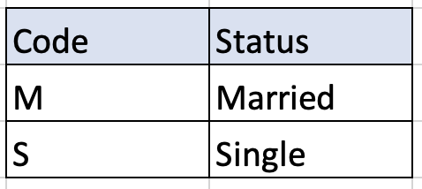
Broadcast Variable
Data Engineering Studies

