Slide 1


Accumulator Variable
Data Engineering Studies

Slide 2
Accumulator Variable
Accumulator is a shared variable that is used to perform Aggregate operations (sum and counter)
Shared by all executors to update and add information
Updates from the workers get propagated automatically to the driver program.
Only the driver program is allowed to access the Accumulator variable using the value property
Data Engineering Studies

Slide 3
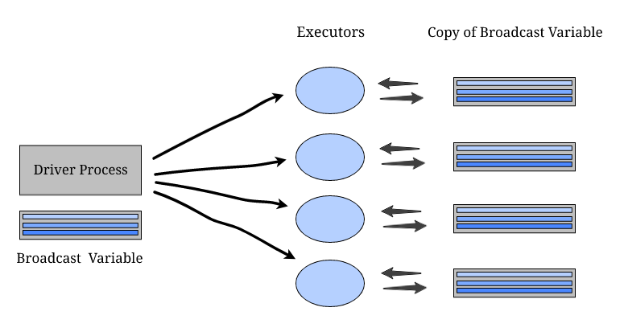


Accumulator Variable
Data Engineering Studies

Slide 4
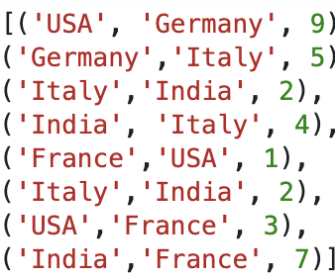
Accumulator Variable
Data Engineering Studies

Slide 5



Accumulator Variable
Data Engineering Studies

