Slide 1


Partition
Data Engineering Studies

Slide 2
Partition:
Splitting the data into multiple partitions to execute transformations on multiple partitions in parallel which allows completing the job faster.
Partition is the basic unit of Spark computation
Partition is a subset of a Data frame
Transformation on a data partition is called task
Each task will take place in one Spark Core
By default, number of partitions = number of cores
Data of each partition resides in a single machine.
Data Engineering Studies

Slide 3
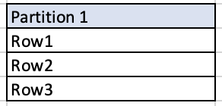
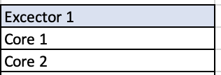
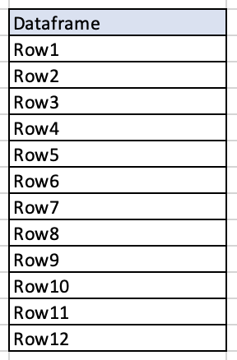
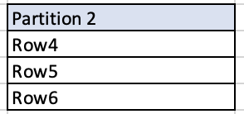
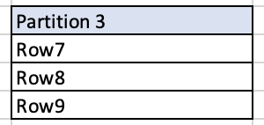
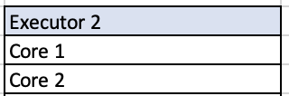
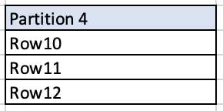
Partition:
Data Engineering Studies

Slide 4
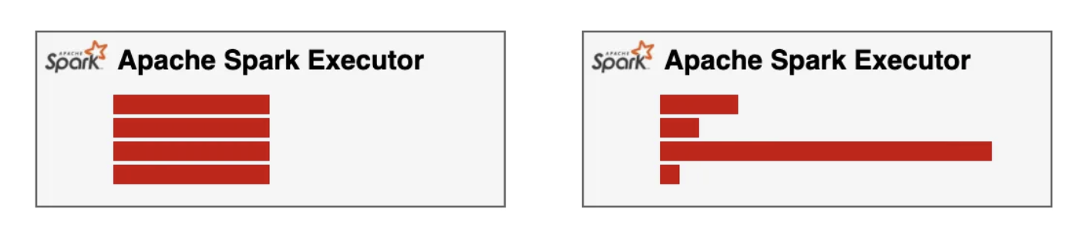
Key Terminologies
Data Shuffle - Move the data from one partition to other partitions.
Data Skew - occurs when the distribution of data across partitions is uneven, leading to some partitions having much larger data sizes than others

Slide 5
Partition Types:
Partition in memory: repartition() or coalesce()
Partition on disk: - partitionBy()
Data Engineering Studies

Slide 6
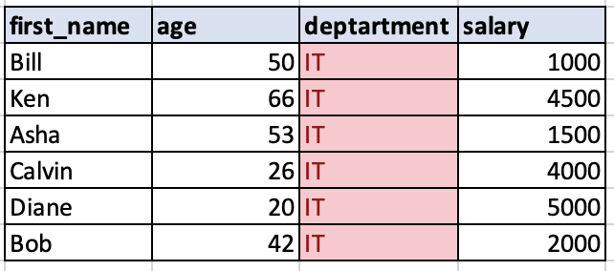
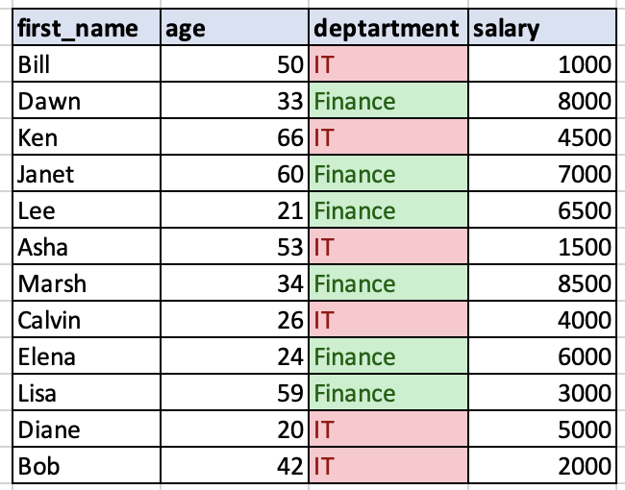
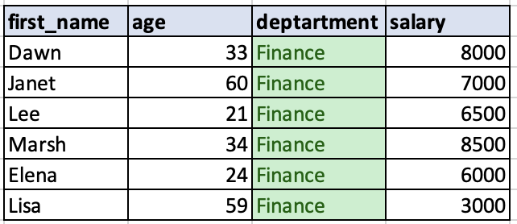
Partition By
Partition based on column values while writing DataFrame to Disk/File system
Data Engineering Studies

Slide 7
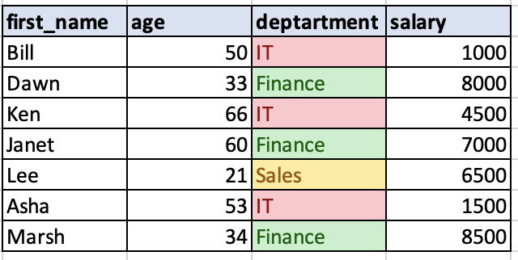
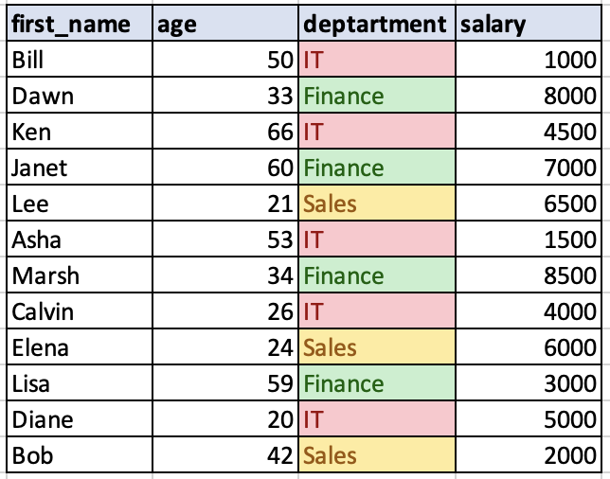
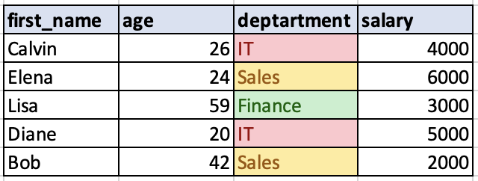
Coalesce
Reduces the number of partitions
Avoid the shuffle and try to merge the partition in the same machine
Output partition will have uneven size
coalesce(2)

Slide 8
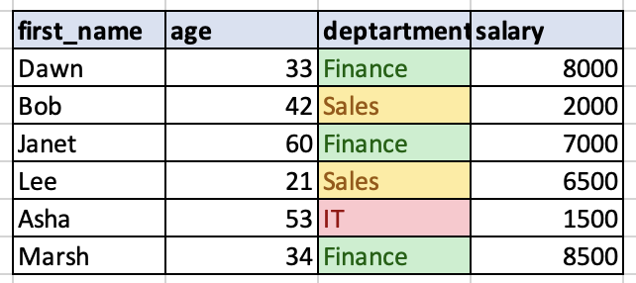
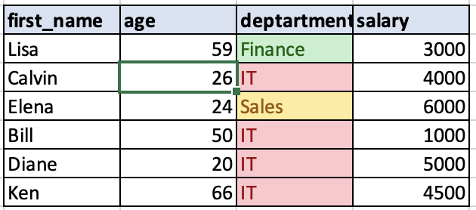
Repartition
Reduces or increases the number of partitions
Expensive operation – fully shuffle the data over the network and redistribute the data evenly.
repartition(2)

Slide 9
Faitus Jeline Joseph
https://www.linkedin.com/in/faitusjeline
Data Engineering Studies

