Slide 1


Explode
Explode_outer
Posexplode
Posexplode_outer
Data Engineering Studies

Slide 2
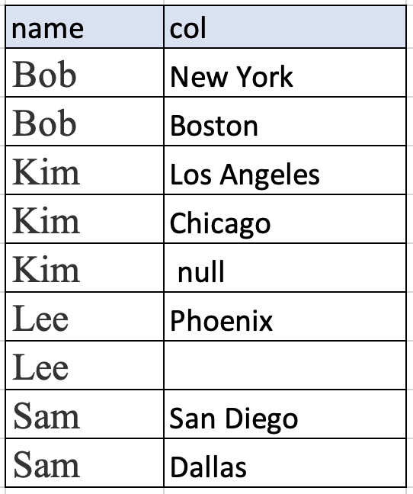
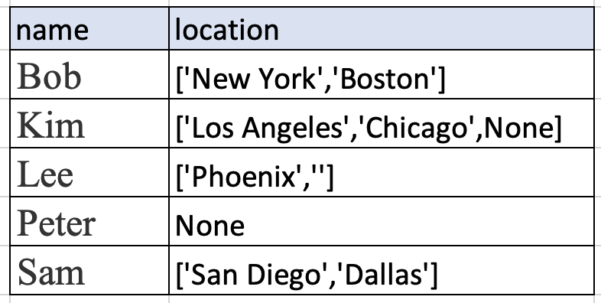
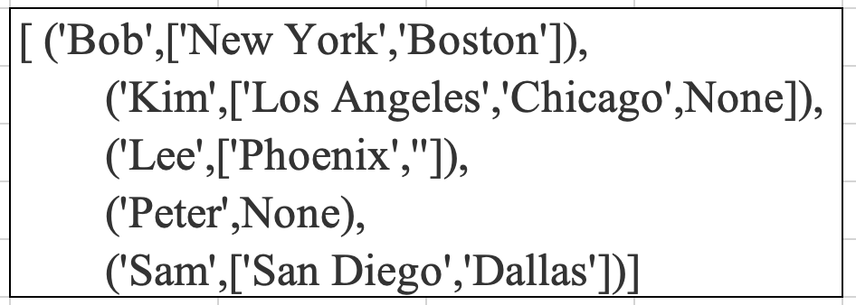
Explode
Returns a new row for each element in the given array.
Default column name col for elements in the array
If array is null that row is eliminated
Data Engineering Studies

Slide 3
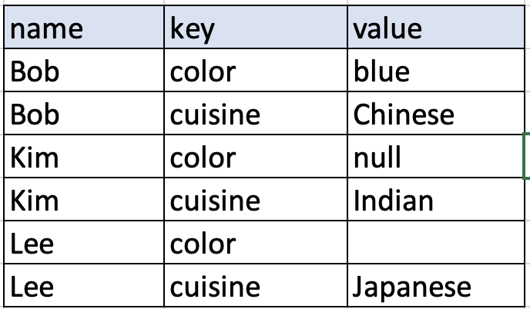
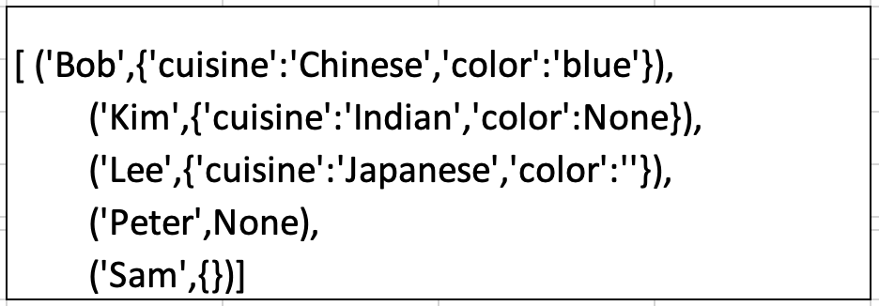
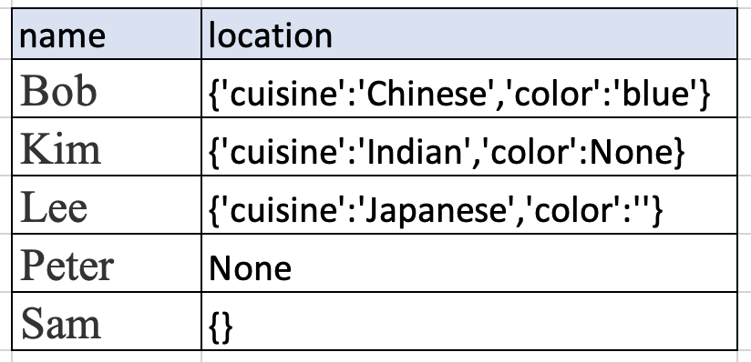
Explode
Returns a new row for each element in the given map.
Default column name key and value for elements in the map
If map is null that row is eliminated
Data Engineering Studies

Slide 4
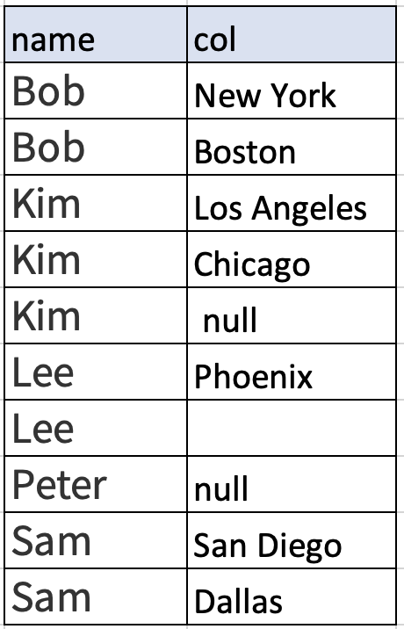
Explode_outer
Returns a new row for each element in the given array.
Default column name col for elements in the array
Unlike explode, if the array/map is null or empty then null is populated.
Data Engineering Studies

Slide 5
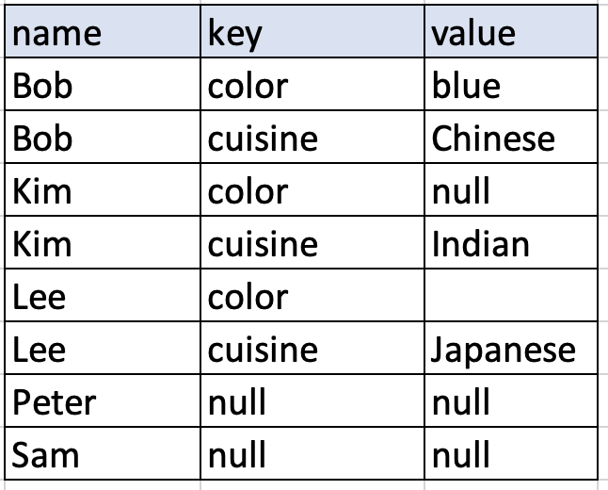
Explode_outer
Returns a new row for each element in the given map.
Default column name key and value for elements in the map
Unlike explode, if the array/map is null or empty then null is populated.
Data Engineering Studies

Slide 6
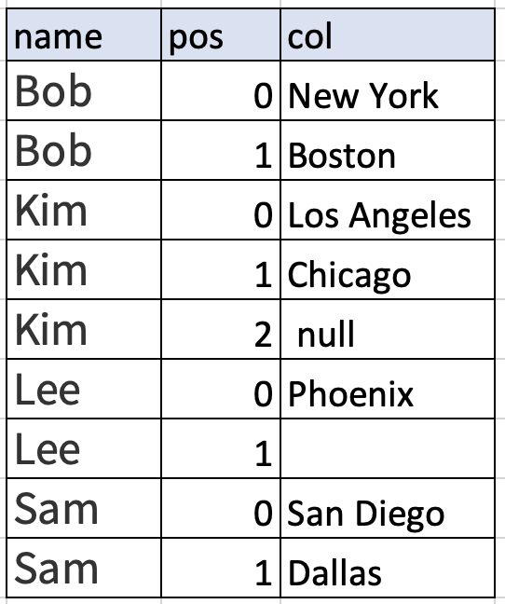
Posexplode
Returns a new row for each element in the given array.
Default column name pos for position, and col for elements in the array
If array is null that row is eliminated
Data Engineering Studies

Slide 7
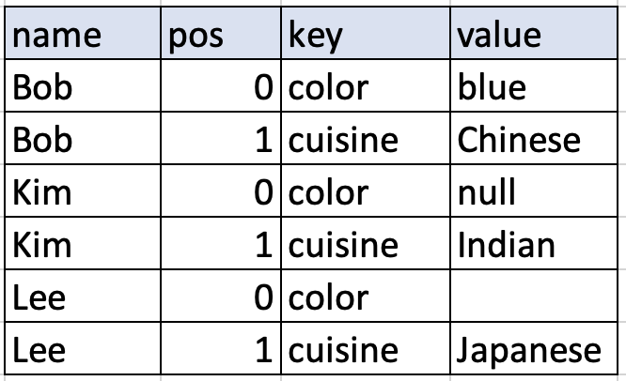
Posexplode
Returns a new row for each element in the given map.
Default column name pos for position, and array and key and value for elements in the map
If map is null that row is eliminated
Data Engineering Studies

Slide 8
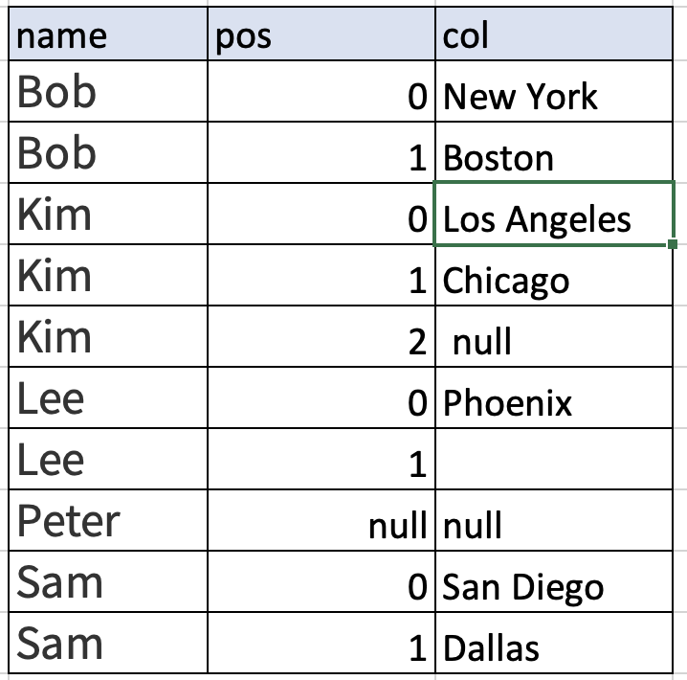
Posexplode_outer
Returns a new row for each element in the given array.
Default column name pos for position, and col for elements in the array
Unlike explode, if the array/map is null or empty then null is populated.
Data Engineering Studies

Slide 9
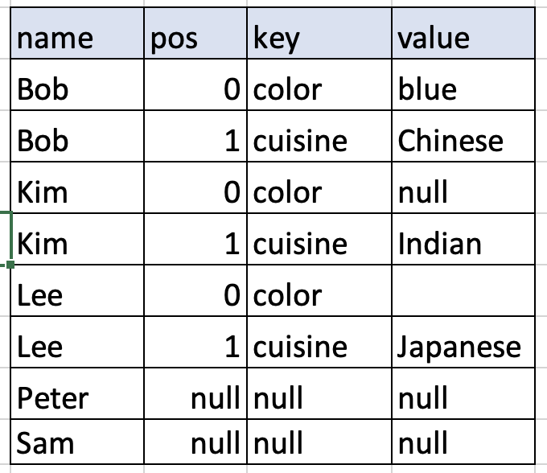
Posexplode_outer
Returns a new row for each element in the given map.
Default column name pos for position, and array and key and value for elements in the map
Unlike explode, if the array/map is null or empty then null is produced.
Data Engineering Studies

