Slide 1
Overview of Spark
Agenda:
Big data concepts
Hadoop, MapReduce and Spark
What is Spark?
Why Python?
Pyspark
Faitus Jeline Joseph
Data Engineering Studies
@faitusjeline

Slide 2
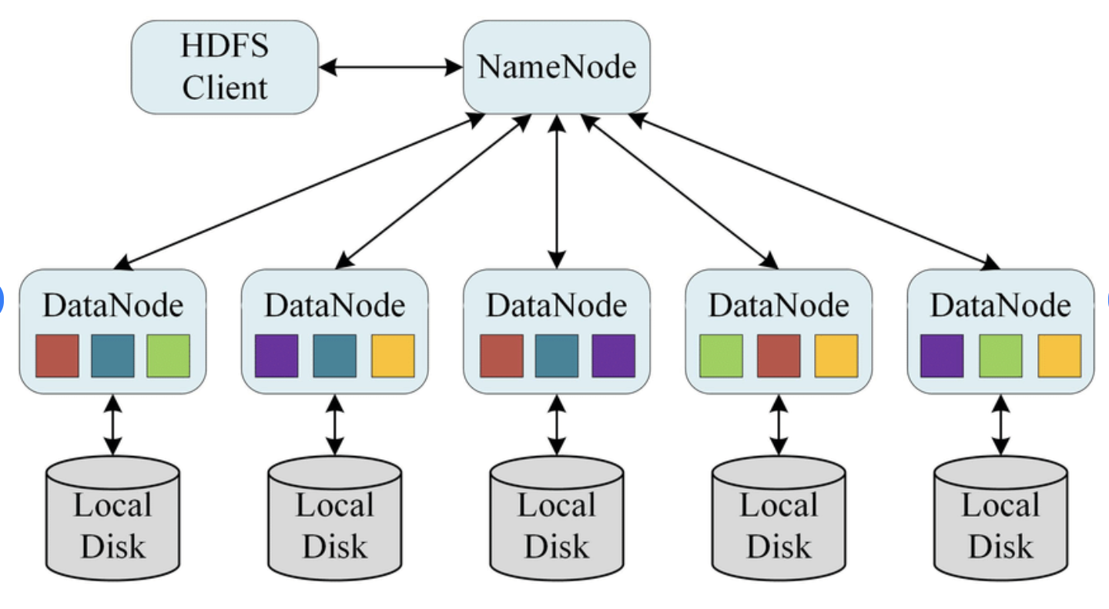

Local Vs Distributed System

Slide 3
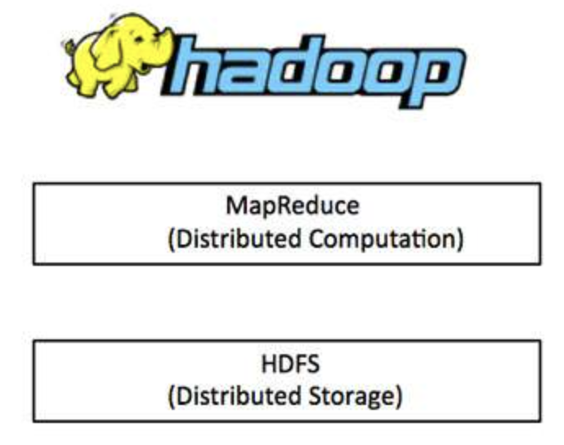

Slide 4

Spark
Spark
Spark vs MapReduce
Spark RDDs
Spark Data Frames

Slide 5
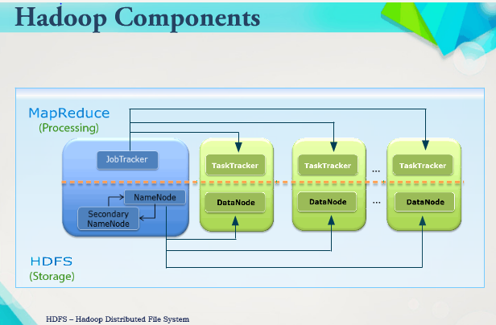

Slide 7
Hadoop MapReduce Vs Apache Spark of Spark
Hadoop MapReduce | Apache Spark
Fast | 100x faster than MapReduce
Stores Data on Disk | Stores Data in Memory
Good for Batch Processing | Good for Real-time Processing
Written in Java | Written in Scala
Agenda:
Big data concepts
Hadoop, MapReduce and Spark
What is Spark?
Why Python?
Pyspark
@faitusjeline

Slide 8
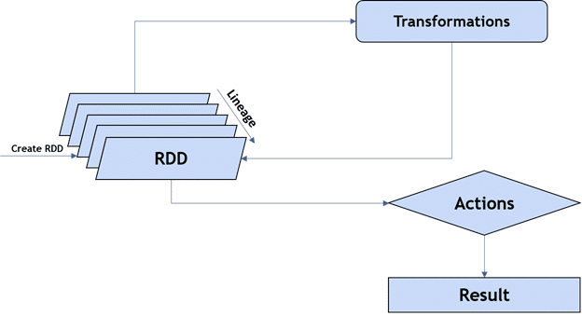
Resilient Distributed Datasets (RDDs)
Resilience
Distributed
Lazy evaluation
Immutability
In-memory computation
Partitioning

Slide 9
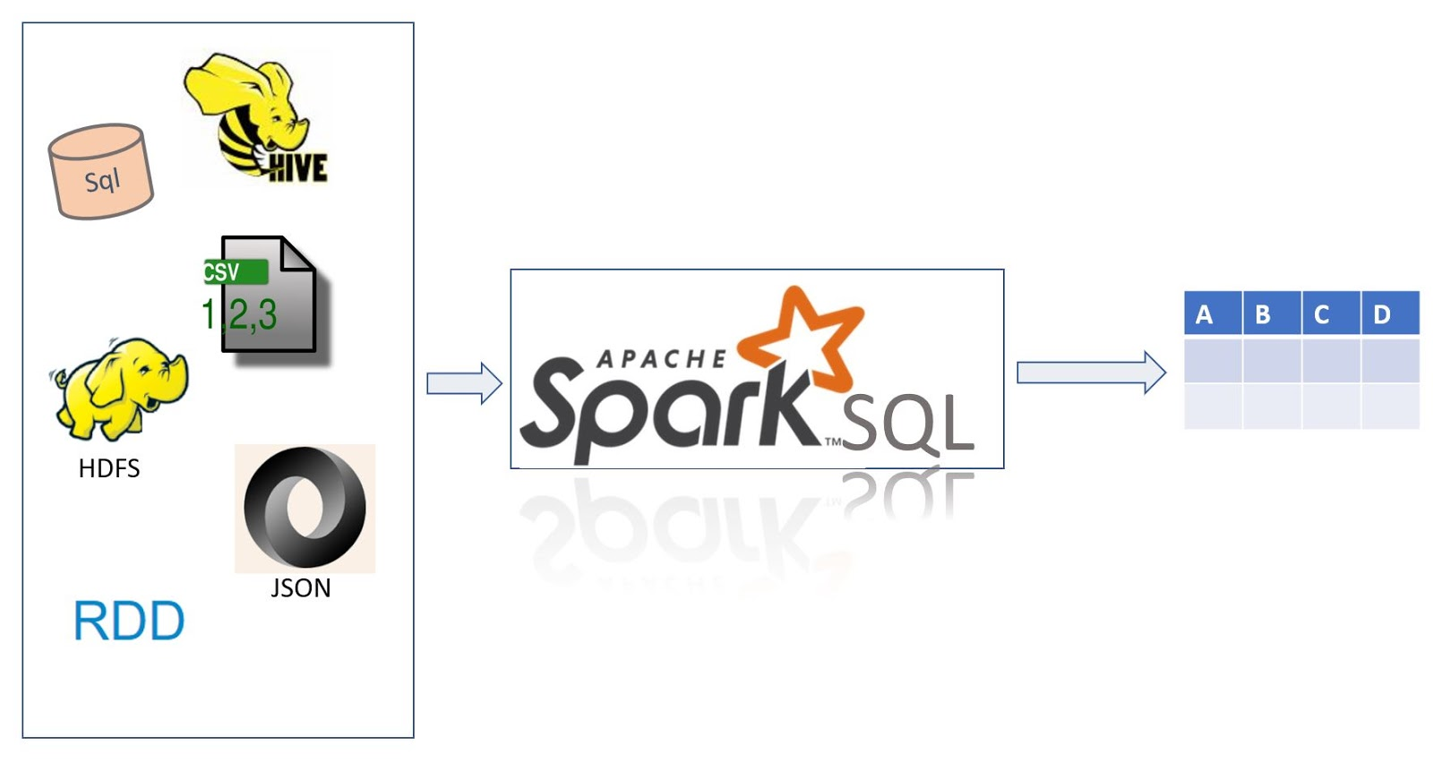
Spark DataFrame
Distributed collections of data, organized into rows and columns.
Each column in a DataFrame has a name and an associated type.

Slide 10

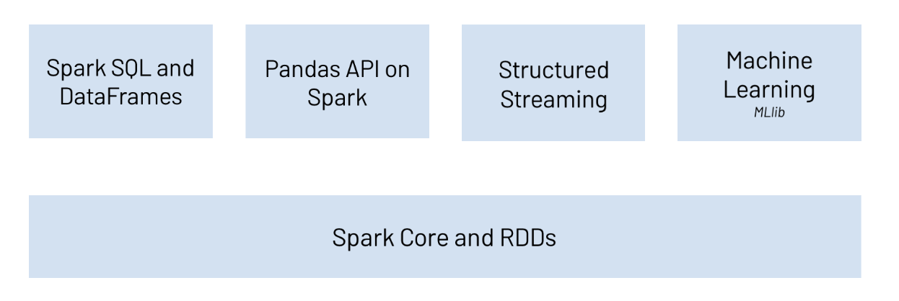
PySpark
Python API for Spark released by the Apache Spark community to support Python with Spark.

