Slide 1

Pivot & Unpivot

Slide 2
Pivot & Unpivot
Pivot & Unpivot are mainly used for data analytics
Pivoting is the process of converting row-based data into a columnar structure, resulting in a summary view of the data.
Pivot function can be applied on a grouped data to display in individual columns
Pivot function
Unpivot process of converting columnar data into a row-based structure.
Stack function

Slide 3
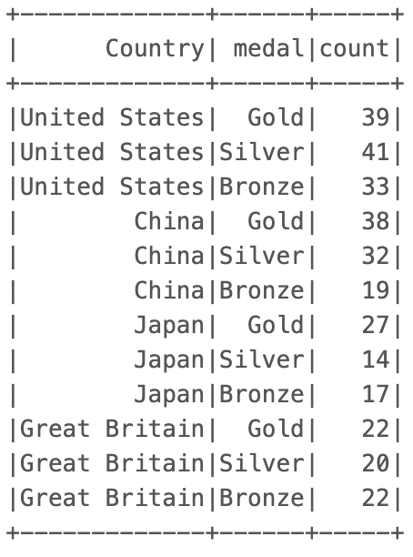
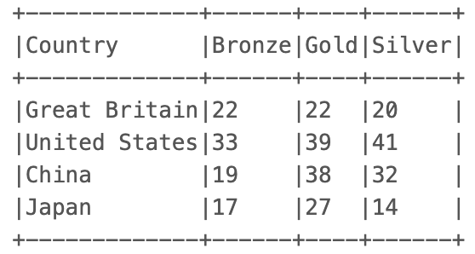
Pivot & Unpivot
PIVOT
UNPIVOT

