Slide 1


withColumn
Data Engineering Studies

Slide 2
Agenda
What is withCoumn
Usecases
Different approaches
Disadvantages

Slide 3
withColumn
Transformation function of DataFrame
Used to change the value, convert the datatype of an existing column, create a new column
Takes two arguments:
The name of the new column
Expression that defines the values of the new column
Data Engineering Studies

Slide 4
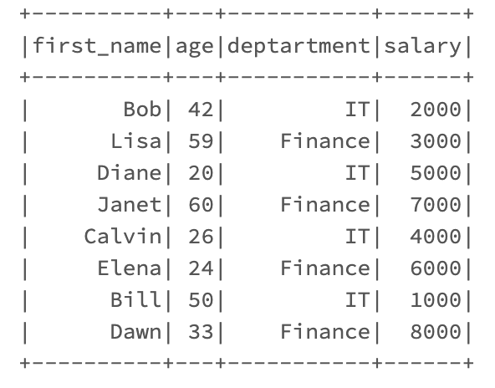
Use cases:
Add a new column and populate default value
Add a new column “percentage increase” and add the default value to 10% and add another column “current timestamp” populate current timestamp
Data Engineering Studies

Slide 5
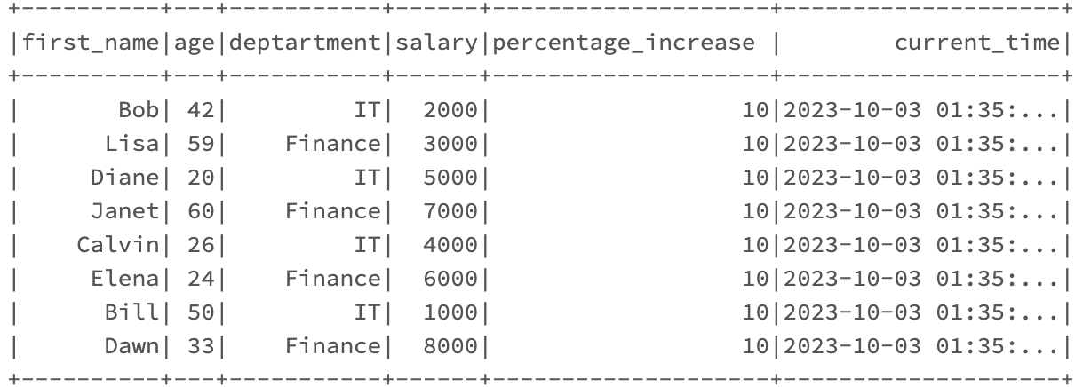
Use cases:
Update existing column using values of another existing column
Update “salary” column based on “percentage_increase” column
Data Engineering Studies

Slide 6
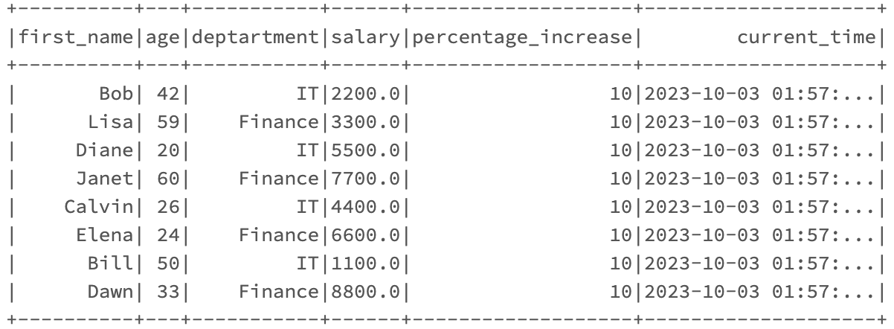
Use cases:
Changing datatype a column using withColumn transformation
Change the datatype of “salary” column from “double” to “integer”
Data Engineering Studies

Slide 7
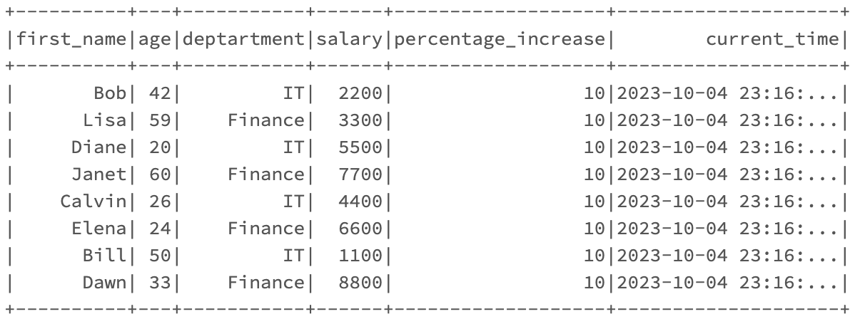
Use cases:
Conditional update using withColumn
Change the department value “IT” to “Information Technology”
Data Engineering Studies

Slide 8
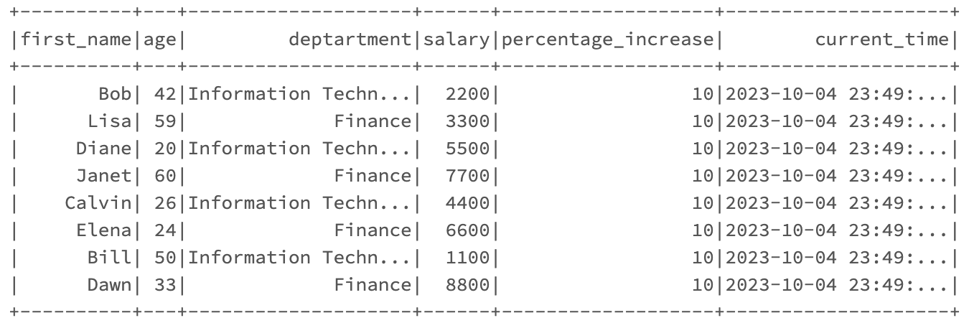
Use cases:
Renaming a column name using withColumn
Rename the “percentage_increase” column name to “bonus_percentage”
Data Engineering Studies

Slide 9
Use cases:
Renaming a column name using withColumn
Rename the “percentage_increase” column name to “bonus_percentage”
Data Engineering Studies

Slide 10
Disadvantages of using withColumn
DataFrames are immutable hence we cannot change anything directly on a DataFrame.
Whenever withColumn is called a new DataFrame is created for each operation
Leads to out of memory issue.

