Slide 1
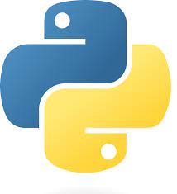

__init__.py
Data Engineering Studies

Slide 2
__init__.py
Use case:
You have folder with several modules
Master program in a different folder which need to reference the modules
Import all the modules to the master program
Solution:
__init__.py file is used to mark a folder as a Python package.
__init__.py runs when the package is first imported
Data Engineering Studies

