Slide 1
PROJECT On Airfare Prediction Using Machine Learning
By
Sheikh Faheem……….. 17088136015
Faisal Hassan . ............. 17088136011
Sheikh Muzamil. ………17088136020

Slide 2
Introduction.
The advantages of travelling by airplanes have increased overtime. The industry tries to make the ticket fare reasonable as well as to make profit out of it.
Travelers are trying to understand how these airline companies make decisions regarding ticket prices over time. Unfortunately, this dynamic pricing strategy is usually carried out programmatically and is based on certain hidden parameters (e.g. number of days left till flight departure, or number of seats left).

Slide 3
Purpose of our project.
The purpose of this project was to study how airline ticket prices change over time, extract the factors that influence these fluctuations.
Then, using that information, build a system that can help consumers make purchasing decisions by predicting how air ticket prices will evolve in the future thus providing them with a simple GUI based web app , where the consumers will simply enter the parameters in the web app and they will be presented with a graph , containing the predicted prices of future dates.

Slide 4
In our project, we focused on flights between Srinagar and Delhi, and collected the data of three airlines namely IndiGo, SpiceJet and Vistara.
Our project consists of four distinctive phases:
(1) Data Collection,
(2) Data Preparation,
(3) selection of the regression ML models.
(4) Pipelining of the model with the user interface. For pipelining we used Flask framework. . In Flask we used POST request for collecting and passing inputs to our model.

Slide 5
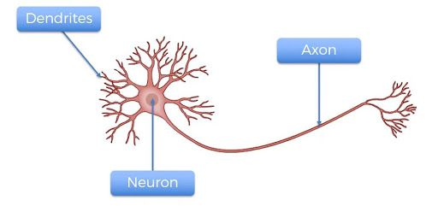
STRUCTURE OF NEURON

Slide 6
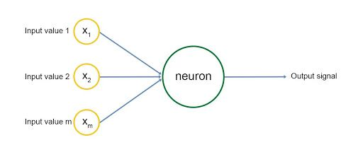
PERCEPTRON:COMPUTER NEURON

Slide 7
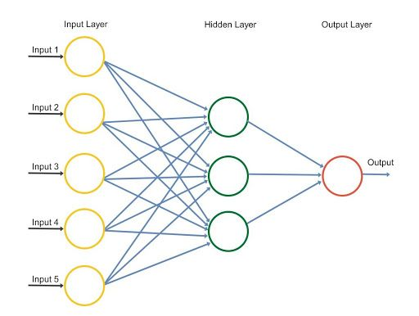
NEURAL NETWORK

Slide 8
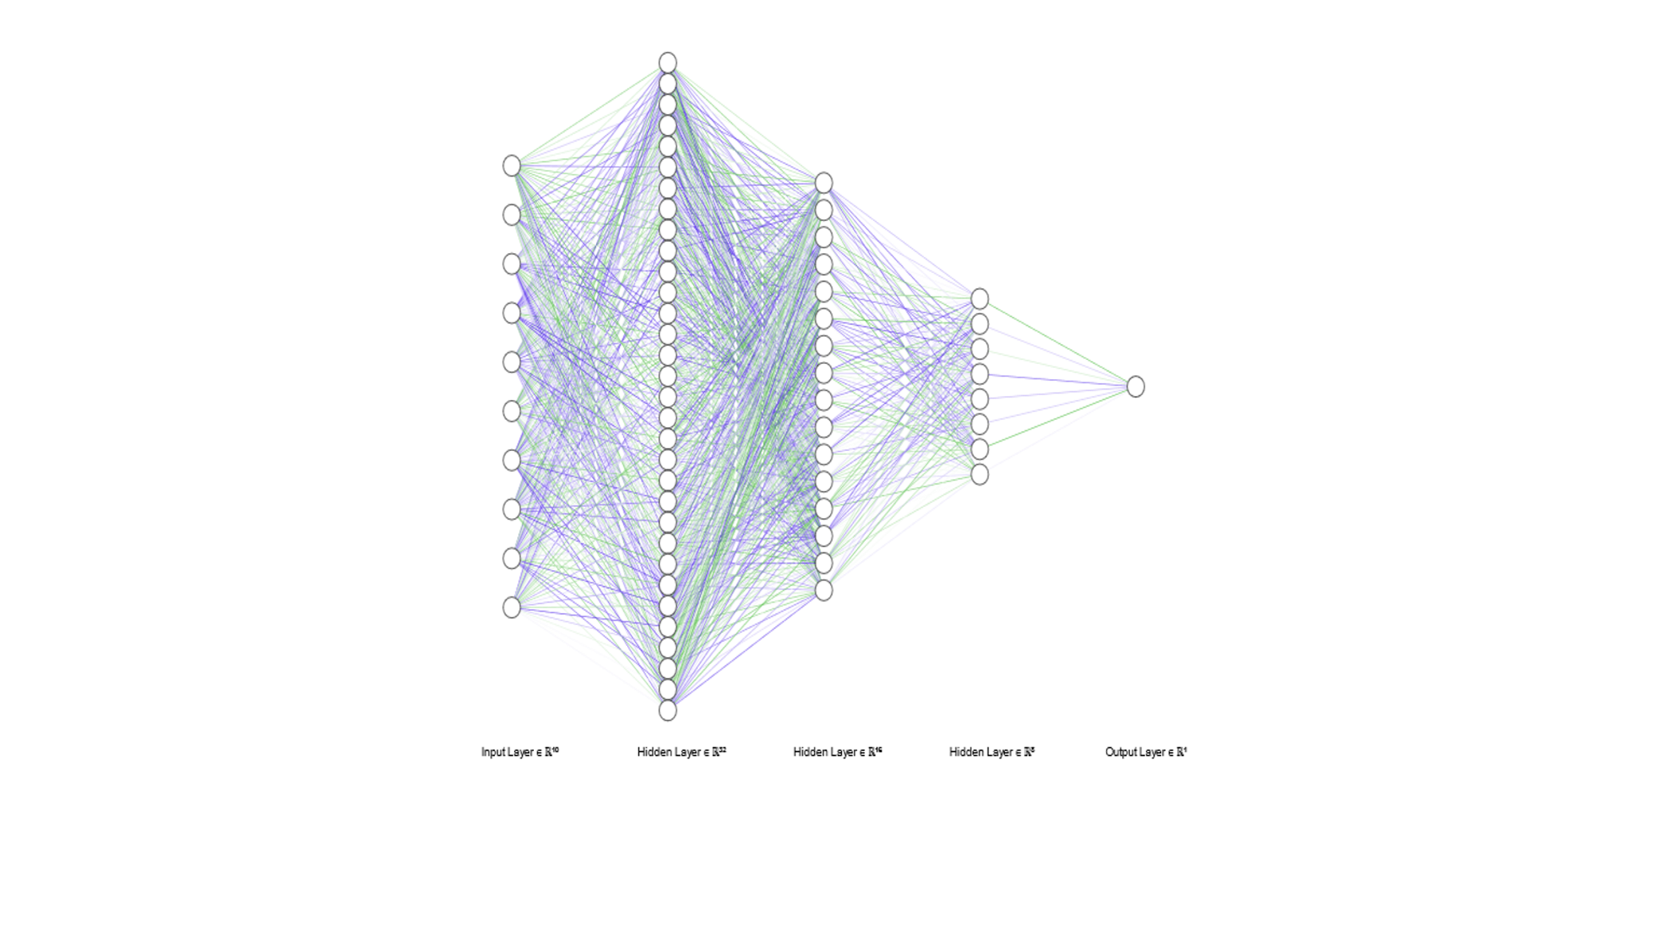
OUR NEURAL NETWORK

Slide 9
Flowchart representing our approach
80 percent data
RAW data
Data modification
Training
Training
MODEL based on ANN
Testing dataset
testing
20 percent data
WEB APPLICATION

Slide 10
Technologies used for creating the Web App.
JQuery.
JavaScript.
HTML.
Bootstrap.
Flask.
Python.
To make the more intuitive we created a graphical representation of all the predicted prices. For this purpose, we used canvas.js library.

Slide 11
TECHNOLOGY USED FOR IMPLEMENTATION OF ML MODEL
Python.
Keras.
Tenrsorflow.
Sklearn.
Pandas.
Numypy.
Matplotlib.

Slide 12
Web Application and User Interface.
We created a web-based GUI application which collects the input parameters from the user and then shows the user a graphical representation of the upcoming flight prices. Only few of the required parameters are taken as inputs from the user while the rest of the parameters are calculated in the backend by the Web App.

Slide 13
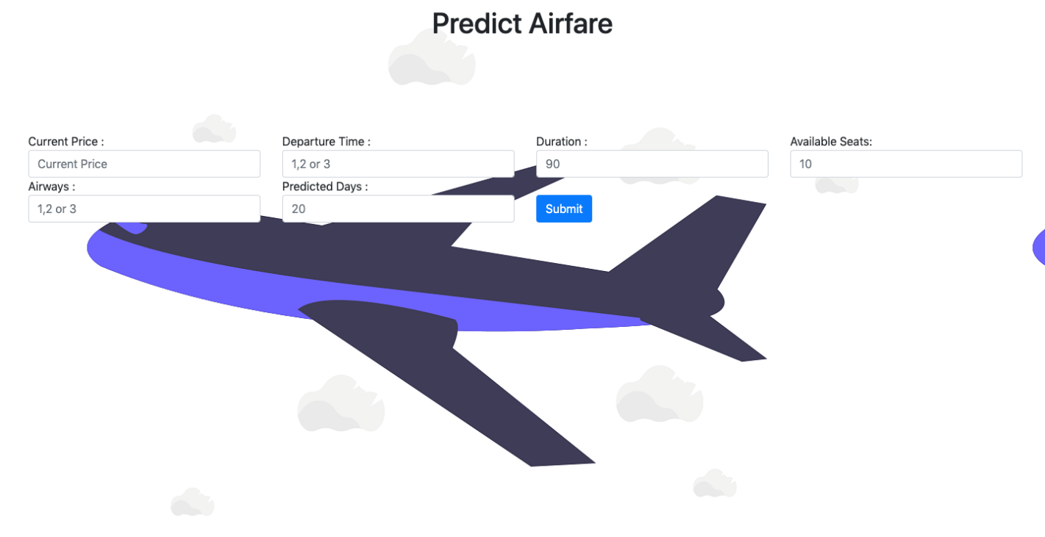
Our index page.

Slide 14
Future Work
The greatest shortcoming of this work is the shortage of data. We want to include holidays, no. of flights on a particular route etc.
A more varied set of flights should be explored, since it is entirely plausible that airlines vary their pricing strategy according to the characteristics of the flight (for example, fares for regional flights out of small airports may behave differently than the major).

Slide 15
Thanks

