Slide 1

Khulna University of Engineering & Technology
Course no: CSE 4000
Course Title: Project/Thesis
A Machine Learning-Based Runtime Data-in-Use
Protection Framework with Adaptive Decryption and
Exposure Control
Supervised By Dr. Muhammad Aminul Haque Akhand Professor Department of CSE, KUET | Presented By Faiyaz Mahmud Roll: 2007103
CSE 4000: PROJECT/THESIS
Date:11/07/2026

Slide 2

Outline
Introduction
Problem Statement
Related Works
Objectives
Proposed Methodology
Result
Experimental Studies
Conclusion

Slide 3


Introduction
Every digital system needs security.
Systems where security is most critical:
  Financial institutions — banks, stock exchanges
  Healthcare systems — sensitive patient records
  Government Institutions — national security data
A single breach can mean:
  Loss of life
  Critical service failure
  Massive economic disruption

Slide 4
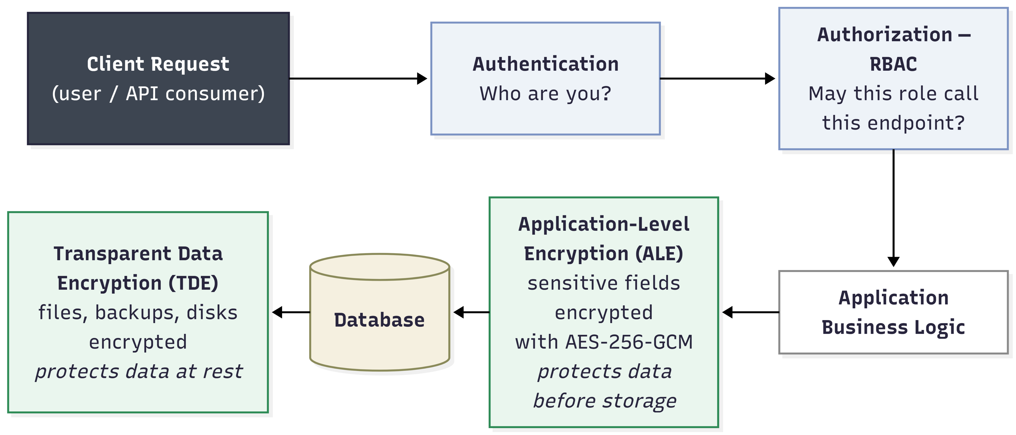
Standard security stack of a backend application

Slide 5
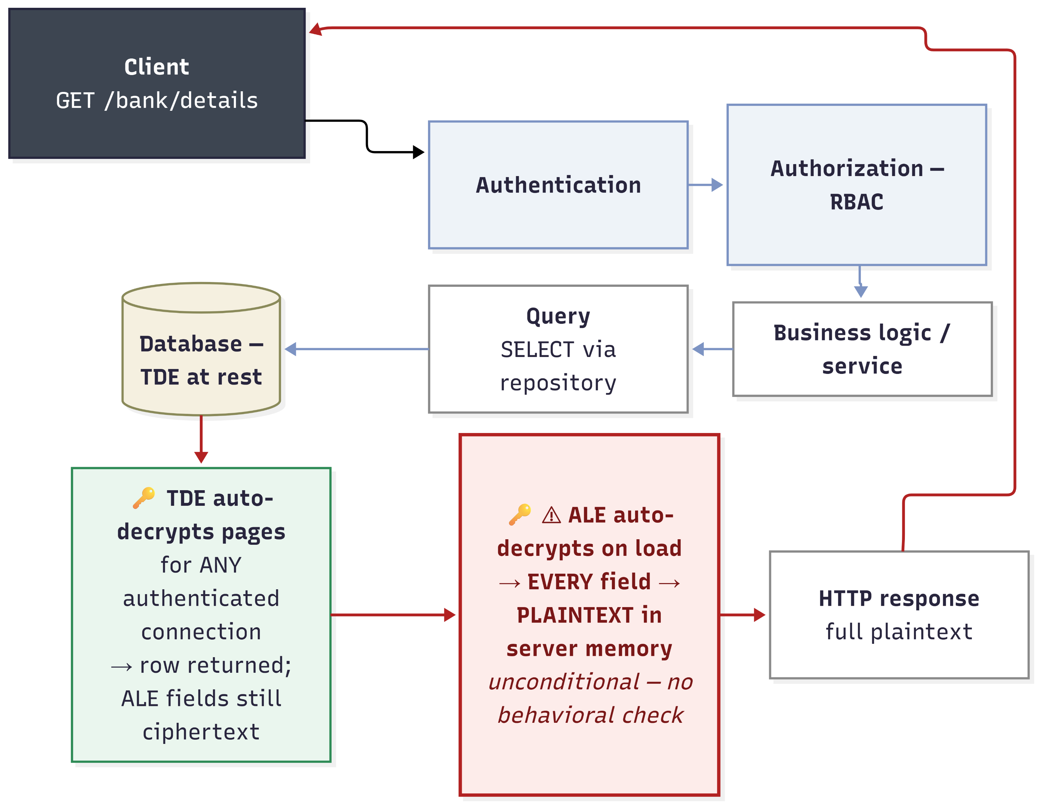
Standard data access flow of a secure backend application

Slide 6

Problem Statement
What if user credential, token or session gets hijacked?
Authenticated and role-authorized - yet behaviorally anomalous.
Nothing re-evaluates trust while data is actually being accessed.
TDE decrypts pages for any authenticated connection.
ALE decrypts unconditionally on read. Decryption is a side effect of the query, not a security decision.
ALE and TDE are blind to behavior.

Slide 7
Related Works
Table 1: Related works
Author(s) and Year | Title | Method | Shortcoming
Houtsma, 2022 [1] | An Explainable Machine Learning Approach to Risk-Adaptive Access Control | Neural networks predict RAdAC decisions. | No decryption-boundary enforcement.
Liu et al., 2021 [2] | Efficient Access Control Permission Decision Engine Based on Machine Learning | Random Forest predicts access permission. | Binary access, no masking tier.
Li et al., 2024 [3] | Context-Aware Risk Attribute Access Control | Context risk controls authorization. | Authorization-focused, not cryptography-coupled.
Anciaux et al., 2023 [4] | Database Encryption | Surveys database encryption methods. | Covers storage, not runtime use

Slide 8
Objectives
Global objective: Adaptive, ML-driven decryption control for data-in-use protection.
Specific objectives:
  Engineer synthetic, rule-labeled access-event dataset
  Design unforgeable runtime behavioral feature scheme
  Train and tune Random Forest risk classifier
  Transpile model to in-process, dependency-free JavaScript
  Re-engineer ORM into late-binding encryption
  Integrate graduated decrypt / mask / deny policy engine
  Verify pipeline end-to-end

Slide 9
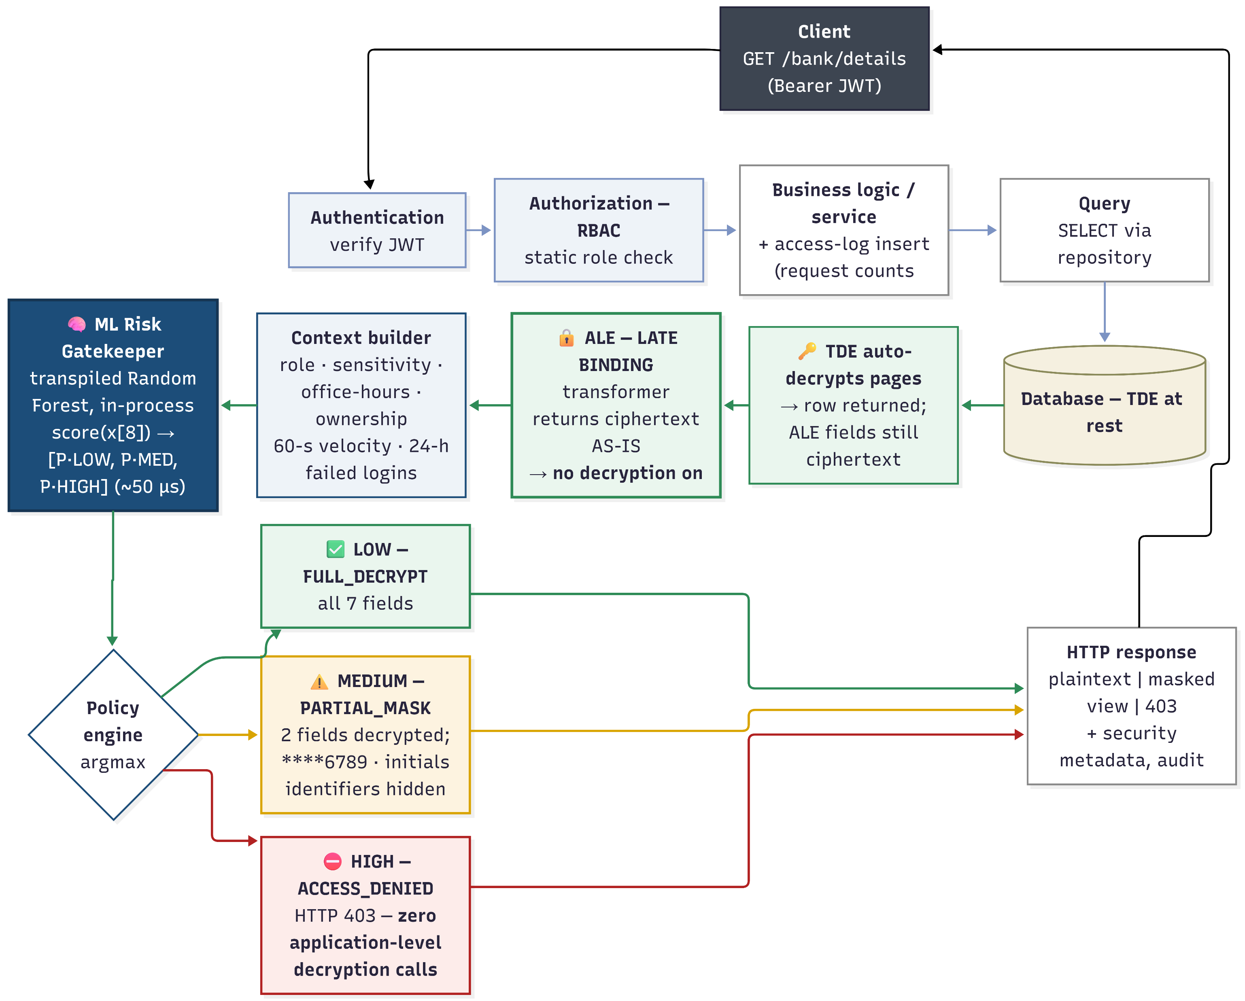
Proposed Methodology

Slide 10
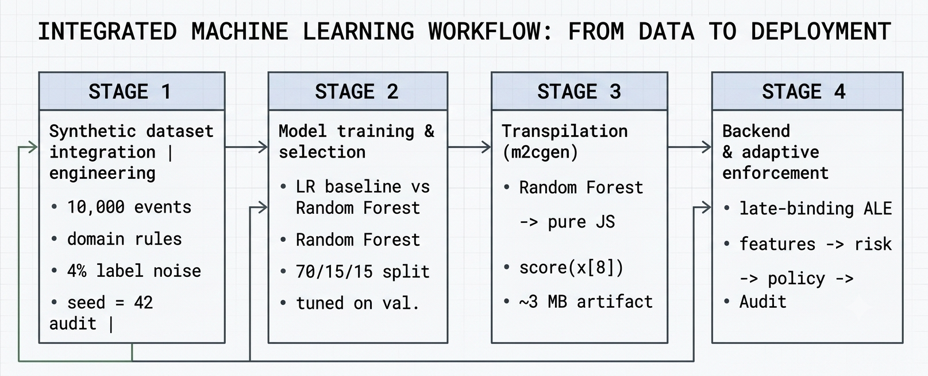
Four-Stage Pipeline

Slide 11
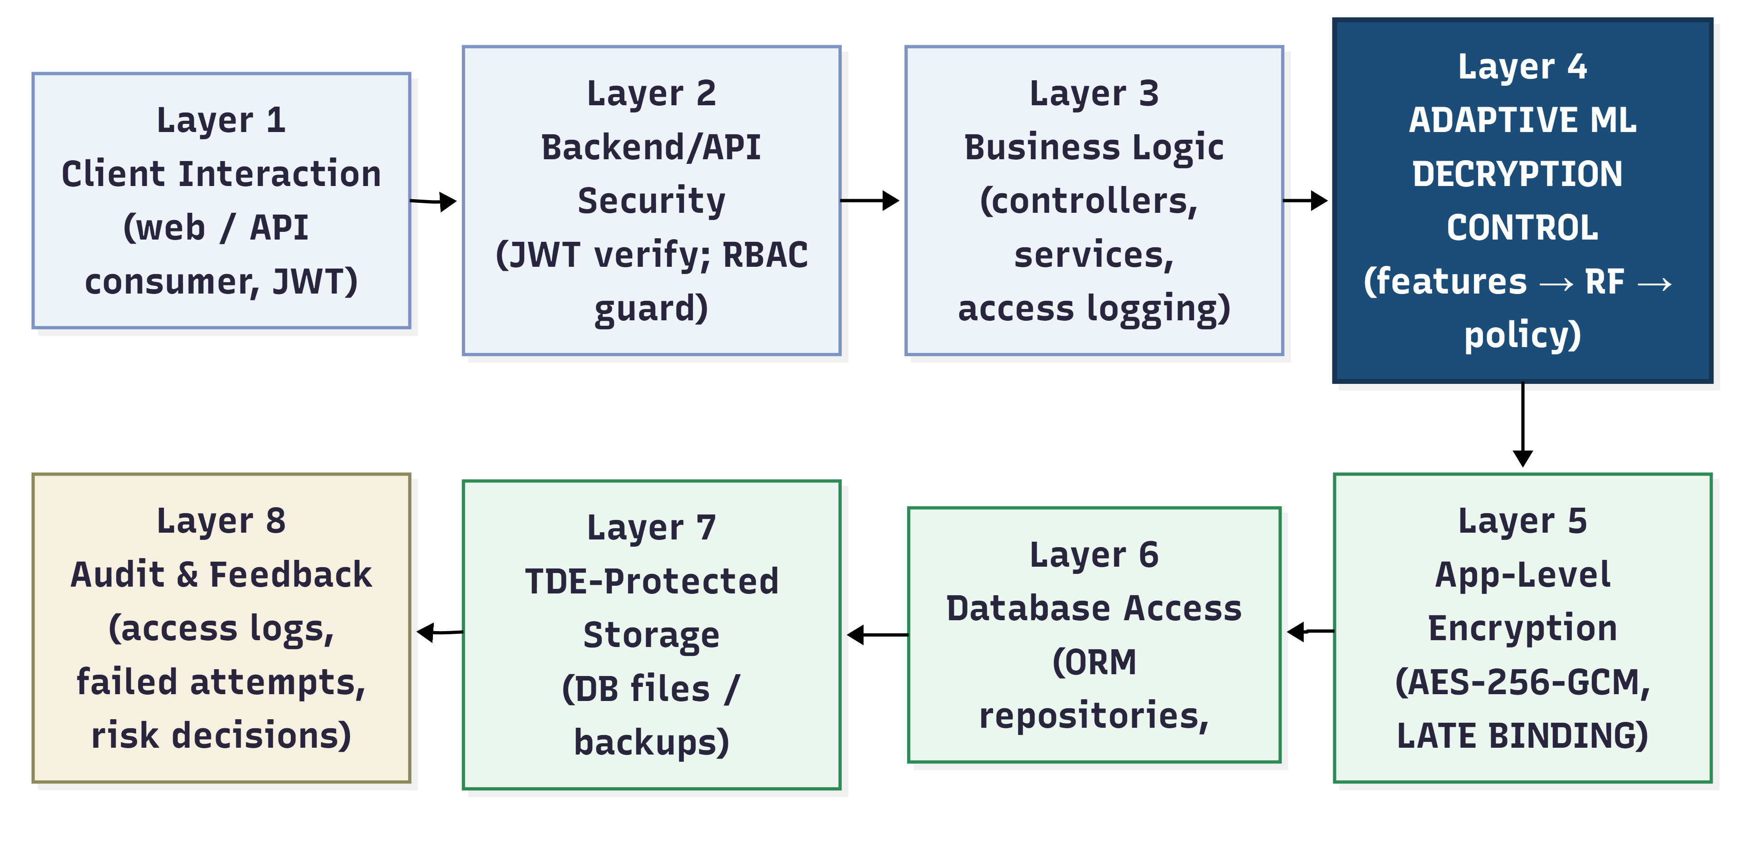
Eight-Layer Security Architecture
Layers 1–3: conventional tiers (client, JWT + RBAC, logic)
Layer 4: Adaptive ML Decryption Control ← contribution
Layers 5–7: late-binding ALE, ORM, TDE storage
Layer 8: audit tables feed the features

Slide 12
Synthetic Dataset Engineering
Feature | Distribution | Parameters / rationale
User_role | Categorical | customer 75%, moderator 20%, admin 5% — read traffic is customer-dominated
Resource_sensitivity | Categorical | LOW 60%, MEDIUM 30%, HIGH 10% — most reads touch low/medium-tier fields
Is_office_hours | Bernoulli | P(1) = 0.80 — operational-hours dominance
Record_owner_match | Role-conditional Bernoulli | customers: P(own record) = 0.95; staff roles: P(match) = 0.15
Recent_request_count | Poisson(λ=4) + injected attack mass | 5% of rows overwritten with Uniform{15…64} scraping bursts
Failed_attempt_count | Discrete exponential decay over {0…8} | P(0) = 0.88; long tail models brute-force campaigns

Slide 13
HIGH-risk labeling rules of the dataset generator
HIGH-risk rule (label = 2) | Threat interpretation
customer ∧ owner_match = 0 ∧ sensitivity ∈ {MEDIUM, HIGH} | IDOR on protected data
customer ∧ request_count > 15 | Scraping / bulk exfiltration velocity
moderator ∧ sensitivity = HIGH | Support tier has no business on HIGH-tier data
moderator ∧ request_count > 25 ∧ owner_match = 0 | Bulk cross-record harvesting
admin ∧ off-hours ∧ sensitivity = HIGH ∧ request_count > 20 | Compromised super-user pattern
failed_attempts ≥ 5 (any role) | Post-brute-force account takeover

Slide 14
MEDIUM-risk labeling rules of the dataset generator.
MEDIUM-risk rule (label = 1) | Threat interpretation
customer ∧ owner_match = 0 ∧ sensitivity = LOW | Cross-record access on public-tier data
customer ∧ request_count ∈ [9, 15] | Elevated velocity below the attack threshold
moderator ∧ off-hours ∧ sensitivity = MEDIUM | Unusual time for support work on personal data
admin ∧ failed_attempts ∈ {3, 4} | Moderate authentication friction on a privileged
(moderator ∨ admin) ∧ request_count > 18 | Staff-tier volume anomaly

Slide 15
Dataset partitions
Partition | Samples | Purpose | Class balance
Training | 7000 (70%) | Model fitting | Stratified: ≈85% LOW / ≈6% MEDIUM / ≈9% HIGH
Validation | 1500 (15%) | Hyperparameter tuning | Same (stratified)
Test | 1500 (15%) | Quarantined; used once for final metrics | 1,274 LOW / 87 MEDIUM / 139 HIGH

Slide 16
Model: Random Forest
Hyperparameter | Value | Justification
n_estimators (T) | 75 | Accuracy saturates at ~75 trees; more only inflates artifact size
max_depth (d) | 12 | Captures deepest 4-antecedent rules; unlimited depth overfits noise, bloats code (~15 MB)
class_weight | Balanced | Inverse-frequency weighting protects minority-class recall (MEDIUM ≈ 6%, HIGH ≈ 9%)
random_state | 42 | Reproducibility

Slide 17
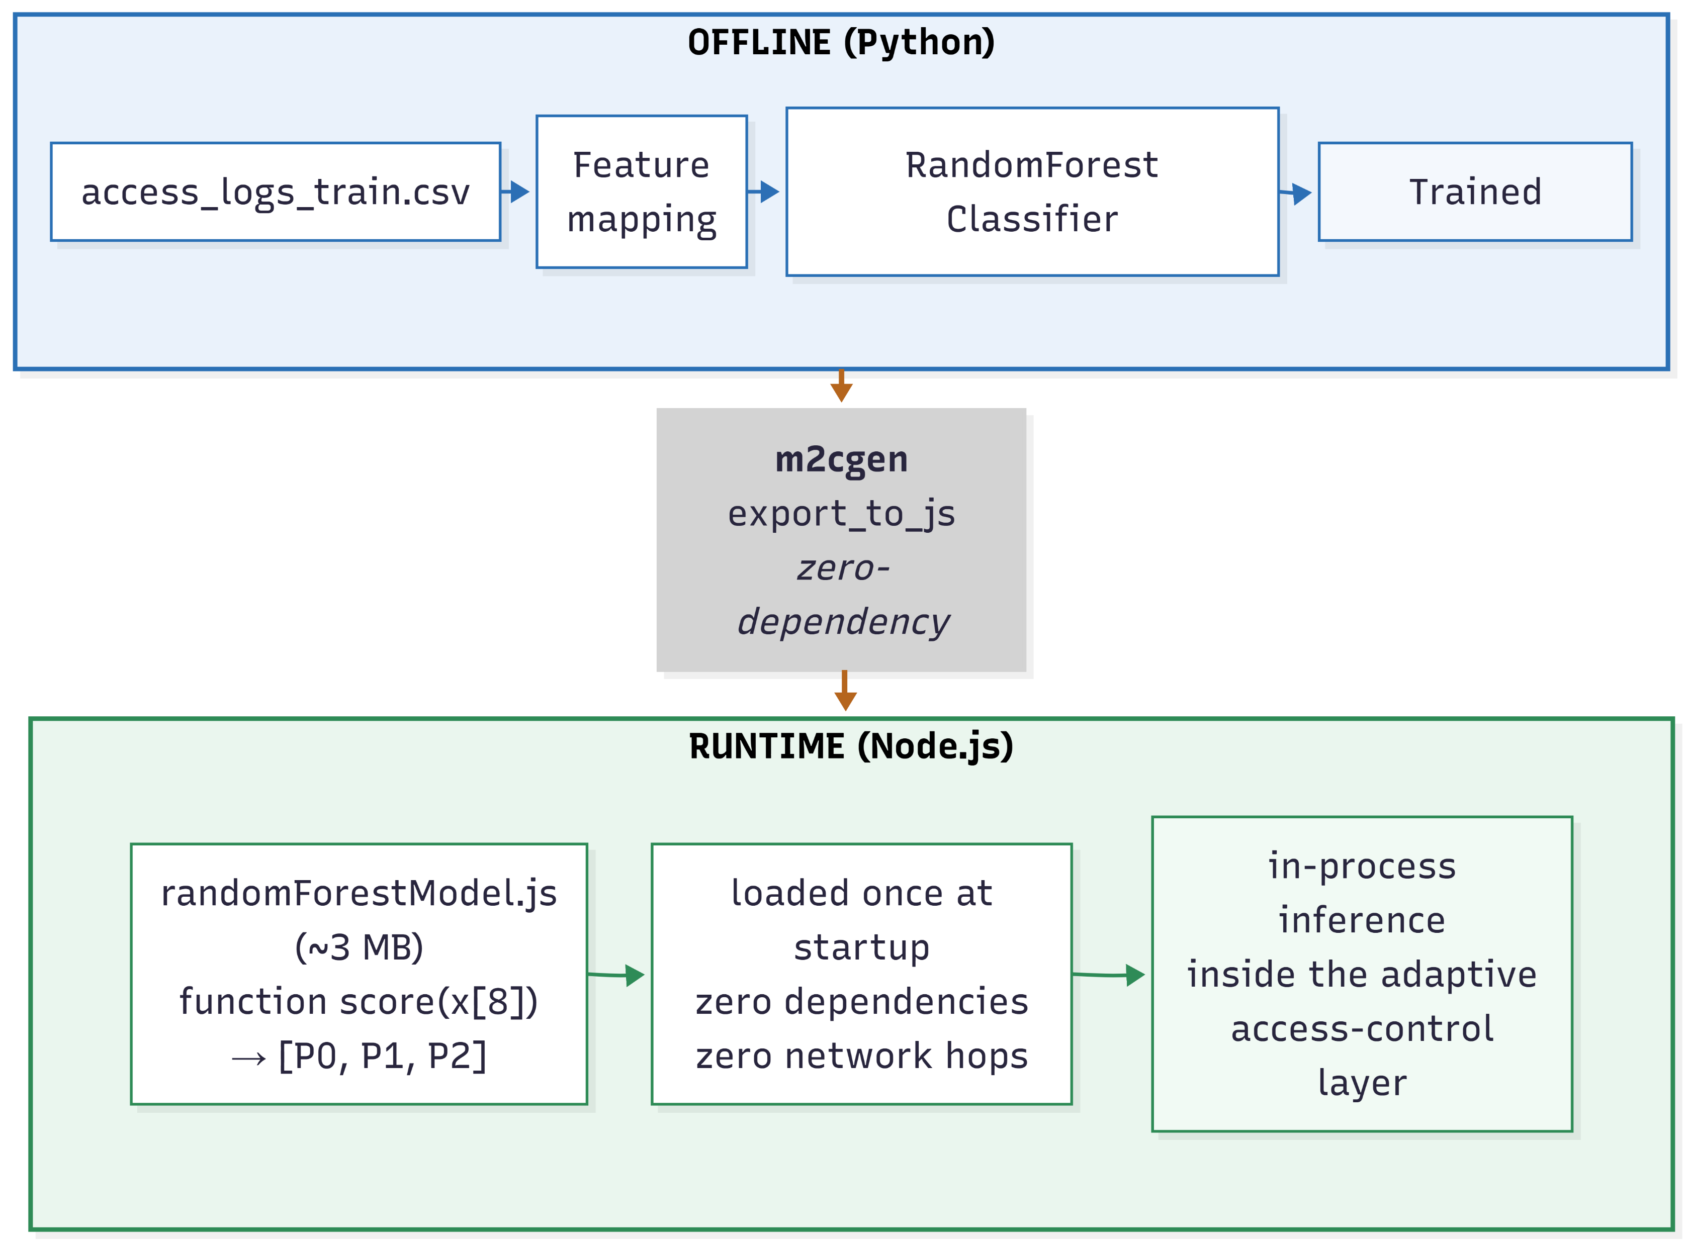
In-Process Transpilation

Slide 18
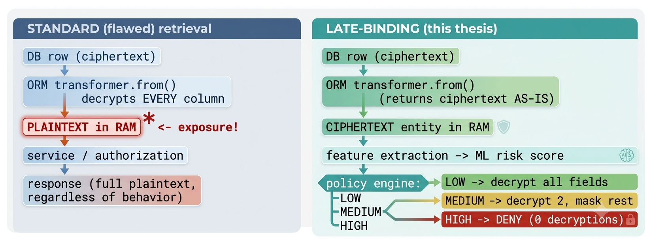
Late-binding cryptographic redesign

Slide 19
Sensitive table in database
DB column | Type | ALE-encrypted
Id | Uuid | NO
User_id | Uuid | NO
Branch_name | Varchar(120) | YES
Account_type | Enum | NO
Account_holder_name | Text | YES
Account_number | Text | YES
Account_last_four | Varchar(4) | NO
Routing_number | Text | YES
Swift_code | Text | YES
Iban | Text | YES
Nid | Text | YES
status | Enum | NO
Created_at/updated_at | timestampz | NO

Slide 20
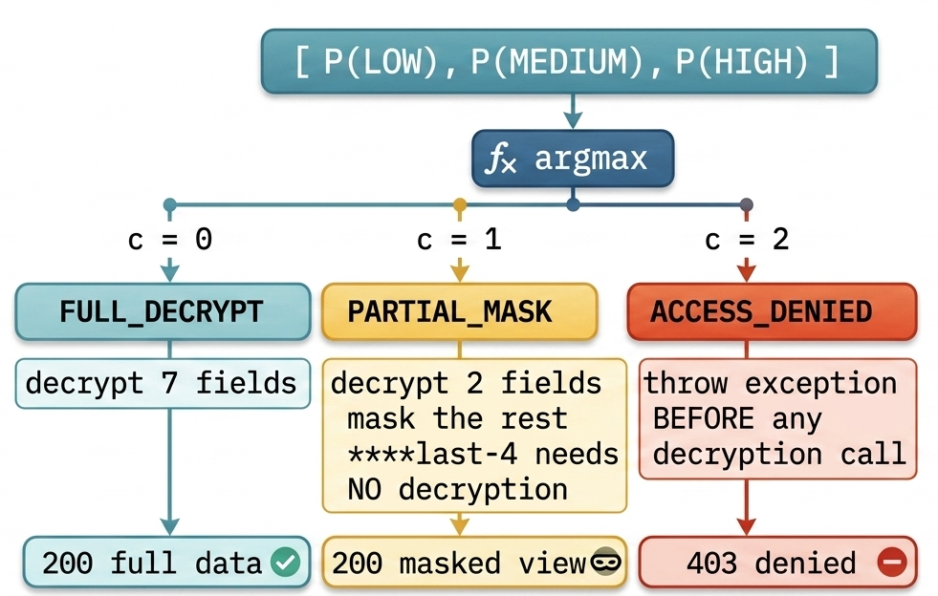
Risk-to-policy decision

Slide 21
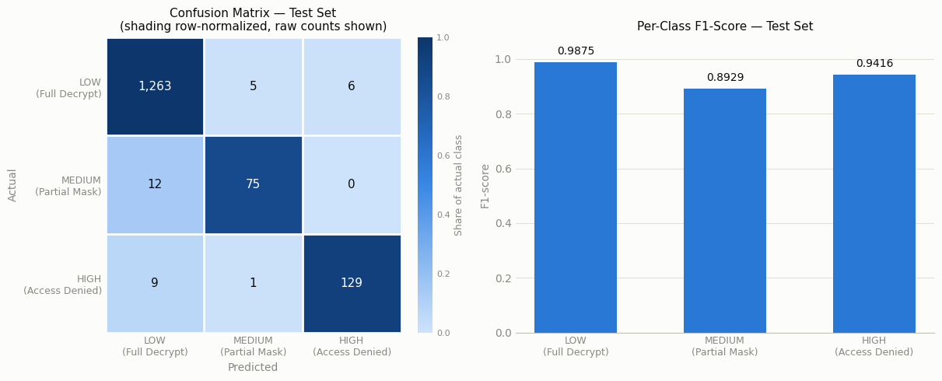
Result Analysis

Slide 22
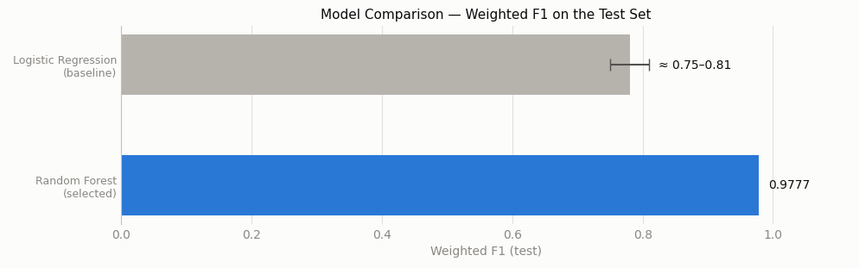
Baseline Comparison
A linear hyperplane cannot represent the conjunction-shaped security rules (role ∧ownership ∧ sensitivity ∧ velocity)
Rule conjunctions are represented natively as root-to leaf paths; ≈17-point absolute improvement

Slide 23
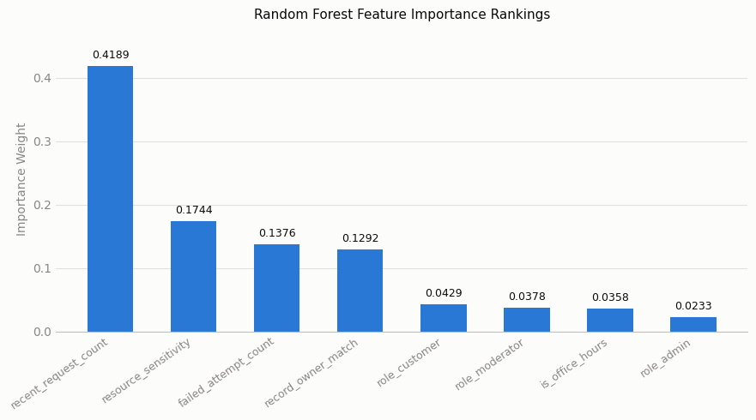
Feature Importance

Slide 24
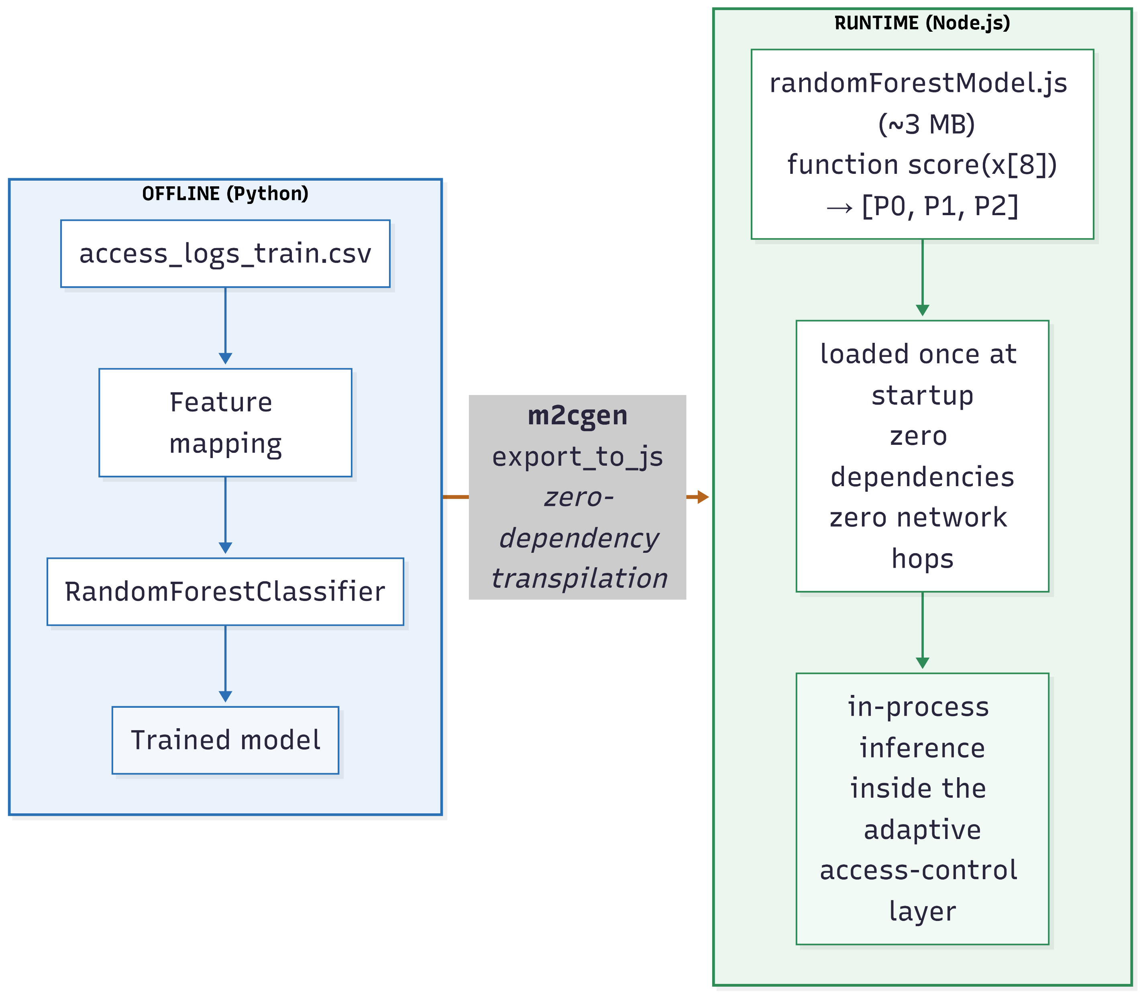
Transpiled Artifact Latency
~3 MB JavaScript · loaded once (~50 ms)
Warm inference: ≈ 50 µs per call
Feature extraction: ≈ 1–2 ms · total overhead ≈ 2 ms
Learned decision bands: LOW ≤ 8 → MEDIUM 9–13 → HIGH ≥ 15 req/min

Slide 25
Comparison with static pipeline
Threat scenario | Static pipeline (ORM+RBAC) | Proposed adaptive framwork
Legitimate self-access | Full plaintext | Full plaintext (99.14% pass rate) + audit trail
Moderate over-querying (9–13 req/min) | Full plaintext | Masked view; workflow continues
Scraping (40 req/min) | Full plaintext on every request | Denied at P(HIGH) = 1.000; zero decryption
IDOR cross-record read | Full plaintext if role-authorized | Denied at P(HIGH) = 0.990; zero decryption
Post-credential-stuffing access | Full plaintext | Denied at P(HIGH) = 0.720; zero
Added latency per request | Usual system latency | ≈ 2 ms total (audit insert + feature counts); inference ≈ 50 µs

Slide 26
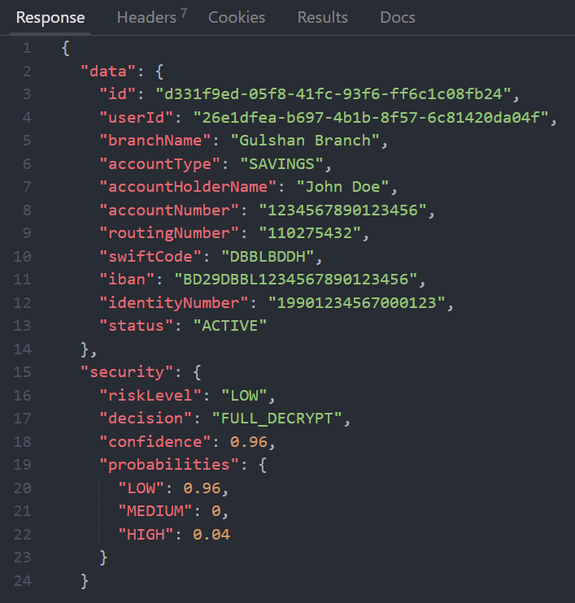
System Demonstration: Low-risk
User_id:
"26e1dfea-b697-4b1b-8f57-6c81420da04f“
API endpoint: http://localhost:3000/api/v1/bank/details

Slide 27
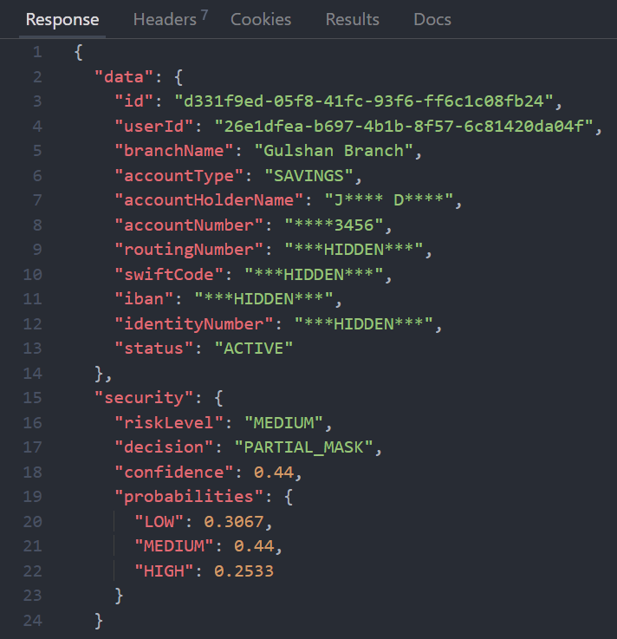
System Demonstration: Medium-risk
User_id:
"26e1dfea-b697-4b1b-8f57-6c81420da04f“
API endpoint: http://localhost:3000/api/v1/bank/details

Slide 28
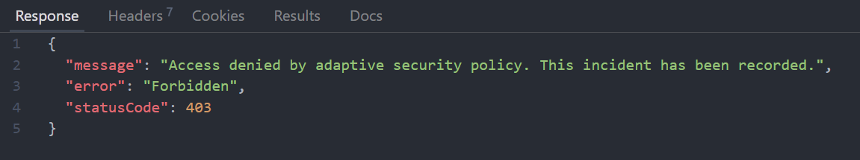
System Demonstration: High-risk
User_id:
"26e1dfea-b697-4b1b-8f57-6c81420da04f“
API endpoint: http://localhost:3000/api/v1/bank/details

Slide 29
Experimental Environment
Component | Detail
Backend framework | NestJS 11 (TypeScript) modular monolith
Runtime | Node.js v22.12.0 (V8 engine)
Database / ORM | PostgreSQL with TypeORM 0.3.x
Cryptography | AES-256-GCM (Node.js crypto), 96-bit random IV, versioned ciphertext envelope
ML training | Python 3, scikit-learn (RandomForestClassifier, LogisticRegression)
Transpilation | m2cgen (model-to-code generator) → pure JavaScript
Operating system | Microsoft Windows 11 (x64)
Hardware | Intel Core i5-1135G7 (11th Gen, 2.40 GHz), 8 GB RAM
Input / output format | CSV (dataset), JSON (API responses)

Slide 30
Conclusion
Novelty & Significance
Late-binding cryptography: ciphertext survives retrieval; decryption becomes a policy decision
Learned per-request risk: from unforgeable, server-controlled behavior
Graduated three-tier policy: decrypt / mask / deny; primary identifier masked with zero decryption
In-process transpiled inference: microsecond-scale, no serving infrastructure

Slide 31
Limitations
Synthetic, rule-labeled corpus → proof-of-concept validation (rule-learning bias)
Low-and-slow attackers below velocity thresholds: 9/139 missed
Single-node prototype; fixed 60-s / 24-h windows
One demonstrated domain (banking); offline evaluation only

Slide 32
Future Work
Retrain on real audit telemetry (Layer 8 already collects it)
Longer-horizon features → catch low-and-slow scraping
Collect more related features
Generalize: healthcare, e-commerce; list/batch endpoints

Slide 33
Closing statement
"The decryption boundary itself can be made adaptive. An application can decide, per request and from runtime evidence, how much encrypted data to reveal, and can withhold it before exposure rather than detect a breach after it."

Slide 34
References
[1] R. Houtsma, "An Explainable Machine Learning Approach to Risk-Adaptive Access Control," M.Sc. thesis, Faculty of Electrical Engineering, Mathematics and Computer Science, University of Twente, Enschede, The Netherlands, 2022.
[2] A. Liu, X. Du, and N. Wang, "Efficient Access Control Permission Decision Engine Based on Machine Learning," Security and Communication Networks, vol. 2021, art. no. 3970485, pp. 1–11, 2021, doi: 10.1155/2021/3970485.
[3] B. Li, F. Yang, and S. Zhang, "Context-Aware Risk Attribute Access Control," Mathematics, vol. 12, no. 16, art. no. 2541, 2024, doi: 10.3390/math12162541.
[4] N. Anciaux, L. Bouganim, and Y. Guo, "Database Encryption," in Encyclopedia of Cryptography, Security and Privacy, 3rd ed., S. Jajodia, P. Samarati, and M. Yung, Eds. Berlin, Heidelberg, Germany: Springer, 2023, doi: 10.1007/978-3-642-27739-9_677-2.

Slide 35
Thank You

