Slide 1

Khulna University of Engineering & Technology
Course no: CSE 4000
Course Title: Project/Thesis
A Machine Learning-Based Runtime Data-in-Use Protection Framework with Adaptive Decryption and Exposure Control
Supervised By: Dr. Muhammad Aminul Haque Akhand Professor Department of CSE, KUET | Presented By: Faiyaz Mahmud Roll: 2007103
CSE 4000: PROJECT/THESIS
Date:11/07/2026

Slide 2
Outline
Introduction
Problem Statement
Related Works
Objectives
Proposed Methodology
Result Analysis
Experimental Setup
Conclusion

Slide 3



Introduction
Every digital system needs security.
Systems where security is most critical:
Financial institutions: MFS, banks, stock exchanges
Healthcare systems: sensitive patient records
Government Institutions: national security data
A single breach can mean:
Loss of life
Critical service failure
Massive economic disruption
Figure 1: Real-world digital systems that require critical security.

Slide 4
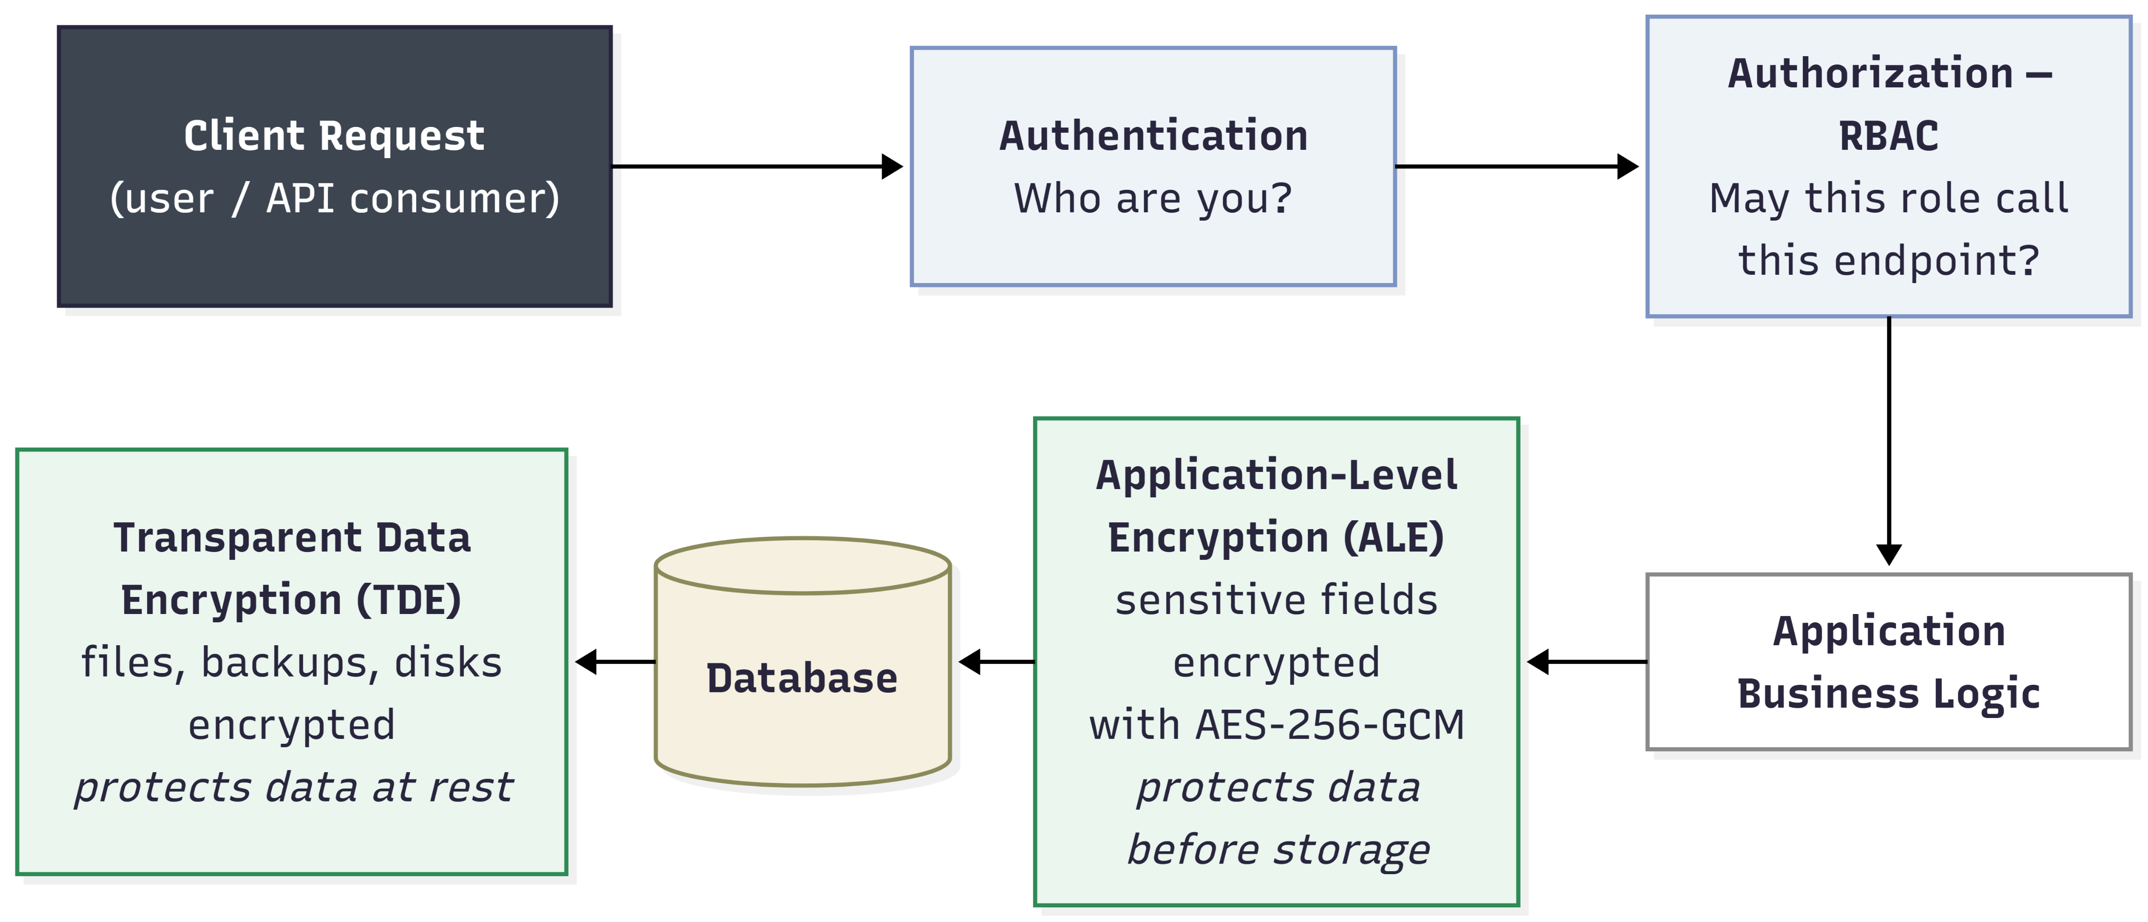
Standard security stack of a backend application
Figure 2: Traditional secure backend system.

Slide 5
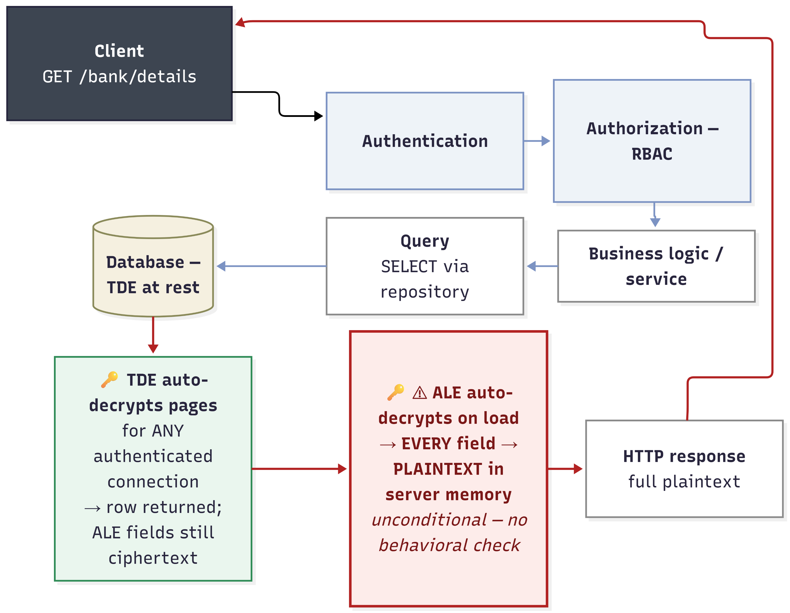
Standard data access flow of a secure backend application
Figure 3: Data access flow of traditional secure backend system.

Slide 6
Problem Statement
What if user credential, token or session gets hijacked?
Anomalous behavior.
Nothing re-evaluates trust while data is actually being accessed.
TDE decrypts pages for any authenticated connection.
ALE decrypts unconditionally on read.
ALE and TDE are blind to behavior.

Slide 7
Related Works
Table 1: Related works.
Author(s) and Year | Title | Method | Shortcoming
Houtsma, 2022 [1] | An Explainable Machine Learning Approach to Risk-Adaptive Access Control | Neural networks predict RAdAC decisions. | No decryption-boundary enforcement.
Liu et al., 2021 [2] | Efficient Access Control Permission Decision Engine Based on Machine Learning | Random Forest predicts access permission. | Binary access, no masking tier.
Li et al., 2024 [3] | Context-Aware Risk Attribute Access Control | Context risk controls authorization. | Authorization-focused, not cryptography-coupled.
Anciaux et al., 2023 [4] | Database Encryption | Surveys database encryption methods. | Covers storage, not runtime use

Slide 8
Objectives
Global objective: Adaptive, ML-driven decryption control for data-in-use protection.
Specific objectives:
Engineer synthetic, rule-labeled access-event dataset
Design unforgeable runtime behavioral feature scheme
Train and tune Random Forest risk classifier
Transpile model to in-process, dependency-free JavaScript
Re-engineer ORM into late-binding encryption
Integrate graduated decrypt / mask / deny policy engine
Verify pipeline end-to-end

Slide 9
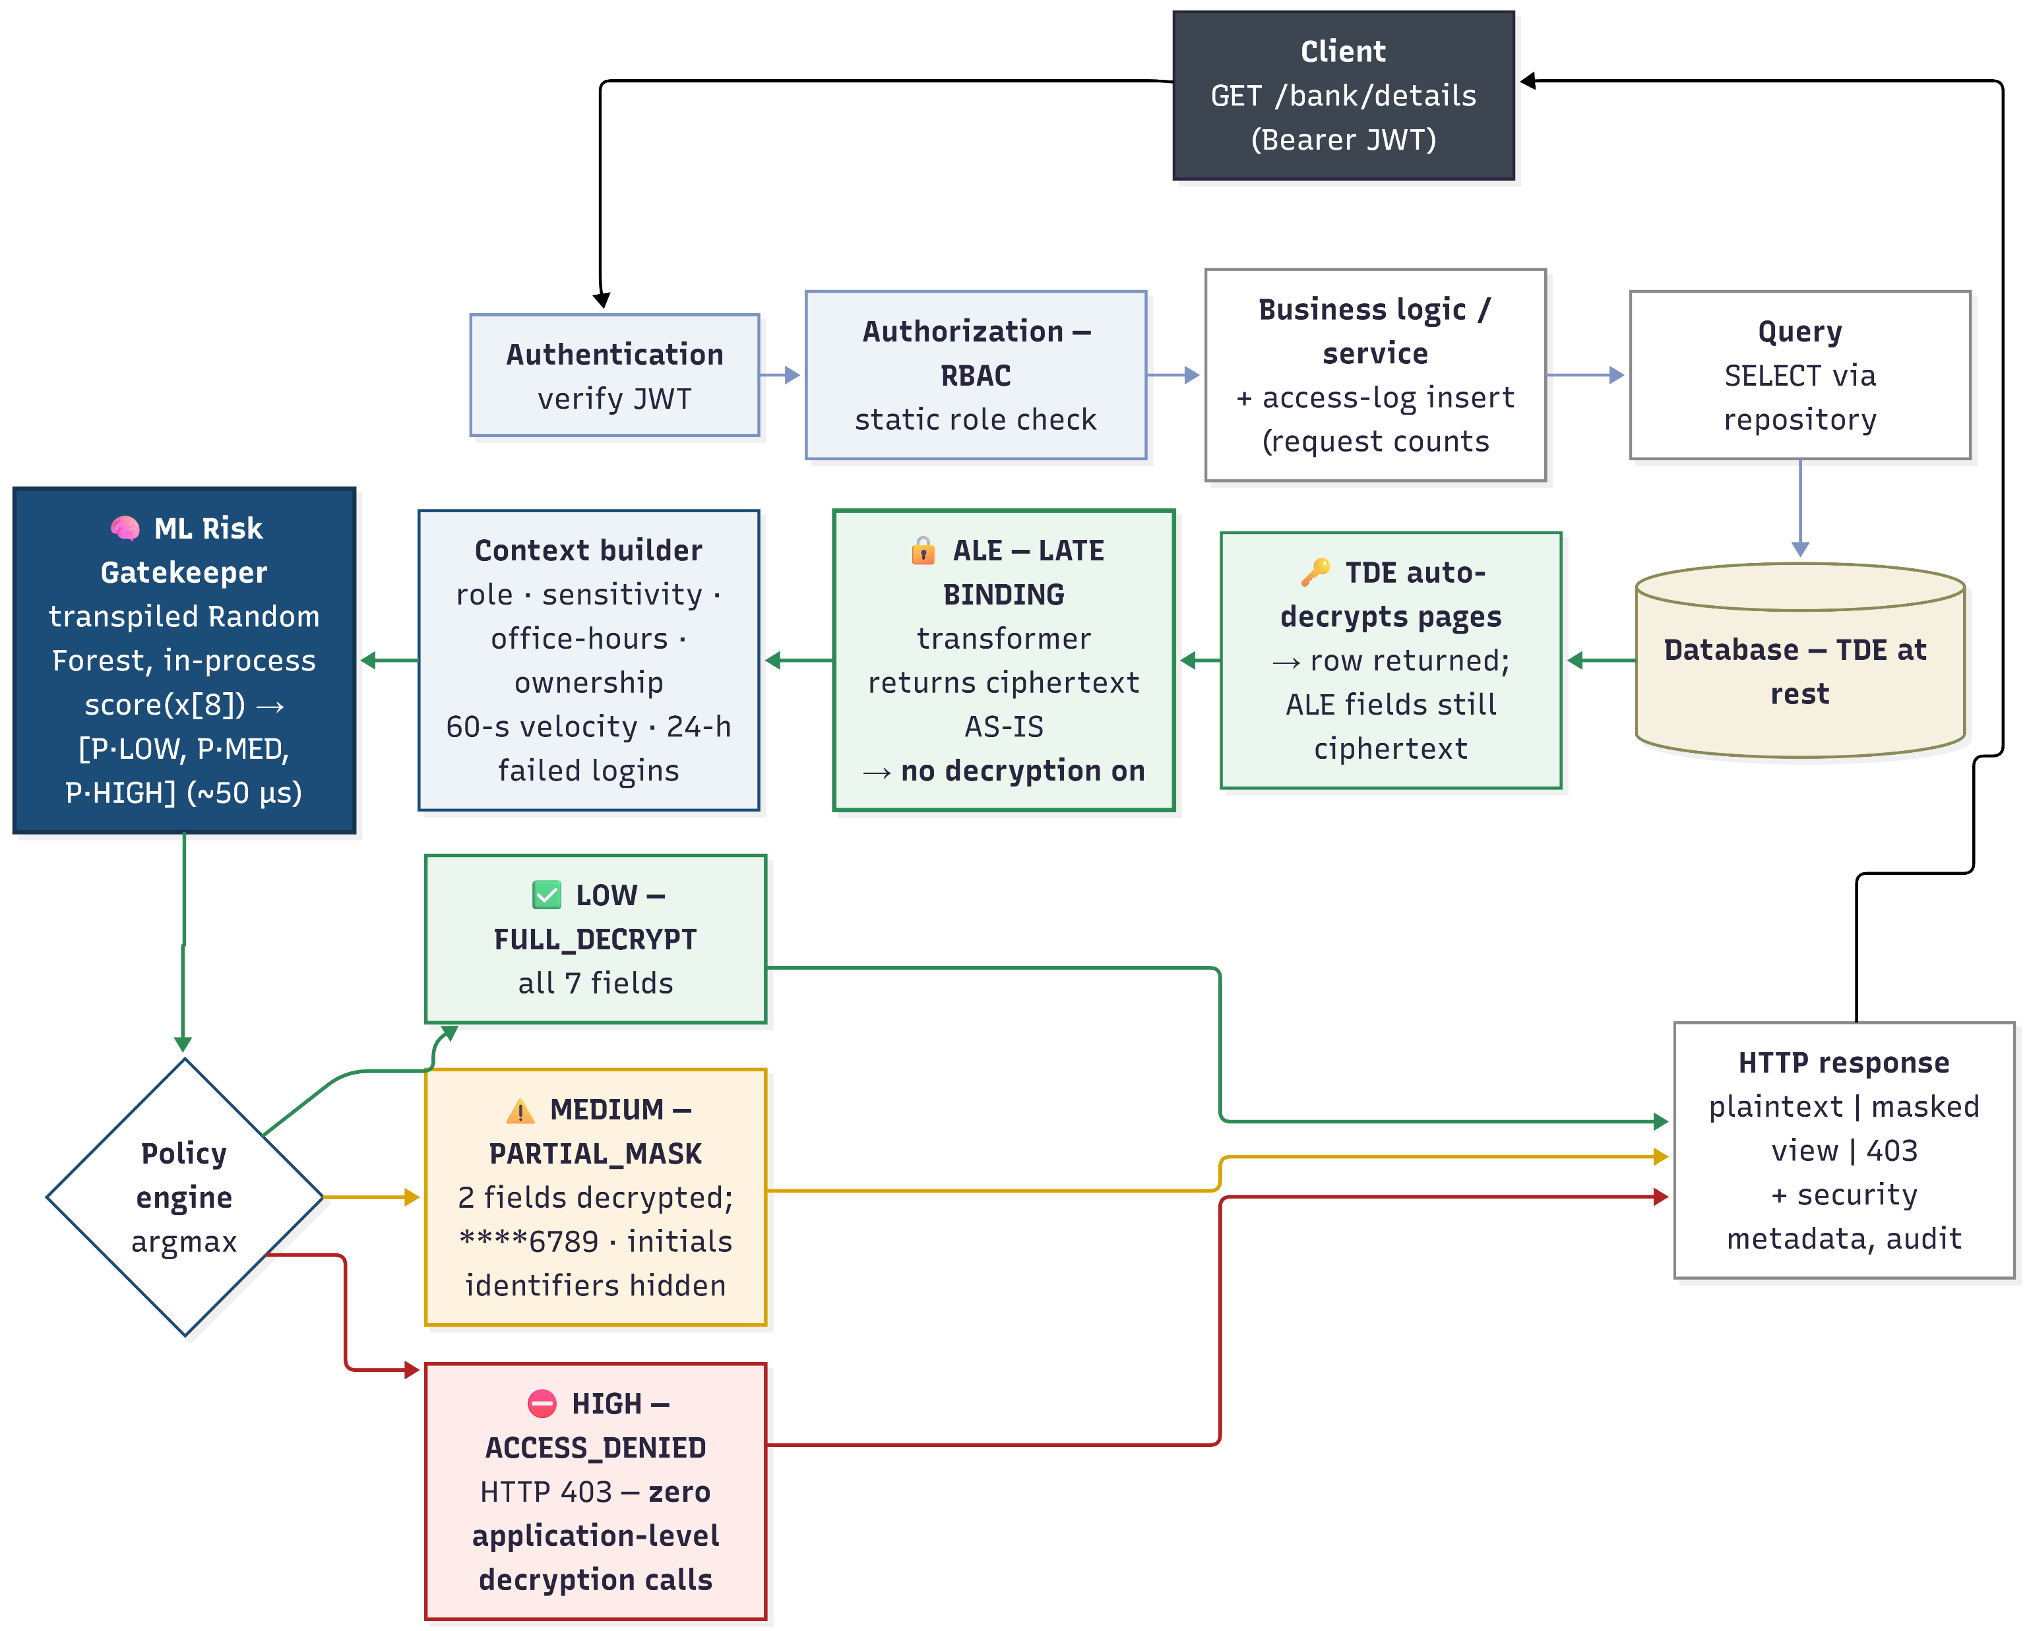
Proposed Methodology
Figure 4: Proposed system architecture.

Slide 10
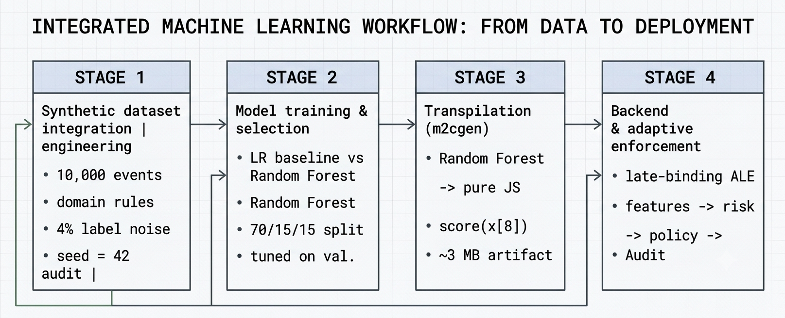
Four-Stage Pipeline
Figure 5: Four-stage integrated ML workflow.

Slide 11
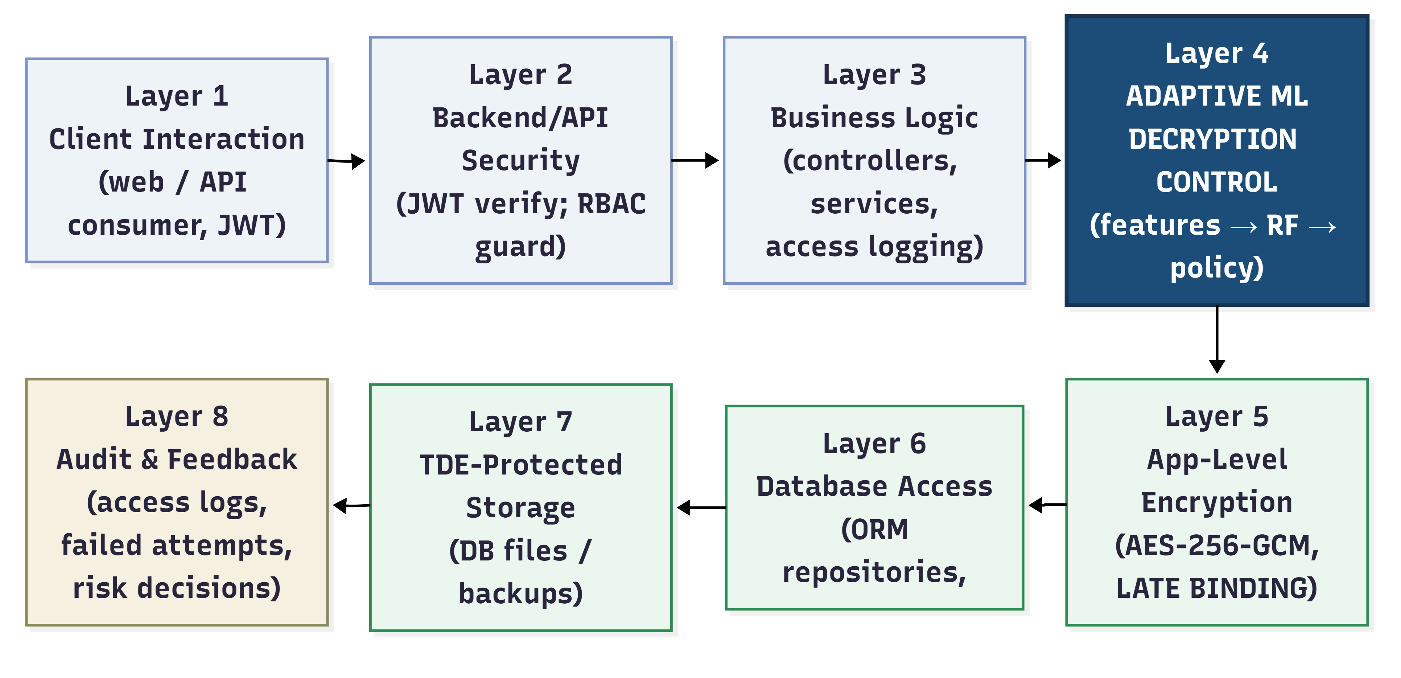
Eight-Layer Security Architecture
Figure 6: Eight-layer security architecture.

Slide 12
Synthetic Dataset Engineering
Table 2: Feature distributions of the synthetic access-event corpus.
Feature | Distribution | Parameters / rationale
user_role | Categorical | customer 75%, moderator 20%, admin 5% — read traffic is customer-dominated
resource_sensitivity | Categorical | LOW 60%, MEDIUM 30%, HIGH 10% — most reads touch low/medium-tier fields
is_office_hours | Bernoulli | P(1) = 0.80 — operational-hours dominance
record_owner_match | Role-conditional Bernoulli | customers: P(own record) = 0.95; staff roles: P(match) = 0.15
recent_request_count | Poisson(λ=4) + injected attack mass | 5% of rows overwritten with Uniform{15…64} scraping bursts
failed_attempt_count | Discrete exponential decay over {0…8} | P(0) = 0.88; long tail models brute-force campaigns

Slide 13
HIGH-risk labeling rules
Table 3: HIGH-risk labeling rules of the dataset generator.
HIGH-risk rule (label = 2) | Threat interpretation
customer ∧ owner_match = 0 ∧ sensitivity ∈ {MEDIUM, HIGH} | IDOR on protected data
customer ∧ request_count > 15 | Scraping / bulk exfiltration velocity
moderator ∧ sensitivity = HIGH | Support tier has no business on HIGH-tier data
moderator ∧ request_count > 25 ∧ owner_match = 0 | Bulk cross-record harvesting
admin ∧ off-hours ∧ sensitivity = HIGH ∧ request_count > 20 | Compromised super-user pattern
failed_attempts ≥ 5 (any role) | Post-brute-force account takeover

Slide 14
MEDIUM-risk labeling rules
Table 4: MEDIUM-risk labeling rules of the dataset generator.
MEDIUM-risk rule (label = 1) | Threat interpretation
customer ∧ owner_match = 0 ∧ sensitivity = LOW | Cross-record access on public-tier data
customer ∧ request_count ∈ [9, 15] | Elevated velocity below the attack threshold
moderator ∧ off-hours ∧ sensitivity = MEDIUM | Unusual time for support work on personal data
admin ∧ failed_attempts ∈ {3, 4} | Moderate authentication friction on a privileged
(moderator ∨ admin) ∧ request_count > 18 | Staff-tier volume anomaly

Slide 15
Dataset partitions
Table 5: Dataset partitions and their roles.
Partition | Samples | Purpose | Class balance
Training | 7000 (70%) | Model fitting | Stratified: ≈85% LOW / ≈6% MEDIUM / ≈9% HIGH
Validation | 1500 (15%) | Hyperparameter tuning | Same (stratified)
Test | 1500 (15%) | Quarantined; used once for final metrics | 1,274 LOW / 87 MEDIUM / 139 HIGH

Slide 16
Model: Random Forest
Table 6: Random Forest hyperparameters and their justification.
Hyperparameter | Value | Justification
n_estimators (T) | 75 | Accuracy saturates at ~75 trees; more only inflates artifact size
max_depth (d) | 12 | Captures deepest 4-antecedent rules; unlimited depth overfits noise, bloats code (~15 MB)
class_weight | Balanced | Inverse-frequency weighting protects minority-class recall (MEDIUM ≈ 6%, HIGH ≈ 9%)
random_state | 42 | Reproducibility

Slide 17
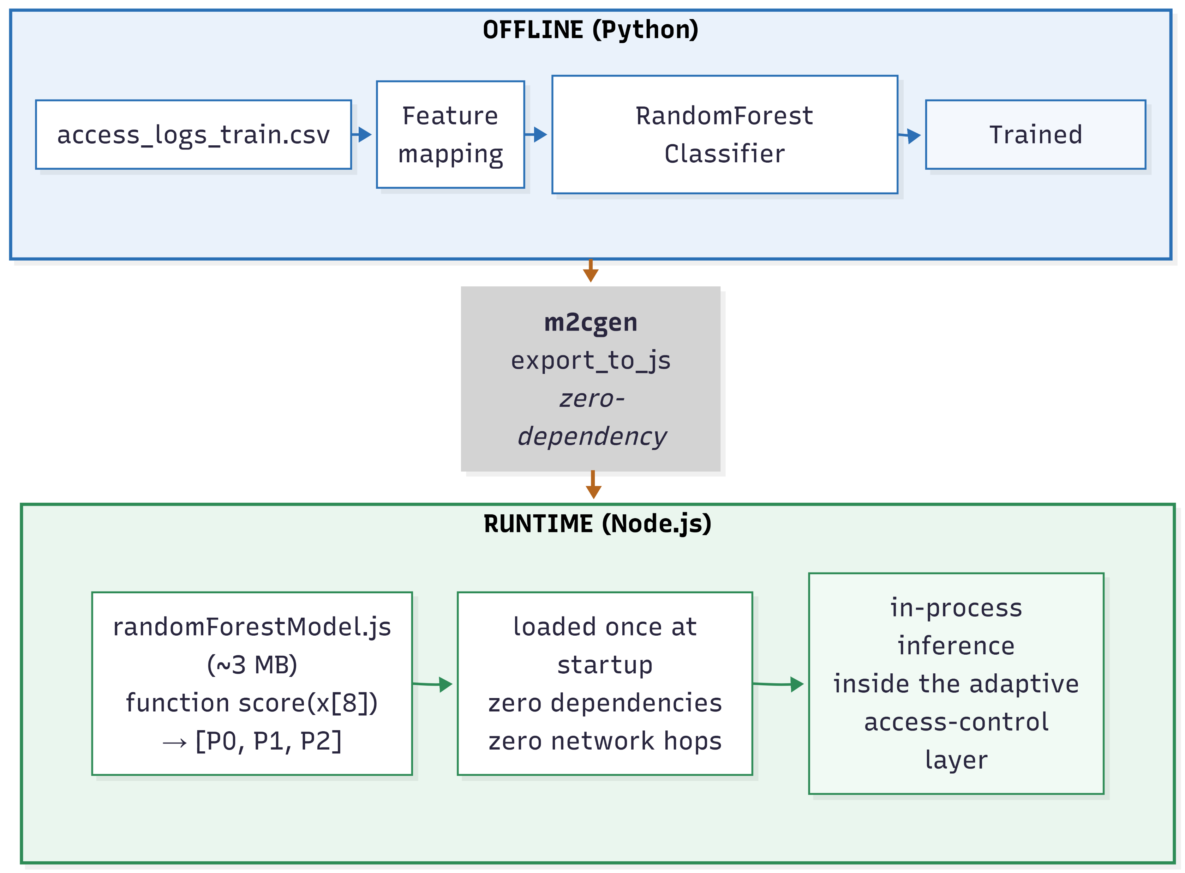
In-Process Transpilation
Figure 7: Zero-dependency transpilation into the backend runtime.

Slide 18
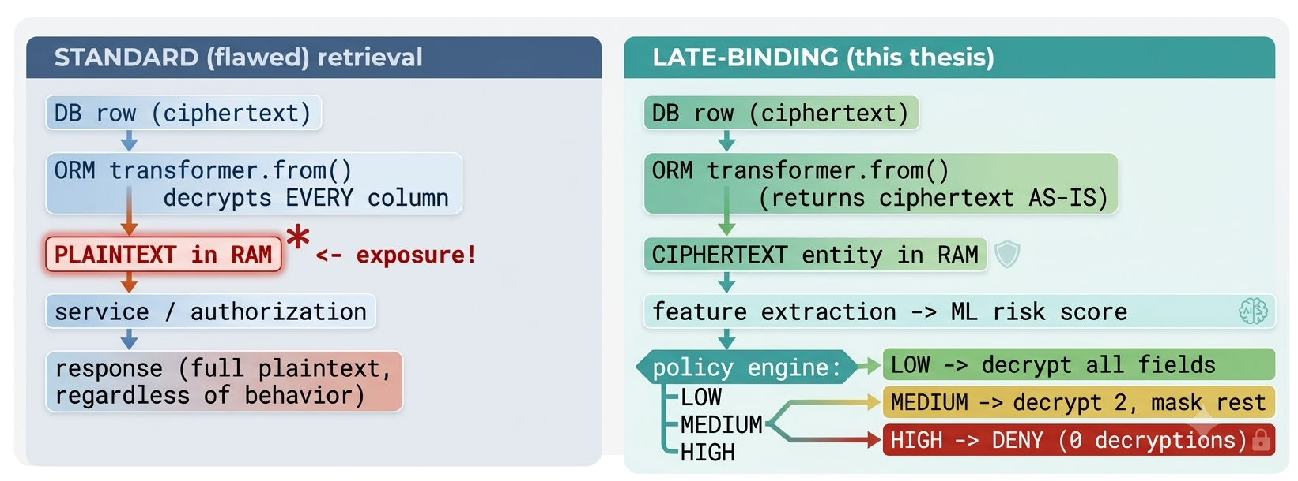
Late-binding cryptographic redesign
Figure 8: Standard ORM retrieval versus the late-binding cryptographic redesign.

Slide 19
Sensitive table in database
Table 7: Description of Bank Details table in database.
DB column | Type | ALE-encrypted
id | uuid | NO
user_id | uuid | NO
branch_name | varchar(120) | YES
account_type | enum | NO
account_holder_name | text | YES
account_number | Text | YES
account_last_four | varchar(4) | NO
routing_number | text | YES
swift_code | text | YES
iban | text | YES
nid | text | YES
status | enum | NO
created_at/updated_at | timestampz | NO

Slide 20
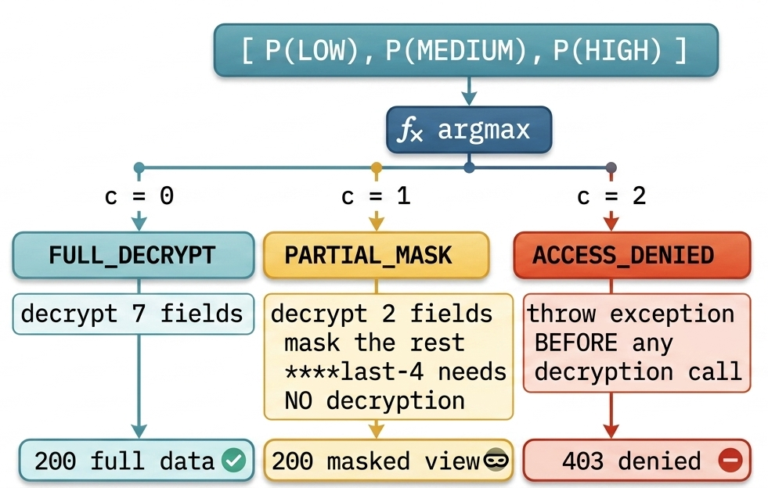
Risk-to-policy decision
Figure 9: Risk-to-policy decision flow.

Slide 21
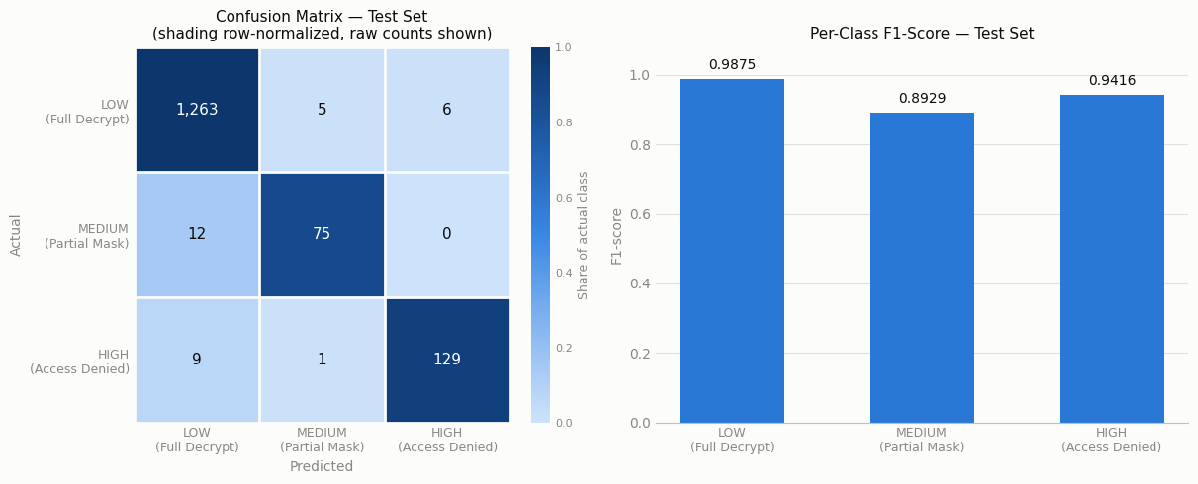
Result Analysis
Figure 10: Test-set confusion matrix (heatmap) and per-class F1-scores.

Slide 22
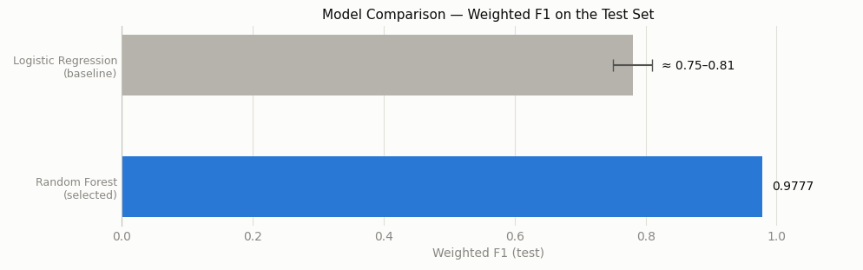
Baseline Comparison
Figure 11: Selected model versus the linear baseline under an identical protocol.

Slide 23
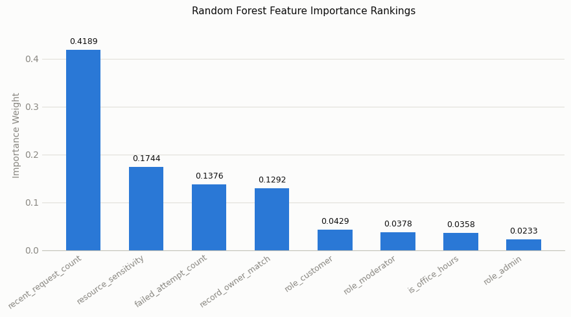
Feature Importance
Figure 12: Feature-importance ranking of the trained model.

Slide 24
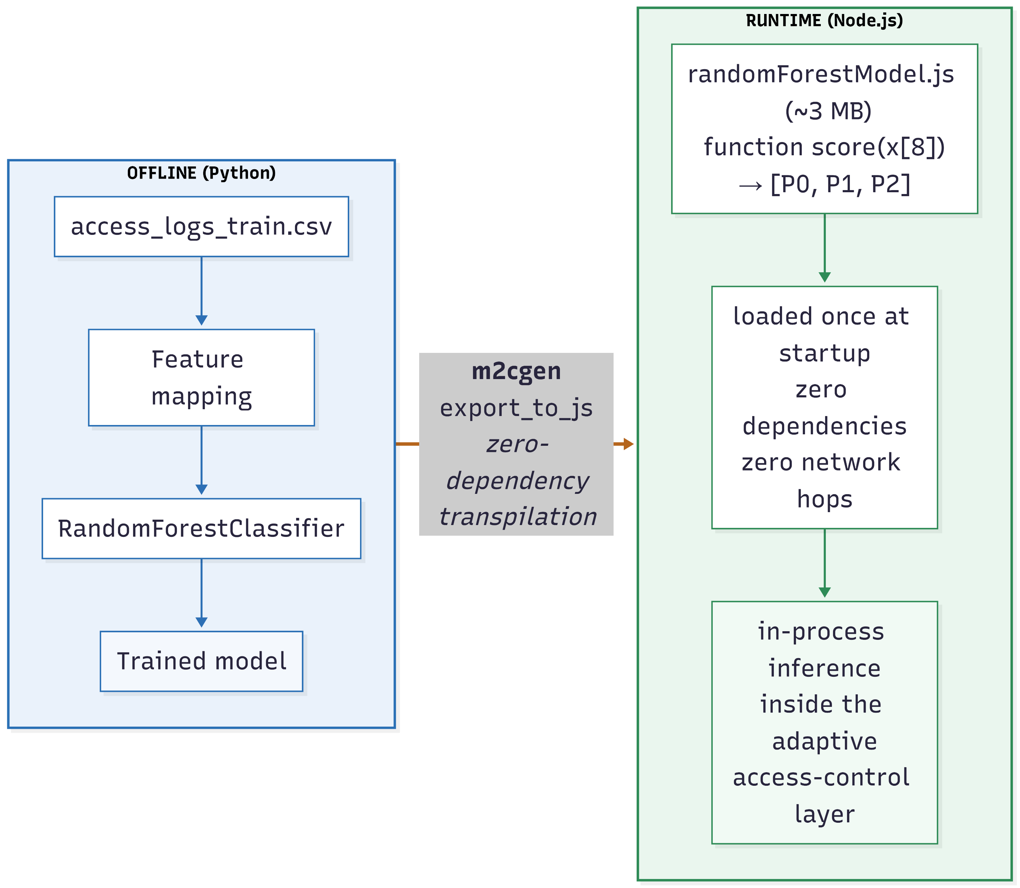
Transpiled Artifact Latency
~3 MB JavaScript · loaded once (~50 ms)
Warm inference: ≈ 50 µs per call
Feature extraction: ≈ 1–2 ms · total overhead ≈ 2 ms
Learned decision bands: LOW ≤ 8 → MEDIUM 9–13 → HIGH ≥ 15 req/min
Figure 13: Zero-dependency transpilation into the backend runtime.

Slide 25
Comparison with static pipeline
Table 8: Threat-by-threat comparison of the static baseline pipeline and the proposed adaptive framework.
Threat scenario | Static pipeline (ORM+RBAC) | Proposed adaptive framwork
Legitimate self-access | Full plaintext | Full plaintext (99.14% pass rate) + audit trail
Moderate over-querying (9–13 req/min) | Full plaintext | Masked view; workflow continues
Scraping (40 req/min) | Full plaintext on every request | Denied at P(HIGH) = 1.000; zero decryption
IDOR cross-record read | Full plaintext if role-authorized | Denied at P(HIGH) = 0.990; zero decryption
Post-credential-stuffing access | Full plaintext | Denied at P(HIGH) = 0.720; zero
Added latency per request | Usual system latency | ≈ 2 ms total (audit insert + feature counts); inference ≈ 50 µs

Slide 26
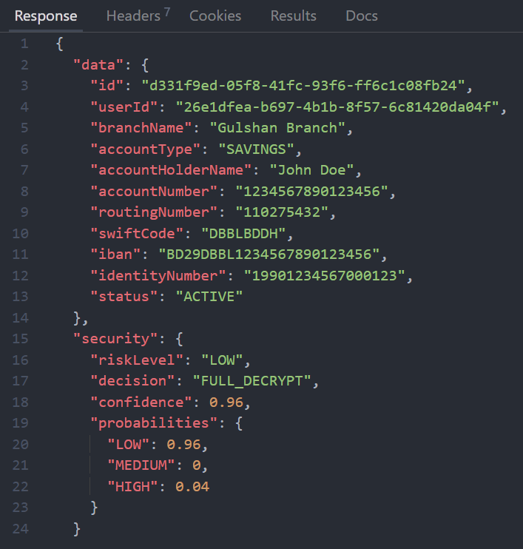
System Demonstration: Low-risk
user_id:
"26e1dfea-b697-4b1b-8f57-6c81420da04f“
API endpoint:
http://localhost:3000/api/v1/bank/details
Figure 14: Screenshot of low-risk response

Slide 27
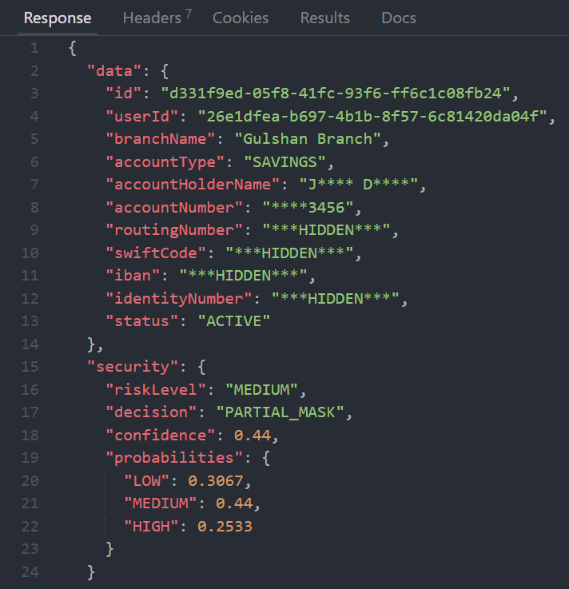
System Demonstration: Medium-risk
user_id:
"26e1dfea-b697-4b1b-8f57-6c81420da04f“
API endpoint:
http://localhost:3000/api/v1/bank/details
Figure 15: Screenshot of medium-risk response

Slide 28
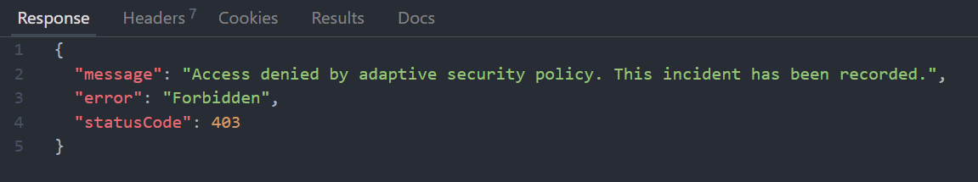
System Demonstration: High-risk
user_id:
"26e1dfea-b697-4b1b-8f57-6c81420da04f“
API endpoint:
http://localhost:3000/api/v1/bank/details
Figure 15: Screenshot of high-risk response

Slide 29
Experimental Setup
Table 9: Implementation environment of the framework.
Component | Detail
Backend framework | NestJS 11 (TypeScript) modular monolith
Runtime | Node.js v22.12.0 (V8 engine)
Database / ORM | PostgreSQL with TypeORM 0.3.x
Cryptography | AES-256-GCM (Node.js crypto), 96-bit random IV, versioned ciphertext envelope
ML training | Python 3, scikit-learn (RandomForestClassifier, LogisticRegression)
Transpilation | m2cgen (model-to-code generator) → pure JavaScript
Operating system | Microsoft Windows 11 (x64)
Hardware | Intel Core i5-1135G7 (11th Gen, 2.40 GHz), 8 GB RAM
Input / output format | CSV (dataset), JSON (API responses)

Slide 30
Conclusion
Novelty & Significance
Late-binding cryptography: ciphertext survives retrieval; decryption becomes a policy decision
Learned per-request risk: from unforgeable, server-controlled behavior
Graduated three-tier policy: decrypt / mask / deny; primary identifier masked with zero decryption
In-process transpiled inference: microsecond-scale, no serving infrastructure

Slide 31
Limitations
Synthetic, rule-labeled corpus → proof-of-concept validation (rule-learning bias)
Low-and-slow attackers below velocity thresholds: 9/139 missed
Single-node prototype; fixed 60-s / 24-h windows
One demonstrated domain (banking); offline evaluation only

Slide 32
Future Work
Retrain on real audit telemetry (Layer 8 already collects it)
Longer-horizon features → catch low-and-slow scraping
Collect more related features
Generalize: healthcare, e-commerce

Slide 33
References
[1] R. Houtsma, "An Explainable Machine Learning Approach to Risk-Adaptive Access Control," M.Sc. thesis, Faculty of Electrical Engineering, Mathematics and Computer Science, University of Twente, Enschede, The Netherlands, 2022.
[2] A. Liu, X. Du, and N. Wang, "Efficient Access Control Permission Decision Engine Based on Machine Learning," Security and Communication Networks, vol. 2021, art. no. 3970485, pp. 1–11, 2021, doi: 10.1155/2021/3970485.
[3] B. Li, F. Yang, and S. Zhang, "Context-Aware Risk Attribute Access Control," Mathematics, vol. 12, no. 16, art. no. 2541, 2024, doi: 10.3390/math12162541.
[4] N. Anciaux, L. Bouganim, and Y. Guo, "Database Encryption," in Encyclopedia of Cryptography, Security and Privacy, 3rd ed., S. Jajodia, P. Samarati, and M. Yung, Eds. Berlin, Heidelberg, Germany: Springer, 2023, doi: 10.1007/978-3-642-27739-9_677-2.

Slide 34
Thank You

