Slide 1
Project Football Analytics
Prepared by: Faiyaz Ahmad

Slide 2
Twitter Streaming Data

Slide 3
API Data Architecture:
season
countries
leagues
H2H
fixtures
live
top scores
teams
team
statistics
standings
predictions
events
lineups
Players statistics
players
Players
transfer
coaches
players
trophies
sidelined
players
players

Slide 4
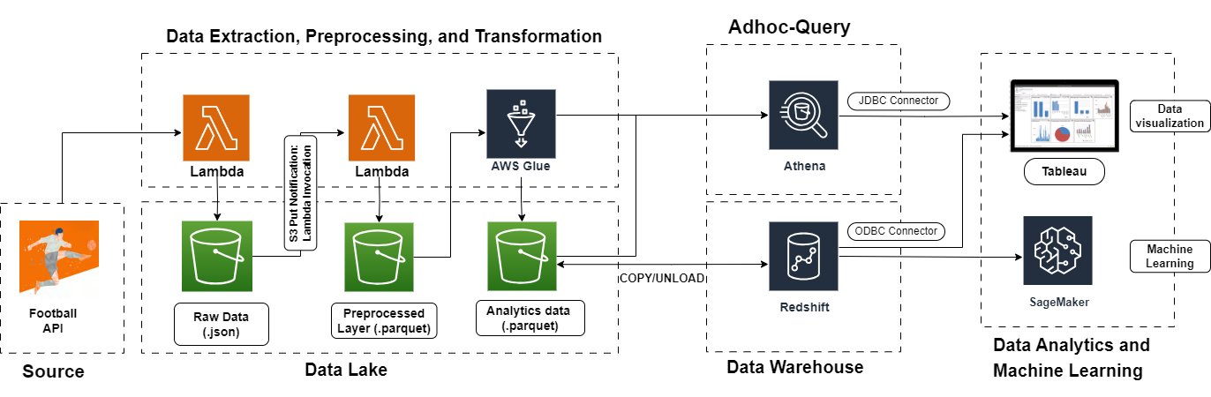
Project overview:

Slide 5
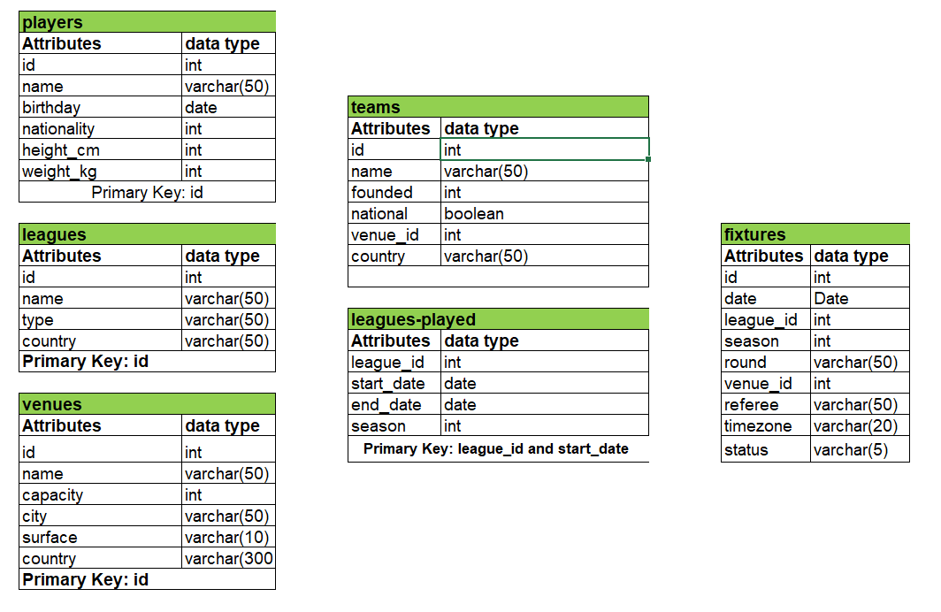
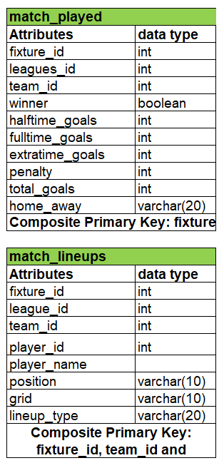
Schema:

Slide 6
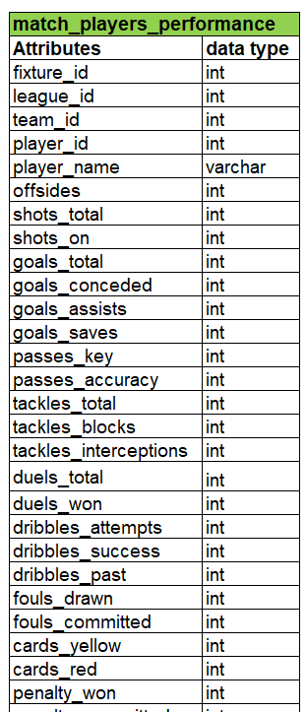
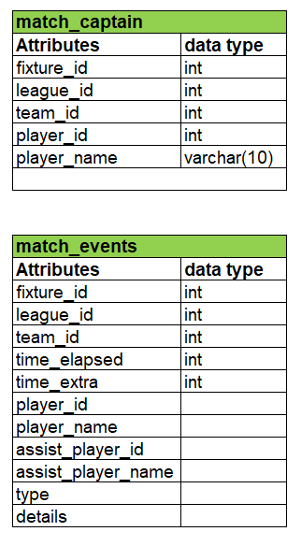
Schema

Slide 7
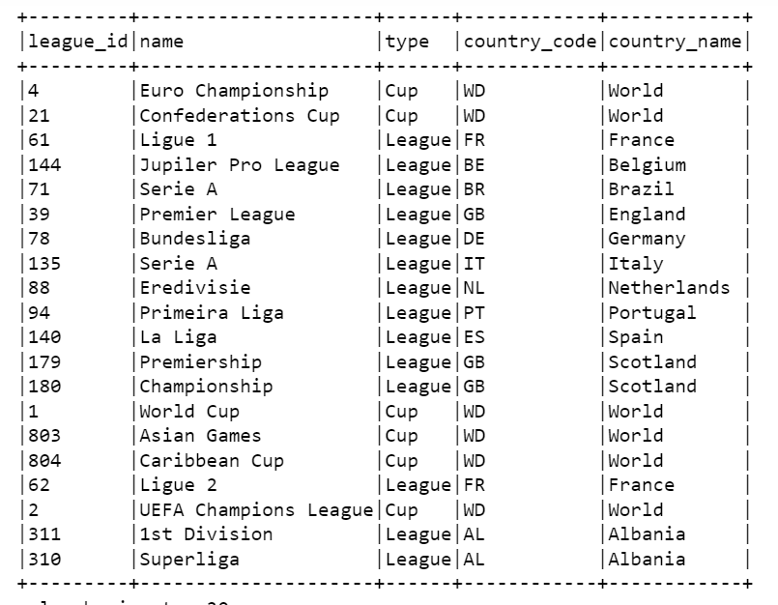
Leagues:

Slide 8
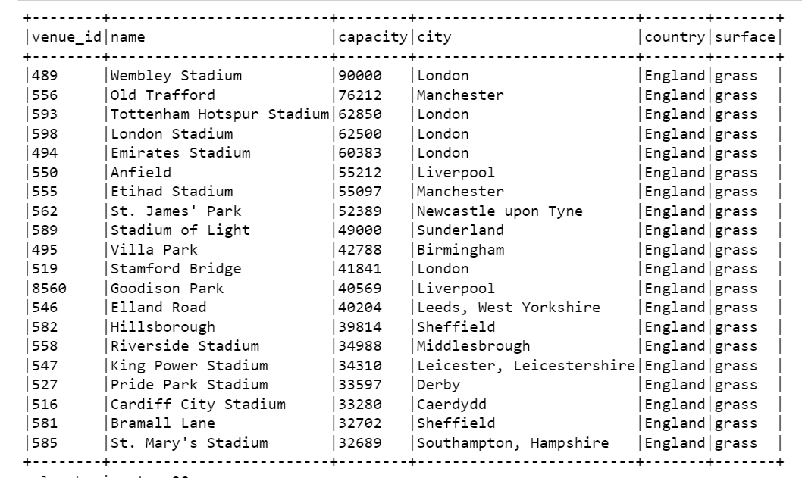
Venue details:

