Slide 1








CAPSTONE PROJECT
DATA ANALYTICS
OLIST
E-COMMERCE
Store Analysis
Sales
Customers
Sellers
Delivery Performance
Analysis based on Brazilian OLIST Public Dataset (2016–2018)
TOOLS & TECHNOLOGIES
PREPARED BY
SQL
Excel
Tableau
Power BI
MF
Mohammad Faiz
EXTRACTION
PROCESSING
VIZ
DASHBOARD

Slide 2



PROJECT OVERVIEW
Introduction
DOMAIN
Key Focus Areas
E-Commerce
Analyzing digital retail performance in the Brazilian market context.
Strategic pillars guiding the data analysis process
Sales Performance
Analyzing revenue trends, order volumes, and average order values (AOV) over time.
SOURCE DATA
Brazilian OLIST
Customer Behavior
Comprehensive public dataset of orders placed at Olist Store.
Understanding geographic distribution and purchasing patterns of customers.
Sellers & Payments
Evaluating seller reach across states and payment method preferences.
ANALYSIS PERIOD
2016 – 2018
24-month historical trend analysis covering peak retail seasons.
Delivery & Satisfaction
Correlating delivery times with customer review scores and identifying logistics bottlenecks.

Slide 3




STRATEGIC GOALS
Project Objectives
Key goals driving the analytical process and dashboard creation.
Sales & Revenue Trends
01
Geographic Distribution
02
Analyze historical sales data to identify seasonal patterns, growth rates, and revenue drivers over the 2016-2018 period.
Map customer and seller locations across Brazilian states to understand market penetration and logistics coverage.
Payment Behavior
03
Delivery & Satisfaction
04
Study payment method preferences (credit card, boleto, voucher) and installment patterns to optimize checkout experiences.
Evaluate delivery performance metrics and correlate delivery times with customer satisfaction scores to identify friction points.
Interactive BI Dashboards
Construct dynamic, interactive dashboards in Power BI and Tableau to enable stakeholders to self-serve insights and monitor KPIs in real-time.
05

Slide 4


TECHNICAL STACK
Tools & Technologies
The integrated technology stack used for data extraction, processing, analysis, and visualization.
MySQL Workbench
Microsoft Excel
Tableau
Core database management for data storage, cleaning, and complex KPI calculations using SQL queries.
Initial data validation, pivot table analysis, and quick verification of results before BI integration.
Advanced exploratory data analysis and creation of compelling visual stories with interactive filters.
Power BI
PowerPoint
Development of multi-page interactive dashboards for deep-dive analysis of sales, customers, and delivery.
Synthesis of findings into a professional presentation deck for stakeholder communication.

Slide 5







PERFORMANCE METRICS
Major KPIs
Key indicators tracking sales, operations, and customer satisfaction across the platform.
Total Orders
Total Revenue
Avg Order Value
Success Rate
Avg Delivery Days
Aggregate count of all purchase orders processed.
Gross Sales Volume (GMV) across all categories.
Mean revenue generated per unique order.
Percentage of orders successfully delivered.
Average time from approval to customer delivery.
Avg Review Score
Payment Types
Top Cust. States
Top Seller States
Product Ranking
Customer satisfaction rating on 1-5 scale.
Distribution of credit card, boleto, vouchers.
Leading states by order volume (e.g., SP, RJ).
Geographic concentration of seller base.
Best and worst performing categories by revenue.

Slide 6
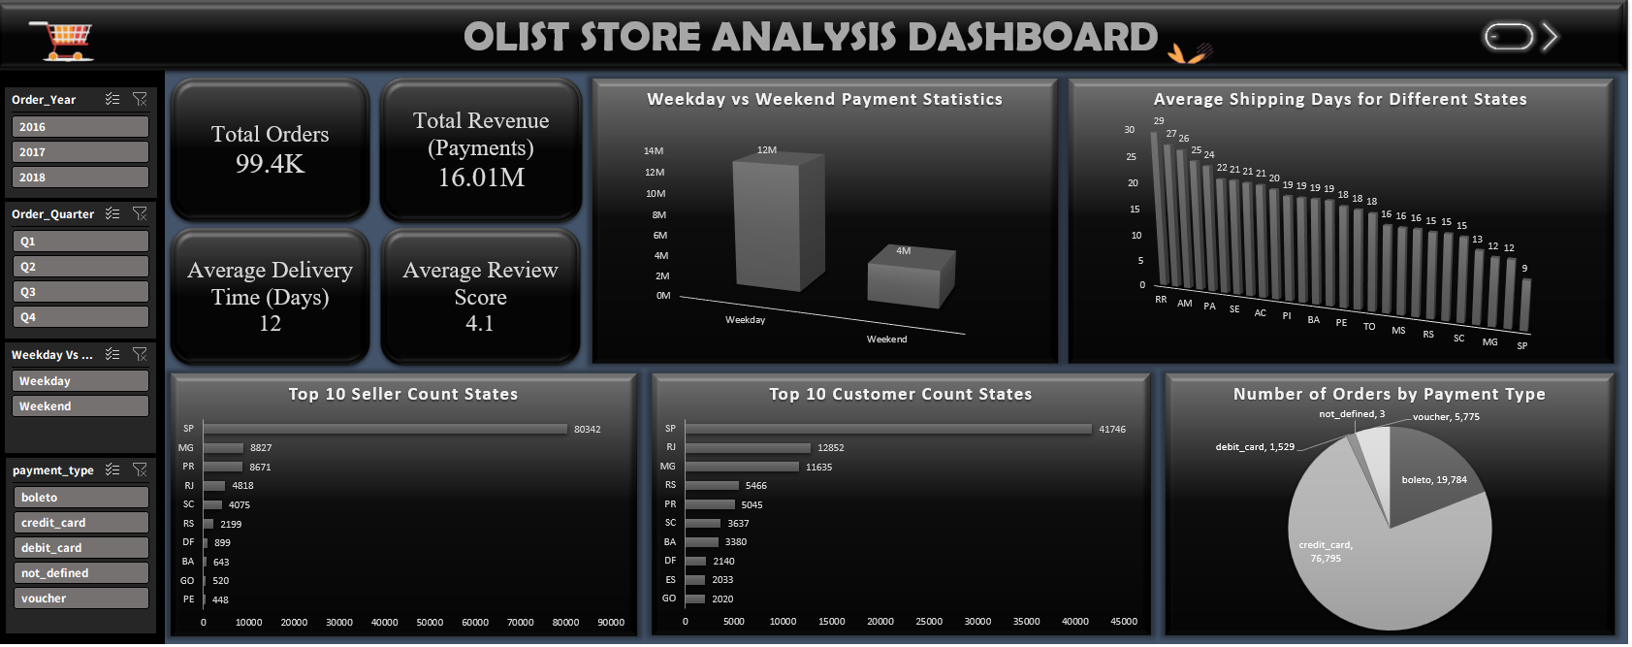
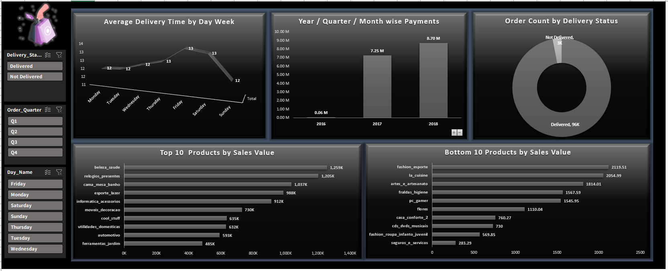

DATA PROCESSING
Excel Dashboard
Preliminary Analysis
Workflow Role
Data Cleaning & Validation
Removing duplicates, handling null values, and standardizing formats.
Pivot Table Analysis
Quick calculation of core KPIs like Revenue and Order Counts.
Preliminary Insights
Initial assessment of sales trends and delivery timelines.
Excel Dashboard Visualization
Cross-Verification
Insert the screenshot of the Excel dashboard here showing pivot tables and initial charts.
Validating numbers before importing into Tableau & Power BI.
Insert Image
VALIDATION STATUS
100% Data Integrity Confirmed

Slide 7

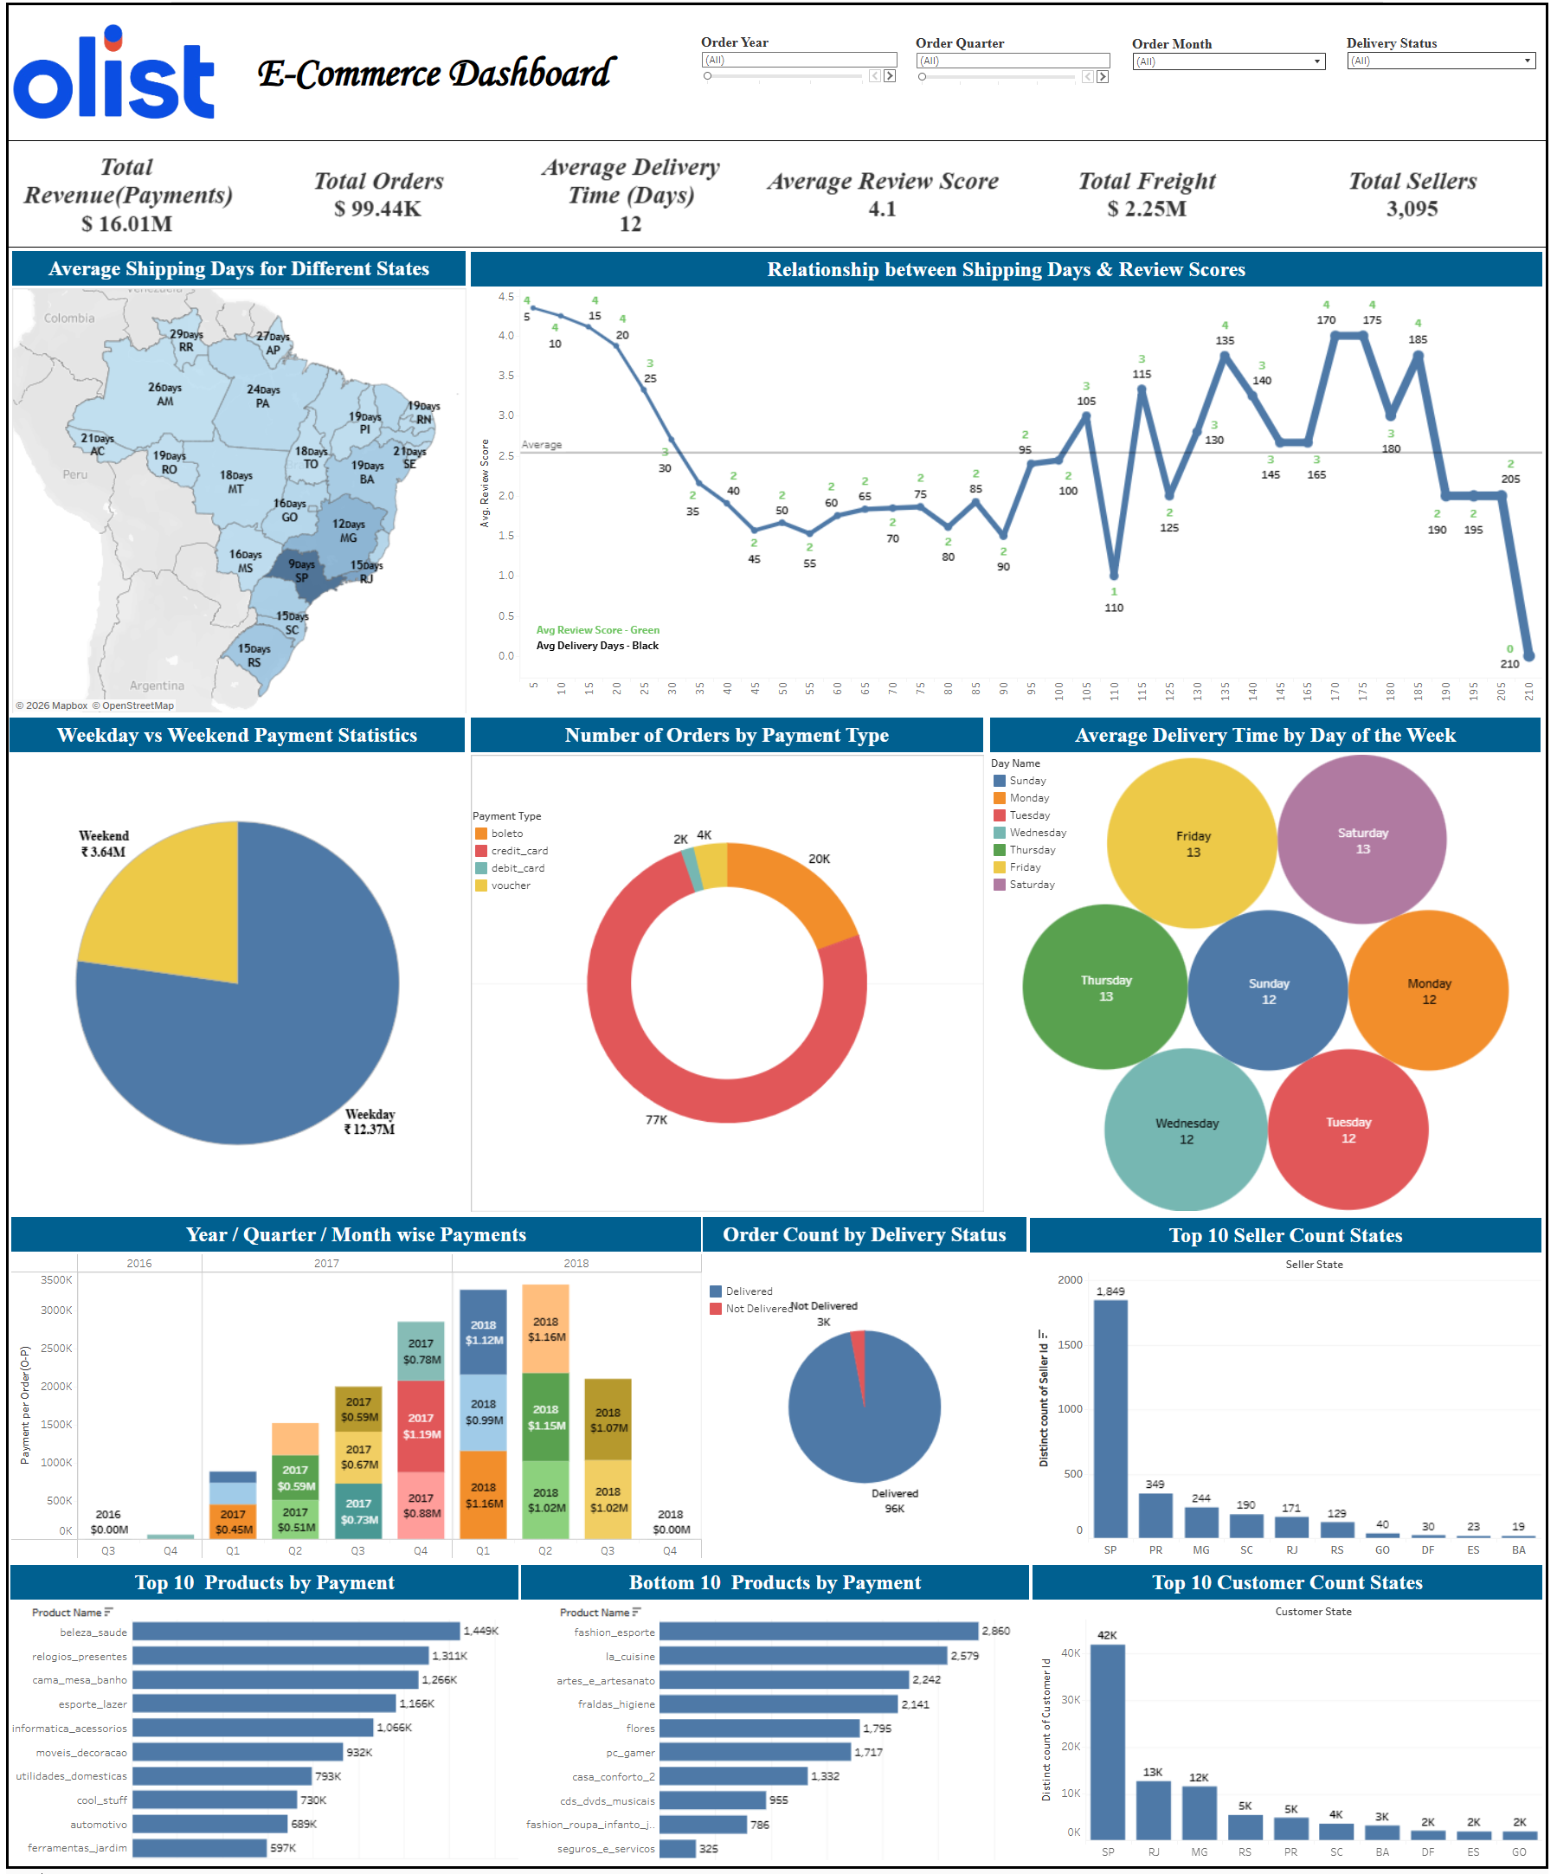

EXPLORATORY ANALYSIS
Visual Storytelling
Tableau Dashboard
Analysis & Modeling
Relationship Data Modeling
Connecting Orders, Customers, and Products for holistic views.
Revenue Trend Analysis
Time-series visualization of sales performance (2016-2018).
Geographic Distribution
Mapping customer and seller density across Brazilian states.
Tableau Visualization
Payment Behavior
Insert the screenshot of the Tableau dashboard here showing maps and trend charts.
Analyzing preference for Credit Cards vs. Boleto methods.
Interactive Filtering
Insert Image
Drill-down capabilities by state, product category, and time.
INTERACTIVITY
Full Drill-Down Enabled

Slide 8

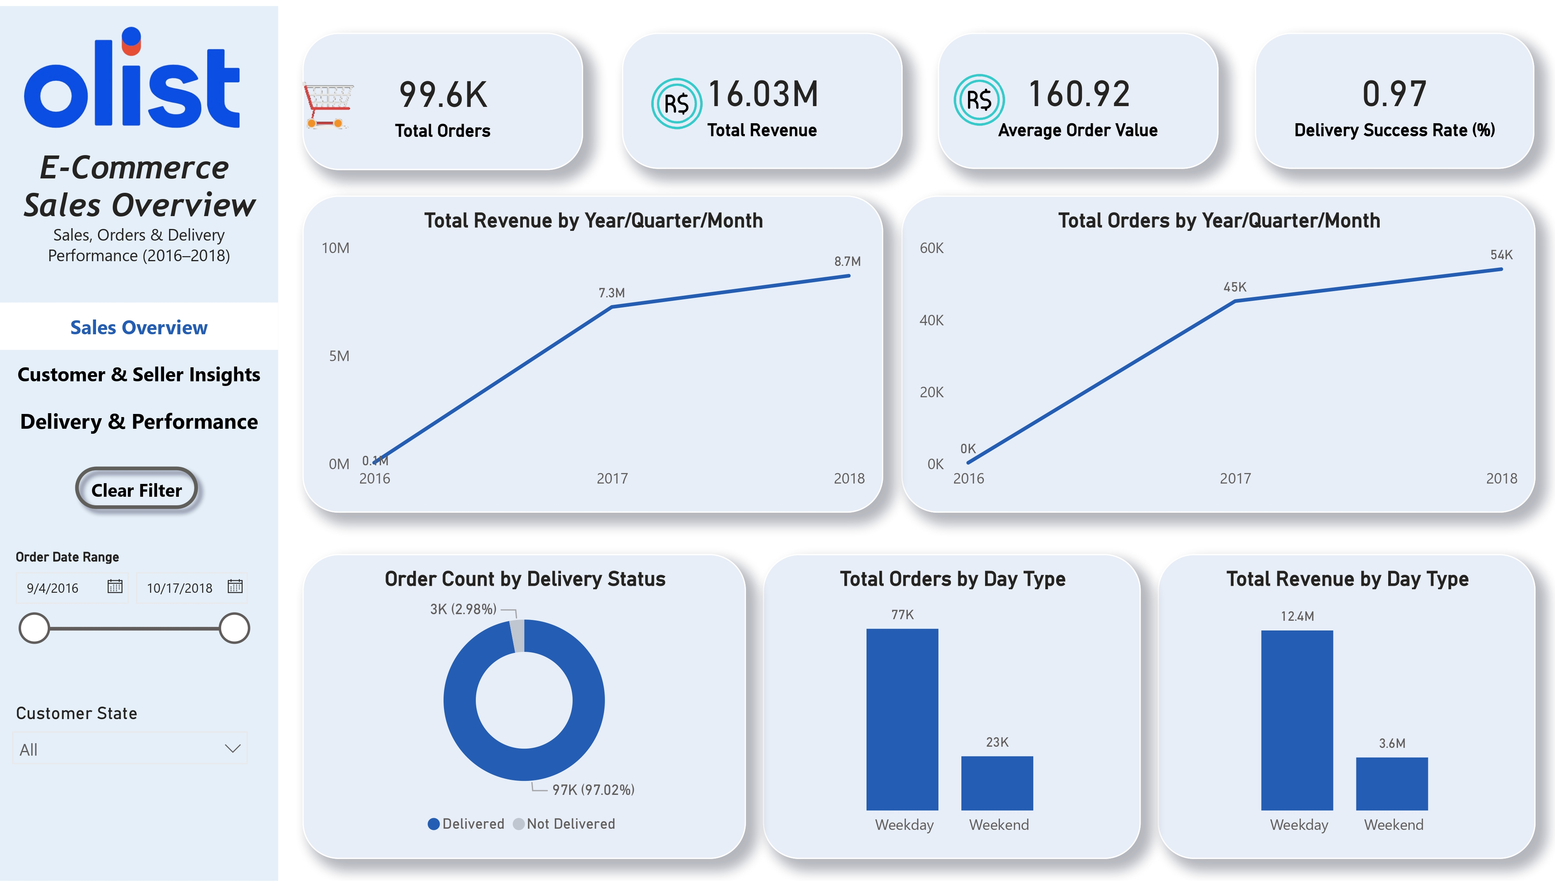

INTERACTIVE DASHBOARD • PAGE 1
Power BI: Sales Overview
Business Performance
Key Visuals & Metrics
Core KPIs
Total Orders, Total Revenue, and Average Order Value (AOV) scorecards.
Revenue Trends
Time-series analysis showing Year/Month-wise revenue growth.
Sales Patterns
Comparative analysis of Weekday vs. Weekend purchasing activity.
Power BI Dashboard
Delivery Success
Insert screenshot of the "Sales Overview" page here.
Overall delivery success rate monitoring logistics efficiency.
Insert Sales Dashboard Image
DASHBOARD INSIGHT
Focus on Revenue Growth & Seasonality

Slide 9
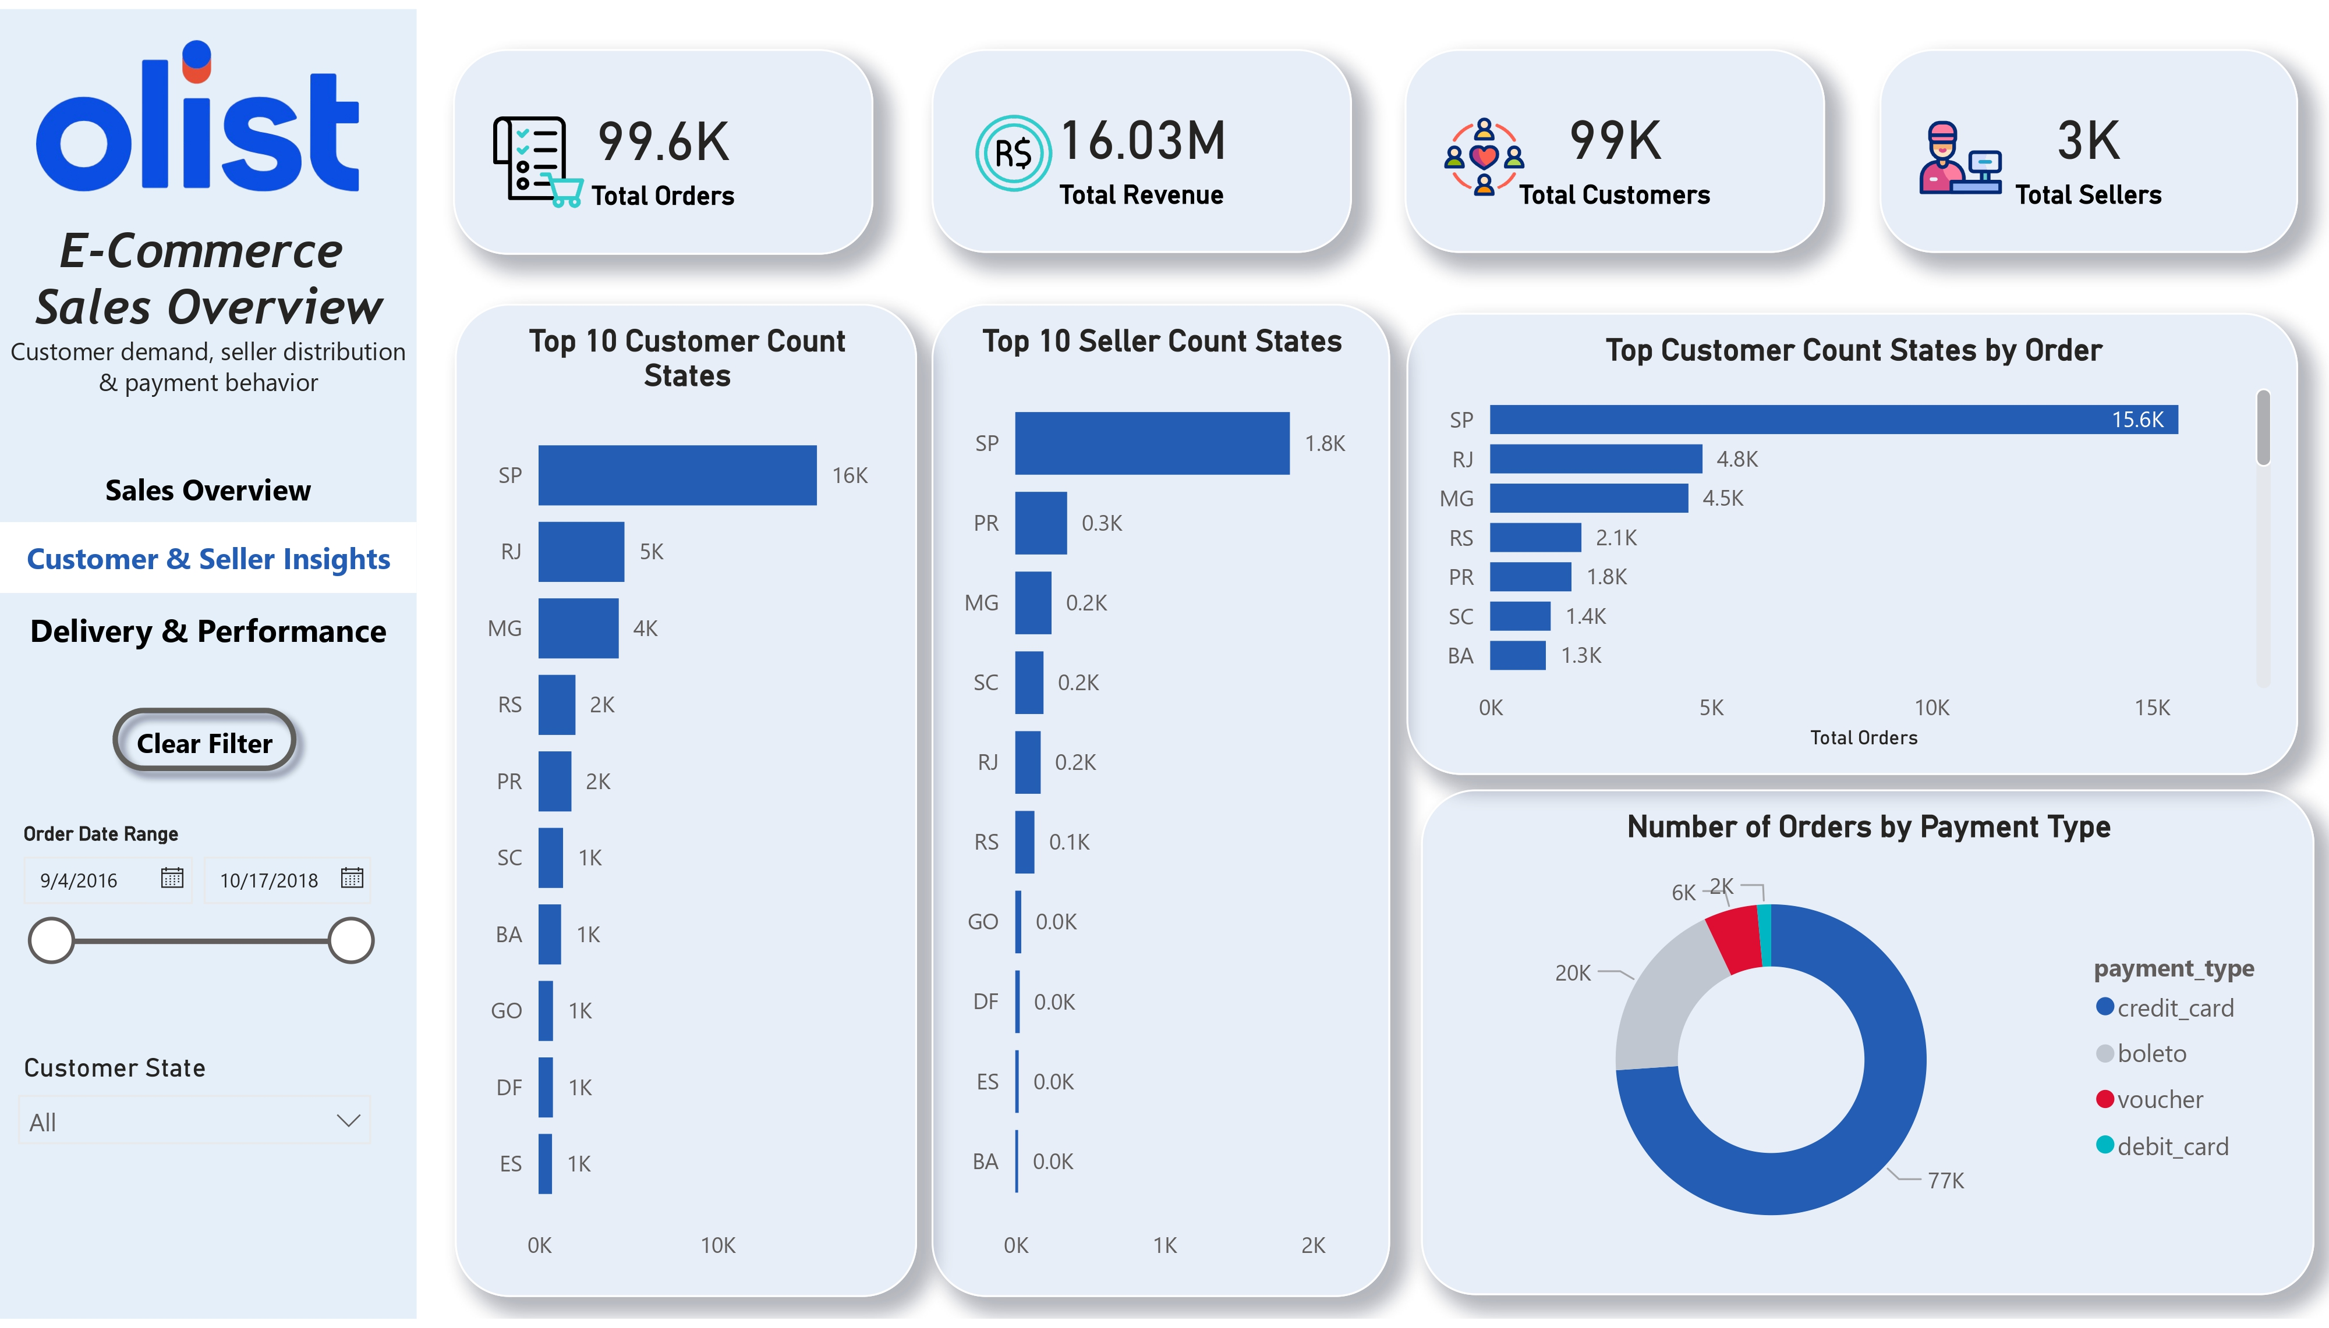


GEOGRAPHIC ANALYSIS
Customer & Seller Insights
Power BI Page 2
Key Focus Areas
Top Customer States
Analyzing concentration of buyers in SP, RJ, and MG regions.
Seller Geography
Mapping seller distribution to identify logistics gaps.
Geographic Distribution
Heatmaps showing order density across Brazilian states.
Customer & Seller Map
Payment Preferences
Insert Power BI screenshot showing geographic maps and payment charts.
Breakdown of Credit Card vs Boleto vs Voucher usage.
Insert Image
SPATIAL INSIGHT
Regional Demand vs Supply

Slide 10

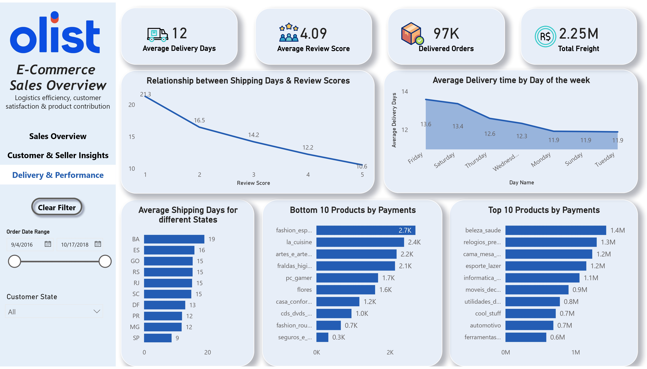
OPERATIONAL METRICS
Delivery & Store Performance
Logistics Analysis
Key Insights
Average Delivery Days
Analyzing logistics efficiency and transit times across regions.
Delivery Time vs Review Score
Correlation between shipping speed and customer satisfaction ratings.
State-wise Performance
Identifying high-delay zones and regional bottlenecks.
Power BI Dashboard
Top & Bottom Products
Insert screenshot showing delivery timelines, state maps, and product performance matrices.
Product performance by revenue and delivery success rates.
Insert Image
LOGISTICS INSIGHT
Optimizing Regional Fulfillment

Slide 11





ETL PROCESS & MODELING
SQL Queries & Data Preparation
Data Pipeline
STEP 01
STEP 02
STEP 03
STEP 04
STEP 05
Database Setup
Data Loading
Data Cleaning
Fact Creation
KPI Calculation
Creating schema and tables in MySQL for Orders, Items, Customers, and Geolocation data.
Bulk importing raw CSV datasets using LOAD DATA INFILE for efficient ingestion.
Handling NULLs, standardizing timestamps, and fixing special characters in city names.
Creating a master VIEW by joining Orders, Payments, and Reviews tables.
Aggregating final metrics: Total Revenue, AOV, and Delivery Days for BI tools.
Outcome: Clean, structured dataset ready for connection with Tableau and Power BI.

Slide 12


KEY TAKEAWAYS
Summary of Findings
Strategic Insights
01
02
03
Robust Growth
Weekday Activity
Logistics Success
Consistent upward trend in total orders and revenue from 2016 to 2018.
Sales volume peaks significantly during weekdays (Mon-Fri), suggesting B2B behavior.
High overall delivery success rate across major states, with most orders completing successfully.
+145% Year-over-Year
Peak: 2 PM - 4 PM
97.4% Delivered
Impact of Delivery Delays
04
05
There is a strong negative correlation between delivery time and customer review scores. Delayed shipments are the primary driver for 1-star reviews.
1.8/5
Revenue Concentration
Avg Score on Delay
Revenue is highly concentrated geographically in São Paulo (SP) and Rio de Janeiro (RJ), and categorically in Bed & Bath.

Slide 13



FINAL ANALYSIS
Conclusion & Recommendations
Action Plan
Strategic Opportunities
>>
Immediate Next Steps
Improve Logistics in High-Delay States
Target regions with >15 day delivery times (e.g., North/Northeast) by establishing local partnerships or switching carriers.
Optimize Operations for Weekday Demand
1
Prioritize Logistics
Align customer support and warehouse staffing with the Mon-Fri peak order volume (10 AM - 4 PM).
Renegotiate SLAs with carriers for underperforming states.
Focus on High-Performing Products
2
Refine Inventory
Increase inventory depth for 'Bed & Bath' and 'Health & Beauty' categories to prevent stockouts during peak seasons.
Adjust stock placement based on regional demand maps.
Reduce Delivery Time to Boost Satisfaction
Implement a goal to keep delivery under 10 days; data shows this is the inflection point for 5-star reviews.
3
Iterate KPIs
Quarterly review of dashboard metrics with stakeholders.
Continuous Monitoring via Dashboards
Utilize the deployed Power BI reports for real-time tracking of KPIs and automated alerts for revenue dips.

Slide 14
Thank You
😊
Author: Mohammad Faiz

