Slide 1
Transmission Control Protocol - TCP
The Transmission Control Protocol (TCP), documented in RFC 793, makes up for IP's deficiencies by providing reliable, stream-oriented connections that hide most of IP's shortcomings.

Slide 2

Transport Layer
The transport layer is responsible for process-to-process delivery—the delivery of a packet, part of a message, from one process to another. Two processes communicate in a client/server relationship, as we will see later.

Slide 3
Transport vs. network layer
network layer: logical communication between hosts
transport layer: logical communication between processes
  relies on, enhances, network layer services
Household analogy:
12 kids sending letters to 12 kids
processes = kids
app messages = letters in envelopes
hosts = houses
transport protocol = Ann and Bill
network-layer protocol = postal service

Slide 4
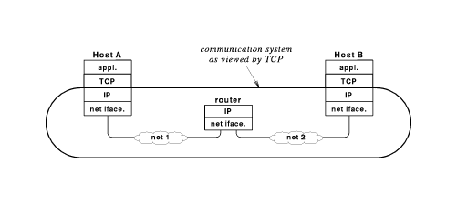
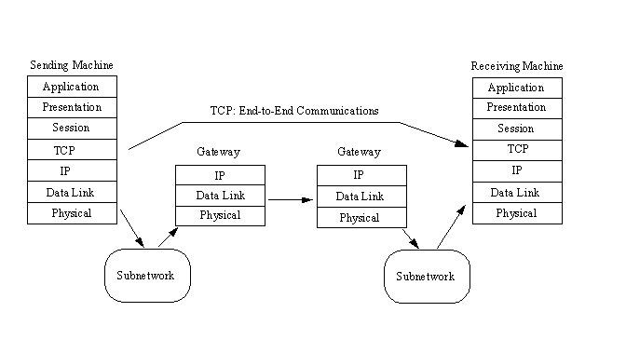
IP treats TCP like data and does not interpret any contents of the TCP message

Slide 5

Position of UDP, TCP, and SCTP in TCP/IP suite

Slide 6
TCP
Transmission Control Protocol (TCP) is the most widely used transport protocol
Provides reliable data delivery by using IP unreliable datagram delivery
Compensates for loss, delay, duplication and similar problems in Internet components
TCP provides considerably more facilities for applications than UDP, notably error recovery, flow control and reliability.
TCP is a connection-oriented protocol unlike UDP which is connection-less.
Most of the user application protocols, such as TELNET and FTP, use TCP

Slide 7
TCP Concept
The primary purpose of TCP is to provide reliable logical circuit or connection service between pairs of processes.
It does not assume reliability from the lower-level protocols (such as IP) so TCP must guarantee this itself.

Slide 8
TCP Features
TCP can be characterised by the following facilities it provides for the applications using it:
  Stream Data Transfer
  Full Duplex
  Multiplexing
  Logical Connections
  Reliability
  Flow Control

Slide 9

Stream Data Transfer
Application delivers arbitrarily large chunks of data to TCP as a``stream''
TCP breaks this data into segments, each of which fits into an IP datagram
Original stream is numbered by bytes
Segment contains sequence number of data bytes

Slide 10
Reliability
TCP assigns a sequence number to each byte transmitted, and expects a positive acknowledgment (ACK) from the receiving TCP.
If the ACK is not received within a timeout interval, the data is retransmitted.
TCP uses many techniques to provide reliable delivery
Recovers from
  Lost packets
  Duplicate packets
  Delayed packets
  Corrupted data
  Transmission speed mismatches
  Congestion
  System reboots

Slide 11
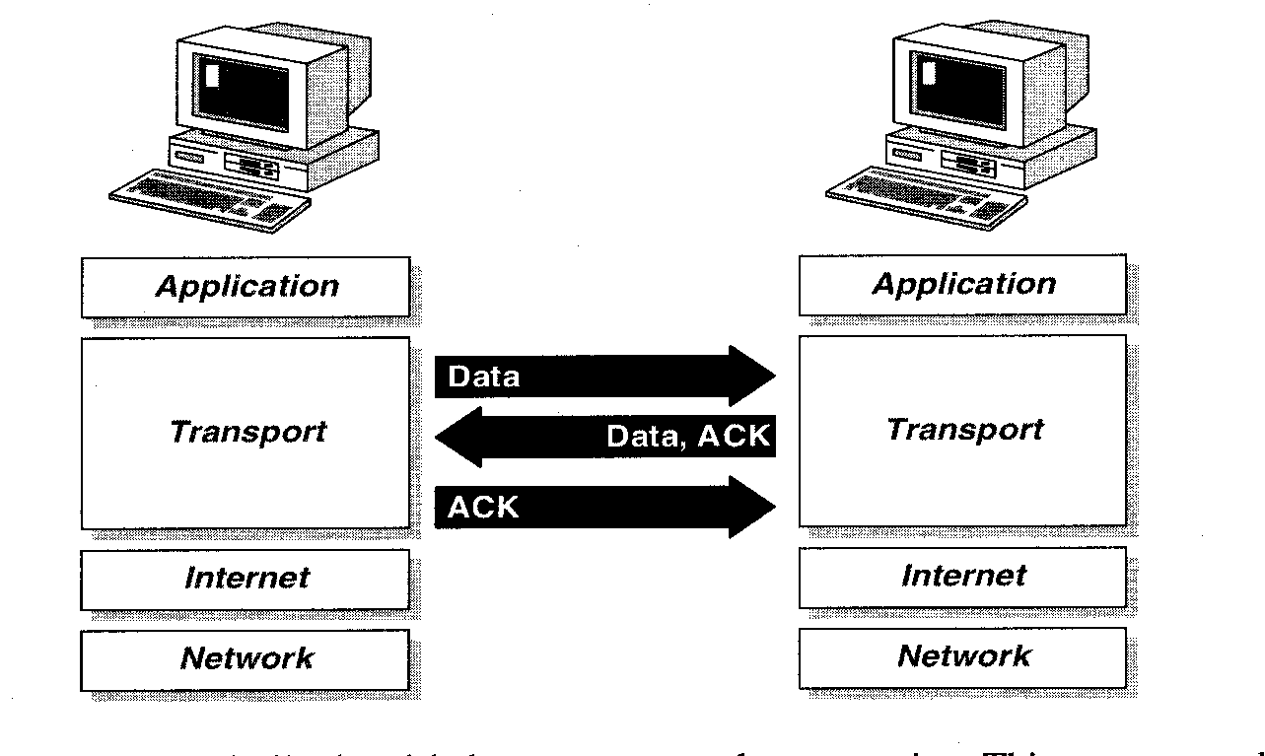
Lost Packets
TCP uses positive acknowledgement with retransmission to achieve reliable data delivery
Recipient sends acknowledgement control messages (ACK) to sender to verify successful receipt of data
Sender sets timer when data transmitted; if timer expires before acknowledgement arrives, sender retransmits (with new timer)

Slide 12
Flow Control
The receiving TCP, when sending an ACK back to the sender, also indicates to the sender the number of bytes it can receive beyond the last received TCP segment, without causing overrun and overflow in its internal buffers.
This is sent in the ACK in the form of the highest sequence number it can receive without problems.
This mechanism is also referred to as a window-mechanism. TCP's method of flow control is called sliding window.
A sliding window algorithm places a buffer between the application program and the network data flow. For TCP, the buffer is typically in the operating system kernel, but this is more of an implementation detail than a hard-and-fast requirement.

Slide 13


Flow Control
The bytes of data being transferred in each connection are numbered by TCP.
The numbering starts with a randomly generated number.
TCP segments

Slide 14
Multiplexing
Is achieved through the use of ports, just as with UDP.
Demultiplexing at rcv host:
Multiplexing at send host:
delivering received segments
to correct socket
gathering data from multiple
sockets, enveloping data with
header (later used for
demultiplexing)
application
application
application
P4
P3
P1
P2
P1
transport
transport
transport
network
network
network
link
link
link
physical
physical
physical
host 1
host 2
host 3

Slide 15
Logical Connections
The reliability and flow control mechanisms described above require that TCP initializes and maintains certain status information for each ``data stream''.
The combination of this status, including sockets, sequence numbers and window sizes, is called a logical connection.
Each connection is uniquely identified by the pair of sockets used by the sending and receiving processes.

Slide 16
Full Duplex
TCP provides for concurrent data streams in both directions.

Slide 17
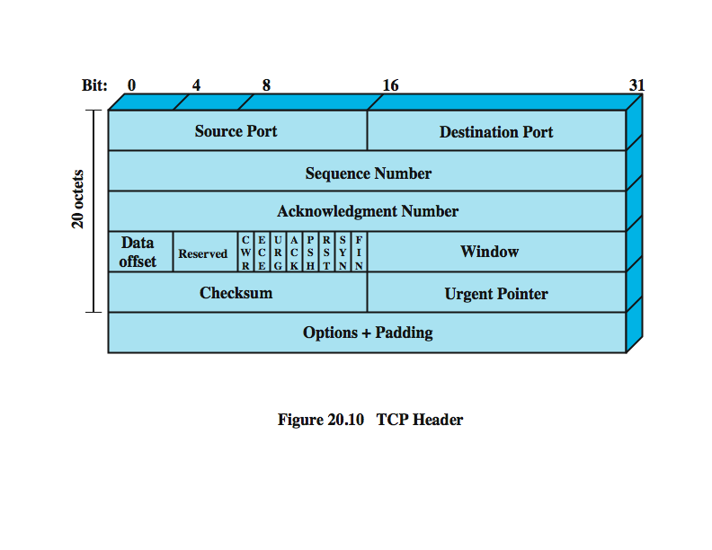
TCP Segment Format

Slide 18
TCP Segment Format
Source Port
  The 16-bit source port number, used by the receiver to reply.
Destination Port
  The 16-bit destination port number.
Sequence Number
  The sequence number of the first data byte in this segment. If the SYN control bit is set, the sequence number is the initial sequence number (n) and the first data byte is n+1.
Acknowledgment Number
  If the ACK control bit is set, this field contains the value of the next sequence number that the receiver is expecting to receive.

Slide 19
TCP Segment Format
Data Offset
  The number of 32-bit words in the TCP header. It indicates where the data begins.
Reserved
  Six bits reserved for future use; must be zero.
Window
  Used in ACK segments. It specifies the number of data bytes beginning with the one indicated in the acknowledgment number field which the receiver (= the sender of this segment) is willing to accept.

Slide 20
TCP Segment Format - 6 Flags
URG
  Indicates that the urgent pointer field is significant in this segment.
ACK
  Indicates that the acknowledgment field is significant in this segment.
PSH
  Push function.
RST
  Resets the connection.
SYN
  Synchronizes the sequence numbers.

Slide 21
TCP Segment Format - 6 Flags
FIN
  No more data from sender.
CWR
  Congestion window is reduced
ECE(ECN echo)
  The CWR and ECE bits, defined in rfc 3168, are used for explicit congestion notification function

Slide 22
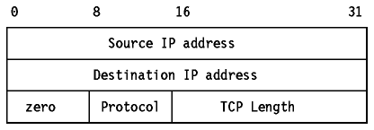
TCP Segment Format
Checksum
  The 16-bit one's complement of the one's complement sum of all 16-bit words in a pseudo-header, the TCP header and the TCP data. While computing the checksum, the checksum field itself is considered zero.
  The pseudo-header is the same as that used by UDP for calculating the checksum. It is a pseudo-IP-header, only used for the checksum calculation, with the format shown in Figure - Pseudo-IP Header:

Slide 23
Two ways of labeling data
data stream push
  user requires transmission of all data up to push flag
  receiver will deliver in same manner
  avoids waiting for full buffers
urgent data signal
  indicates urgent data is upcoming in stream
  user decides how to handle it

Slide 24
TCP Segment Format
Urgent Pointer
  Points to the first data octet following the urgent data. Only significant when the URG control bit is set.
Options
  Just as in the case of IP datagram options, options can be either:
  A single byte containing the option number, or
  A variable length option in the following format:

Slide 25
TCP Segment Format
Checksum
  The 16-bit one's complement of the one's complement sum of all 16-bit words in a pseudo-header, the TCP header and the TCP data. While computing the checksum, the checksum field itself is considered zero.
  The pseudo-header is the same as that used by UDP for calculating the checksum. It is a pseudo-IP-header, only used for the checksum calculation, with the format shown in Figure - Pseudo-IP Header:

Slide 26
TCP Segment Format - Options
There are currently only three options defined:
Kind Length Meaning
0 - End of option list.
1 - No-Operation.
2 4 Maximum Segment Size.

Slide 27



Slide 28
Ports
Each process that wants to communicate with another process identifies itself to the TCP/IP protocol suite by one or more ports
A port is a 16-bit number, used by the host-to-host protocol to identify to which higher-level protocol or application program (process) it must deliver incoming messages.
some higher-level programs are themselves protocols, standardised in the TCP/IP protocol suite, such as TELNET and FTP, they use the same port number in all TCP/IP implementations know as well-known ports

Slide 29
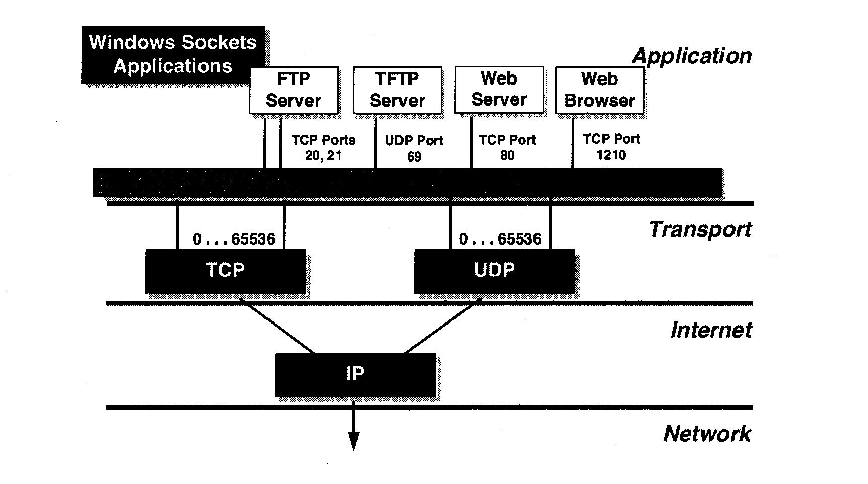

Ports
IANA ranges

Slide 30
Frequently Used TCP Port Numbers
Port Number Process Name Description
1 TCPMUX TCP Port Service Multiplexer
5 RJE Remote Job Entry
7 ECHO Echo
9 DISCARD Discard
11 USERS Active Users
13 DAYTIME Daytime
17 Quote Quotation of the Day
19 CHARGEN Character generator
20 FTP-DATA File Transfer ProtocoloData
21 FTP File Transfer ProtocoloControl
23 TELNET Telnet
25 SMTP Simple Mail Transfer Protocol
27 NSW-FE NSW User System Front End
29 MSG-ICP MSG-ICP
31 MSG-AUTH MSG Authentication
33 DSP Display Support Protocol
35 Private Print Servers
37 TIME Time
39 RLP Resource Location Protocol

Slide 31
Frequently Used TCP Port Numbers
41 GRAPHICS Graphics
42 NAMESERV Host Name Server
43 NICNAME Who Is
49 LOGIN Login Host Protocol
53 DOMAIN Domain Name Server
67 BOOTPS Bootstrap Protocol Server
68 BOOTPC Bootstrap Protocol Client
69 TFTP Trivial File Transfer Protocol
79 FINGER Finger
101 HOSTNAME NIC Host Name Server
102 ISO-TSAP ISO TSAP
103 X400 X.400
104 X400SND X.400 SND
105 CSNET-NS CSNET Mailbox Name Server
109 POP2 Post Office Protocol v2
110 POP3 Post Office Protocol v3
111 RPC Sun RPC Portmap
137 NETBIOS-NS NETBIOS Name Service
138 NETBIOS-DG NETBIOS Datagram Service
139 NETBIOS-SS NETBIOS Session Service
146 ISO-TP0 ISO TP0
147 ISO-IP ISO IP
150 SQL-NET SQL NET
153 SGMP SGMP
156 SQLSRV SQL Service
160 SGMP-TRAPS SGMP TRAPS
161 SNMP SNMP
162 SNMPTRAP SNMPTRAP
163 CMIP-MANAGE CMIP/TCP Manager
164 CMIP-AGENT CMIP/TCP Agent
165 XNS-Courier Xerox
179 BGP Border Gateway Protocol

Slide 32
TCP Ports
TCP uses the same port principle as UDP to provide multiplexing.
Like UDP, TCP uses well-known and ephemeral ports.
Each side of a TCP connection has a socket which can be identified by the triple <TCP, IP address, port number>. Also, knowas a half-association.
If two processes are communicating over TCP, they have a logical connection that is uniquely identifiable by the two sockets involved, that is by the combination <TCP, local IP address, local port, remote IP address, remote port>.
Server processes are able to manage multiple conversations through a single port.

Slide 33
Sockets
The socket model provides a process with a full-duplex byte stream connection to another process
  It is a special type of file handle which is used by a process to request network services from the operating system.
An association is the 5-tuple that completely specifies the two processes that comprise a connection:
{protocol, local-address, local-process, foreign-address, foreign-process}
{tcp, 193.44.234.3, 1500, 193.44.234.5, 21}
  could be a valid association.
A half-association is either:
{protocol, local-address, local-process} or
{protocol, foreign-address, foreign-process}
  which specify each half of a connection.

Slide 34
Sockets
The half-association is also called a socket or a transport address
P3
P3
P4
P1
P1
SP: 80
SP: 80
DP: 9157
DP: 5775
SP: 9157
SP: 5775
client
IP: A
DP: 80
server
IP: C
DP: 80
Client
IP:B

Slide 35
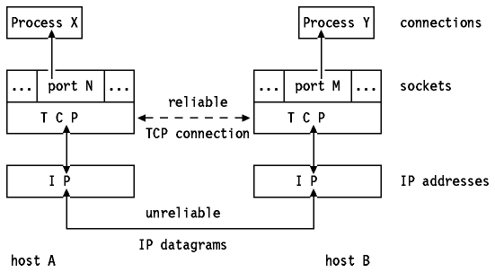
Figure: TCP Connection - Processes X and Y communicate over a TCP connection carried by IP datagrams

Slide 36

Figure 23.7 Error control

Slide 37
TCP Connection Establishment
Before any data can be transferred, a connection has to be established between the two processes.
One of the processes (usually the server) issues a passive OPEN call, the other an active OPEN call.
The passive OPEN call remains dormant until another process tries to connect to it by an active OPEN.
On the network, three TCP segments are exchanged:

Slide 38
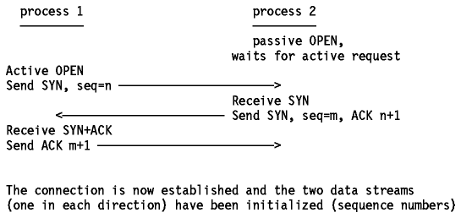
Figure: TCP Connection Establishment

Slide 39
Three-way Handshake
TCP uses three-way handshake for reliable connection establishment and termination
  Host 1 sends segment with SYN bit set and random sequence number
  Host 2 responds with segment with SYN bit set, acknowledgement to Host 1 and random sequence number
  Host 1 responds with acknowledgement
TCP will retransmit lost segments
Note that the exchanged TCP segments include the initial sequence numbers from both sides, to be used on subsequent data transfers.
Random sequence numbers ensure synchronisation between endpoints

Slide 40
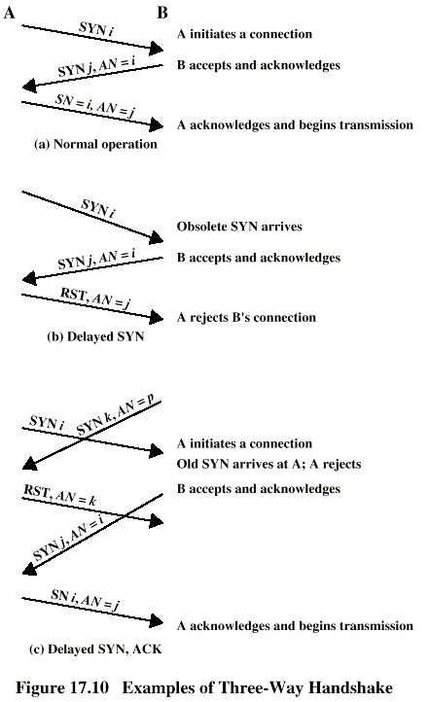
Three-way Handshake

Slide 41
Acknowledgments and Retransmission
TCP sends data in variable length segments. Sequence numbers are based on a byte count. Acknowledgements specify the sequence number of the next byte that the receiver expects to receive.
Now suppose that a segment gets lost or corrupted. In this case, the receiver will acknowledge all further well-received segments with an acknowledgement referring to the first byte of the missing packet.
The sender will stop transmitting when it has sent all the bytes in the window. Eventually, a timeout will occur and the missing segment will be retransmitted.

Slide 42
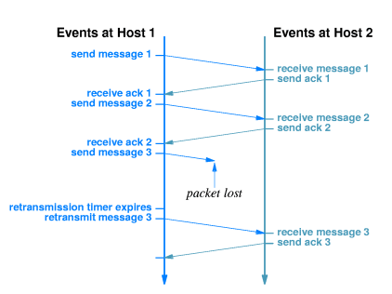
Acknowledgments and Retransmission

Slide 43
Acknowledgment
Receiver sends segment with sequence number of acknowledged data (not segments)
One ACK can acknowledge many segments

Slide 44
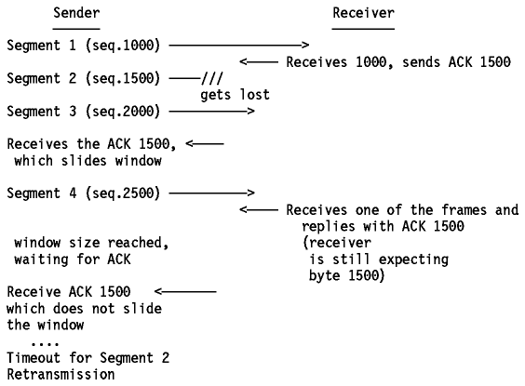
Acknowledgments and Retransmission
Suppose a window size of 1500 bytes, and segments of 500 bytes.

Slide 45
Acknowledgments and Retransmission
A problem now arises, since the sender does know that segment 2 is lost or corrupted, but doesn't know anything about segments 3 and 4. The sender should at least retransmit segment 2, but it could also retransmit segments 3 and 4 (since they are within the current window). It is possible that:
  1. Segment 3 has been received, and for segment 4 we don't know: it could be received, but ACK didn't reach us yet, or it could be lost also.
  2. Segment 3 was lost, and we received the ACK 1500 upon the reception of segment 4.

Slide 46
Acknowledgments and Retransmission
Each TCP implementation is free to react to a timeout as the implementers wish.
It could retransmit only segment 2, but in case 2 above, we will be waiting again until segment 3 times out.
In this case, we lose all of the throughput advantages of the window mechanism. Or TCP might immediately resend all of the segments in the current window.
Whatever the choice, maximal throughput is lost. This is because the ACK does not contain a second acknowledgement sequence number indicating the actual frame received.

Slide 47
TCP Sliding Window
TCP uses sliding window for flow control
Receiver specifies window
  Called window advertisement
  Specifies which bytes in the data stream can be sent
Carried in segment along with ACK
Sender can transmit any bytes, in any size segment, between last acknowledged byte and within window size

Slide 48
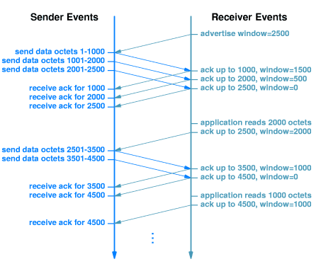
TCP Sliding Window

Slide 49
TCP Timers
TCP uses several timers to ensure that excessive delays are not encountered during communications. Several of these timers are elegant, handling problems that are not immediately obvious at first analysis.
Variable Timeout Intervals Each TCP should implement an algorithm to adapt the timeout values to be used for the round trip time of the segments.
To do this, TCP records the time at which a segment was sent, and the time at which the ACK is received.
A weighted average is calculated over several of these round trip times, to be used as a timeout value for the next segment(s) to be sent.
This is an important feature, since delays may be variable on an internet, depending on multiple factors, such as the load of an intermediate low-speed network or the saturation of an intermediate IP gateway.

Slide 50
TCP Timers
TCP Maintains Several Timers. Following are the important ones:
  Connection Establishment Timer
    A connection establishment timer starts when a SYN is sent to establish a new connection. If a response is not received within 75 seconds, the connection establishment is aborted.
  Retransmission Timer
    A retransmission timer is set when TCP sends data.
    If the data is not acknowledged by the other end when this timer expires, TCP retransmits the data.
    The value of this timer is calculated dynamically, based on the round-trip time measured by TCP for this connection, and based on the number of times this data segment has been retransmitted.
    The retransmission timer is bounded by TCP to be between 1 and 64 seconds.

Slide 51
TCP Timers
The Retransmission Timer (Retransmission Time Outs)
  The retransmission timer manages retransmission timeouts (RTOs), which occur when a preset interval between the sending of a datagram and the returning acknowledgment is exceeded.
  The value of the timeout tends to vary, depending on the network type, to compensate for speed differences. If the timer expires, the datagram is retransmitted with an adjusted RTO, which is usually increased exponentially to a maximum preset limit.
  If the maximum limit is exceeded, connection failure is assumed, and error messages are passed back to the upper-layer application.
  Values for the retransmission timeout are determined by measuring the average time that data takes to be transmitted to another machine and the acknowledgement received back, which is called the round-trip time, or RTT.
  From experiments, these RTTs are averaged by a formula that develops an expected value, called the smoothed round-trip time, or SRTT. This value is then increased to account for unforeseen delays.

Slide 52
TCP Timers
Delayed ACK Timer
Persistence Timer
The Keepalive Timer and Idle Timer
The Quiet Timer

Slide 53
Setting The Timeout
Inappropriate timeout can cause poor performance:
  Too long - sender waits longer than necessary before retransmitting
  Too short - sender generates unnecessary traffic
Timeout must be different for each connection and set dynamically
  Host on same LAN should have shorter timeout than host 20 hops away
  Delivery time across internet may change over time; timeout must accommodate changes

Slide 54
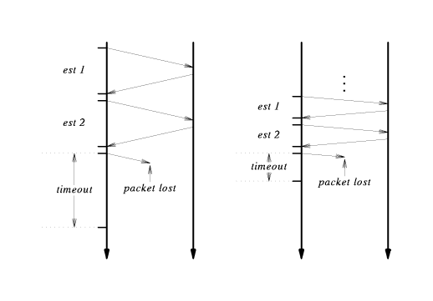
Packet Loss and Transmission Timeout

Slide 55
Picking a Timeout Value
Timeout should be based on round trip time (RTT)
Sender can't know RTT of any packet before transmission
Sender picks retransmission timeout (RTO) based on previous RTTs
Specific method is call adaptive retransmission algorithm
Computing RTT and RTO
Weighted average for RTT:
    RTT_{new} = (alpha*RTT_{old}) + ((1 - alpha)*RTT_{sample}))
Computation of RTO:
    RTO = beta*RTT_{new}

Slide 56
Silly Window Syndrome
Under some circumstances, sliding window can result in transmission of many small segments
If receiver window full, and receiving application consumes a few data bytes, receiver will advertise small window
Sender will immediately send small segment to fill window
Inefficient in processing time and network bandwidth
Solutions:
  Receiver delays advertising new window
  Sender delays sending data when window is small

Slide 57
Congestion Control
Excessive traffic can cause packet loss
  Transport protocols respond with retransmission
  Excessive retransmission can cause congestion collapse
TCP interprets packet loss as an indicator of congestion
Sender uses TCP congestion control and slows transmission of packets
  Sends single packet
  If acknowledgement returns without loss, sends two packets
When TCP sends one-half window size, rate of increase slows

