Slide 1


Crop And Fertilizer Recommendation System

Slide 2

Learning Objectives
Understand the basic concepts of crop and fertilizer recommendation systems.
Learn how to identify suitable crops based on soil type, climate, and other environmental factors.
Recognize the importance of selecting the right fertilizer for different crops to improve yield.
Explore how technology helps farmers make better decisions regarding crop and fertilizer selection.
Develop an awareness of sustainable farming practices through effective crop and fertilizer management.
GOAL
Source :
www.freepik.com/

Slide 3
Tools and Technology used
Platform & Environment | Google Colab
Programming Language | Python
Python Libraries Used | Numpy, Matplotlib, Pandas, Scikit-Learn, Seaborn
Machine Learning Algorithm | Random Forest
Data Preprocessing | Scikit-Learn(for encoding categorical data)

Slide 4
Methodology
1. Collect data about different crops, soil types, weather conditions, and fertilizers.
2. Organize the data into tables with columns like crop type, soil type, temperature, humidity, and fertilizer.
3. Analyze the data to understand the relationship between crops, soil, and fertilizers.
4. Use Python programming in Google Colab to build a recommendation model by Random Forest algorithm.
5. Test the model using sample data to check its accuracy ( Providing 99.71% accuracy).
6. Evaluate the model by comparing its recommendations with real-world data.

Slide 5
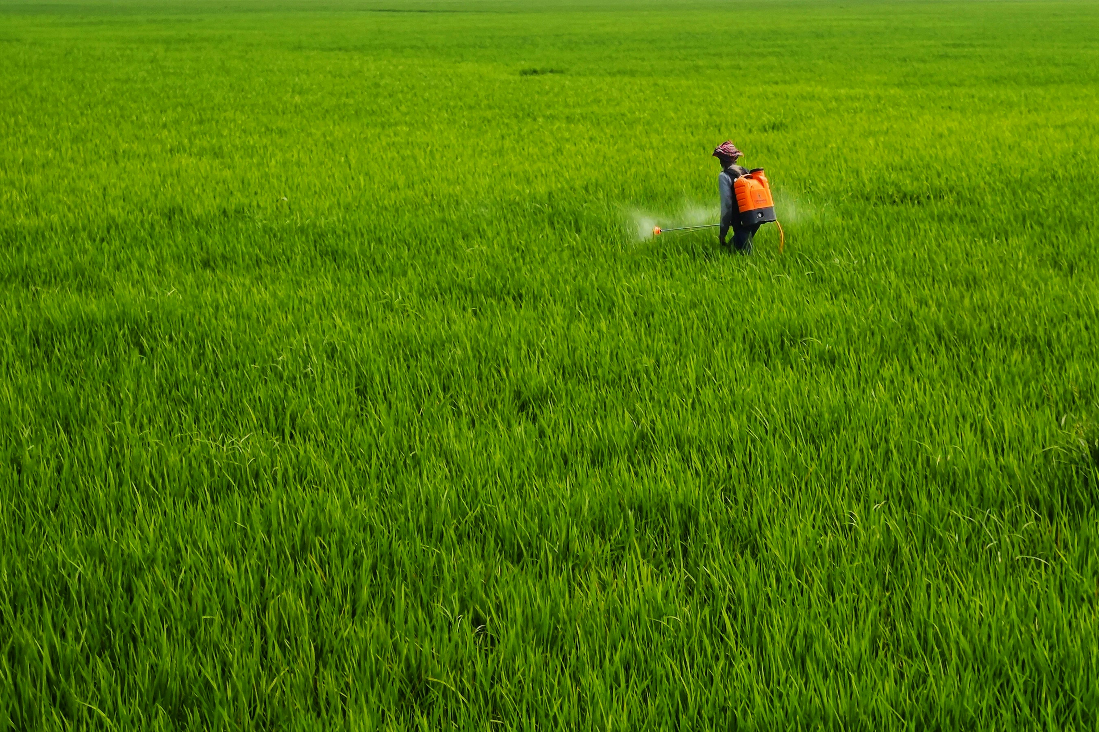
Problem Statement:
Farmers often struggle with selecting suitable crops
and fertilizers, leading to poor yield and soil
degradation. This project aims to develop a Crop and
Fertilizer Recommendation System using Google
Colab, providing data-driven suggestions based on
soil type and climate, promoting informed decisions
and sustainable farming practices.

Slide 6
Solution:
1. Gather information about crops, soil types, weather, and fertilizers from reliable sources.
2. Study the data to identify patterns between soil, climate, and suitable crops/fertilizers.
3. Develop a machine learning model in Google Colab to recommend crops and fertilizers based on inputs.
4. Design a simple interface where users enter soil and climate data to get recommendations.
5. Test the system using sample data and refine it for better accuracy and reliability.

Slide 7
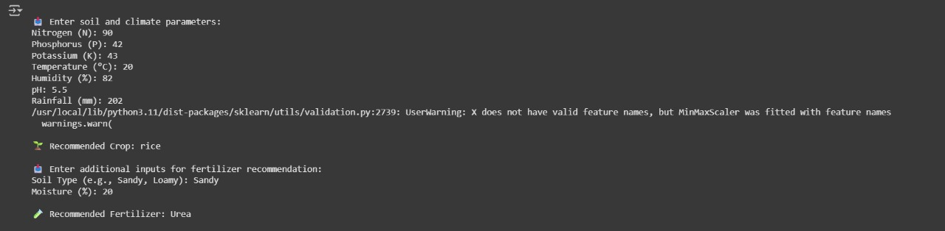
Screenshot of Output:

Slide 8
Conclusion:
1. The project successfully developed a system to recommend crops and fertilizers based on soil and climate data.
2. It helps farmers make better decisions, improving crop yield and reducing resource wastage.
3. The system uses data analysis and machine learning to provide accurate suggestions.
4. The Google Colab platform makes it easy to implement and test the model effectively.
5. Continuous data updates can further enhance the system’s accuracy and reliability.

