Slide 1
CareerCompass AI
Represented By:
Iqra Sajid
Faiza Kousar
Tayyaba Sahar

Slide 2
CareerCompass AI
Student Profile → Career Path → 12-week Roadmap
Career Advisor Agent powered by LangGraph
Problem: students often know some skills, but they are confused about the best career path and next learning steps.
1
Analyze education, interests, skills
2
Route to a specialist career node
Conditional Workflow
Iterative Loop
3
Search latest roadmap context
Streamlit Demo
4
Generate + evaluate + retry
CareerCompass AI • LangGraph Group Project • 1/5

Slide 3
Workflow Type & Required Features
Designed to satisfy the QAU LangGraph rubric
TypedDict State
Tool Usage
CareerState stores profile, route, research, roadmap, score, retries.
DuckDuckGo search tool collects roadmap context.
Conditional Edges
MemorySaver
Career classifier routes to AI, Cyber, Data, Web, or Cloud.
thread_id persists each student session.
Iterative Loop
Pydantic Output
Roadmap is regenerated if quality score is below 8.
CareerDecision and RoadmapReview validate LLM decisions.
Why this workflow? Career choice needs branching; roadmap quality needs retry/reflection before final output.
CareerCompass AI • LangGraph Group Project • 2/5

Slide 4
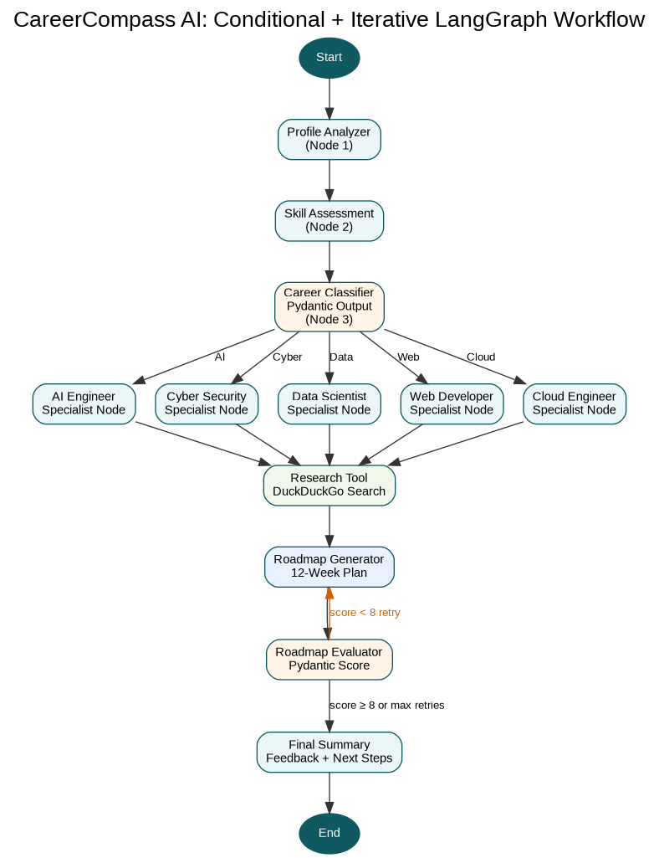
Graph Architecture
Every node, edge, decision point, tool node, and loop
Decision point
Career classifier chooses one route using Pydantic structured output.
Loop point
If roadmap score < 8, evaluator sends feedback back to roadmap generator.
Tool node
Research node calls DuckDuckGoSearchRun for latest roadmap context.
CareerCompass AI • LangGraph Group Project • 3/5

Slide 5
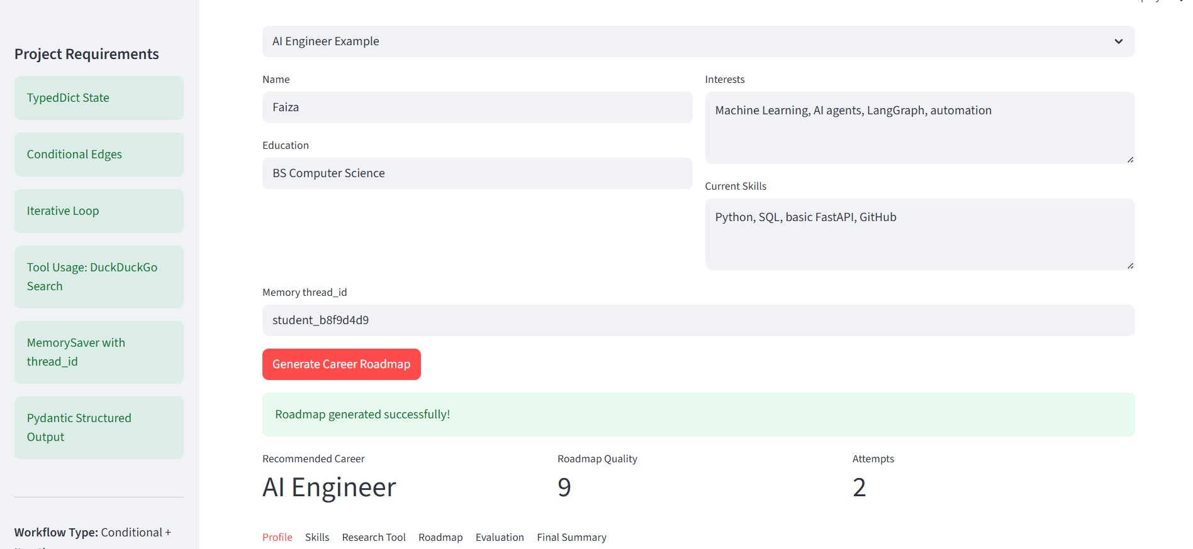
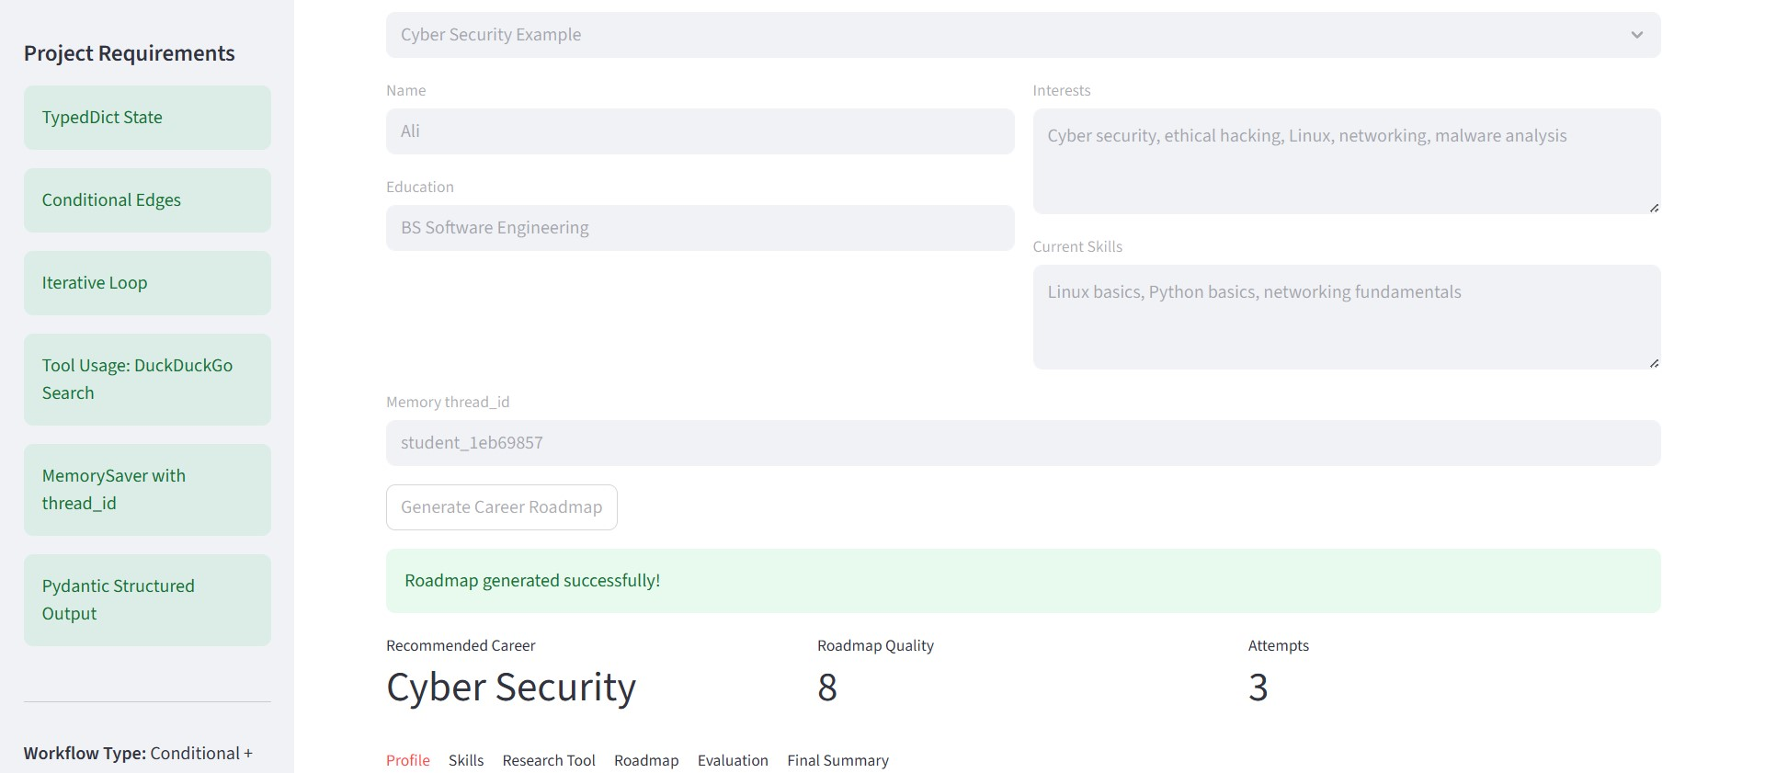
Live Demo Screenshots
Use two inputs to prove branching behavior
Demo 1: AI interests input
Demo 2: security interests input
Recommended Career
Quality
Attempts
Recommended Career
Quality
Attempts
9/10
1
Cyber Security
8/10
2
Demo command: streamlit run app.py
CareerCompass AI • LangGraph Group Project • 4/5

Slide 6
Challenges & Future Work
How the agent handles failure gracefully
Challenge
LLM can choose unexpected career labels.
Future Work
Resume upload and skill extraction
Solution
Literal Pydantic schema restricts routes to five careers.
Challenge
Weak or generic roadmap output.
LinkedIn / GitHub profile analysis
Solution
Evaluator scores roadmap and loops back with feedback.
Job market API integration
Challenge
Web search can fail.
Progress tracker with weekly check-ins
Solution
Tool node catches errors and continues gracefully.
Presentation split: all 3 members speak
Problem → Architecture → Live Demo/Q&A
CareerCompass AI • LangGraph Group Project • 5/5

