Slide 1

HESTIA
Real Estate Mobile App for Buyer Self-Service
Find Where You Belong
DBSE Project — 1st Review
Faizaan — 2520030359 | Ishaan Kulkarni — 2520030267 | Abhiram Koppisetty — 2520030357

Slide 2
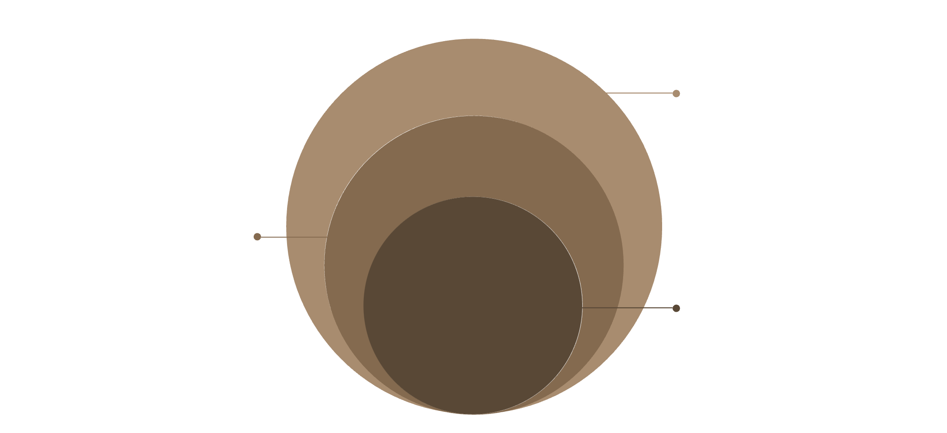
Abstract
API & Database
Node.js/Express REST API and MySQL storage
HESTIA is a buyer-focused Android mobile application that provides a self-service platform for discovering and managing real-estate properties.
Retrofit Layer
HTTP client for network requests
Android App
Buyer-facing mobile interface and features
Buyer Features
Offline Access
Notifications
Registration, login, property discovery, property details, saved properties, expressions of interest, EMI calculation, profile access and activity history.
Previously loaded property information remains available offline through a Room local cache.
Property update notifications delivered through Firebase FCM.

Slide 3
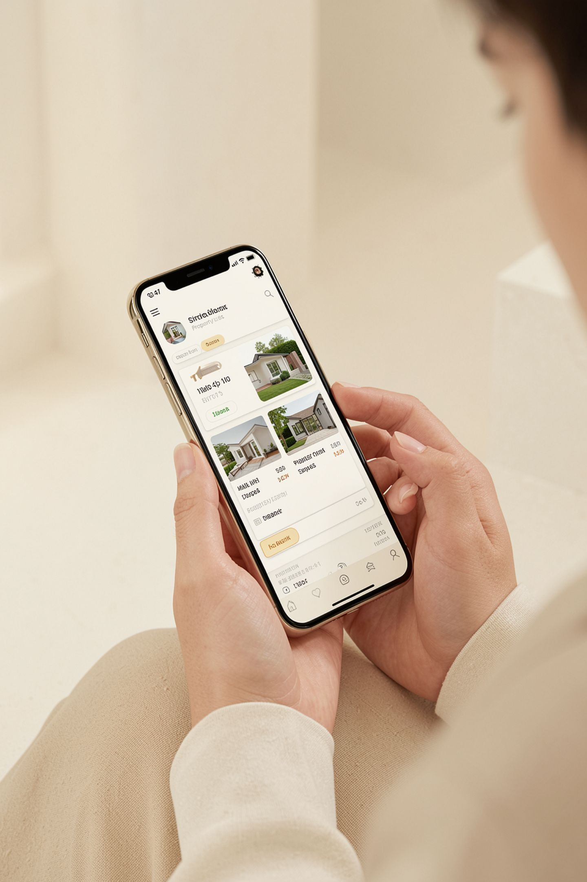
Introduction
The Problem Space
Target User
Real-estate buyers need to search and compare multiple properties across fragmented sources.
Buyer activities and property interactions lack a centralized platform.
Internet dependency prevents access to previously viewed information.
HESTIA provides a unified buyer self-service platform to address all of these gaps.
BUYER
Property seekers requiring discovery, comparison, and management tools in one place.
Core Domain
REAL ESTATE
Property discovery and buyer activity management through a mobile-first self-service platform.

Slide 4
Existing System — Limitations
Current real-estate buyer experiences are fragmented across tools, platforms, and manual processes. Key limitations identified:
1
Scattered Information
Property data is spread across multiple sources with no unified view.
2
Multi-Step Interest Management
Registering buyer interest requires navigating multiple disconnected steps.
3
Connectivity Dependency
No offline access to previously viewed property information.
4
No Integrated EMI Tool
EMI estimation requires a separate external calculator.
5
No Activity History
Buyer browsing and interaction history is not centralized or retrievable.
6
Delayed Updates
Property status changes are difficult to track in real time.

Slide 5
Problem Statement
"How can we provide property buyers with a single mobile platform to discover properties, manage their interests, estimate EMI, maintain activity history, and access previously loaded property information even when connectivity is unavailable?"
Challenge Areas
Property Discovery
Buyer Activity
Find and inspect available listings from a single interface.
Save properties, express interest, and review interaction history.
Offline Access
Timely Updates
Access previously loaded property data without network connectivity.
Receive push notifications for property status changes.

Slide 6

Solution / Contribution
HESTIA is the proposed integrated buyer self-service platform combining relational database engineering, RESTful backend services, offline caching, and property update notifications.
Core path
Buyer → Android → Retrofit → Node.js → MySQL
Core Path
BUYER → ANDROID → RETROFIT → NODE.JS/EXPRESS → MYSQL
HESTIA Architecture
Offline Path
ANDROID → ROOM CACHE → OFFLINE ACCESS → SYNC ON RESTORE
Notification path
Offline path
Notification Path
BACKEND → FIREBASE FCM → BUYER DEVICE
Android → Room cache → Sync on restore
Backend → Firebase FCM → Buyer device

Slide 7

Objectives
1
Normalized Relational Database
Design a structured and normalized MySQL schema.
2
ER Modelling
Model users, properties and buyer activities using ER concepts.
3
REST API Development
Develop Node.js + Express APIs for all application operations.
4
Android Application
Build a buyer-friendly Kotlin + Jetpack Compose mobile app.
5
Offline Caching
Support offline property access through Room local cache.
6
EMI & Activity Tracking
Provide EMI calculation and centralized buyer activity history.
7
Scalable Architecture
Establish a foundation for future service decomposition and CI/CD.

Slide 8
Modules
1. Buyer Onboarding
2. Property Discovery
Registration, login, and profile management.
Browse listings and view detailed property information.
3. Buyer Interaction
4. EMI Calculator
Save properties, express interest, and review history.
Loan amount, interest rate, tenure, and EMI output.
5. Offline & Sync
6. Notifications
Room cache, offline access, and network synchronization.
Property update alerts via Firebase FCM.
7. Property Data Mgmt
8. Future Scalability
Backend and admin-side property entry and maintenance.
Service decomposition and deployment roadmap.

Slide 9





Software Requirements — Technology Stack
CO1 — DATABASE
MOBILE APPLICATION
MySQL
MySQL Workbench
Kotlin + Android
Jetpack Compose
Central relational database and SQL operations
ER and schema design tooling
Native mobile application development
Declarative UI framework
CO3 / CO4 — BACKEND
Room Database
Firebase FCM
Node.js + Express
Retrofit
Local offline cache layer
Push notification delivery
REST API and backend services
Android-to-API HTTP communication
CO6 — DELIVERY
Git + GitHub for version control and delivery pipeline.
Postman
API testing and validation
CO2 — Comparative / Future Scope: SQL vs NoSQL, relational vs document schema, CAP theorem, and polyglot persistence (MongoDB for activity/log data) are considered for comparative study and future extensions — not part of the current core implementation.

Slide 10

System Workflow & Database Design
Compact ER / Database Design
Core request flow
Entity | Primary Key | Foreign Keys
USER | user_id | —
PROPERTY | property_id | —
PROPERTY_IMAGE | image_id | property_id
FAVOURITE | favourite_id | user_id, property_id
INTEREST | interest_id | user_id, property_id
ACTIVITY_HISTORY | activity_id | user_id, property_id
Notifications
Push updates to Buyer
Property Admin → MySQL → Node.js
Buyer actions
System Workflow Overview
API delivery
Save/Interest → EMI → History
Node.js → Retrofit → HESTIA Android
Buyer journey
Buyer endpoint
Register → Browse → View Details
HESTIA Android → Buyer
Logical relationships: USER 1:N FAVOURITE, USER 1:N INTEREST, USER 1:N ACTIVITY_HISTORY; PROPERTY 1:N PROPERTY_IMAGE. USER and PROPERTY interact through FAVOURITE and INTEREST junction entities.

Slide 11

Conclusion & Future Scope
Conclusion
Planned Deployment & Delivery Roadmap (Future)
01
HESTIA combines relational database engineering, REST API backend, and Android mobile application development into a unified buyer self-service platform.
The design includes offline caching, buyer activity management, EMI calculation, and push notifications.
CO1, CO3, and CO4 are represented through the current relational, API, and Node.js/Express core architecture.
System Assembly
App + REST API + MySQL integration; request-flow documentation.
02
Containerisation
Dockerfile, Docker Compose, container networking.
03
Deployment Awareness
Kubernetes Pods, Deployments, Services and Ingress basics.
04
Planned Scalable Architecture (Future)
Observability
OpenTelemetry, Prometheus and Grafana dashboards.
The current prototype uses a centralized MySQL database and Node.js/Express backend. Microservice decomposition is a planned scalability extension.
API GATEWAY → USER SERVICE / PROPERTY SERVICE / ACTIVITY SERVICE → DB-PER-SERVICE
Planned concepts: service boundaries, API Gateway, centralized auth/token forwarding, resilience, timeouts, and Saga / compensating actions.
05
CI/CD & Security
GitHub Actions, automated testing, image scanning, OWASP practices.
06
Documentation & Showcase
C4 architecture diagrams, README, load testing, final demo.
Additional future scope: admin portal, advanced search/filtering, map-based discovery, personalized recommendations, and polyglot persistence.

