Slide 1


CFAI PROJECT
Intelligent Campus Navigation Assistant
Using BFS, UCS and A* Search Algorithms
Computational Foundations of Artificial Intelligence
SECTION 12 | BATCH 17
Faizaan (2520030359) · Ishaan (2520030267) · Anirudh (2520080058)

Slide 2
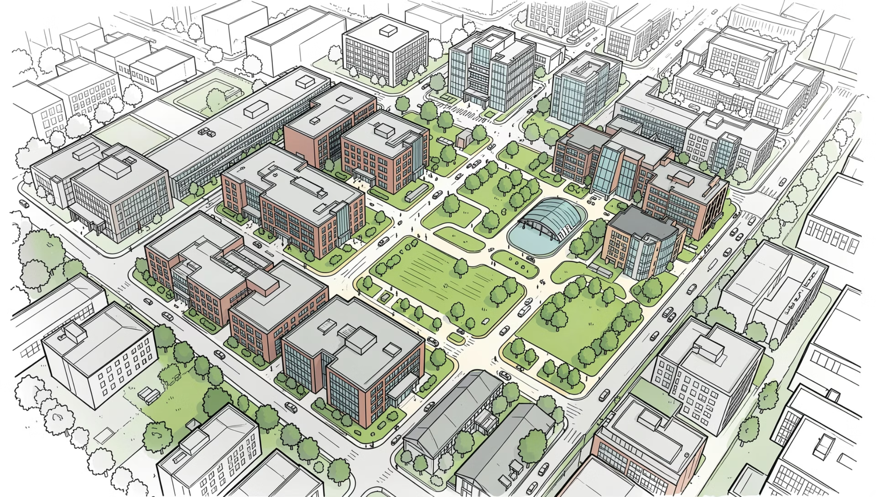
INTRODUCTION
What Does This Project Do?
This project models a college campus as a weighted graph — nodes represent locations, edges represent paths with associated distance and time costs.
Three AI search algorithms find the optimal route between any two campus locations:
BFS
UCS
A*
Explores all nodes level by level
Expands the lowest-cost path first
Combines cost + heuristic for efficiency

Slide 3
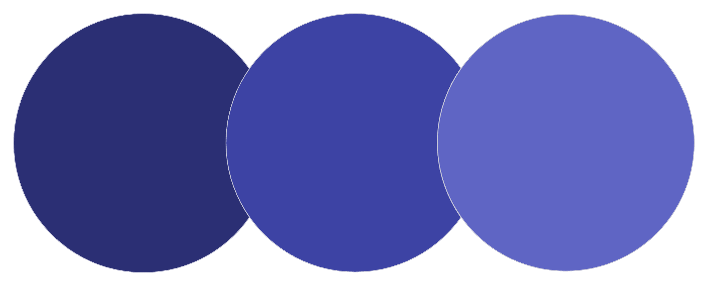
TECHNOLOGIES & AI CONCEPTS
Under the Hood
AI Concepts
Technologies
State-space representation — each location is a state
Heuristic search — A* estimates remaining distance
Cost optimization — UCS minimizes cumulative cost
Graph traversal — systematic node exploration
Python
heapq
deque
Adjacency Lists
BFS
UCS
A*
Unweighted, level-order, complete
Weighted, cost-optimal, greedy tie-breaks
Heuristic-guided, optimal and efficient
The diagram above illustrates how each algorithm differs in strategy — from BFS's exhaustive level-order traversal to A*'s heuristic-guided efficiency.

Slide 4

MOTIVATION
Why Intelligent Navigation?
The Problem
The Gap
Large campuses are complex. Manual maps are static, GPS lacks indoor routing, and traditional tools ignore real path costs.
Existing solutions don't optimize for both distance and time, nor do they compare algorithmic approaches side-by-side.
Our Solution
A Python-based system using AI search algorithms to compute optimal, verifiable routes — with full transparency into each algorithm's decisions.

Slide 5
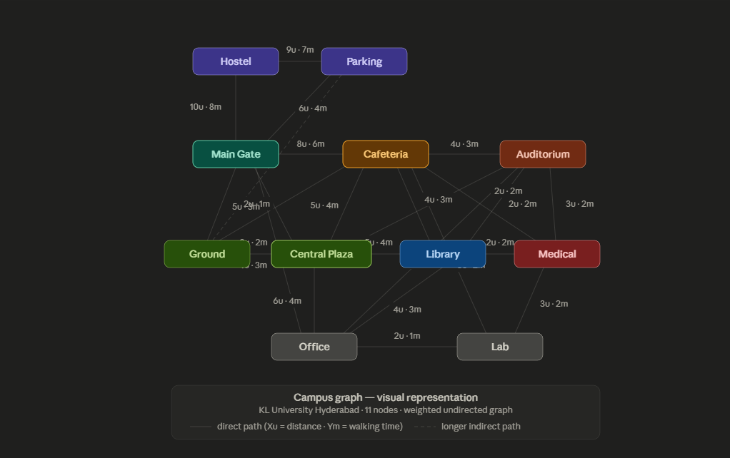
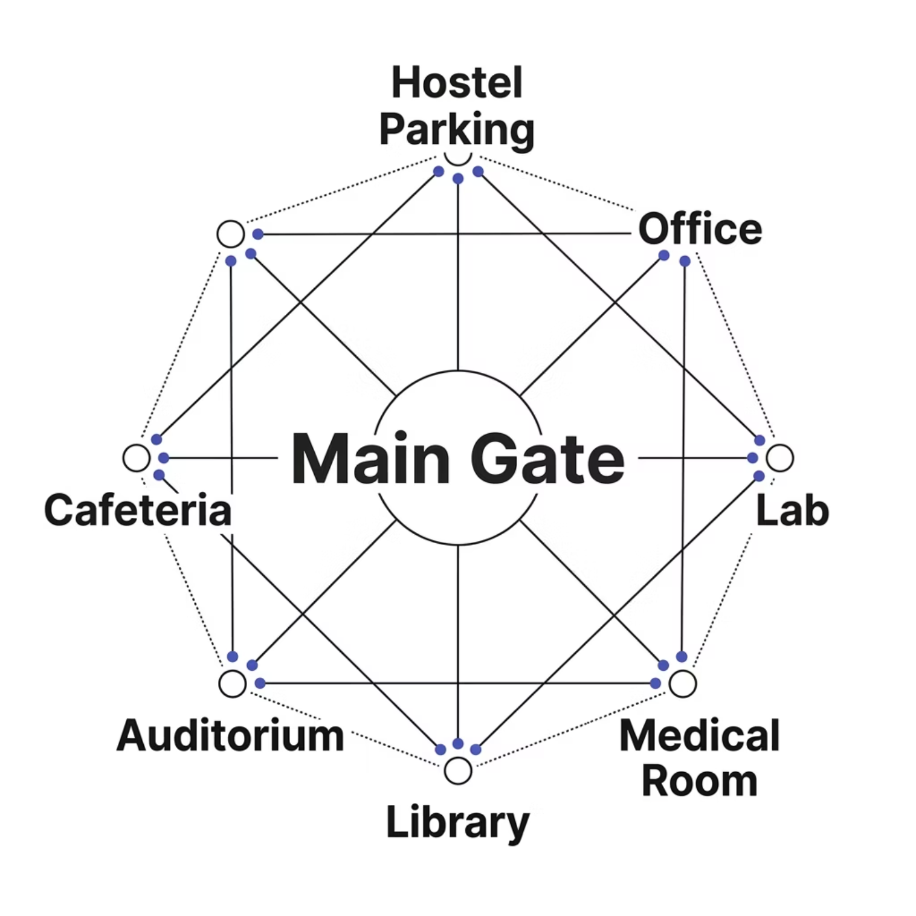


IMPLEMENTATION
Campus Graph & Algorithm Comparison
Graph Representation
Each campus location is a node; paths are weighted edges storing distance and time. A* uses a heuristic table (straight-line estimates to goal).
Sample Output — Main Gate → Lab
Algorithm
Distance
Time
Nodes Explored
BFS
Non-optimal
Higher
9
UCS
Optimal
Optimal
7
A*
Optimal
Optimal
5
A* explores 44% fewer nodes than BFS while guaranteeing the optimal path.

Slide 6
CONCLUSION
Key Takeaways & What's Next
✅ What We Achieved
🚀 Future Enhancements
Successfully modeled campus as a weighted graph
Implemented BFS, UCS, and A* in Python
A* demonstrated superior efficiency via heuristics
Modular, scalable architecture for extension
GUI and mobile app version
Real-time congestion & GPS integration
Live tracking and accessibility-based routing
Thank You
Questions are welcome — Faizaan · Ishaan · Anirudh | CFAI

