Slide 1

Customer Credit Scoring Using Elastic Net Regularized Logistic Regression
Finance | Machine Learning
Team: Faizaan — 2520030359 · Abhiram K — 2520030357

Slide 2
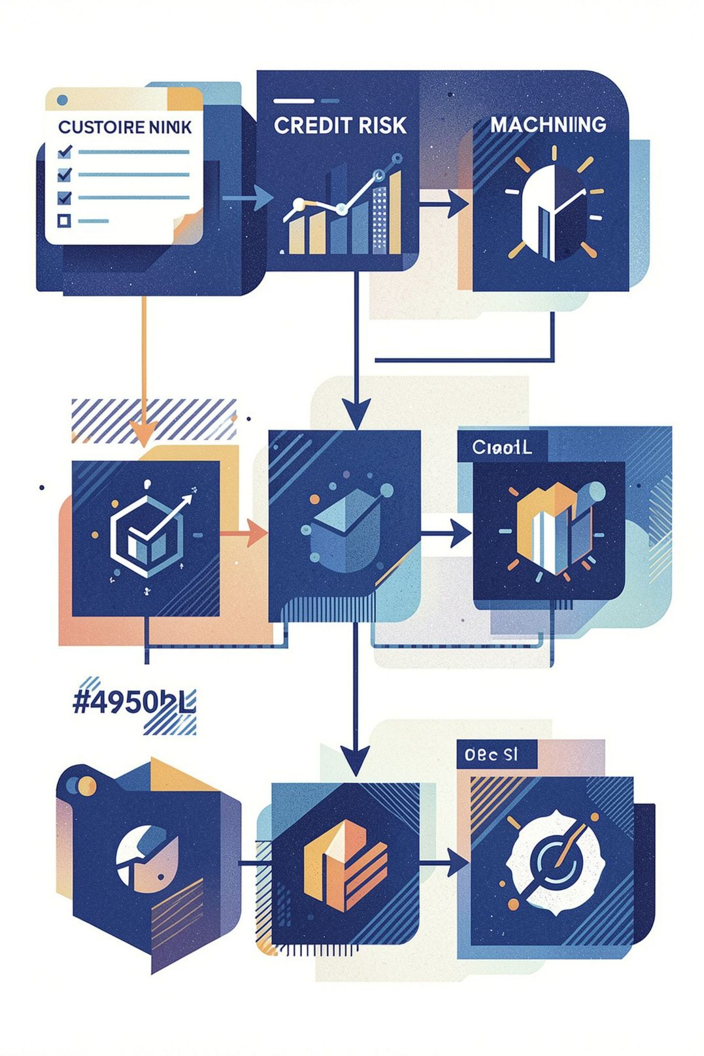
Problem Statement
Financial institutions must assess creditworthiness before approving loans; traditional rules can miss complex patterns.
Goal: build a data-driven classifier that predicts whether a customer will default (loan_status = 1) or not (loan_status = 0).
Business value: reduce credit risk, identify high‑risk applicants, and support consistent, data‑informed lending decisions.
Note: model is a decision support tool and does not replace human judgement.

Slide 3
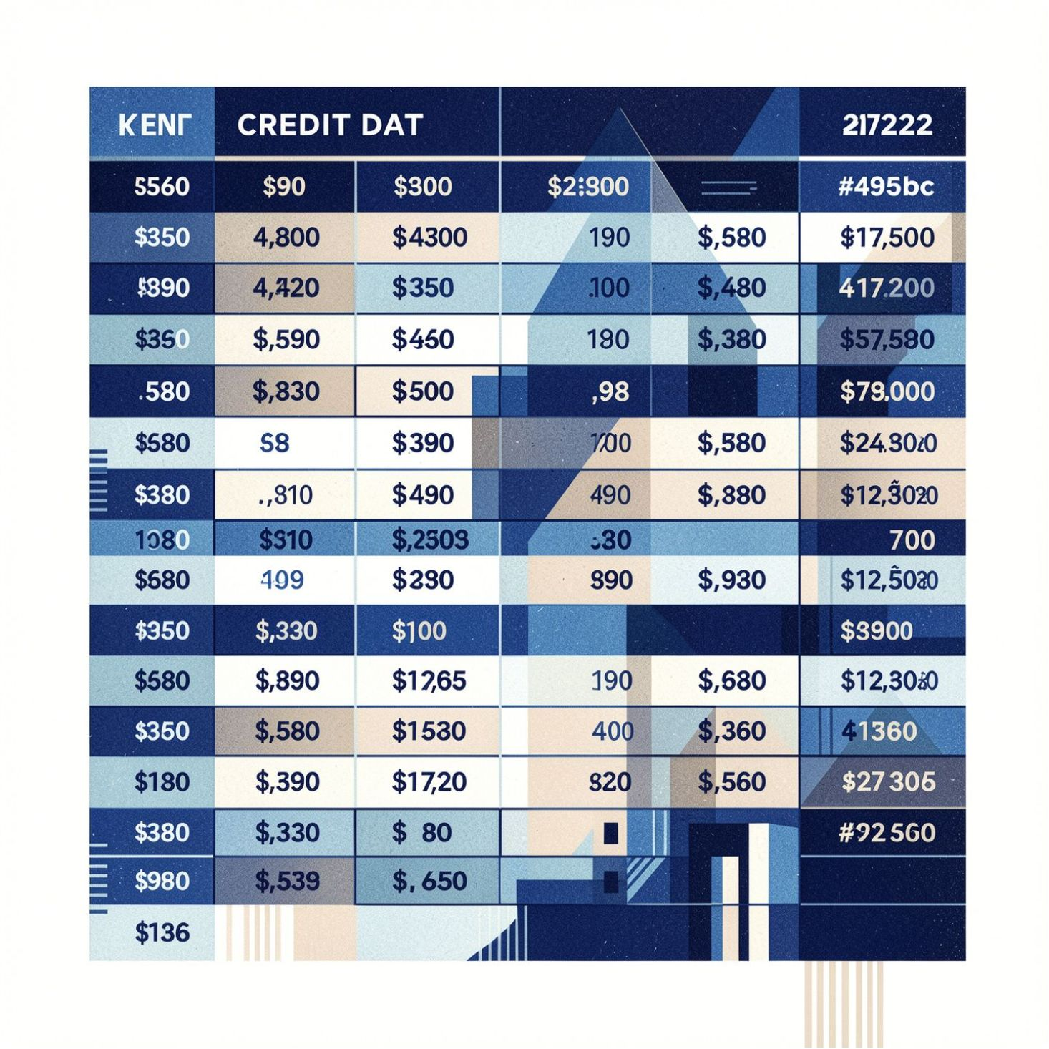


Dataset & Features
Source: Kaggle Credit Risk Dataset (used in project)
Records: 32,581 (before duplicate removal)
Columns: 12
Target: loan_status — 0 = Non-default, 1 = Default
Selected Features
Numerical: person_age, person_income, person_emp_length, loan_amnt, loan_int_rate, loan_percent_income, cb_person_cred_hist_length
Categorical: person_home_ownership, loan_intent, loan_grade, cb_person_default_on_file
Mixed variable types → careful preprocessing (imputation, encoding, scaling)

Slide 4


Data Quality & Target Distribution
Key data-quality notes:
165 duplicate rows were identified and removed.
Missing values concentrated in: person_emp_length (895 missing), loan_int_rate (3,116 missing).
Target imbalance: ≈ 78.18% non-default vs 21.82% default.
Because classes are imbalanced, evaluate with precision, recall, F1 and ROC‑AUC — not accuracy alone.

Slide 5
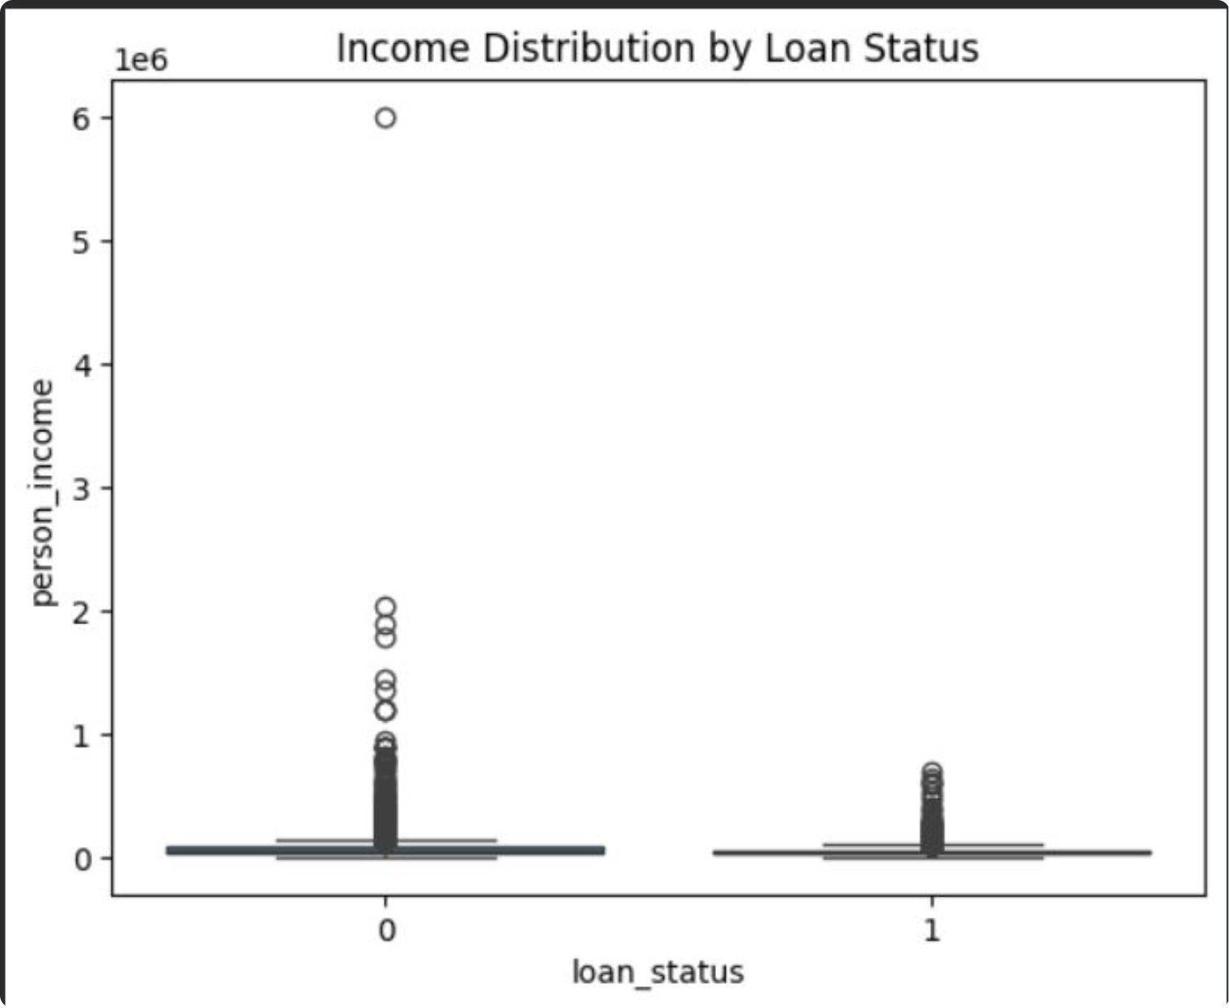
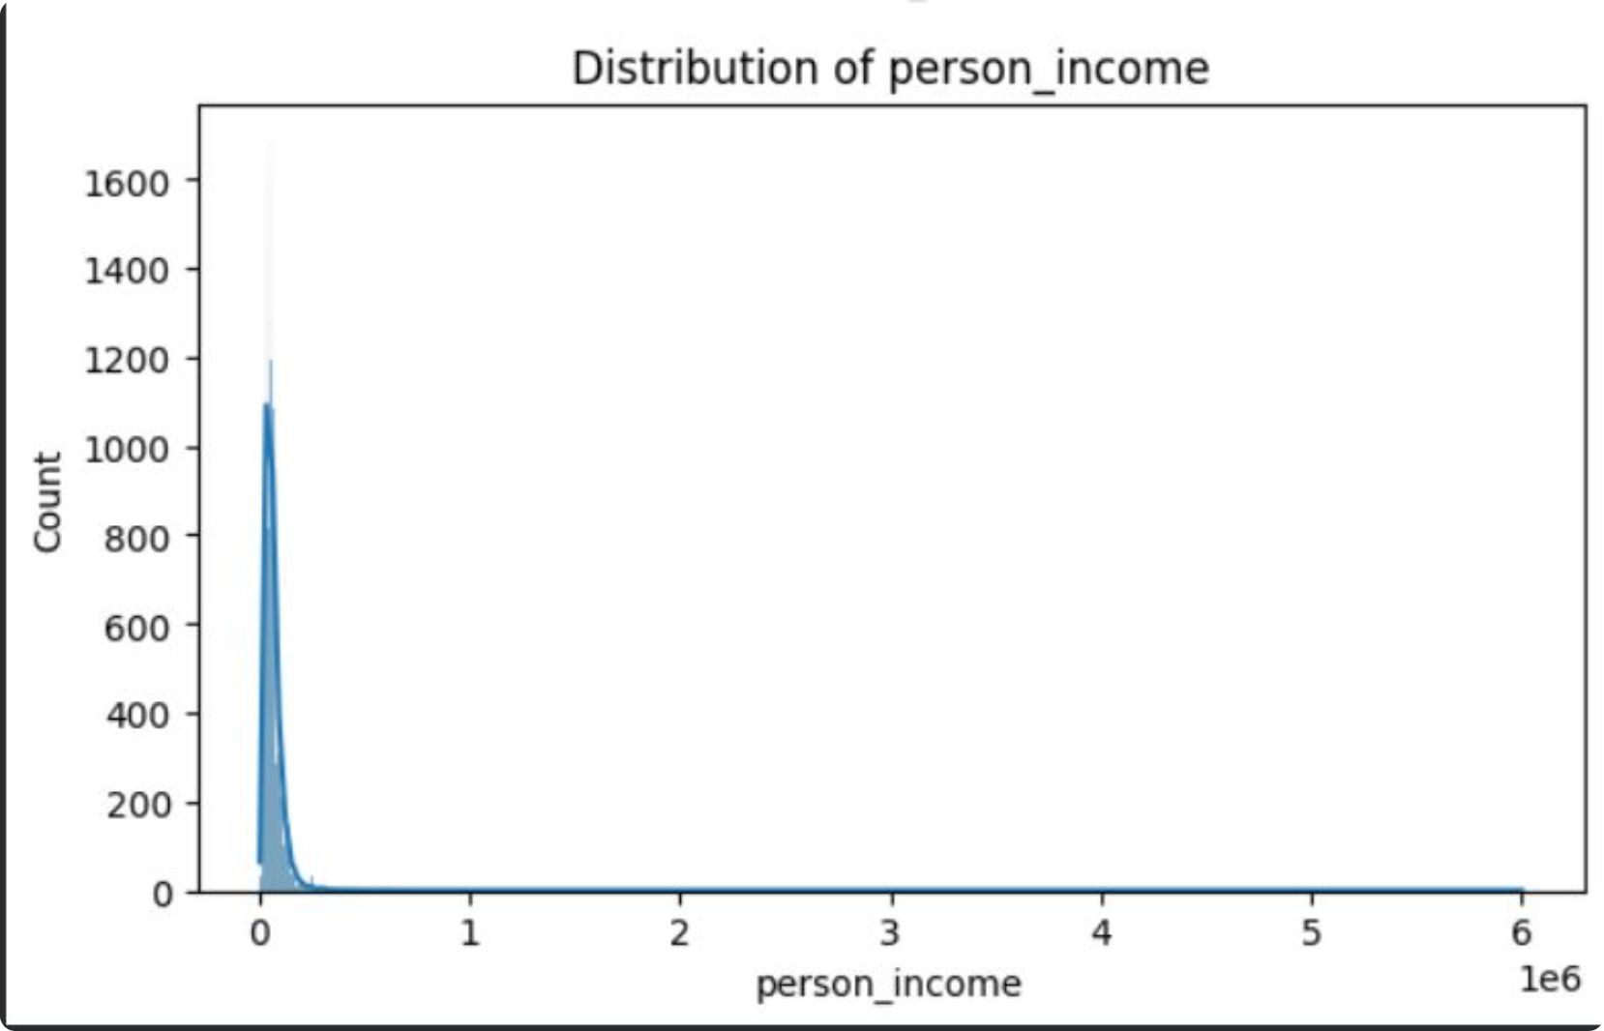
Numerical EDA — Income & Loan Burden
Income distribution: person_income is highly right‑skewed with extreme high‑income outliers.
Loan-to-income insight: higher loan-to-income ratios are associated with defaulting customers.
Implication: apply robust scaling / transformation and consider outlier handling before Logistic Regression.

Slide 6
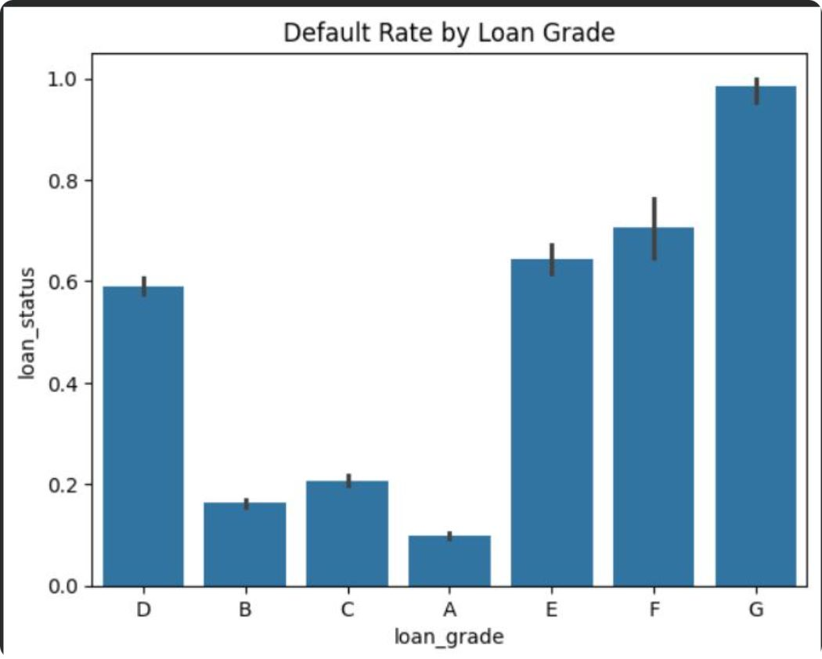
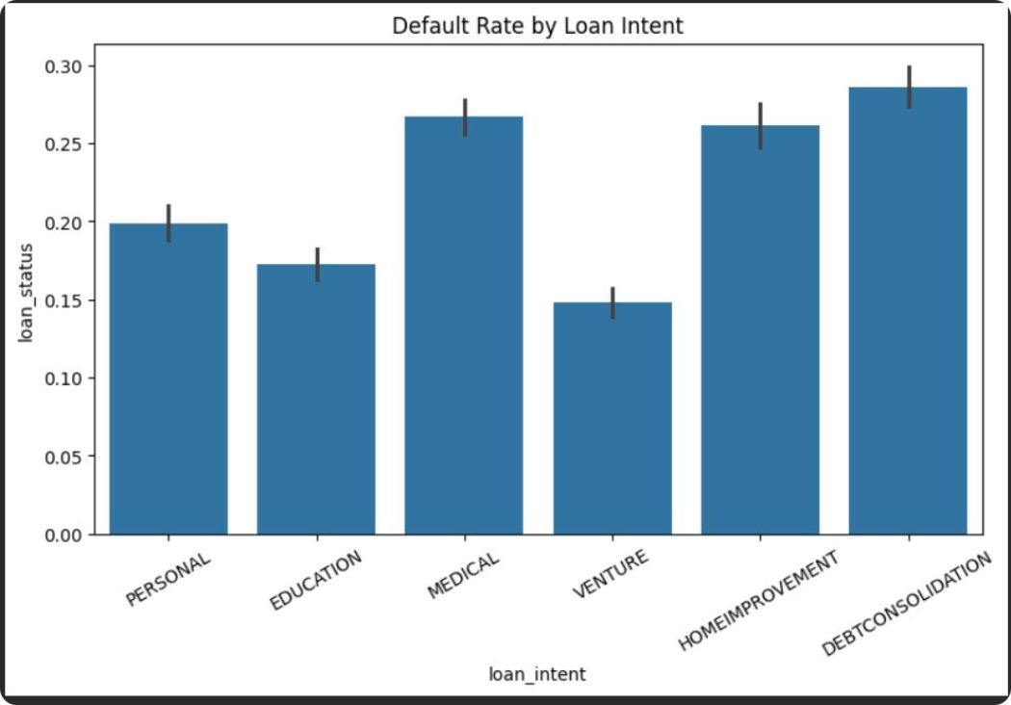
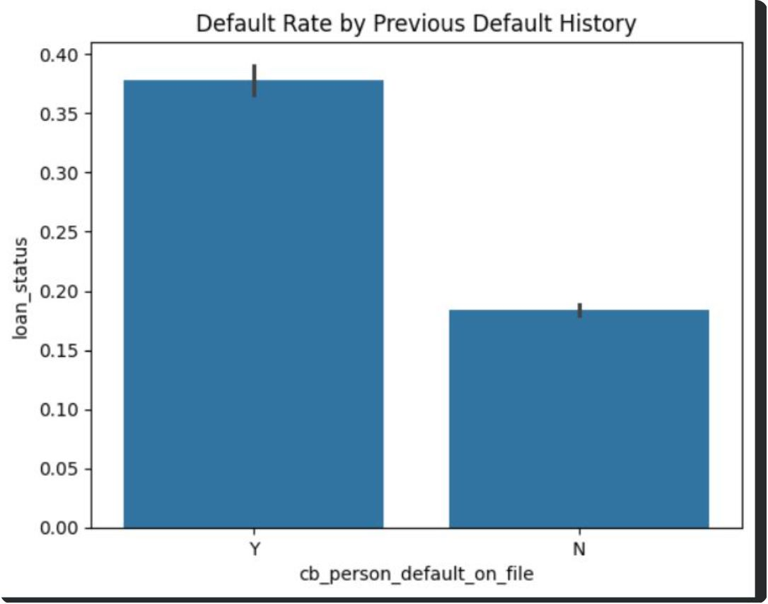

Credit Risk Patterns (Categorical)
Three views from EDA — place side by side for comparison.
Loan Intent: default rates vary by purpose (e.g., Debt consolidation ~29% vs Venture ~15%).
Loan Grade: default rate rises markedly from A (~10%) to G (~99%).
Previous Default: Y → ~38% default vs N → ~18% default.
Loan grade shows a strong association with observed credit risk.
Past default history is strongly associated with current default risk.

Slide 7
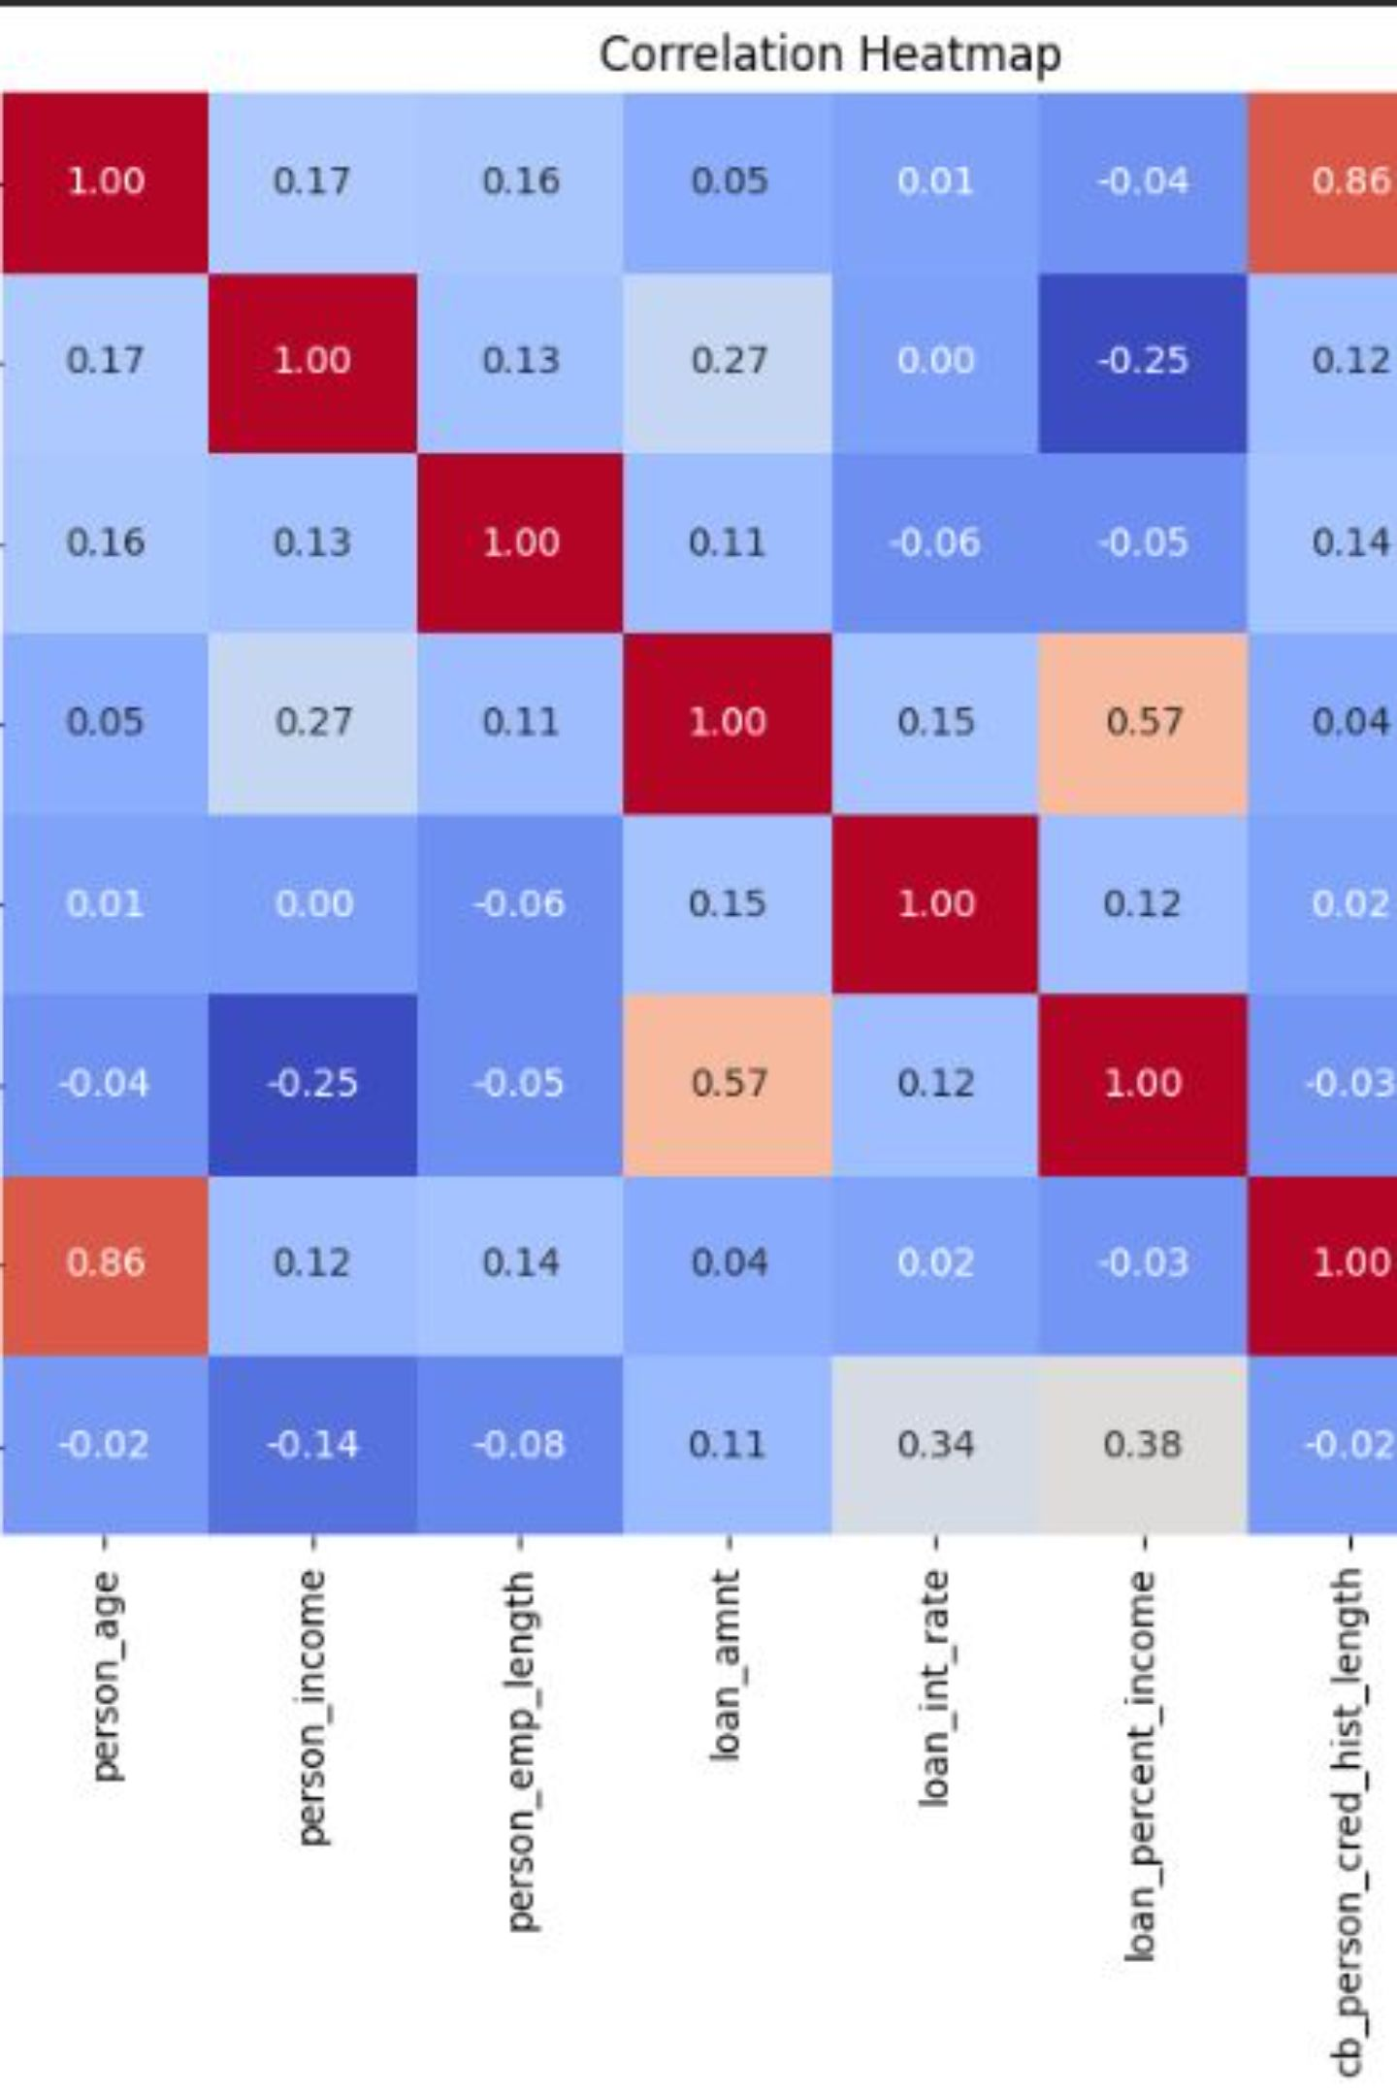
Correlation Analysis
Relevant correlations with loan_status (association, not causation):
loan_percent_income → +0.38
loan_int_rate → +0.34
loan_amnt → +0.11
person_income → −0.14
person_emp_length → −0.08
person_age → −0.02
cb_person_cred_hist_length → −0.02
Strong inter‑predictor correlation: person_age ↔ cb_person_cred_hist_length = +0.86 — overlapping information among predictors.
Elastic Net helps when predictors are correlated by combining L1 (sparsity) and L2 (stability).

Slide 8

Proposed ML Pipeline
Stage highlights:
Data Cleaning: remove duplicates and fix data types.
Imputation: use median, mode, or model-based strategies for missing values.
Encoding: apply one-hot or target encoding for categorical features.
Scaling: use robust or standard scaling for numeric features, especially with skew or outliers.
Train/Test Split: separate data for modeling and validation.
Data Cleaning
Imputation
Remove duplicates and fix types.
Fill missing values with robust methods.
Encoding
Scaling & Split
Convert categoricals to numeric features.
Scale features then split for training.

Slide 9

Model Evaluation & Next Steps
Planned evaluation metrics (after training):
Metric |  | Result
Accuracy |  | To be evaluated
Precision |  | To be evaluated
Recall |  | To be evaluated
F1-score |  | To be evaluated
ROC‑AUC |  | To be evaluated
Confusion matrix: to be generated after model predictions on test set.
Do NOT invent results — model evaluation will follow training and proper cross‑validation.
Next steps
Implement preprocessing pipeline and cross‑validated hyperparameter search for Elastic Net (alpha, l1_ratio).
Address class imbalance with resampling or class weights; tune decision threshold based on business priorities (precision vs recall).
Validate model fairness and stability; prepare explainability outputs (feature coefficients or SHAP summaries) for stakeholder review.

