Slide 1

OPERATING SYSTEMS PROJECT
Linux Process
Tree Visualizer
A tool for visualizing running Linux processes and their parent-child relationships.
Team members: 2520030359-Mohammad Faizaan,
2520030267- Ishaan Kulkarni
Faculty name : Harika .

Slide 2




THE PROBLEM
A flat process list hides the relationships that matter
Many processes run at once
Tables flatten context
Linux systems may run many processes simultaneously.
Tabular output lists processes, but does not make hierarchy immediately clear.
Ownership is easy to miss
The project makes it visible
It can be difficult to see which processes are parents and which are children.
This project represents those relationships as a clear tree structure.
WHY A TREE

Slide 3
FROM RECORDS TO RELATIONSHIPS
Find currently running processes.
Read PID, PPID, and process name where accessible.
Establish parent-child relationships.
Show the relationships as a process tree.
Update periodically as processes change.
The visualizer turns process records into a live hierarchy
Each refresh moves from Linux process data to a readable parent-child view.

Slide 4
THE OS MODEL
Five OS concepts explain the tree
Five concepts
Illustrative process tree
Process: an instance of a program being executed.
PID: the identifier assigned to a process.
PPID: the identifier of its parent process.
Parent-child relationship: formed when processes create other processes.
Process tree: a hierarchical representation of those relationships.
systemd (PID 1)
├── bash (PID 500)
│ └── python (PID 650)
└── cron (PID 300)
Illustrative example, not actual system output: systemd (PID 1) → bash (PID 500) → python (PID 650); systemd also → cron (PID 300)

Slide 5
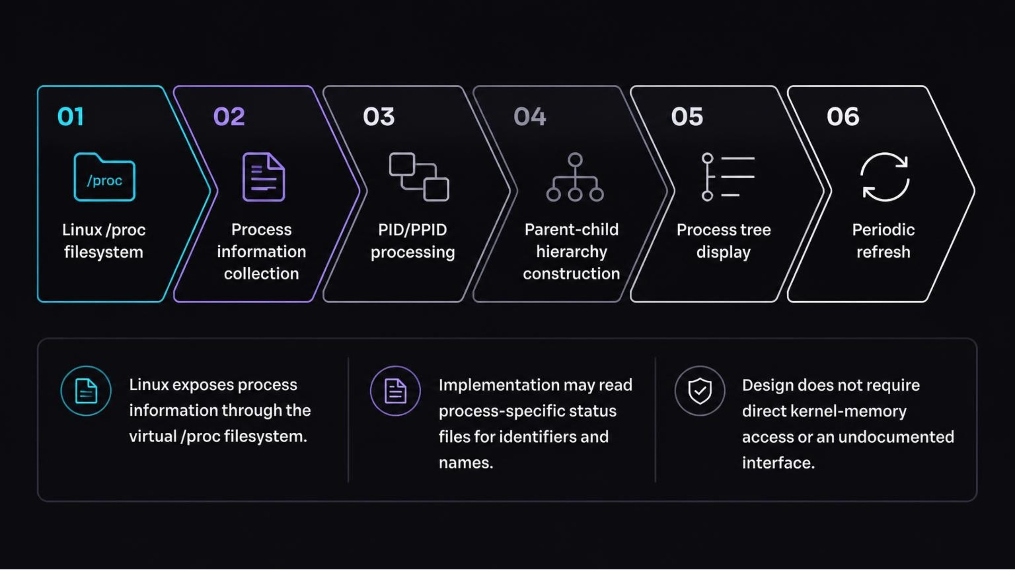
PROPOSED ARCHITECTURE
The proposed architecture follows Linux's documented process view
The design reads documented process information from the virtual /proc filesystem rather than requiring direct kernel-memory access or an undocumented interface.

Slide 6
REFRESH MODEL
Each refresh builds a new snapshot of the hierarchy
01
02
03
Inspect
Collect
Organize
Inspect available process entries.
Collect PID, PPID, and process name where accessible.
Organize the collected records.
04
05
06
Match
Display
Repeat
Match each process to its parent using PPID.
Display the resulting hierarchy.
Repeat collection and update the display at a defined interval.
Processes may start or terminate during collection, so missing entries and read errors should be handled.

Slide 7
OPEN DESIGN DECISIONS
Implementation choices still need to be filled in by the team
Decision | Current specification
Operating system | Linux.
Process information | /proc virtual filesystem.
Programming language | [Specify language actually used]
Libraries | [Specify libraries actually used, if any]
Data structures | [Specify structures used for process records and hierarchy construction]
Interface | [Specify the actual terminal-based or graphical interface]

Slide 8
The result is useful, but every view is a changing snapshot
Expected outcome
Limitations
Readable hierarchy of running Linux processes.
Visibility into PID, PPID, and process names.
Periodic updates as the process list changes.
Refreshes may introduce a short delay before changes appear.
Processes may disappear during collection.
Permissions or incomplete information may affect results.
A snapshot may miss very short-lived processes.
Conclusion: The project applies Linux process-management concepts and basic data structures to make parent-child relationships easier to understand.

