Slide 1



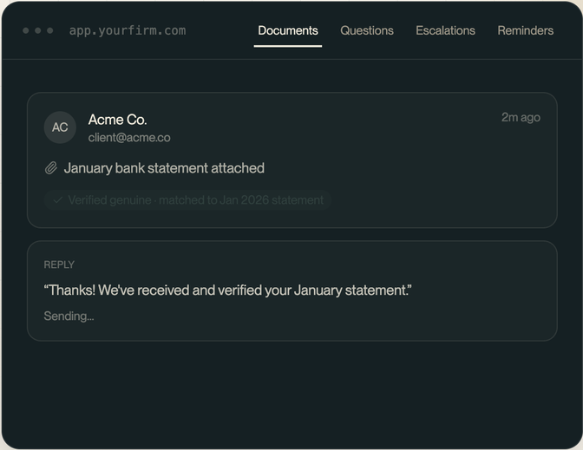
AUTOMATED INTAKE
For accounting & professional-services firms
Stop chasing clients.
We send the follow-up.
[Sept 2026]

Slide 2


THE PROBLEM
Manual document chasing is eating
your team's time
Hours per client, every season
Verified by hand
Lost in the inbox
Staff spend their week in back-and-forth email, chasing what's still missing.
Every incoming file gets cross-checked against the list manually, one at a time.
Wrong attachments, quiet clients, and missed replies fall through the cracks.
It's not that your team isn't capable - it's that the process doesn't scale.
02 / 13

Slide 3

THE SOLUTION
Compozor turns document collection into a system your firm can rely on - not a task your staff has to babysit.
Request
Collect
Verify
Deliver
03 / 13

Slide 4
HOW IT WORKS
One workflow, start to finish
1
Checklist set
The firm defines exactly what's needed, per client.
2
Client emailed
Compozor sends the request automatically — no manual send.
3
Client replies
Documents arrive whenever the client is ready to send them.
4
AI reviews
Each file is classified, verified as genuine, and matched to the checklist.
5
Ready
Status updates automatically; a complete set downloads as one zip.
6
Workflows run
The data is reconciled, formatted, and unified automatically — exactly as your workflow defines it.
04 / 13

Slide 5
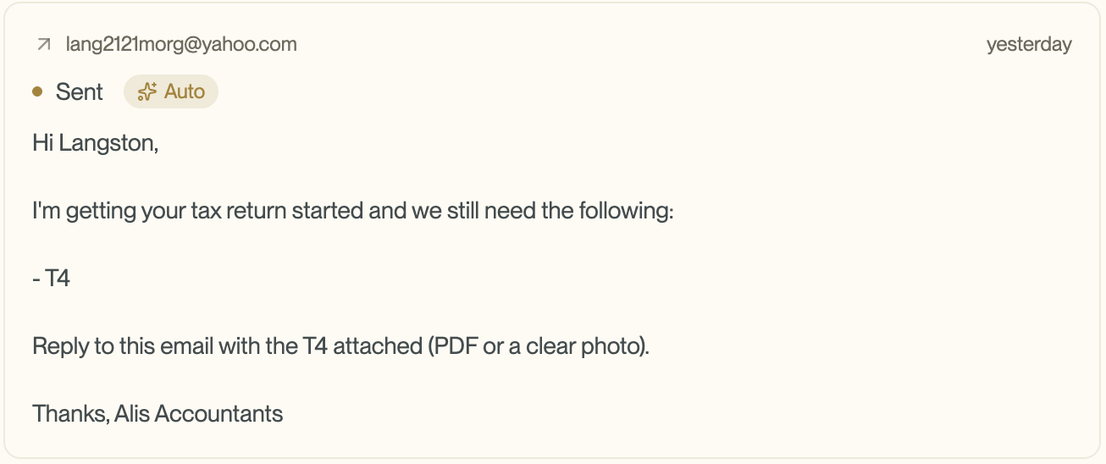
FEATURE 01
Automated emails that sound
like your firm
Initial checklist requests go out automatically — no one has to remember to send them.
Clients who go quiet get re-reminded on their own, without staff tracking who's overdue.
Every AI-drafted email can be reviewed before sending — or sent automatically once you trust it.
05 / 13

Slide 6





FEATURE 02
It doesn't just flag problems — it fixes them
Every document is classified, verified as genuine, and matched to the right checklist item. If something's wrong, Compozor emails the client back automatically — explaining exactly why — and keeps at it until the right file arrives.
Document arrives
AI reviews it
Wrong? Auto-corrected
Still wrong the 3rd time
Client replies with an attachment, any time.
Classified, verified as genuine, matched to the checklist.
Client gets an email explaining exactly why, and what to send instead. Repeats automatically.
Escalated to your team, with the full history attached.
06 / 13

Slide 7
FEATURE 03
One click.
Fully organized.
Once every checklist item is received and verified, the complete set is ready — no more digging through an inbox. Download the whole client file as a single zip.
07 / 13

Slide 8
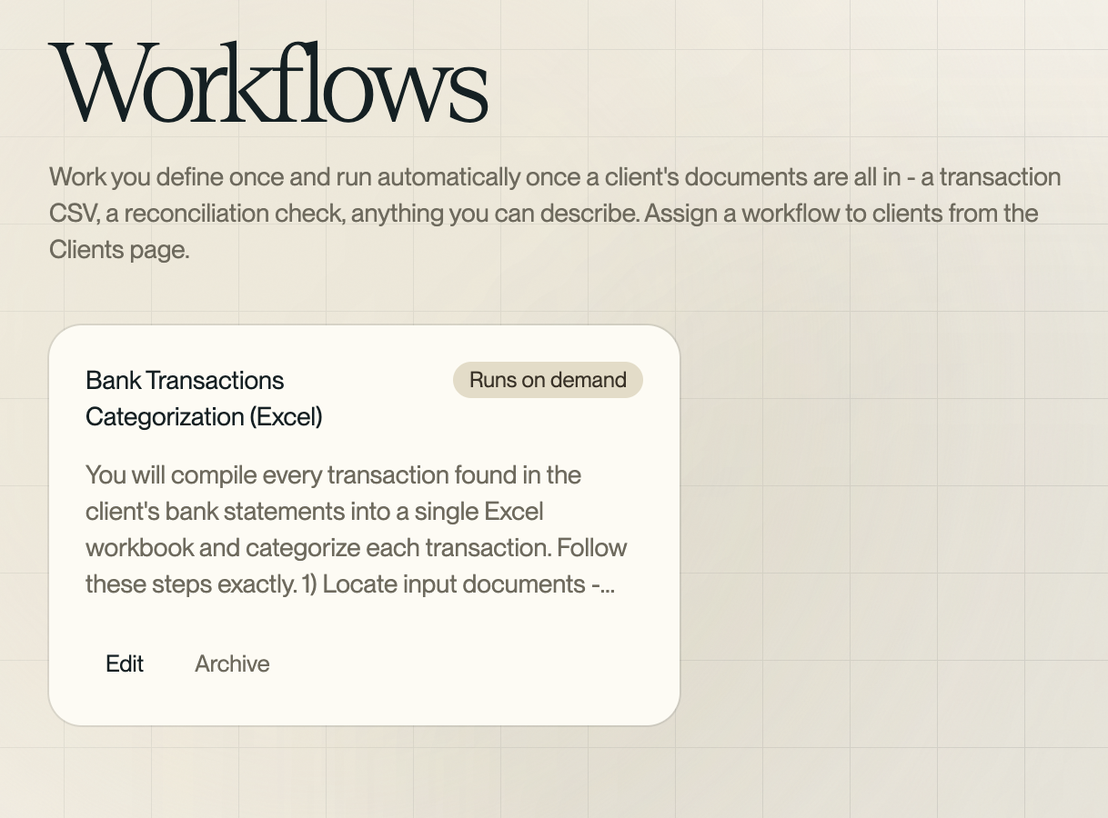
FEATURE 04 — WHAT HAPPENS NEXT
You decide what happens
after the documents arrive
“Once everything's in, then what?”
Workflows answer it - describe what you want done, in plain language, and Compozor does it once a client's documents are complete.
Build a transaction CSV
Run a reconciliation check
Notify the engagement lead
08 / 13

Slide 9


ON THE ROADMAP
One view of every client,
every day
One dashboard gives the accountant a quick read on where every client stands the moment they sit down each morning — who's complete, who's missing documents, who needs attention.
Complete
In progress
Ready for the accountant
Documents still coming in
Needs attention
Awaiting client
Escalated for a human
Reminder already sent
CONCEPT — IN DESIGN
09 / 13

Slide 10
TRUST & CONTROL
AI that works for you - never around you
You set the automation level
Human review by default
Escalation, not silence
No automation, medium, or high — every firm chooses how much runs on its own.
New firms start with every AI-drafted email needing a click to send.
Repeated issues — a wrong document, an unanswerable question — go to a human, with full context, instead of stalling quietly.
10 / 13

Slide 11

THE BUSINESS CASE
Where the savings come from
Staff hours reclaimed
More clients, same headcount
Faster turnaround, peak season
Less time spent manually chasing, checking, and re-sending the same requests.
Admin overhead per client drops, so capacity grows without hiring.
Documents move through the pipeline without waiting on a free staff hour.
Exact savings depend on client volume and your current process — worth working through your own numbers together.
11 / 13

Slide 12
WHY COMPOZOR
Built for how firms actually work
THE OLD WAY
WITH COMPOZOR
Chasing clients
Manual emails, easy to forget
Automatic requests + reminders
Verifying documents
By hand, item by item
AI classifies & verifies automatically
Wrong document arrives
A staff member re-emails the client
Auto-corrected — up to twice, then escalated
After documents arrive
Ad hoc, inconsistent
Configurable workflows, your rules
Daily status check
Digging through inboxes
One dashboard view
12 / 13

Slide 13
NEXT STEPS
The Pilot
1
Onboarding
2
Set up checklists & workflows together
3
See it run for a season, then decide
Questions? [Name] · [email] · [phone]
13 / 13

