Slide 1
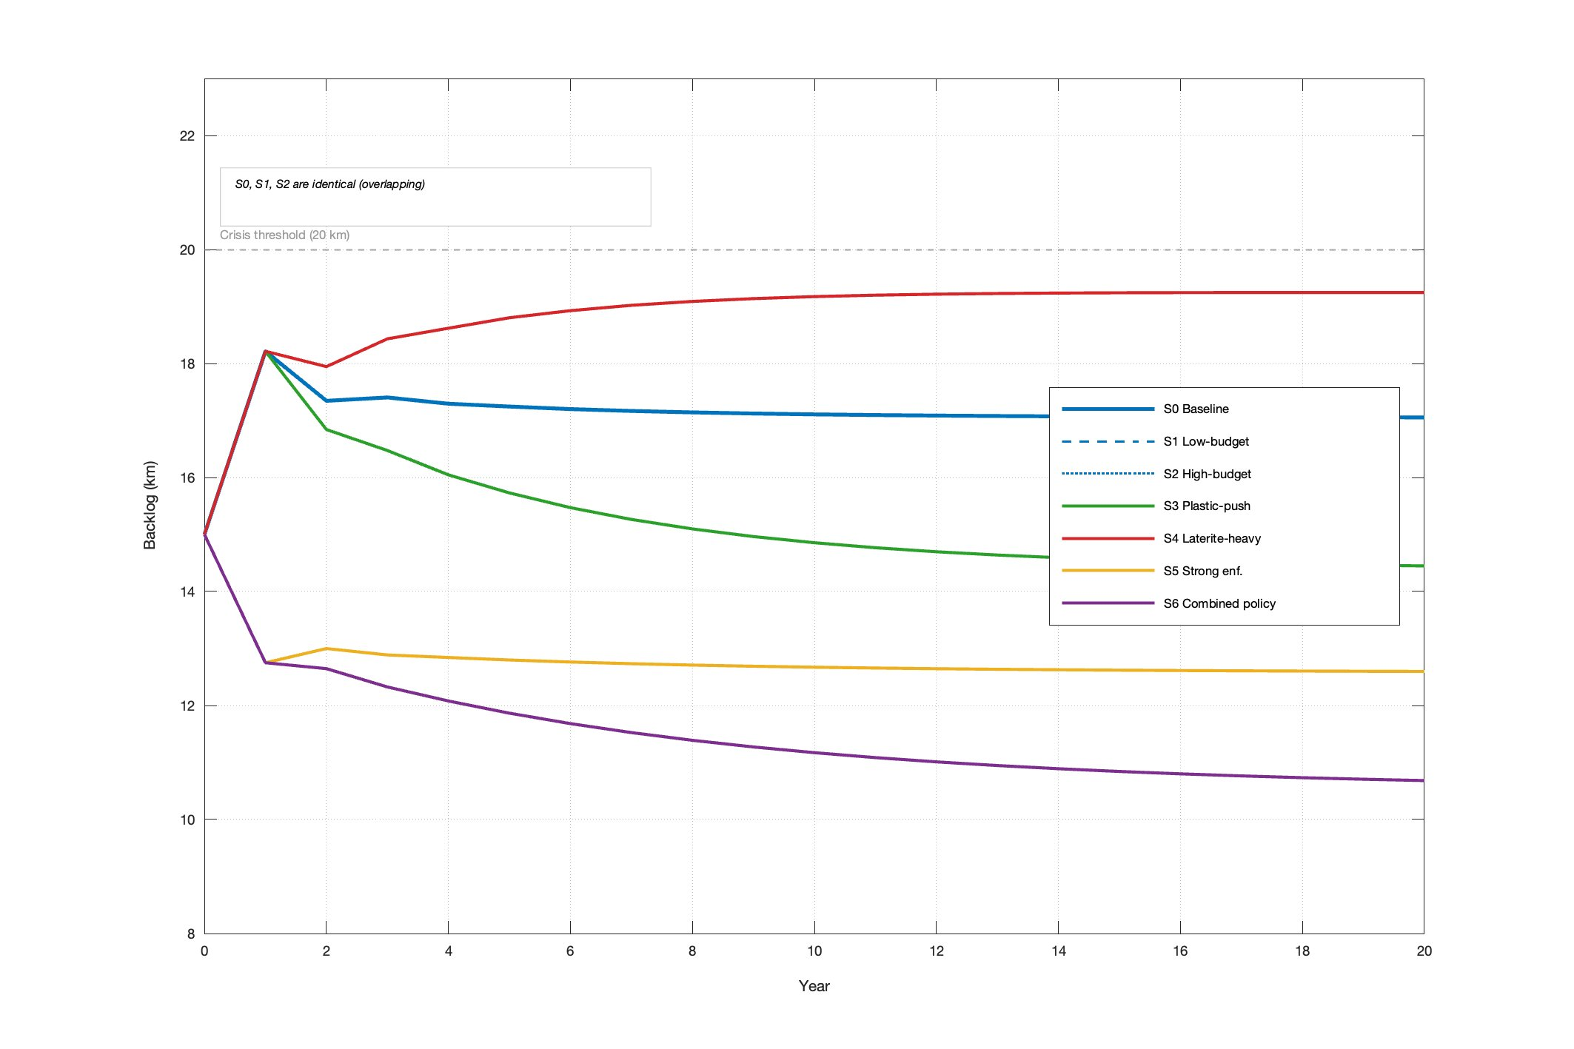
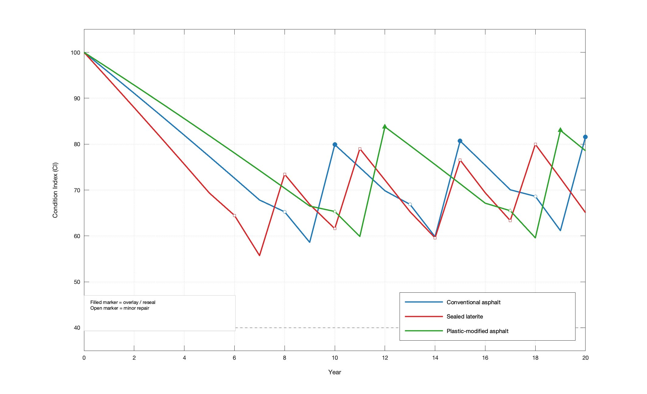
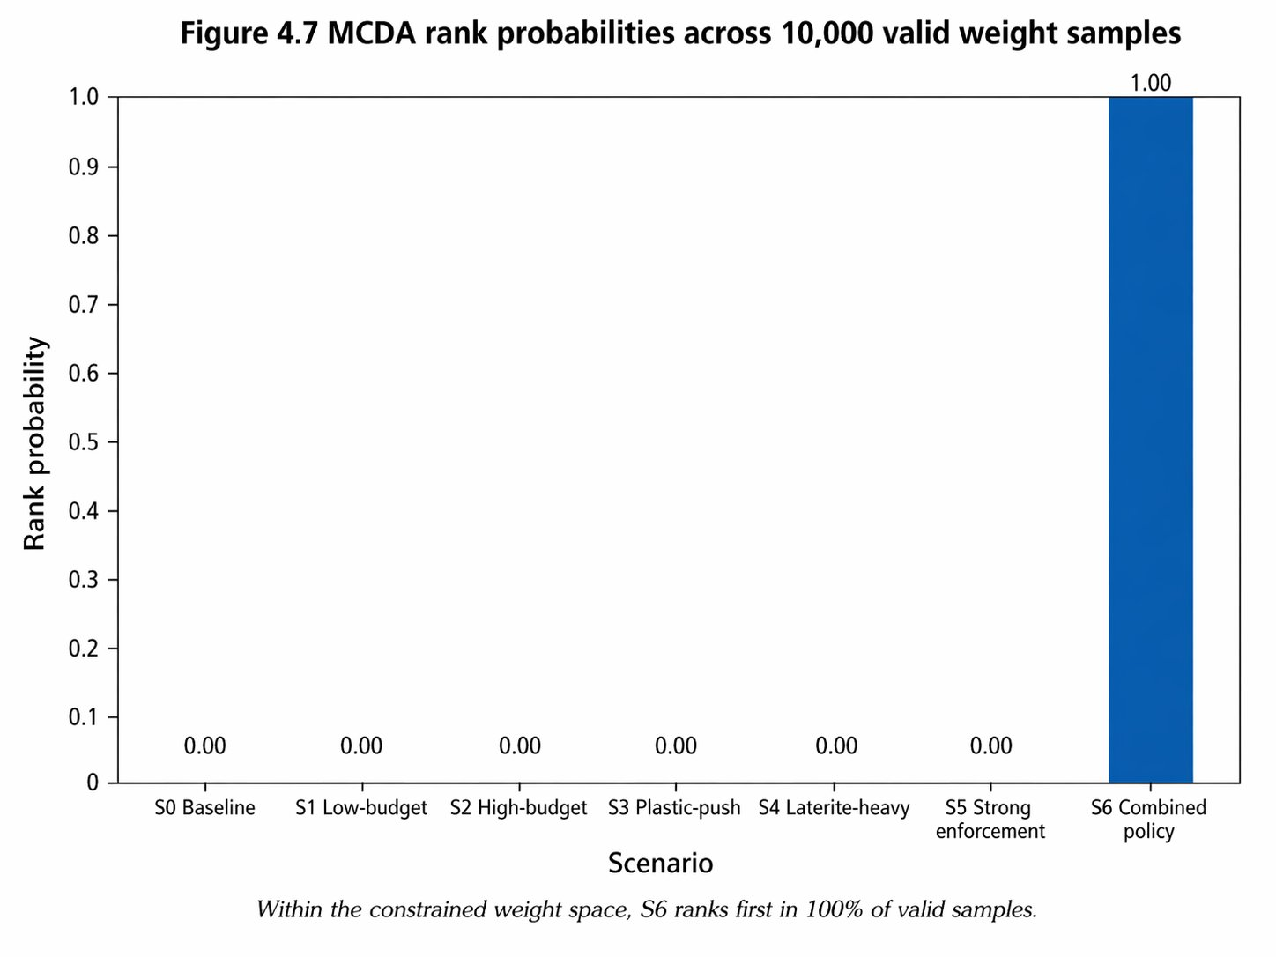
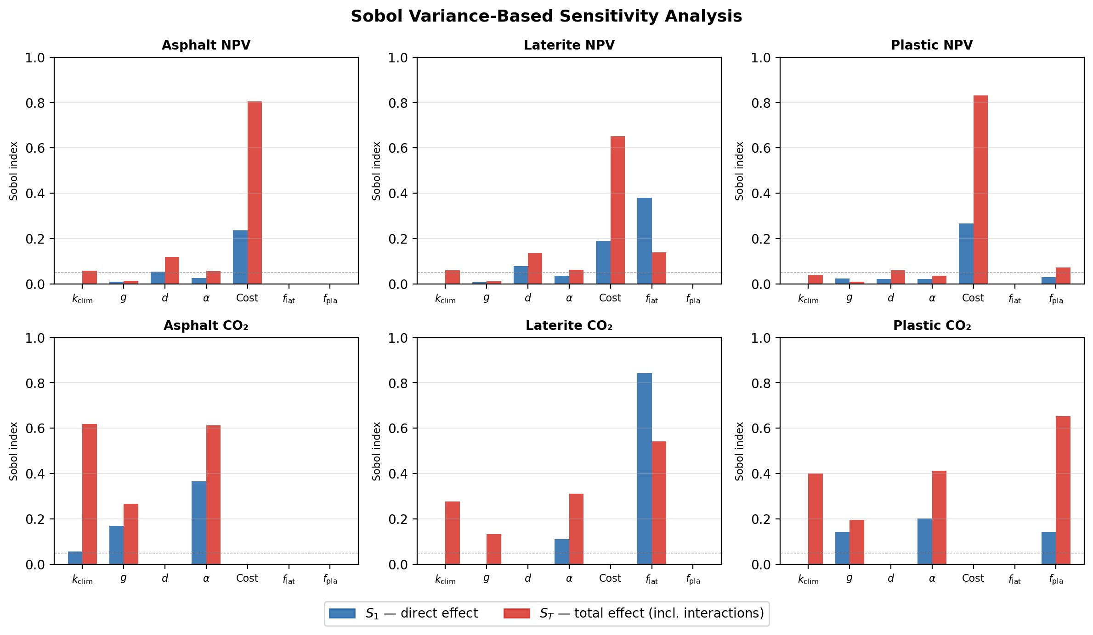
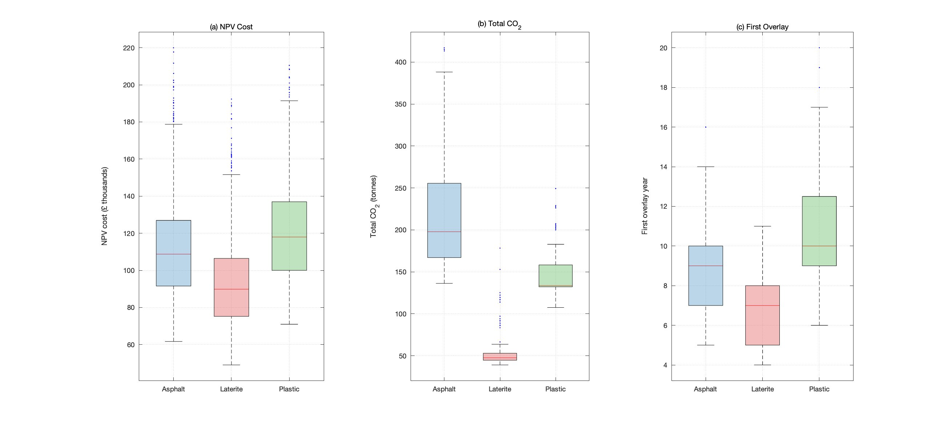

42
PM
Digital-Twin-Enabled Life-Cycle Assessment of Sustainable Pavement Materials for Nigerian Roads
Faizaan Umar (34411364) · fu1e22@soton.ac.uk · FEEG3003 Individual Project
Supervised by Dr Paul Kemp · Faculty of Engineering & Physical Sciences, University of Southampton · 5 June 2026
KEY FINDING — The Laterite Inversion: best material at asset scale (1 km) becomes worst at network scale (100 km) — a scale-dependent trade-off invisible to single-scale LCA
20-year horizon · 7 policy scenarios · 100 km network · 2,000 Monte Carlo runs · 9,216 Sobol samples · 10,000 MCDA draws
1 Introduction & Background
5 Asset-Level Results (1 km, 20-year baseline)
7 Network-Level Results (100 km, 7 scenarios)
Nigeria relies on roads for ~80% of freight movement, yet over 60% of the paved network is in poor condition. Routine over-axle loading — reaching 200% of legal limits — accelerates deterioration far beyond temperate benchmarks [1].
Three materials compete: conventional asphalt, sealed laterite (locally available iron-rich gravel), and plastic-modified asphalt (PMA). No prior study couples asset-level LCA to network-level system dynamics — leaving scale-dependent trade-offs hidden from policy-makers.
Material
NPV Cost
Const. CO₂
W-L CO₂
1st Overlay
Conventional asphalt
£99,872
195.9 t
335.4 t
Year 10
Sealed laterite
£79,688 ✓
44.7 t ✓
236.7 t ✓
Year 8
Plastic-modified (PMA)
£110,692
132.1 t
253.9 t
Year 12
Asphalt construction CO₂ (195.9 t) = 58% of whole-life total — contradicting temperate-climate use-phase dominance. Tropical overloading creates a construction-dominant emissions profile absent from OECD LCA literature.
Multi-metric
(cost + CO₂
+ condition)
Asset scale (1 km)
Network scale (100 km)
Egilmez & Tatari (2012)
Ruiz & Guevara (2020)
Shiboub & Assaf (2022)
★
THIS STUDY
Digital-twin coupling
Fig. 5: Network backlog over 20 yr. The top red line is S4 at 19.24 km (Inversion). Three lines overlap in the middle at 17.05 km — those are S0, S1 and S2 (budget non-binding). The bottom purple line is S6 at 10.68 km (combined policy).
Single-metric
(condition only)
Scenario
Yr-20 Backlog
Cum. Cost
W-L CO₂
Talaghat et al. (2024)
Linard (2009, 2010)
S0 Baseline
17.05 km
£6.79M
17,929 t
S1 Low-budget
17.05 km
£6.79M
17,929 t
S2 High-budget
17.05 km
£6.79M
17,929 t
S3 Plastic-push
14.45 km
£6.94M
17,179 t
Fig. 2: CI vs time. The line staying highest longest is PMA (most durable). The line dropping first is laterite (Yr 8 overlay). Filled markers = overlay events.
S4 Laterite-heavy
19.24 km
£6.04M
16,507 t
S5 Enforcement
12.60 km
£5.09M
16,855 t
Fig. 1: Research positioning. The top-right cell (network-scale, multi-metric) was previously unoccupied. This study fills it.
6 Sensitivity & Uncertainty Analysis
S6 Combined ★
10.68 km
£5.26M
16,182 t
2 Research Questions
Monte Carlo (N = 2,000):
CO₂ ranking is stochastically dominant — laterite 95th-pct (88.9 t) < plastic 5th-pct (109.0 t). NPV rankings overlap: laterite median (£89,874) lowest, 95th-pct (£135,945) overlaps other materials.
Sobol decomposition (N = 9,216):
NPV driven by unit cost factor (S_T = 0.65–0.83). Asphalt CO₂: k_climate S₁ = 0.06 but S_T = 0.62 — 91% of variance from interaction. OAT methods systematically understate CO₂ uncertainty.
Why WIM enforcement is so powerful: pavement damage ∝ load⁴ (AASHO Road Test, 1962). A truck at 2× legal load does 16× the damage of a legal one [2].
RQ1 What are the 20-year life-cycle cost, CO₂ and condition trajectories for each material at asset level?
RQ2 How does one-way coupling of asset outputs into a system-dynamics model enable network-level interpretation?
RQ3 How do budget, adoption mix, and axle-load enforcement affect network backlog, cost, and emissions?
Answers to Research Questions
A1 Laterite: lowest 20-yr NPV (£79,688) and CO₂ (236.7 t). PMA: longest service life (Yr 12 first overlay). Asset-level cost and carbon rankings are robust across all 2,000 Monte Carlo draws.
A2 Coupling reveals The Laterite Inversion: asset-optimal material produces the worst network backlog. This scale-dependent trade-off cannot be detected by single-scale asset LCA.
A3 Budget is non-binding above £346k/yr (S0 = S1 = S2 identically). WIM axle-load enforcement is the only effective lever, reducing Yr-20 backlog from 17.05 → 10.68 km (−37%).
Fig. 6: The single bar reaching 1.0 is S6 — it ranks first in every one of 10,000 Dirichlet weight samples. Other scenarios never rank first under any weighting.
3 Methodology Pipeline
8 Discussion & Conclusions
1
CALIBRATE
PIARC tropical curves [1] + literature
① The Laterite Inversion — Asset-Optimal ≠ Network-Optimal
2
ASSET MC
MATLAB · 3 materials · N = 2,000
Asset Scale (1 km) ✓
Network Scale (100 km) ✗
3
UNIT OUTPUTS
TTL · £/km · t CO₂/km → feed network
NPV:
£79,688
✓
TTL = 3.33 yr
Yr-20 backlog:
19.24 km
✗
asset → network coupling
WL CO₂:
236.7 t
✓
(network-scale variance)
vs S0:
+13%
✗
4
NETWORK SD
Vensim · 100 km · 7 scenarios · 20 yr [3]
Fig. 3: Sobol S₁ vs S_T. Look at k_climate for asphalt CO₂: tiny S₁, large S_T — the gap is interaction variance OAT cannot detect.
TTL:
8 yr
►
MCDA rank:
5th / 7
✗
5
SOBOL
Variance decomp. · N = 9,216 (Saltelli)
Monte Carlo Distributions (N = 2,000)
MC CO₂:
1st / 3
✓
overwhelms
cum. cost:
£6.04M
6
MCDA
10,000 Dirichlet weight draws → rank robustness
BEST
rehab queue
WORST
Hidden from conventional single-scale LCA — requires digital-twin coupling to detect
4 Network Scenario Design (7 scenarios)
② Budget Non-Binding
S0
Baseline
100% asphalt; calibrated budget; overload multiplier ODM = 1.0
Binding constraint on Nigerian network performance is deterioration rate, not budget. S0 = S1 = S2 identically. Policy should redirect resources to enforcement, not more rehabilitation contracts.
S1
Low-budget ×0.7
70% of baseline annual road agency budget
S2
High-budget ×1.3
130% of baseline annual road agency budget
③ Multiplicative CO₂ Uncertainty
S3
Plastic-push
40% PMA / 40% asphalt / 20% laterite rehabilitation mix
Climate and overload factors interact multiplicatively. OAT methods miss 91% of asphalt CO₂ variance. Sobol decomposition is necessary for carbon-critical infrastructure assessment in tropical contexts.
S4
Laterite-heavy
50% laterite / 30% asphalt / 20% PMA rehabilitation mix
Fig. 4: MC distributions. Laterite CO₂ box sits entirely below the others — stochastic dominance, robust to all parameter draws.
S5
Strong enforcement
WIM enforcement reduces ODM: 1.0 → 0.6 (−40%)
S6
Combined policy ★
S5 enforcement + S3 plastic mix — best on all 4 metrics
Key Metrics at a Glance
9 Policy Recommendations
References
1.4–3.8
£88,481
100%
Immediate
Install WIM axle-load enforcement. Capital cost £120k–320k; payback 1.4–3.8 yr from agency savings alone [2]. Budget-equivalent benefit: £88,481/yr per 100 km.
[1] PIARC (2022). Pavement Management Systems. World Road Association. [2] Torres Martínez et al. (2018). WIM cost-benefit analysis. Road Mater. Pavement Des. [3] Ruiz & Guevara (2020a,b). SD for road networks. Transp. Res. D. [4] Talaghat et al. (2024). Pavement LCA review. J. Clean. Prod. [5] Shiboub & Assaf (2022). Network LCCA. Int. J. Pave. Res. Technol. [6] Linard (2009, 2010). SD in transport infrastructure. Syst. Dyn. Rev.
yr
/yr
Conditional
WIM payback
(agency savings only)
Budget-equivalent
benefit of enforcement
S6 ranks 1st in
all 10,000 MCDA draws
Expand laterite only where corridor TTL evidence ≥ 5 yr. Survey justified at P(TTL≥5yr) = 40% (EVPI = £78/km). Wrong-decision cost: £437/km.
Validation & Limitations
Strategic
Adopt PMA where CO₂ reduction has policy value. Advantage over asphalt doubles by Year 25 and is robust to all Monte Carlo draws.
✓ Validation
• PIARC (2022) tropical deterioration curves
• SD structure: Ruiz & Guevara (2020)
• Sobol convergence at 5% tolerance
• LCA boundary aligned with EN 15804
! Limitations
• Tropical analogue calibration (not Nigerian)
• One-way coupling only (no feedback)
• Current climate (no IPCC trajectories)
• Homogeneous network (no spatial variation)
Scan to access code, Vensim model, data & full dissertation on GitHub
10 Future Work
In-situ TTL measurement (FERMA partnership) to resolve laterite inversion (EVPI = £78/km)
Regional disaggregation: PMA in humid south, polymer-asphalt in arid north, laterite for rural
Two-way coupling (condition → user costs → GDP) + IPCC climate trajectories
RECOMMENDED ACTION — S6 Combined Policy: WIM axle-load enforcement + 40% PMA / 40% asphalt / 20% laterite mix. −37% Yr-20 backlog · payback 1.4–3.8 yr · ranks 1st in 100% of MCDA draws

