Slide 1
DISCRETE STRUCTURES
RELATIONS

Slide 2
WHY STUDY RELATIONS ?
We study relations because they help us understand and model connections between things in mathematics, computer science, and real life.
▶ In Mathematics: Relations help us study connections between numbers. For example: One number divides another (like 2 divides 6).
▶ In Computers: Relations describe connections such as:
A program and the variables it uses.
A programming language and its valid statements.
A database storing related information.
▶ In Real-World Problems: Relations help us solve practical problems, such as:
Finding which cities are connected by flights.
Deciding the correct order of tasks in a project.

Slide 3
DOMAIN & RANGE OF RELATIONS
DOMAIN OF A RELATION:
The domain of a relation R from A to B is the set of all first
elements of Dom(R).
Symbolically:
the ordered pairs which belong to R denoted
Dom (R) = {a ∈A| (a,b) ∈R}
RANGE OF A RELATION:
The range of A relation R from A to B is the set of all second elements of the ordered pairs which belong to R denoted Ran(R).
Symbolically:
Ran(R) = {b ∈B|(a,b) ∈ R}
If: R = {(1,2),(1,3),(2,3)}
Domain: All first elements, Dom(R) = {1,2}
Range: All second elements, Ran(R) = {2,3}

Slide 4
EXAMPLE
Let A = {1, 2}, B = {1, 2, 3}, Define a binary relation R from A to B as follows: R = {(a, b) ∈A × B | a < b}
Then
Find the ordered pairs in R.
Find the Domain and Range of R.
Is 1R3, 2R2?
SOLUTION:
Given A = {1, 2}, B = {1, 2, 3}, then
A × B = {(1,1), (1,2), (1,3), (2,1), (2,2), (2,3)}
R = {(a, b) ∈ A × B | a < b}
R = {(1,2), (1,3), (2,3)}
Dom(R) = {1,2} and Ran(R) = {2, 3}
Since (1,3) ∈ R so 1R3, But (2, 2) ∉R so 2 is not related.

Slide 5
PROPERTIES OF RELATIONS
There are several properties that are used to classify relations on a set.
A relation R on a set A is called
reflexive if for all a ∈ A, aRa. Every element is related to itself.
symmetric if for all a, b ∈ A, aRb implies bRa. If (a,b) ∈ R then (b,a) must also be in R
antisymmetric if for all a, b ∈ A, aRb and bRa implies a = b. If:(a,b) ∈ R and (b,a) ∈ R Then: a = b
transitive if for all a, b, c ∈ A, aRb and bRc implies aRc. If:(a,b) ∈ Rand (b,c) ∈ R Then:(a,c) must also be in R

Slide 6
REFLEXIVE RELATION
A relation R on a set A is called reflexive if (a, a) ∈ R for every element a ∈ A.
(a,a) ∈ R
Every element is related to itself.
Example A = {1,2,3}
If R = {(1,1),(2,2),(3,3),(1,2)}
This is reflexive because:
(1,1)
(2,2)
(3,3)
All elements relate to themselves.
If one is missing?
If (3,3) is missing → NOT reflexive.

Slide 7
REFLEXIVE RELATION
EXAMPLE G
Consider the following relations on {1, 2, 3, 4}:
▶ R1 = {(1, 1), (1, 2), (2, 1), (2, 2), (3, 4), (4, 1), (4, 4)},
▶ R2 = {(1, 1), (1, 2), (2, 1)},
▶ R3 = {(1, 1), (1, 2), (1, 4), (2, 1), (2, 2), (3, 3), (4, 1), (4, 4)},
▶ R4 = {(2, 1), (3, 1), (3, 2), (4, 1), (4, 2), (4, 3)},
▶ R5 = {(1, 1), (1, 2), (1, 3), (1, 4), (2, 2), (2, 3), (2, 4), (3, 3), (3, 4), (4, 4)},
▶ R6 = {(3, 4)}.
Which of these relations are reflexive? SOLUTION:
▶ The relations R3 and R5 are reflexive because they both contain all pairs of the form (a, a), namely, (1, 1), (2, 2), (3, 3), and (4, 4).
▶ The other relations are not reflexive because they do not contain all of these ordered pairs. In particular, R1, R2, R4, and R6 are not reflexive because (3, 3) is not in any of these relations.

Slide 8
SYMMETRIC & ANTISYMMETRIC RELATION
A relation R on a set A is called symmetric if (b, a) ∈ R whenever (a, b) ∈ R, for all a, b ∈ A.
AND
A relation R on a set A such that for all a, b ∈ A, if (a, b) ∈ R and (b, a) ∈ R, then a = b is called antisymmetric.
A symmetric relation: A relation R on a set A is symmetric if: (𝑎,𝑏)∈𝑅 ⇒ (𝑏,𝑎)∈𝑅 Meaning: Whenever a is related to b, b must also be related to a.
Let 𝐴={1,2,3} so 𝑅={(1,2),(2,1),(2,3),(3,2)} So R is symmetric
An antisymmetric relation: A relation R on A is antisymmetric if: (𝑎,𝑏)∈𝑅 and (𝑏,𝑎)∈𝑅⇒ 𝑎=𝑏 Meaning: If both directions happen, then a and b must be the same element.
Let 𝐴={1,2,3}, 𝑅={(1,1),(2,2),(3,3),(1,2)} Notice: (1,2) is there (2,1) is NOT there So no two different numbers point to each other.

Slide 9
EXAMPLE I
Consider the following relations on {1, 2, 3, 4}:
▶ R2 = {(1, 1), (1, 2), (2, 1)},
▶ R3 = {(1, 1), (1, 2), (1, 4), (2, 1), (2, 2), (3, 3), (4, 1), (4, 4)},
▶ R4 = {(2, 1), (3, 1), (3, 2), (4, 1), (4, 2), (4, 3)},
▶ R5 = {(1, 1), (1, 2), (1, 3), (1, 4), (2, 2), (2, 3), (2, 4), (3, 3), (3, 4), (4, 4)},
▶ R6 = {(3, 4)}.
Which of these relations are Symmetric and antisymmetric ?
SOLUTION:
▶ The relations R2 and R3 are symmetric, because in each case (b, a) belongs to the relation whenever (a, b) does. For R2, the only thing to check is that both (2, 1) and (1, 2) are in the relation. For R3, it is necessary to check that both (1, 2) and (2, 1) belong to the relation, and (1, 4) and (4, 1) belong to the relation.
▶ R4, R5, and R6 are all antisymmetric. For each of these relations there is no pair of elements a and b with a ≠ b such that both (a, b) and (b, a) belong to the relation. This is done by finding a pair (a, b) with a ≠ b such that (a, b) and (b, a) are both in the relation.

Slide 10
TRANSITIVE RELATION
A relation R on a set A is called transitive if whenever (a, b) ∈ R and (b, c)∈ R, then (a, c) ∈ R, for all a, b, c ∈ A.
If two-step paths exist, the shortcut must exist. If no two-step path exists, nothing can go wrong.
NOTE:
Transitivity only requires that when a chain exists, the resulting pair (a,c) is in the relation.
If no chain exists, there’s nothing to check → automatically OK

Slide 11
TRANSITIVE RELATION
A relation R on a set A is called transitive if whenever (a, b) ∈ R and (b, c)
∈ R, then (a, c) ∈ R, for all a, b, c ∈ A.
EXAMPLE K
Consider the following relations on {1, 2, 3, 4}:
▶ R1 = {(1, 1), (1, 2), (2, 1), (2, 2), (3, 4), (4, 1), (4, 4)},
▶ R2 = {(1, 1), (1, 2), (2, 1)},
▶ R3 = {(1, 1), (1, 2), (1, 4), (2, 1), (2, 2), (3, 3), (4, 1), (4, 4)},
▶ R4 = {(2, 1), (3, 1), (3, 2), (4, 1), (4, 2), (4, 3)},
▶ R5 = {(1, 1), (1, 2), (1, 3), (1, 4), (2, 2), (2, 3), (2, 4), (3, 3), (3, 4), (4, 4)}.
Which of these relations are transitive ? SOLUTION:
R4 and R5 are transitive. For each of these relations, we can show that it is transitive by verifying that if (a, b) and (b, c) belong to this relation, then (a, c) also does. For instance, R4 is transitive, because of (3, 2) and (2, 1), (4, 2) and
(2, 1), (4, 3) and (3, 1), and (4, 3) and (3, 2) are the only such sets of pairs, and
(3, 1), (4, 1), and (4, 2) belong to R4.
R1 is not transitive because (3, 4) and (4, 1) belong to R1, but (3, 1) does not.
R2 is not transitive because (2, 1) and (1, 2) belong to R2, but (2, 2) does not.
R3 is not transitive because (4, 1) and (1, 2) belong to R3, but (4, 2) does not. Transitivity means: ALL possible chains must satisfy the rule.

Slide 12
METHODS FOR REPRESENTING RELATIONS
▶ Two methods for representing relations:
Square Matrices
Directed Graphs (consisting of vertices and directed edges)

Slide 13
REPRESENTING RELATIONS USING MATRICES
A relation between finite sets can be shown using a matrix of 0s and 1s.
Suppose: A = {a₁, a₂, …, aₘ} & B = {b₁, b₂, …, bₙ}
▶ The relation R can be represented by the matrix M_{R} = [m_{ij}], where
Rows → elements of A
Columns → elements of B
For each position (i, j):
Put 1 if aᵢ is related to bⱼ
Put 0 if aᵢ is not related to bⱼ
1 if (a_{i}, b_{j}) ∈ R,
0 if (a_{i}, b_{j}) ∉ R.
m_{ij} =

Slide 14
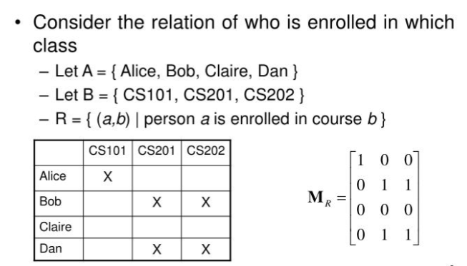

Slide 15
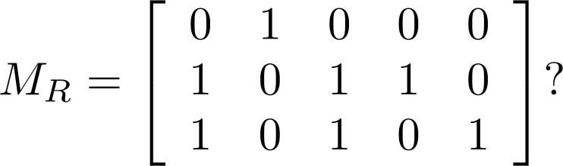
Examples of Representing Relations Using Matrices (cont.)
Example 3: Let A = {a₁,a₂, a₃} and B = {b₁,b₂, b₃,b₄, b₅}. Which ordered pairs are in the relation R represented by the matrix
Solution:
R = {(a₁, b₂), (a₂, b₁),(a₂, b₃), (a₂, b₄),(a₃, b₁), {(a₃, b₃), (a₃, b₅)}.

Slide 16
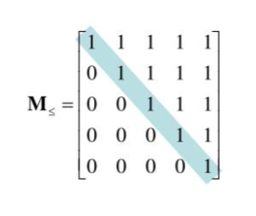
Matrices of Relations on Sets
If R is a reflexive relation, all the elements on the main diagonal of M_{R} are equal to 1.

Slide 17
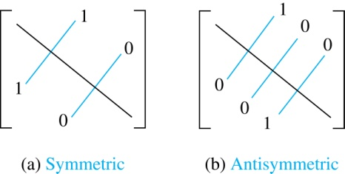
Matrices of Relations on Sets
R is a symmetric relation If aᵢ is related to aⱼ, then aⱼ is related to aᵢ.
In the matrix: If position (i, j) is 1, then position (j, i) must also be 1.
So the matrix looks mirrored across the diagonal.
R is a symmetric relation,
if and only if m_{ij} = 1 whenever m_{ji} = 1.

Slide 18
Matrices of Relations on Sets
The matrix of an antisymmetric relation has the property that if 𝑚𝑖𝑗=1 with 𝑖≠𝑗, then 𝑚𝑗𝑖=0 ​
OR Either 𝑚𝑖𝑗=0 or 𝑚𝑗𝑖=0 when 𝑖≠𝑗
In other words:
If i ≠ j, at least one of the two entries must be 0.

Slide 19
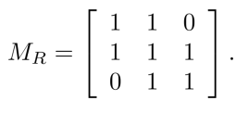
Matrices of Relations on Sets
Suppose that the relation R on a set is represented by the matrix
Is R reflexive, symmetric, and/or antisymmetric?
Solution:
Because all the diagonal elements are equal to 1, R is reflexive.
Because MR is symmetric, R is symmetric and not antisymmetric because both m1,2 and m2,1 are 1.

Slide 20
REPRESENTING RELATIONS USING Directed Graph (Digraph)
A directed graph (or digraph) has:
A set of vertices (points or nodes) called V.
A set of edges (arrows) called E.
Each edge is an ordered pair like (a, b), meaning an arrow from a to b.
The vertex a is the start (initial vertex) of the arrow.
The vertex b is the end (terminal vertex) of the arrow.
If an edge goes from a vertex back to itself, like (a, a), it’s called a loop.
In short:
Vertices = points
Edges = arrows between points
Loop = arrow that starts and ends at the same point

Slide 21
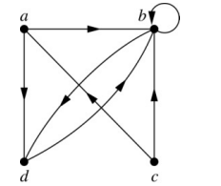
REPRESENTING RELATIONS USING Directed Graph (Digraph)
A drawing of the directed graph with
vertices a, b, c, and d, and
edges (a, b), (a, d), (b, b), (b, d), (c, a), (c, b), (d, b) is shown here.

Slide 22
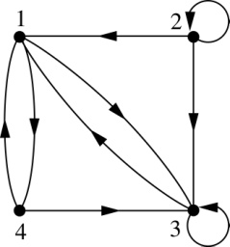
REPRESENTING RELATIONS USING Directed Graph (Digraph)
Example : What are the ordered pairs in the relation represented by this directed graph?
Solution: The ordered pairs in the relation are
(1, 3), (1, 4), (2, 1), (2, 2), (2, 3), (3, 1), (3, 3), (4, 1), and (4, 3)

Slide 23
Determining which Properties a Relation has from its Digraph
1. Reflexive: Every vertex must have a loop.
That means:
For every element x
The pair (x, x) must exist
In the graph: Every vertex must have a small circle (loop) on itself.
If even one vertex does not have a loop, Then it is NOT reflexive.
2. Symmetric
If there is an arrow from x to y, there must also be an arrow from y to x.
So If (x, y) exists, then (y, x) must also exist.
In the graph: Every arrow must have a matching arrow going back.
Example: x → y y → x
If one direction is missing, Then it is NOT symmetric.
3. Antisymmetric
If x → y exists (and x ≠ y), then y → x must NOT exist.
So you cannot have arrows both ways
between two different vertices.
If you see: x → y and y → x
and x ≠ y, then it is NOT antisymmetric.
4. Transitive: This means:
If you can go from x → y and from y → z then you must also be able to go from x → z.
So if: x → y y → z
Then (x → z) must also be present.
If that direct arrow is missing Then it is NOT transitive.

Slide 24
DIRECTED GRAPH OF A REFLEXIVE RELATION
The directed graph of every reflexive relation includes an arrow from every point to the point itself (i.e., a loop).
EXAMPLE Q
Let A = {1, 2, 3, 4} and define relations R₁, A by
R₁ = {(1, 1), (3, 3), (2, 2), (4, 4)}
R₂ = {(1, 1), (1, 4), (2, 2), (3, 3), (4, 3)}
R₃ = {(1, 1), (1, 2), (2, 1), (2, 2), (3, 3), (4, 4)}
R₄ = {(1, 4), (2, 2), (2, 3), (4, 1), (3, 3)}
Then their directed graphs are:
R₂, R₃, and R₄ on

Slide 25
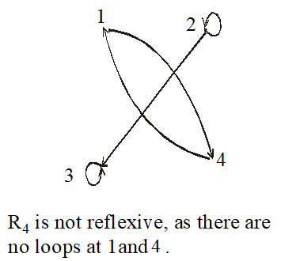

1
2
1
2
4 3
R₁ is reflexive because at every point of the set A we have a loop in the graph.
4 3
R₂ is not reflexive, as there is no loop at 4.
1
2
1
2
4
3
4
3
R₄ is not reflexive, as there are
R₃ is reflexive
no loops at 1and 3.

Slide 26
GRAPH OF A SYMMETRIC RELATION
For a symmetric directed graph whenever there is an arrow going from one point of the graph to a second, there is an arrow going from the second point back to the first.
EXAMPLE S
Let A = {1, 2, 3, 4} and define relations R₁, R₂, R₃, and R₄on A by the directed graphs:
R₁ = {(1, 1), (1, 3), (2, 4), (3, 1), (4,2)}
R₂ = {(1, 1), (2, 2), (3, 3), (4, 4)}
R₃ = {(2, 2), (2, 3), (3, 4)}
R₄= {(1, 1), (2, 2), (3, 3), (4, 3), (4, 4)}

Slide 27







2
1
1
2
4
4
R₂ is symmetric Because reversing any pair gives the same pair, which is already in the relation.
3
3
R₁ is symmetric
1
1
2
2
4
3
4 3
R₄ is not symmetric since there is an arrow from 4 to 3 but no arrow from 3 to 4 But R4 is antisymmetric.
R₃ is not symmetric since there are arrows from 2 to 3 and from 3 to 4 but not conversely But R3 is antisymmetric.

Slide 28
DIRECTED GRAPH OF A TRANSITIVE RELATION
For a transitive directed graph, whenever there is an arrow going from one point to the second, and from the second to the third, there is an arrow going directly from the first to the third.
EXAMPLE W
Let A = {1, 2, 3, 4} and define relations R₁, R₂ and R₃ on A by the directed graphs:
R₁ = {(1, 1), (1, 2), (1, 3), (2, 3)}
R₂ = {(1, 2), (1, 4), (2, 3), (4, 3)}
R₃ = {(2, 1), (2, 4), (2, 3), (4,3)}

Slide 29
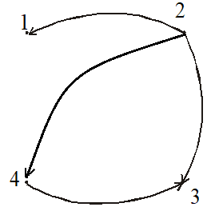
1
1
2
2
4
4
3
3
R₁ is transitive
R₂ is not transitive since there is an arrow from 1 to 2 and from 2
to 3 but no arrow from 1 to 3 directly
2
1
4
3
R₃ is transitive

Slide 30
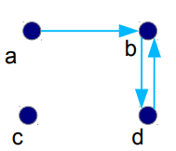
Determining which Properties a Relation has from its Digraph
• Reflexive? No, there are no loops
• Symmetric? No, there is an edge from a to b, but not from b to a
• Antisymmetric? No, there is an edge from d to b and b to d
● Transitive? No, there are edges from a to b and from b to d, but there is no edge from a to d

Slide 31
Composition
Composition means linking two relations through a common middle element.
Let R₁ connect set A to set B.
Let R₂ connect set B to set C.
To form the composition R₂ ∘ R₁ (read: “R₂ after R₁”):
If R₁ connects x to y,
And R₂ connects y to z,
Then the composition connects x to z.
Match the middle element (y), & connect the first to the last.
Let the sets be:
A = {1, 2}, B = {a, b}, C = {X, Y}
R₁ = { (1, a), (2, b) }
R₂ = { (a, X), (b, Y) }
(R₂ ∘ R₁)= { (1, X), (2, Y) }

Slide 32

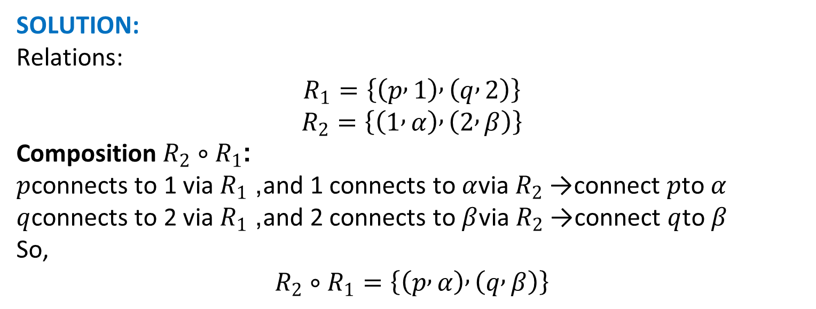
Composition
Let
$$A=\left\{p , q\right\}$$
$$B=\left\{1 , 2\right\}$$
$$C=\left\{α , β\right\}$$
SOLUTION:
Relations:
$$R_{1}=\left\{\left(p , 1\right) , \left(q , 2\right)\right\}$$
$$R_{2}=\left\{\left(1 , α\right) , \left(2 , β\right)\right\}$$
Composition $R_{2}∘R_{1}$:
$p$connects to 1 via $R_{1}$, and 1 connects to $α$via $R_{2}$→ connect $p$to $α$
$q$connects to 2 via $R_{1}$, and 2 connects to $β$via $R_{2}$→ connect $q$to $β$
So,
$$R_{2}∘R_{1}=\left\{\left(p , α\right) , \left(q , β\right)\right\}$$

Slide 33
Power of a Relation
Powers of a relation mean applying the same relation again and again.
Let R be a binary relation on A. Then the powers R^{n} of the relation R can be defined inductively by:
Basis Step: R¹ = R
(The first power is just the relation itself)
Inductive Step: R^{n+1} = R^{n} ∘ R means
R^2=R∘R
𝑅^3=𝑅^2∘𝑅 𝑅^4=𝑅^3∘𝑅
Each time:
Take previous result
Apply relation again

Slide 34
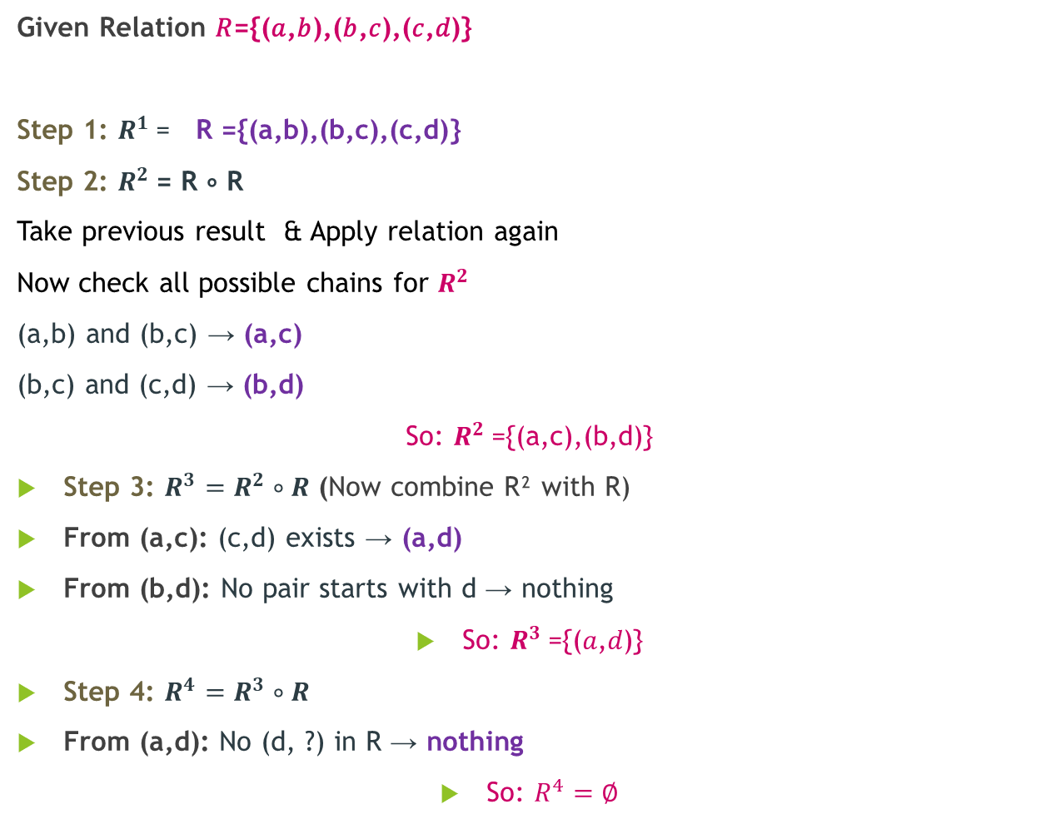
Power-Example
Given Relation 𝑅={(𝑎,𝑏),(𝑏,𝑐),(𝑐,𝑑)}
Step 1: $R^{1}$= R ={(a,b),(b,c),(c,d)}
Step 2: $R^{2}$= R ∘ R
Take previous result & Apply relation again
Now check all possible chains for $R^{2}$
(a,b) and (b,c) → (a,c)
(b,c) and (c,d) → (b,d)
So: $R^{2}$={(a,c),(b,d)}
Step 3: $R^{3}=R^{2}∘R$ (Now combine R² with R)
From (a,c): (c,d) exists → (a,d)
From (b,d): No pair starts with d → nothing
So: $R^{3}$={(𝑎,𝑑)}
Step 4: $R^{4}=R^{3}∘R$
From (a,d): No (d, ?) in R → nothing
So: $R^{4}=∅$

Slide 35

Power-Example
Find R, R², R³, R⁴, $R^{5}$ if
R={(1,2),(2,3),(3,4),(4,5)}

Slide 36
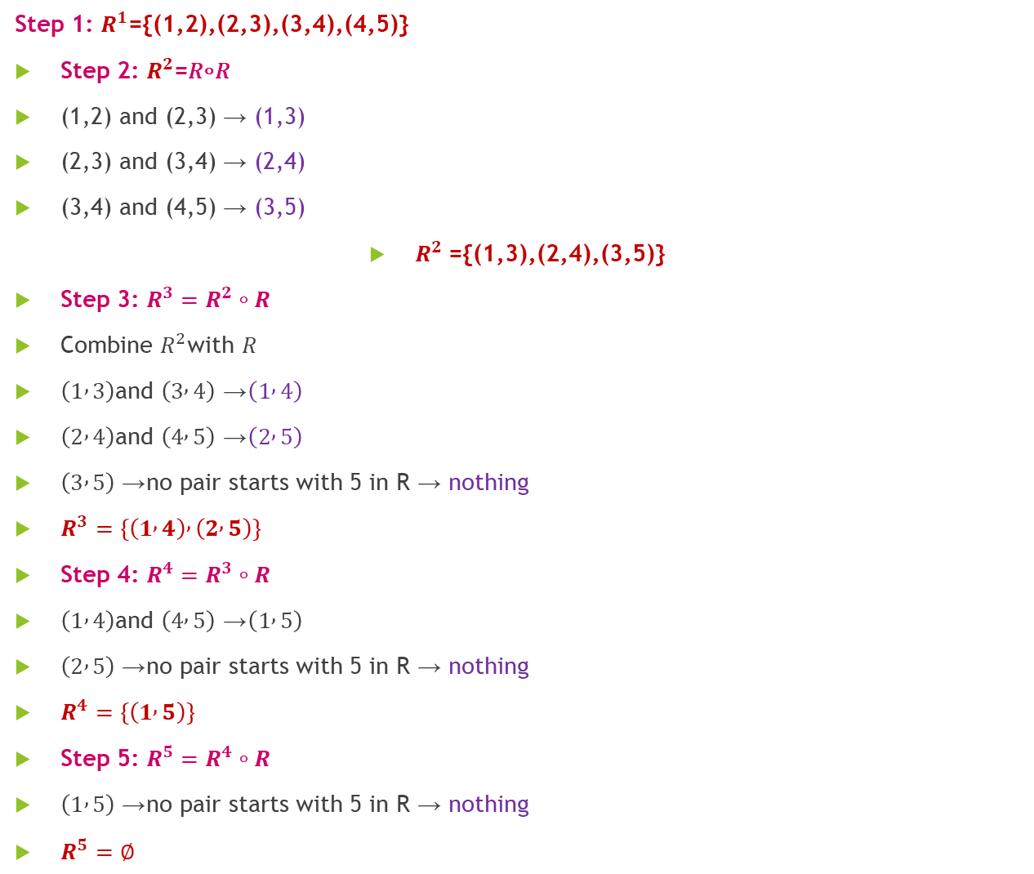
Step 1: $R^{1}$={(1,2),(2,3),(3,4),(4,5)}
Step 2: $R^{2}$=𝑅∘𝑅
(1,2) and (2,3) → (1,3)
(2,3) and (3,4) → (2,4)
(3,4) and (4,5) → (3,5)
$R^{2}$={(1,3),(2,4),(3,5)}
Step 3: $R^{3}=R^{2}∘R$
Combine $R^{2}$with $R$
$\left(1 , 3\right)$and $\left(3 , 4\right)$→ $\left(1 , 4\right)$
$\left(2 , 4\right)$and $\left(4 , 5\right)$→ $\left(2 , 5\right)$
$\left(3 , 5\right)$→ no pair starts with 5 in R → nothing
$R^{3}=\left\{\left(1 , 4\right) , \left(2 , 5\right)\right\}$
Step 4: $R^{4}=R^{3}∘R$
$\left(1 , 4\right)$and $\left(4 , 5\right)$→ $\left(1 , 5\right)$
$\left(2 , 5\right)$→ no pair starts with 5 in R → nothing
$R^{4}=\left\{\left(1 , 5\right)\right\}$
Step 5: $R^{5}=R^{4}∘R$
$\left(1 , 5\right)$→ no pair starts with 5 in R → nothing
$R^{5}=∅$

Slide 37
Equivalence Relations
Section 9.5

Slide 38
Equivalence Relations
A relation is called an equivalence relation if it has all these 3 properties:
Reflexive → every element relates to itself
Symmetric → if a relates to b, then b relates to a
Transitive → if a→b and b→c, then a→c
The notation a ∼ b is used to denote that a and b are equivalent

Slide 39
Strings (Length of words)
Equivalence: Two strings are related if they have same length
Example:
"cat" and "dog" → related (length 3)
"hi" and "no" → related (length 2)
"abc" ∼ "xyz" ∼ "def“→ related (length 3)
Check properties:
✔ Reflexive: Every string has same length as itself
✔ Symmetric: If a and b same length → b and a also same
✔ Transitive: If a and b same length, b and c same → a and c same

Slide 40
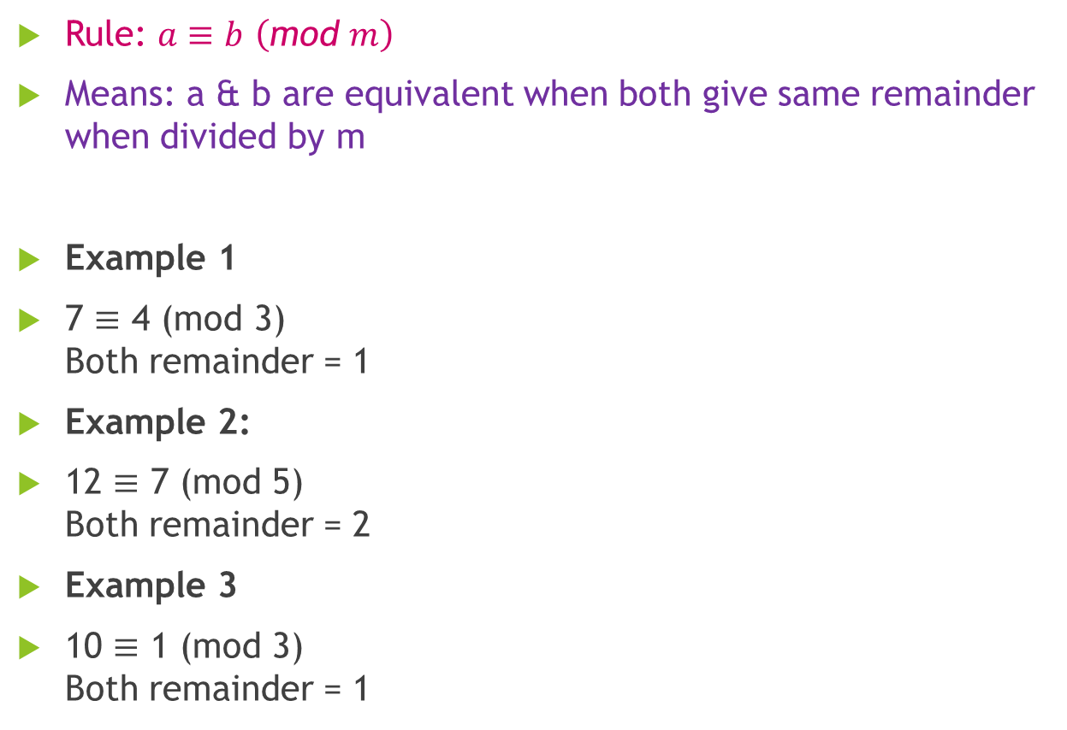
Congruence Modulo m
Rule: $a≡b \left(\text{mod} m\right)$
Means: a & b are equivalent when both give same remainder when divided by m
Example 1
7 ≡ 4 (mod 3) Both remainder = 1
Example 2:
12 ≡ 7 (mod 5) Both remainder = 2
Example 3
10 ≡ 1 (mod 3) Both remainder = 1
Check properties:
✔ Reflexive:
a ≡ a
✔ Symmetric:
if a ≡ b → b ≡ a
✔ Transitive:
if a ≡ b and b ≡ c → a ≡ c

Slide 41
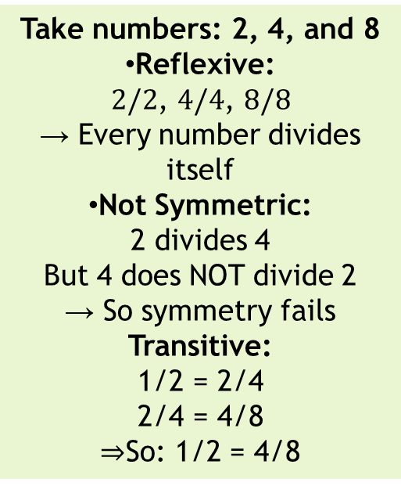
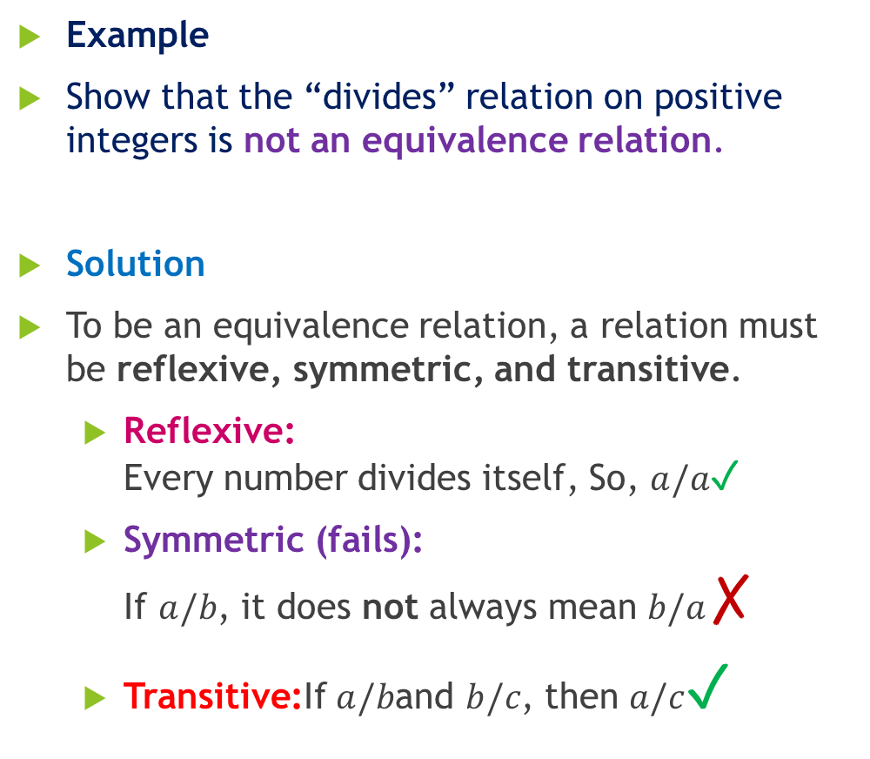
Divides
Example
Show that the “divides” relation on positive integers is not an equivalence relation.
Solution
To be an equivalence relation, a relation must be reflexive, symmetric, and transitive.
Reflexive: Every number divides itself, So, $a/a$✓
Symmetric (fails): If $a/b$, it does not always mean $b/a$✗
Transitive:If $a/b$and $b/c$, then $a/c$✓
Take numbers: 2, 4, and 8
Reflexive: $2/2$, $4/4$, $8/8$ → Every number divides itself
Not Symmetric: 2 divides 4 But 4 does NOT divide 2 → So symmetry fails
Transitive: 1/2 = 2/4 2/4 = 4/8 ⇒So: 1/2 = 4/8

Slide 42
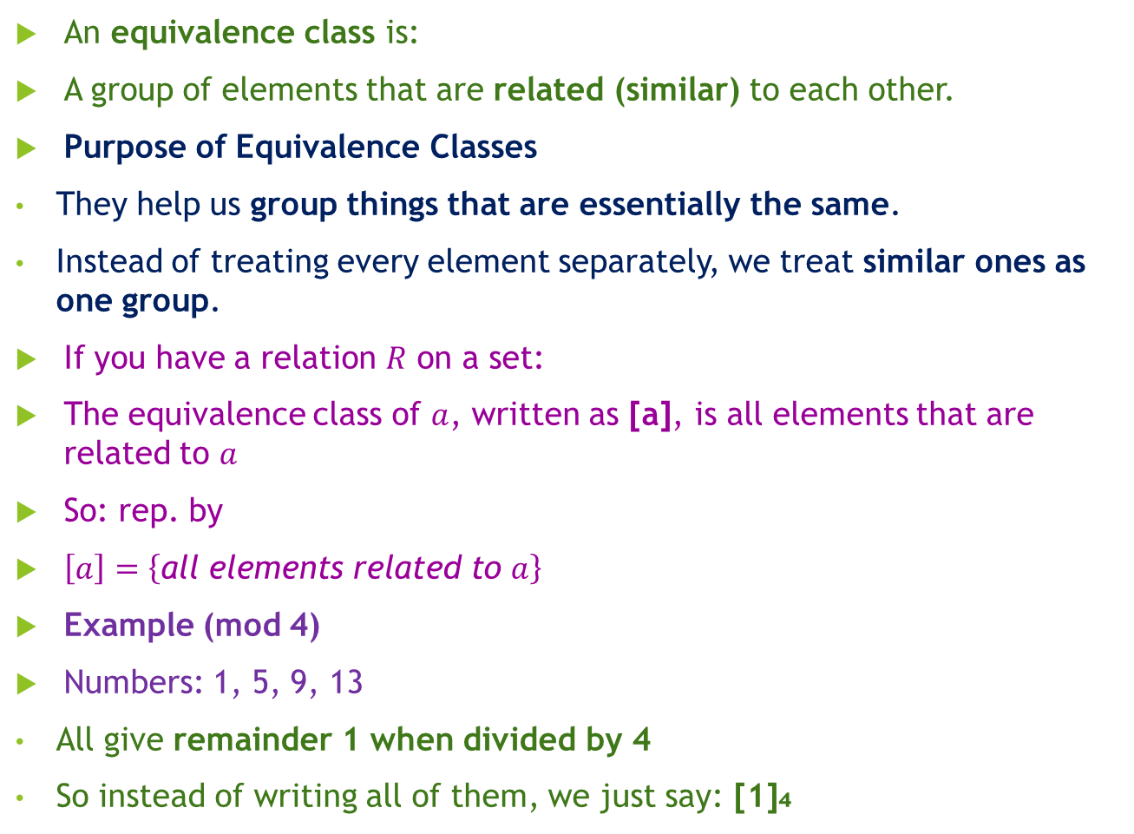
Equivalence Classes
An equivalence class is:
A group of elements that are related (similar) to each other.
Purpose of Equivalence Classes
They help us group things that are essentially the same.
Instead of treating every element separately, we treat similar ones as one group.
If you have a relation $R$ on a set:
The equivalence class of $a$, written as [a], is all elements that are related to $a$
So: rep. by
$\left[a\right]=\left\{\text{all} \text{elements} \text{related} \text{to} a\right\}$
Example (mod 4)
Numbers: 1, 5, 9, 13
All give remainder 1 when divided by 4
So instead of writing all of them, we just say: [1]₄

Slide 43
Equivalence Classes
Group 1: [0]₄ (Numbers with remainder 0)
[0]₄ = {…, −8, −4 , 0, 4 , 8 , …}
Group 2: [1]₄ (Numbers with remainder 1)
[1]₄ = {…, −7, −3 , 1, 5 , 9 , …}
Group 3: [2]₄
[2]₄ = {…, −6, −2 , 2, 6 , 10 , …}
Group 4: [3]₄
[3]₄ = {…, −5, −1 , 3, 7 , 11 , …}
Notes:
2 ÷ 4 = 0 remainder 2
6 ÷ 4 = 1 remainder 2
10 ÷ 4 = 2 remainder 2
Now negatives:
−2 ÷ 4 = −1 remainder 2
−6 ÷ 4 = −2 remainder 2

Slide 44
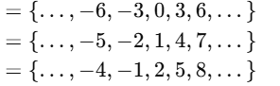
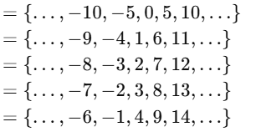
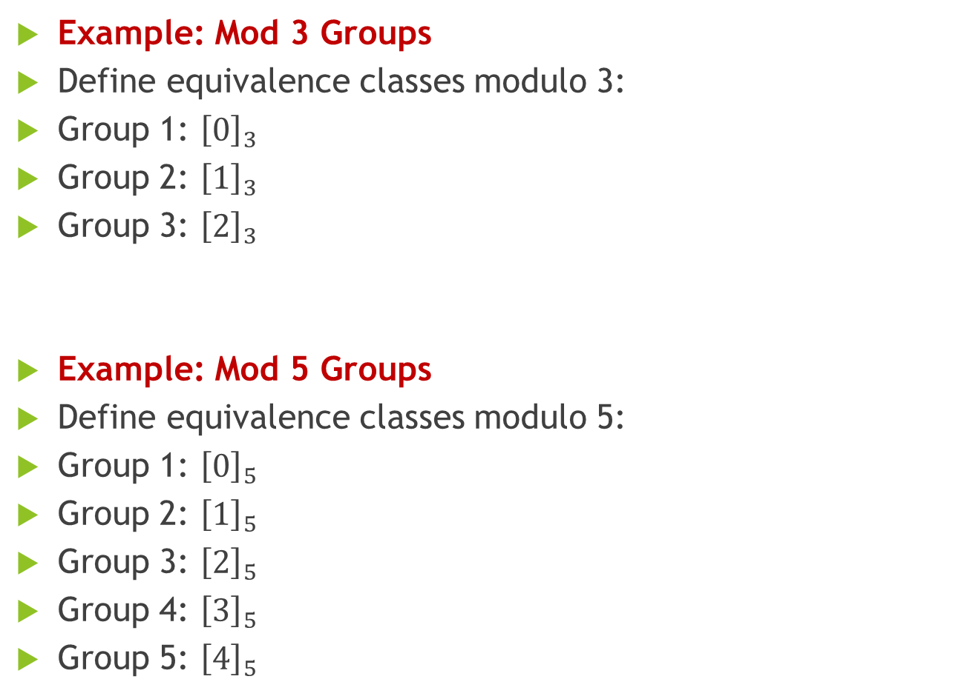
Equivalence Classes
Example: Mod 3 Groups
Define equivalence classes modulo 3:
Group 1: ${\left[0\right]}_{3}$
Group 2: ${\left[1\right]}_{3}$
Group 3: ${\left[2\right]}_{3}$
Example: Mod 5 Groups
Define equivalence classes modulo 5:
Group 1: ${\left[0\right]}_{5}$
Group 2: ${\left[1\right]}_{5}$
Group 3: ${\left[2\right]}_{5}$
Group 4: ${\left[3\right]}_{5}$
Group 5: ${\left[4\right]}_{5}$
Notes:
2 ÷ 4 = 0 remainder 2
6 ÷ 4 = 1 remainder 2
10 ÷ 4 = 2 remainder 2
Now negatives:
−2 ÷ 4 = −1 remainder 2
−6 ÷ 4 = −2 remainder 2

Slide 45
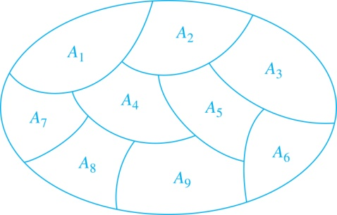
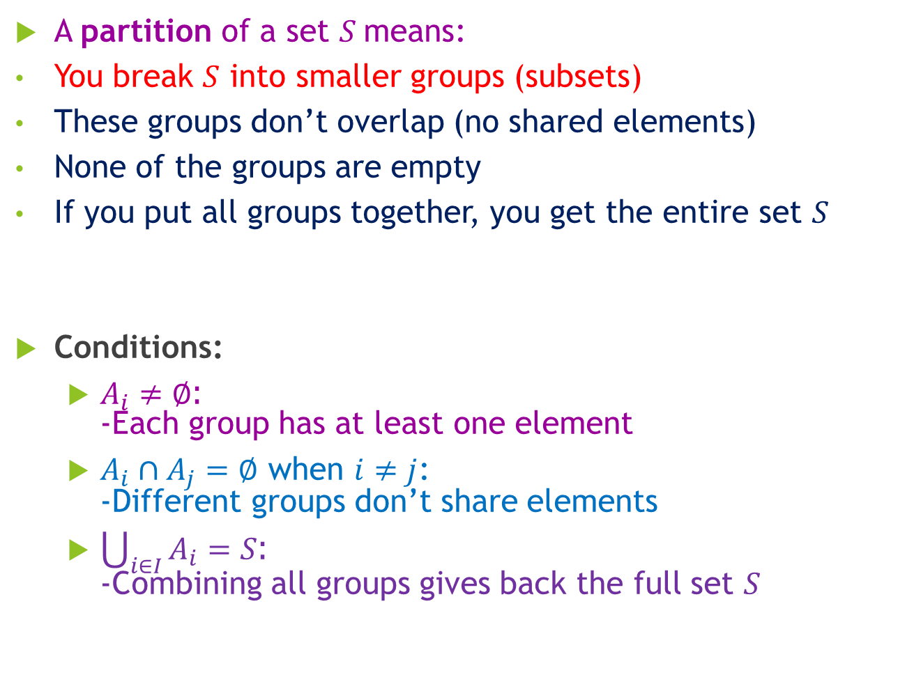
Partition of a Set
A partition of a set $S$means:
You break $S$ into smaller groups (subsets)
These groups don’t overlap (no shared elements)
None of the groups are empty
If you put all groups together, you get the entire set $S$
Conditions:
$A_{i}≠∅$: -Each group has at least one element
$A_{i}∩A_{j}=∅$ when $i≠j$: -Different groups don’t share elements
$\bigcup_{i∈I}{A_{i}}=S$: -Combining all groups gives back the full set $S$
Notes:
Let: $I=\left\{1 , 2 , 3\right\}, { A}_{1}=\left\{1 , 2\right\}, A_{2}=\left\{3\right\}, A_{3}=\left\{4 , 5\right\}$
Then:
$$\bigcup_{i∈I}{A_{i}}=A_{1}∪A_{2}∪A_{3}=\left\{1 , 2 , 3 , 4 , 5\right\}$$

Slide 46
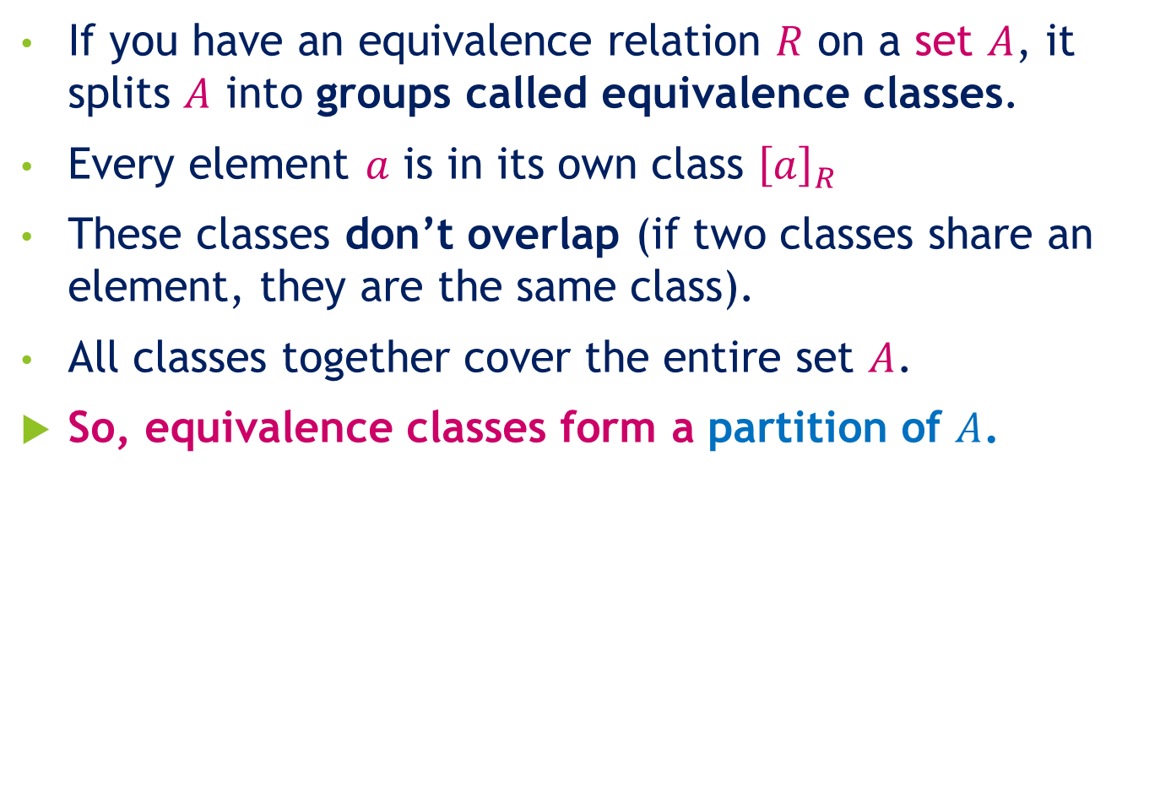
Equivalence Relation Creates a Partition
If you have an equivalence relation $R$ on a set $A$, it splits $A$ into groups called equivalence classes.
Every element $a$ is in its own class ${\left[a\right]}_{R}$
These classes don’t overlap (if two classes share an element, they are the same class).
All classes together cover the entire set $A$.
So, equivalence classes form a partition of $A$.

Slide 47
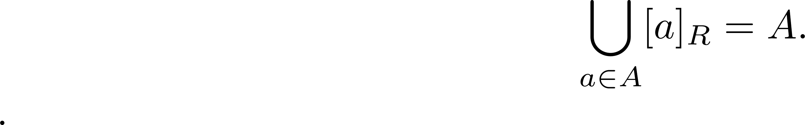
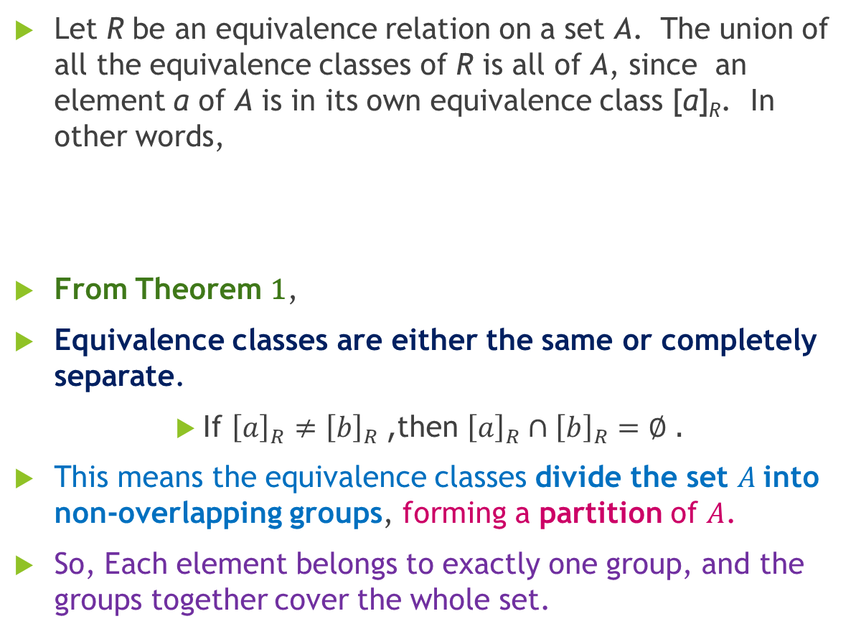
An Equivalence Relation- Partitions a Set
Let R be an equivalence relation on a set A. The union of all the equivalence classes of R is all of A, since an element a of A is in its own equivalence class [a]_{R}. In other words,
From Theorem 1,
Equivalence classes are either the same or completely separate.
If ${\left[a\right]}_{R}≠{\left[b\right]}_{R}$, then ${\left[a\right]}_{R}∩{\left[b\right]}_{R}=∅$.
This means the equivalence classes divide the set $A$into non-overlapping groups, forming a partition of $A$.
So, Each element belongs to exactly one group, and the groups together cover the whole set.

Slide 48

An Equivalence Relation Partitions a Set
Theorem 2:
Equivalence relation → partition: If R is an equivalence relation on a set S, then its equivalence classes split S into separate groups (a partition).
Partition → equivalence relation: If you have a partition of S (groups that don’t overlap and cover the set), you can define a relation R where two elements are related if they are in the same group. This relation is an equivalence relation.
Proof Idea
Step 1: Reflexive Every element is in the same group as itself → (a,a)$∈R$.
Step 2: Symmetric If $a$and $b$are in the same group → $b$and $a$are also in the same group → (b,a)$∈R$.
Step 3: Transitive If $a$and $b$are in the same group, and $b$and $c$ are in the same group → all three must be in the same group → (a,c)$∈R$.
So, the relation satisfies reflexive, symmetric, transitive, which makes it an equivalence relation.

Slide 49
An Equivalence Relation Partitions a Set
Let S = {1, 2, 3, 4, 5, 6}
Equivalence class: “numbers have the same remainder when divided by 2”
Step 1: Make groups (partition)
Even numbers → {2, 4, 6}
Odd numbers → {1, 3, 5}
These are non-overlapping groups and cover all elements. So, this is a partition
Step 2: Make relation from groups {Every group element can relate itself}
“a is related to b if they are in the same group”
Examples:
2 ~ 4 (both even)
1 ~ 5 (both odd)
2 ~ 3 (different groups)
Step 3: Check properties
Reflexive: 2 ~ 2 (2 is even, and 2 is even → same type)
Symmetric: if 2 ~ 4 → 4 ~ 2 (2 and 4 are both even → same group, order doesn’t matter)
Transitive: if 2 ~ 4 and 4 ~ 6 → 2 ~ 6 (2, 4, 6 are all even, so 2 and 6 are also related)

Slide 50
Partial Orderings
Section 9.6

Slide 51
Partial Ordering
A partial order is a way to organize things when:
some elements can be compared & some cannot
JUST LIKE
Total Order (everything comparable):
Heights of students → 170cm > 160cm
Numbers → 5 > 3
Ages → 20 > 18
Partial Order (not always comparable):
Skills → Math vs English
Subjects difficulty → Programming vs History
Tasks → “Study” vs “Exercise” (no fixed order)
A partial order is just a relation that follows 3 rules:
✔ Reflexive
✔ Antisymmetric
✔ Transitive
If a relation has these 3 properties, we call it a partial ordering

Slide 52
Partial Ordering
Example 1: Show that the “greater than or equal” relation (≥) is a partial ordering on the set of integers.
Reflexivity: a ≥ a for every integer a.
Antisymmetry: If a ≥ b and b ≥ a , then a = b.
Transitivity: If a ≥ b and b ≥ c , then a ≥ c.

Slide 53
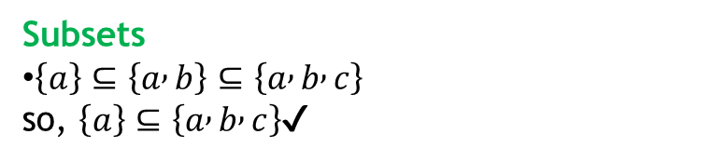
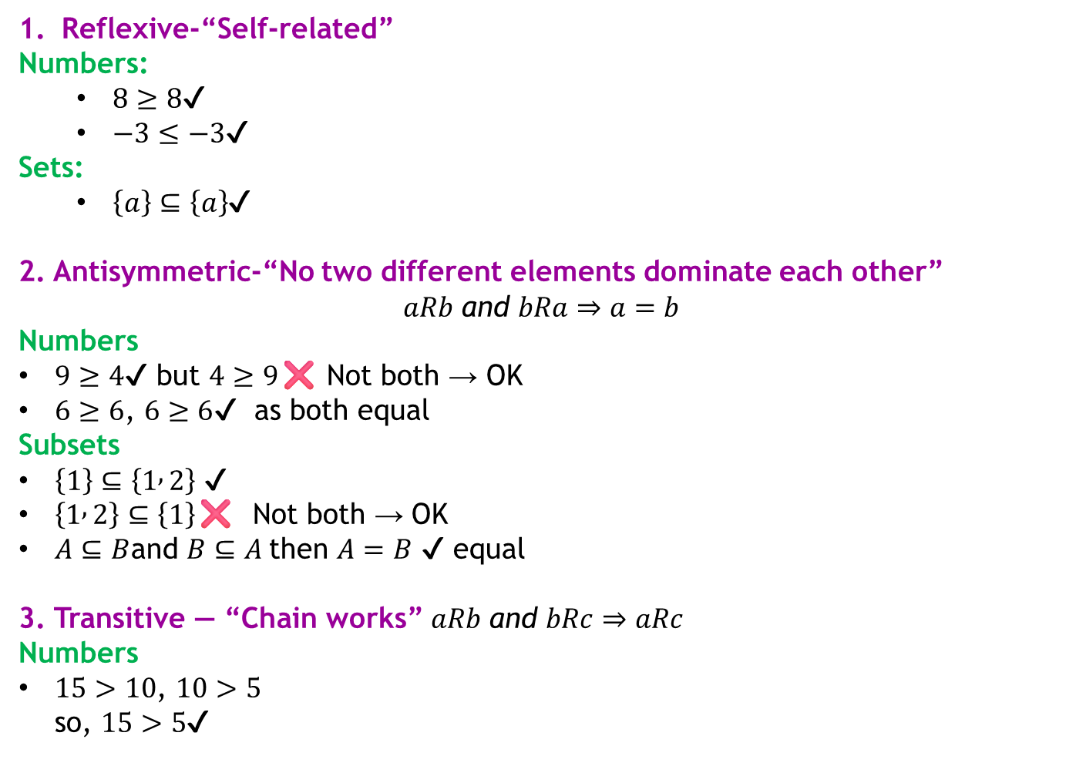
Partial Ordering
Reflexive-“Self-related”
Numbers:
$8≥8$✔
$−3≤−3$✔
Sets:
$\left\{a\right\}⊆\left\{a\right\}$✔
2. Antisymmetric-“No two different elements dominate each other”
$$aRb \text{and} bRa⇒a=b$$
Numbers
$9≥4$✔ but $4≥9$❌ Not both → OK
$6≥6$, $6≥6$✔ as both equal
Subsets
$\left\{1\right\}⊆\left\{1 , 2\right\}$✔
$\left\{1 , 2\right\}⊆\left\{1\right\}$❌ Not both → OK
$A⊆B$and $B⊆A$then $A=B$ ✔ equal
3. Transitive — “Chain works” $aRb \text{and} bRc⇒aRc$
Numbers
$15>10$, $10>5$ so, $15>5$✔
Subsets
$\left\{a\right\}⊆\left\{a , b\right\}⊆\left\{a , b , c\right\}$ so, $\left\{a\right\}⊆\left\{a , b , c\right\}$✔

Slide 54
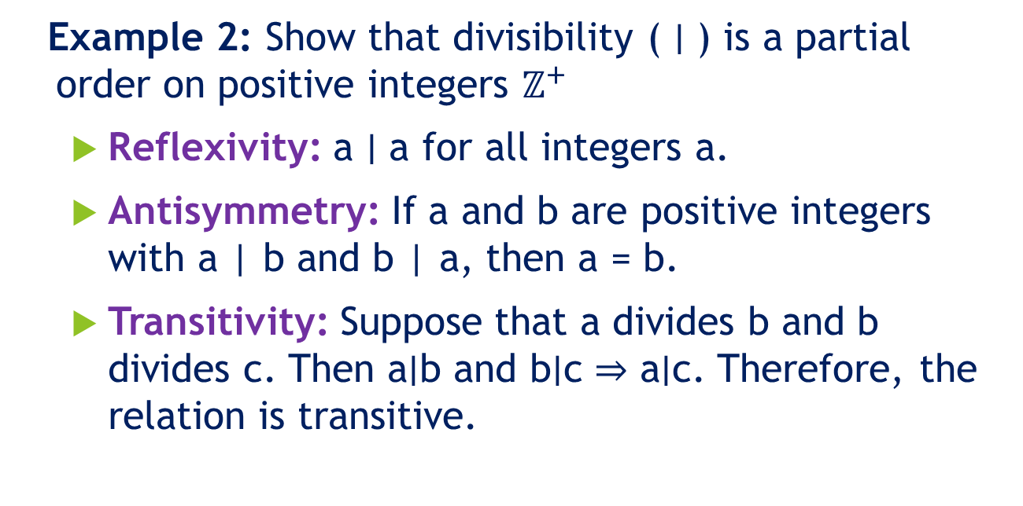
Partial Orderings (continued)
Example 2: Show that divisibility ( ∣ ) is a partial order on positive integers $ℤ^{+}$
Reflexivity: a ∣ a for all integers a.
Antisymmetry: If a and b are positive integers with a | b and b | a, then a = b.
Transitivity: Suppose that a divides b and b divides c. Then a∣b and b∣c ⇒ a∣c. Therefore, the relation is transitive.

Slide 55
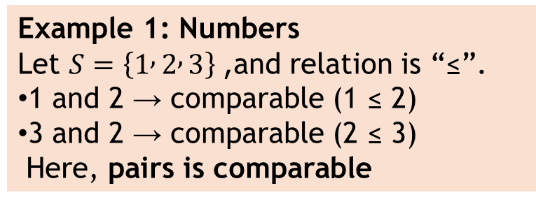

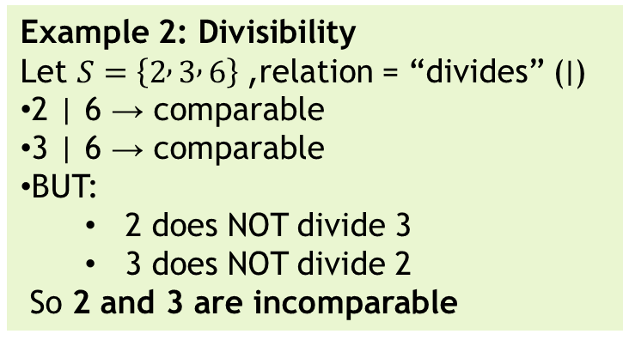
Comparability
The symbol ≼ is used to denote it.
Two elements a and b are comparable if:
either a comes before b → $a⪯b$
or b comes before a → $b⪯a$
If neither is true, they are incomparable.
Example 1: Numbers
Let $S=\left\{1 , 2 , 3\right\}$, and relation is “≤”.
1 and 2 → comparable (1 ≤ 2)
3 and 2 → comparable (2 ≤ 3)
Here, pairs is comparable
Example 2: Divisibility
Let $S=\left\{2 , 3 , 6\right\}$, relation = “divides” ($∣$)
2 | 6 → comparable
3 | 6 → comparable
BUT:
2 does NOT divide 3
3 does NOT divide 2
So 2 and 3 are incomparable
This is the key idea: Not all elements can always be compared! It’s a pair property

Slide 56
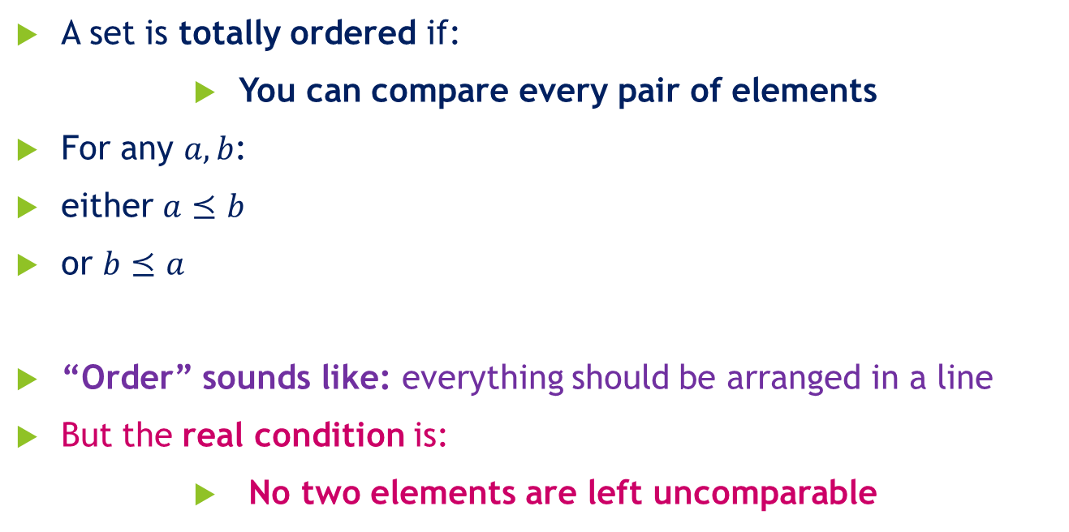
Totally Ordered Set
A set is totally ordered if:
You can compare every pair of elements
For any $a,b$:
either $a⪯b$
or $b⪯a$
“Order” sounds like: everything should be arranged in a line
But the real condition is:
No two elements are left uncomparable

Slide 57
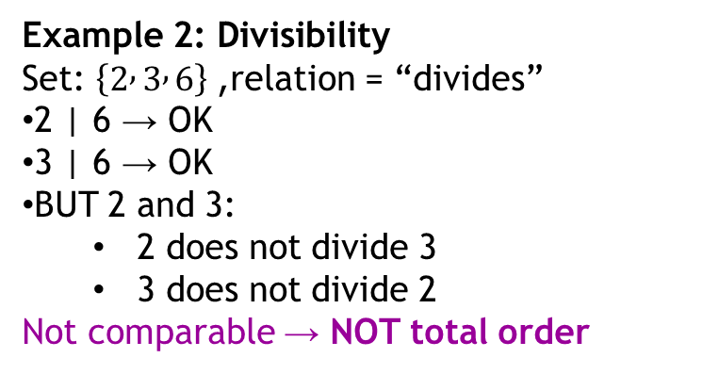
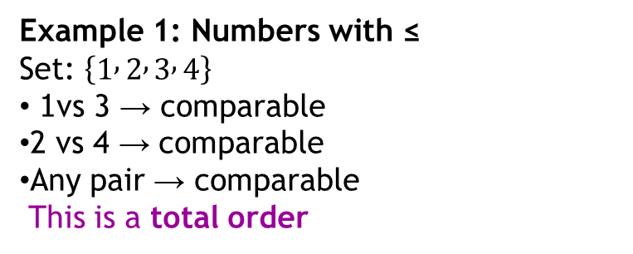
Totally Ordered Set
Example 1: Numbers with ≤
Set: $\left\{1 , 2 , 3 , 4\right\}$
1 vs 3 → comparable
2 vs 4 → comparable
Any pair → comparable
This is a total order
Total order = every pair can be compared
Example 2: Divisibility
Set: $\left\{2 , 3 , 6\right\}$, relation = “divides”
2 | 6 → OK
3 | 6 → OK
BUT 2 and 3:
2 does not divide 3
3 does not divide 2
Not comparable → NOT total order

Slide 58
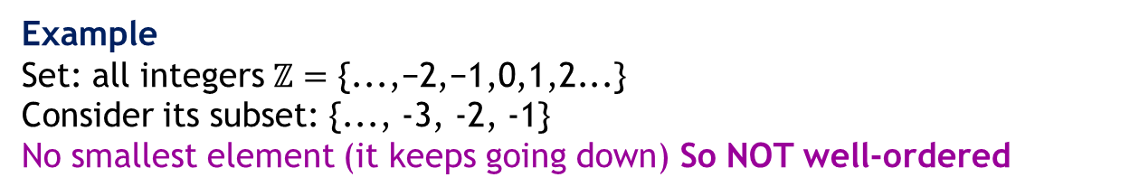
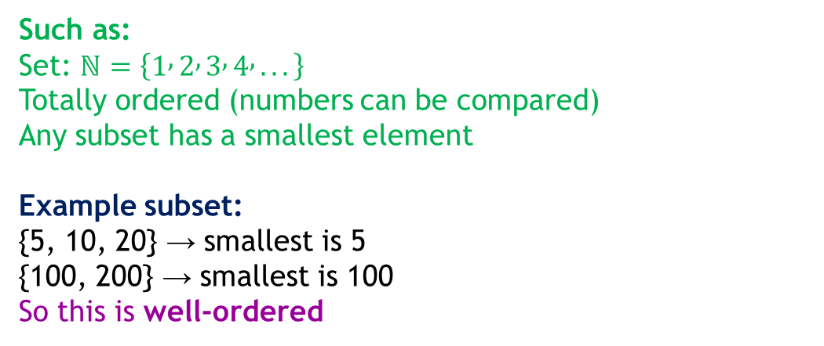
Well Ordered Set
A set is well-ordered if:
It is totally ordered
Every non-empty subset has a smallest element
Such as:
Set: $ℕ=\left\{1 , 2 , 3 , 4 , ...\right\}$
Totally ordered (numbers can be compared)
Any subset has a smallest element
Example subset:
{5, 10, 20} → smallest is 5
{100, 200} → smallest is 100
So this is well-ordered
Example
Set: all integers $ℤ=\text{\{...,}\text{−}\text{2}\text{,}\text{−}\text{1,0,1,2}\text{...}\text{\}}$
Consider its subset: {..., -3, -2, -1}
No smallest element (it keeps going down) So NOT well-ordered

Slide 59
Lexicographic Set
Lexicographic order is a way to arrange words or strings in the same way a dictionary does.
How it works
Compare two words letter by letter from left to right
The first different letter decides the order
If one word ends first, the shorter word comes first
Examples
apple < banana (a comes before b)
apple < apricot (a = a, p = p, p < r)
app < apple (app is part of apple → shorter comes first)
car < cat (r comes before t)

Slide 60
Lexicographic Set
Important point (When numbers are treated as strings, they are compared like words:)
Numbers treated as strings are different:
Lexicographic order: "10" < "2" (because '1' < '2')
Numerical order: 2 < 10
Example: ["1", "2", "10", "20"]
Lexicographic sort:
Compare as strings:
"1"
"10"
"2"
"20"
Order becomes:[1,10,2,20]
Not correct: Numerical sort [1,2,10,20]

Slide 61
Lexicographic Set
Sort using Lexicographic Order (NUMBERS)
"1"
"10"
"2"
"20"
"3"
"11"
"12"
Sort using Lexicographic Order (STRINGS)
"zebra"
"apple"
"banana"
"car"
"apricot"
"dog"
"ant"
"bat"
"cat"
"ball"

Slide 62
Hasse Diagrams
A Hasse diagram is a simple picture of a partial order that removes extra unnecessary edges.
It does NOT show:
self-loops (because of reflexive property)
indirect edges (because of transitive property)
It only shows the important direct connections.

Slide 63
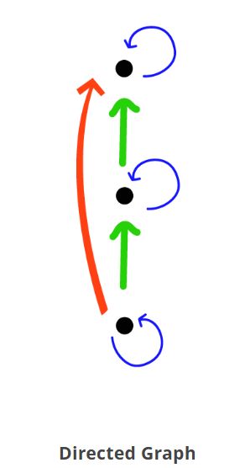
Hasse Diagrams
To construct a Hasse diagram, we follow these four steps:
Step 1
Create a directed graph from the relation.

Slide 64

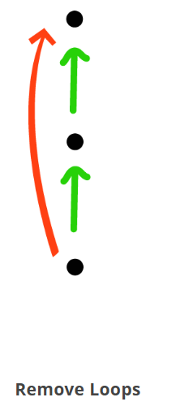

Step 3
Remove all transitivity.
Step 4
Remove directed arrows.
Step 2
Remove all self-loops.

Slide 65
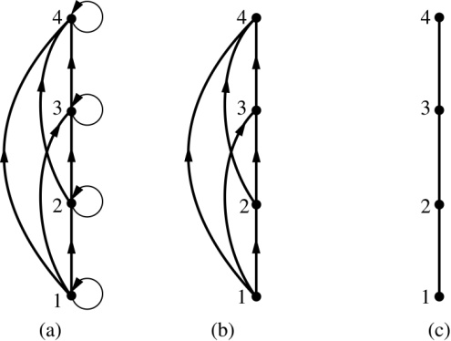
Hasse Diagrams
STEPS
Draw all relations
Remove self-loops (a → a)
Remove indirect (transitive) edges
Place smaller elements below larger ones
Remove arrows (assume upward direction)

Slide 66
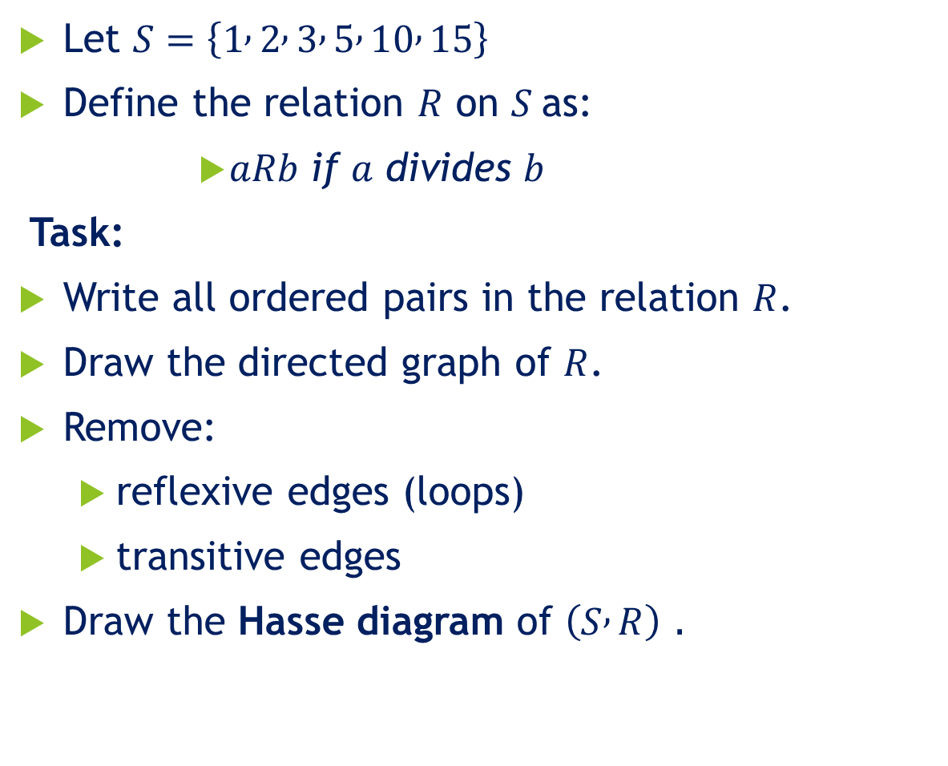
Hasse Diagrams
Let $S=\left\{1 , 2 , 3 , 5 , 10 , 15\right\}$
Define the relation $R$ on $S$as:
$aRb \text{if} a \text{divides} b$
Task:
Write all ordered pairs in the relation $R$.
Draw the directed graph of $R$.
Remove:
reflexive edges (loops)
transitive edges
Draw the Hasse diagram of $\left(S , R\right)$.

Slide 67
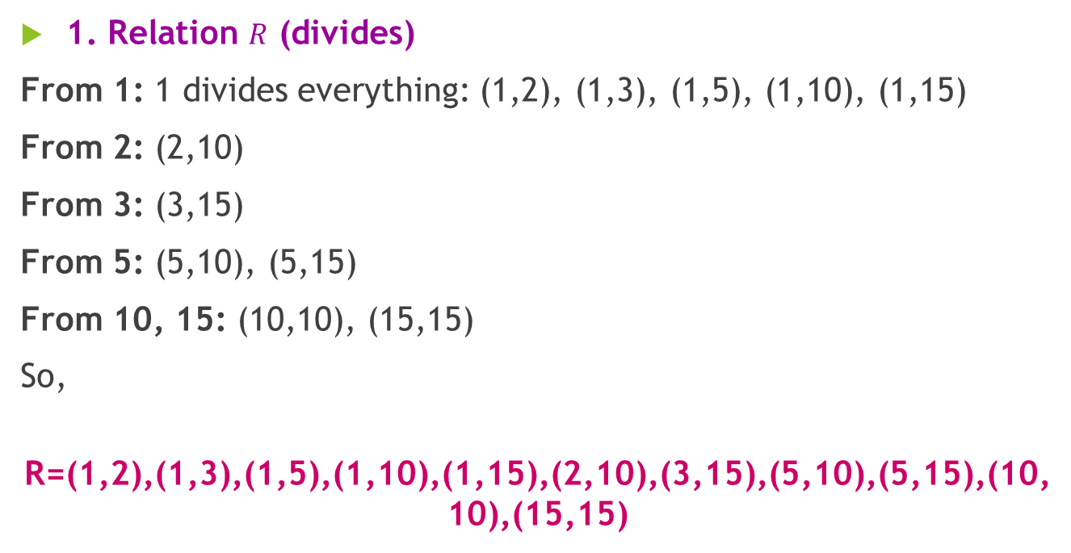
Hasse Diagrams
1. Relation $R$ (divides)
From 1: 1 divides everything: (1,2), (1,3), (1,5), (1,10), (1,15)
From 2: (2,10)
From 3: (3,15)
From 5: (5,10), (5,15)
From 10, 15: (10,10), (15,15)
So,
R=(1,2),(1,3),(1,5),(1,10),(1,15),(2,10),(3,15),(5,10),(5,15),(10,10),(15,15)

Slide 68
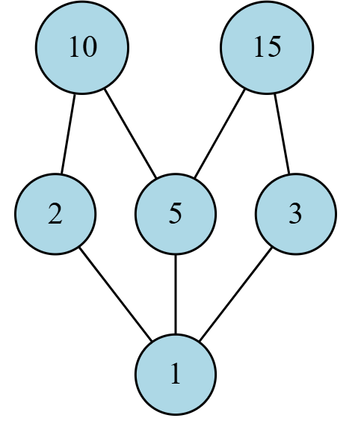
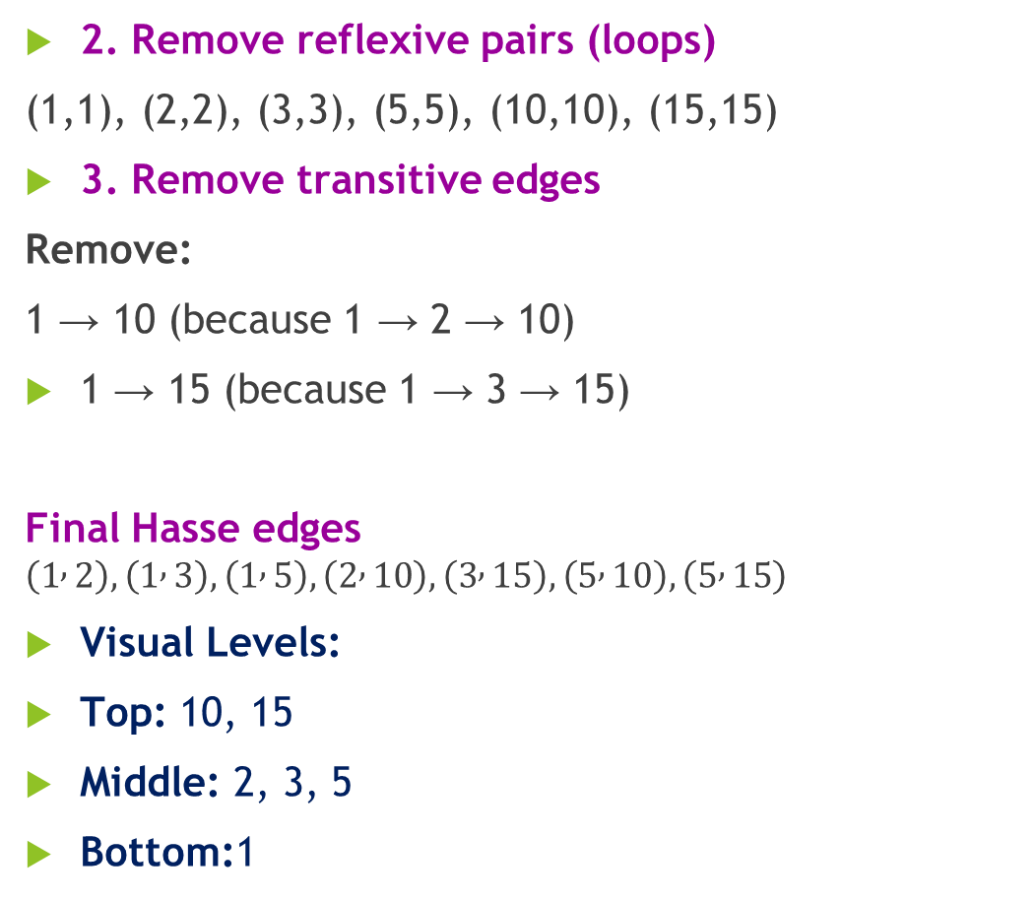
Hasse Diagrams
2. Remove reflexive pairs (loops)
(1,1), (2,2), (3,3), (5,5), (10,10), (15,15)
3. Remove transitive edges
Remove:
1 → 10 (because 1 → 2 → 10)
1 → 15 (because 1 → 3 → 15)
Final Hasse edges $\left(1 , 2\right),\left(1 , 3\right),\left(1 , 5\right),\left(2 , 10\right),\left(3 , 15\right),\left(5 , 10\right),\left(5 , 15\right)$
Visual Levels:
Top: 10, 15
Middle: 2, 3, 5
Bottom:1

