Slide 1
Induction and recursion
Chapter 5

Slide 2

What is Induction?
INDUCTION IS A PROOF TECHNIQUE
Mathematical induction is a way to prove something is true for all numbers (1, 2, 3, …).
Domino Example
Suppose we align an infinite number of dominoes, such that if some domino falls, the next one in line falls as well. What happens when we knock down the first domino?
So what happens? All the dominoes fall.
This intuition is formalized in the principle of mathematical induction.

Slide 3
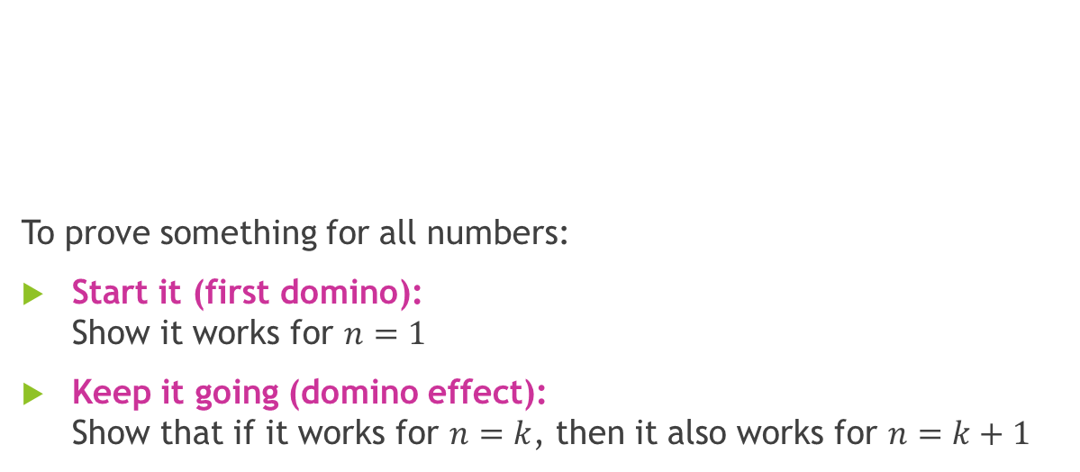
How this relates to induction ?
To prove something for all numbers:
Start it (first domino): Show it works for $n=1$
Keep it going (domino effect): Show that if it works for $n=k$, then it also works for $n=k+1$

Slide 4
Why Induction ?
Induction is a useful method for:
defining things,
proving ideas,
and writing programs.
It is important in algorithms because it helps us:
prove that a program works correctly
understand how fast it runs
Even though problems can be big and complex, induction helps by:
breaking them into small steps
solving one step at a time (like falling dominoes)
Induction makes big problems easier by solving them step by step.

Slide 5
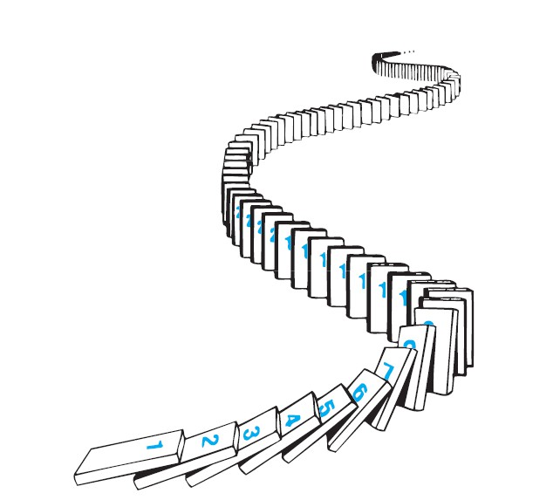
MATHEMATICAL INDUCTION
▶ Mathematical Induction is a special way of proving things. It has only 2 steps:
Step 1. Verify it is true for the first one .
Step 2. Show that if any one is true then the next one is true .
▶ Domino effect :
Step 1. The first domino falls
Step 2. When any domino falls, the next domino falls So ... all dominos will fall!
That’s how Mathematical Induction works.

Slide 6

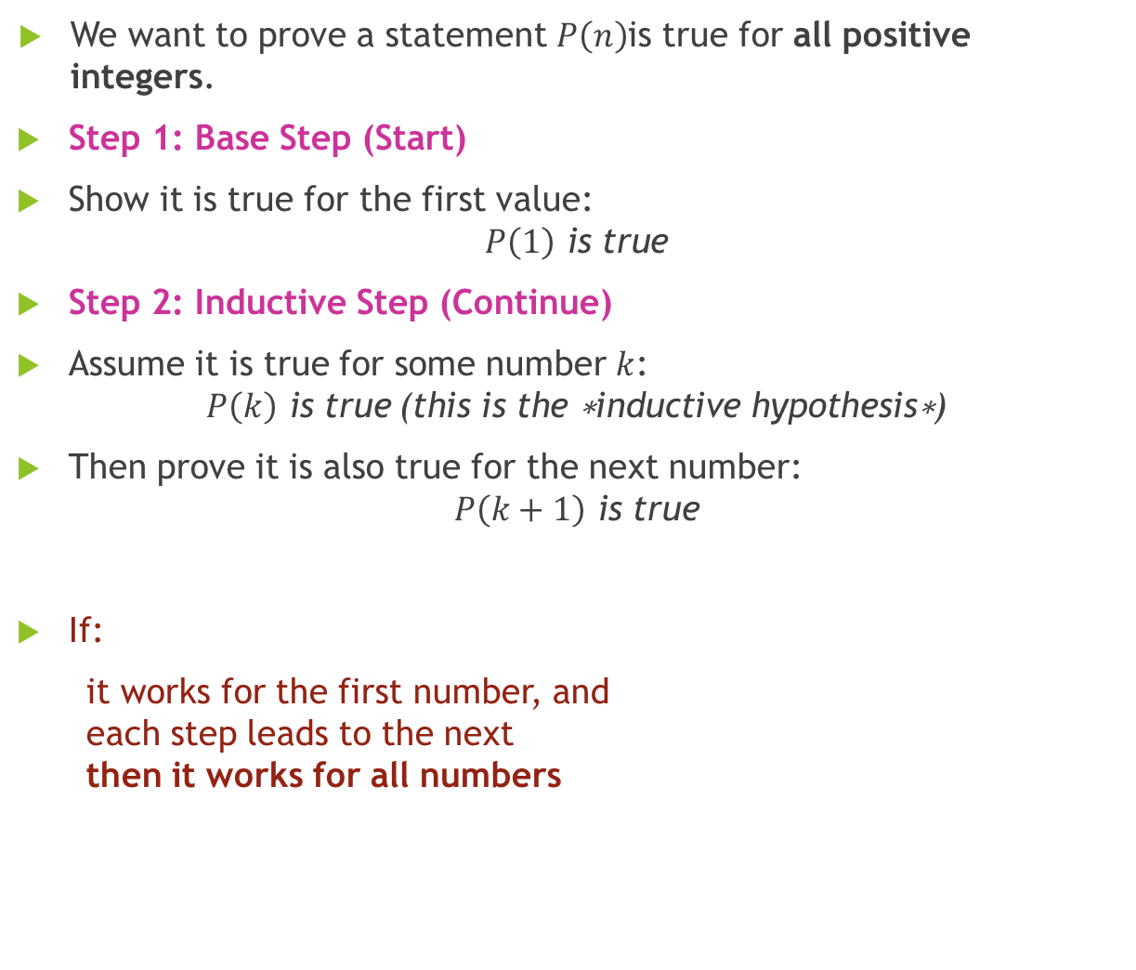
Principal of Mathematical Induction
We want to prove a statement $P\left(n\right)$is true for all positive integers.
Step 1: Base Step (Start)
Show it is true for the first value:
$$P\left(1\right) \text{is} \text{true}$$
Step 2: Inductive Step (Continue)
Assume it is true for some number $k$:
$$P\left(k\right) \text{is} \text{true} \text{(}\text{this} \text{is} \text{the} \text{∗}\text{inductive} \text{hypothesis}\text{∗}\text{)}$$
Then prove it is also true for the next number:
$$P\left(k+1\right) \text{is} \text{true}$$
If:
it works for the first number, and each step leads to the next then it works for all numbers
Prove first case + prove next step works → true for all $n$

Slide 7
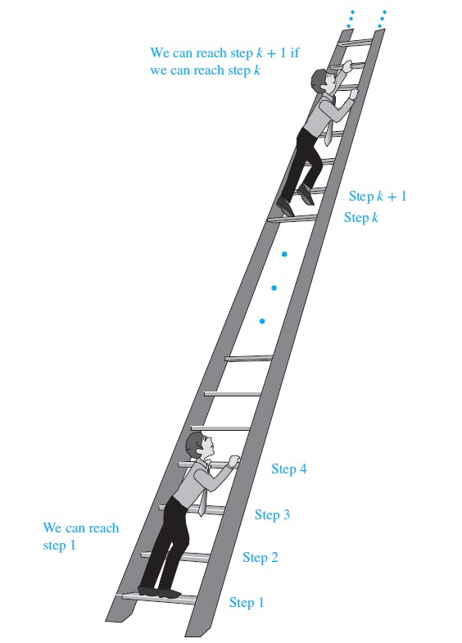
CLIMBING AN INFINITE LADDER.

Slide 8
Proof by INDUCTION
Prove the “Induction Basis”. That is, prove that the number 1 satisfies the claim. (This step is often easy, but is crucially important, and should never be omitted!)
Assume the “Induction Hypothesis”. That is, state the assumption that the claim holds for some positive integer K.
Prove, using the Induction Hypothesis, that the claim holds for K+1. The proof should consist of a chain of clear statements, each logically following from the previous ones combined with our shared knowledge base. The final statement in the chain should state that the claim holds for k + 1.

Slide 9
EXAMPLE 1
1. Use mathematical induction to prove that
1 + 2 + 3 + ... + n = ^{𝑵 𝑵+𝟏}
𝟐
for all positive integers n >= 1.
SOLUTION :
Let the statement P (n) be
1 + 2 + 3 + ... + n =
𝑁 𝑁+1
2
STEP 1(Induction Basis): We first show that p (1) is true (n=1).
LHS = 1
RHS = 1 (1 + 1) / 2 = 1
Both sides of the statement are equal hence P(1) is true.

Slide 10

STEP 2: We now assume that p(k) is true (n = k)
1 + 2 + 3 + ... + k = ^{𝐾 𝐾+1} Induction hypothesis
2
Assuming this , we have to now have to proof that the axiom is true for its
successor i.e. p(k+1). To do that we must show L.H.S = R.H.s
1
On the L.H.S of eq 1, 1+2+3+…+k can be replaced by:
1 + 2 + 3 + . . . + k+(k + 1) | = | (k + 1)(k + 2) 2
𝐾 𝐾+1
𝐮𝐬𝐢𝐧𝐠 𝐈𝐧𝐝𝐮𝐜𝐭𝐢𝐨𝐧 𝐇𝐲𝐩𝐨𝐭𝐡𝐞𝐬𝐢𝐬. Therefore eq 1 now becomes
2
=>
𝐾 𝐾+1 𝐾+1 𝐾+2
+ (k + 1) =
2 2
𝐾 𝐾+1 +2 𝐾+1 𝐾+1 𝐾+2
⇒
=
2 2
=>
𝐾+1 𝐾+2 2
=
𝐾+1 𝐾+2 2
L.H.S = R.H.S HENCE PROVED

Slide 11
EXAMPLE 2
2. Use mathematical induction to prove that (ab)^{n} = a^{n}b^{n}.
for every natural number n >=1.
SOLUTION:
Let the statement P (n) be
(ab)^{n} = a^{n}b^{n}
STEP 1(Induction Basis):
We first show that p (1) is true (n=1). (ab)¹ = a¹b¹.
But (ab)¹ = ab; and a¹b¹ = ab.
Both sides of the statement are equal hence P(1) is true.

Slide 12
STEP 2: We now assume that p(k) is true (n = k)
(ab)^{k} = a^{k}b^{k} ……… Induction hypothesis
Assuming this , we have to now have to proof that this is true for (k+1). To do that we must show L.H.S=R.H.S in eq 1 :
(ab)^{k + 1} = a^{k + 1}b^{k + 1}. . . . . . .
1
_{a}k+1_{b}k+1
=
_{a}k+1_{b}k+1
L.H.S = R.H.S HENCE PROVED

Slide 13
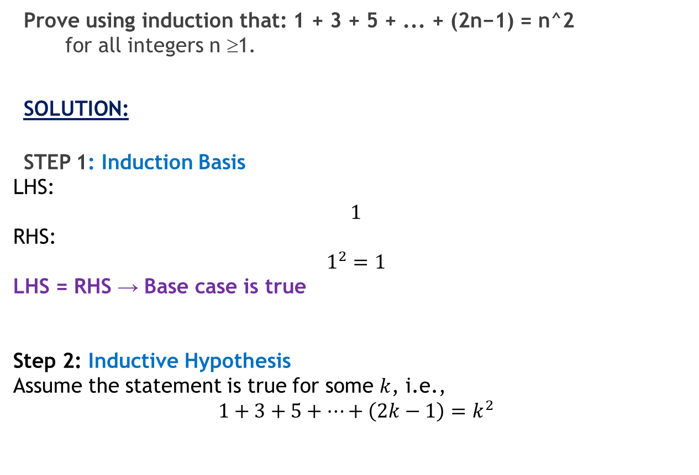
EXAMPLE 3
Prove using induction that: 1 + 3 + 5 + ... + (2n−1) = n^2 for all integers n ≥1.
SOLUTION:
STEP 1: Induction Basis
LHS:
$$1$$
RHS:
$$1^{2}=1$$
LHS = RHS → Base case is true
Step 2: Inductive Hypothesis
Assume the statement is true for some $k$, i.e.,
$$1+3+5+⋯+\left(2k−1\right)=k^{2}$$

Slide 14
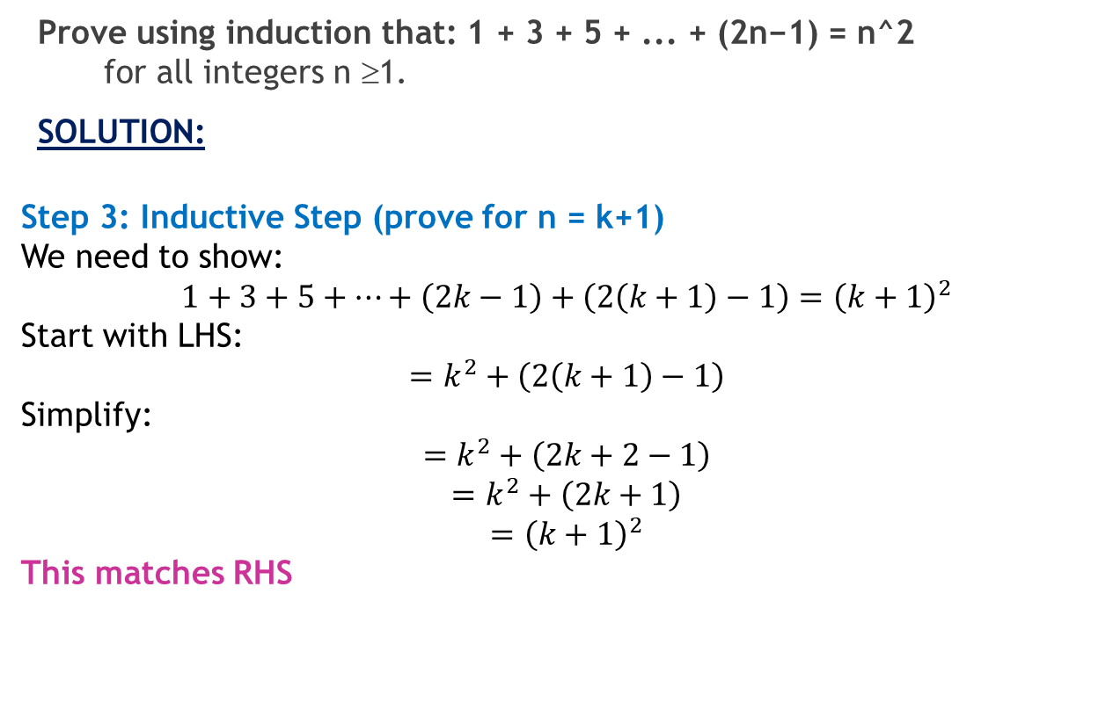
EXAMPLE 3
Prove using induction that: 1 + 3 + 5 + ... + (2n−1) = n^2 for all integers n ≥1.
SOLUTION:
Step 3: Inductive Step (prove for n = k+1)
We need to show:
$$1+3+5+⋯+\left(2k−1\right)+\left(2\left(k+1\right)−1\right)={\left(k+1\right)}^{2}$$
Start with LHS:
$$=k^{2}+\left(2\left(k+1\right)−1\right)$$
Simplify:
$$=k^{2}+\left(2k+2−1\right)$$
$$=k^{2}+\left(2k+1\right)$$
$$={\left(k+1\right)}^{2}$$
This matches RHS

Slide 15

EXERCISE A
Prove that: 1³ + 2³ + 3³ + ... + n³ = ¼n²(n + 1)²
Prove that: 1+2+2² + … + 2^{n} = 2^{n+1} – 1, for all integers n ≥0
Prove that: ₁2 ₊ ₂2 ₊ ₃2 _{+ + n}2 ₌ ^{n(n +1)(2n +1)} , for all integers n ≥1.
6
4. PROVE THAT:
∑
n+1
i2^{i} = n ⋅ 2^{n+2} + 2, for all integers n ≥ 0
i =1

Slide 16


EXERCISE B
1. Prove by mathematical induction
1 ₊ 1 ₊ ₊ 1 ₌ n
1⋅ 2 2 ⋅ 3 n(n +1) n +1
for all integers n≥1
2. Use mathematical induction to prove that
⎛₁₋ 1 ⎞ ₌ n +1
⎛1− ^{1 ⎞} ⋅⎛1− ^{1 ⎞}
for all integers n ≥2
⎜ ⎟ ⎜ ⎟ ⎜
⎟
2 2 2
2 3 n 2n
⎝ ⎠ ⎝ ⎠ ⎝ ⎠

Slide 17
Recursion
Section 5.3

Slide 18
What is a Recursive Definition?
A recursive definition defines something in terms of smaller versions of itself.
It always has two parts:
Basis Step (Base Case)
This tells you where to start (the simplest value).
Example: f(0) = 3
Recursive Step
This tells you how to build new values from earlier ones.
Example: f(n + 1) = 2f(n) + 3

Slide 19
EXAMPLE
Let {a_{n}} be a sequence that satisfies the recurrence relation
a_{n} = a_{n−1} + 3 for n = 1, 2, 3,…, and suppose that a₀ = 2.
What are a₁, a₂, and a₃?
SOLUTION:
We see from the recurrence relation that
a₁ = a₀ + 3 = 2+3 = 5 .
It then follows that
a₂ = 5 + 3 = 8 and a₃ = 8 + 3 = 11.

Slide 20
EXAMPLE 6
Let {an} be a sequence that satisfies the recurrence relation
an = an−1 − an−2 for n = 2, 3, 4,…, and suppose that a0 = 3 and a1 = 5.
What are a2 and a3?
SOLUTION:
We see from the recurrence relation that a2 = a1 − a0 = 5 − 3 = 2
and a3 = a2 − a1 = 2 − 5 = −3.
We can find a4, a5, and each successive term in a similar way.

Slide 21
Recursively Defined Functions
Example: Suppose f is defined by:
f(0) = 3,
f(n + 1) = 2f(n) + 3
Find f(1), f(2), f(3), f(4)
Solution:
f(1) = 2f(0) + 3 = 2∙3 + 3 = 9
f(2) = 2f(1)+ 3 = 2∙9 + 3 = 21
f(3) = 2f(2) + 3 = 2∙21 + 3 = 45
f(4) = 2f(3) + 3 = 2∙45 + 3 = 93
Key Idea:
You must go in order.
You can’t jump to f(4) without knowing f(3).

Slide 22
Recursively Defined Functions
Example: Give a recursive definition of the factorial function n!
Suppose f is defined by:
f(0) = 1
f(n + 1) = (n + 1)∙ f(n)
Find f(1), f(2), f(3), f(4)
Factorial means:
n! = n × (n−1) × (n−2) × ... × 1
Recursive definition just breaks that into steps.
Solution:
f(0) = 1
f(1) = 1 × f(0) = 1
f(2) = 2 × f(1) = 2
f(3) = 3 × f(2) = 6
f(4) = 4 × f(3) = 24

Slide 23
Recursively Defined Functions
Example: The Fibonacci numbers are defined as follows:
f₀ = 0
f₁ = 1
f_{n} = f_{n−1} + f_{n−2}
Find f₂, f₃ , f₄ , f₅ .
Solution:
f₂ = f₁ + f₀ = 1 + 0 = 1
f₃ = f₂ + f₁ = 1 + 1 = 2
f₄ = f₃ + f₂ = 2 + 1 = 3
f₅ = f₄ + f₃ = 3 + 2 = 5

Slide 24
EXERCISE A
Find the first four terms of the following recursively defined sequence.
b₁ = 2 , b_{k} = b_{k-1} + 2 · k, for all integers k ≥ 2
Find the first five terms of the following recursively defined sequence.
t₀ = – 1, t₁ = 1 , t_{k} = t_{k-1} + 2 · t_{k-2}, for all integers k ≥ 2
3 . Find f (1), f (2), f (3), and f (4) if f (n) is defined recursively by f (0) = 1
and for n = 0, 1, 2,…
f (n + 1) = f (n) + 2.
f (n + 1) = 3f (n).
f (n + 1) = 2f (n).
f (n + 1) = f (n)2 + f (n) + 1.

