Slide 1
Counting
Chapter 6
With Question/Answer Animations
Copyright © McGraw-Hill Education. All rights reserved. No reproduction or distribution without the prior written consent of McGraw-Hill Education.

Slide 2
The Basics of Counting
Section 6.1

Slide 3
Counting
Figuring out how many possible outcomes there are without listing them all.
Instead of writing every possibility (which can be huge), we use rules to calculate the total quickly.

Slide 4
Basic Counting Principles: The Product Rule
The Product Rule says:
If a process happens in steps, you multiply the number of choices at each step.
In simple terms:
Step 1 has n₁ choices
Step 2 has n₂ choices
Total outcomes = n₁ × n₂
If there are more steps, just keep multiplying.
Example:
You choose a shirt (3 options)
Then choose pants (2 options)
Total outfits = 3 × 2 = 6 outfits
Because for each shirt, you can pair any pants.

Slide 5
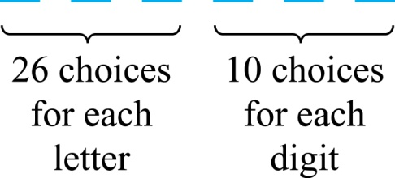
The Product Rule
Example 2: License plates
3 letters + 3 digits
Condition:
Each letter: 26 choices (A–Z)
Each digit: 10 choices (0–9)
So:
Total=
=26 × 26 × 26 × 10 × 10 × 10 = 26³ × 10³ = 17,576,000
That’s over 17 million possible plates!
Example 1: Bit strings of length 7
A bit is either: 0, 1
So each position has 2 choices.
There are 7 positions, so:
Total = 2 × 2 × 2 × 2 × 2 × 2 × 2 = 2⁷ = 128
So, there are 128 possible bit strings

Slide 6
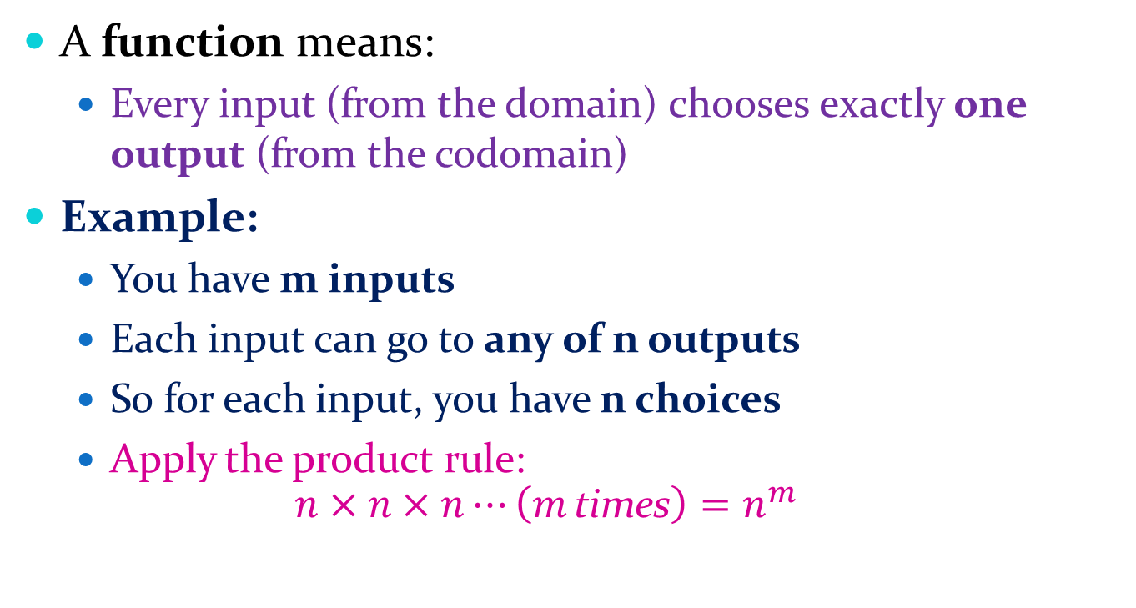
Counting Functions
A function means:
Every input (from the domain) chooses exactly one output (from the codomain)
Example:
You have m inputs
Each input can go to any of n outputs
So for each input, you have n choices
Apply the product rule:
$$n×n×n⋯\left(m \text{times}\right)=n^{m}$$

Slide 7
Counting Functions
2. One-to-One Functions (Injective)
Now there’s a restriction:
No two inputs can go to the same output
So choices decrease each time.
n×(n−1)×(n−2)×…
This only works if m ≤ n (otherwise impossible to assign unique outputs)
m = 3 inputs
n = 5 outputs
Choices: 1st → 5 2nd → 4 3rd → 3
Total = 5 × 4 × 3 = 60
Like:
First input → n choices
Second input → n−1 choices
Third input → n−2 choices
Keep going...

Slide 8
Telephone Numbering Plan
Example: The North American numbering plan (NANP) specifies that a telephone number consists of 10 digits, consisting of a three-digit area code, a three-digit office code, and a four-digit station code. There are some restrictions on the digits.
Let X denote a digit from 0 through 9 → 10 choices
Let N denote a digit from 2 through 9 → 8 choices
Let Y denote a digit that is 0 or 1 → 2 choices
In the old plan (in use in the 1960s) the format was NYX-NNX-XXX.
In the new plan, the format is NXX-NXX-XXX.
How many different telephone numbers are possible under the old plan and the new plan?

Slide 9
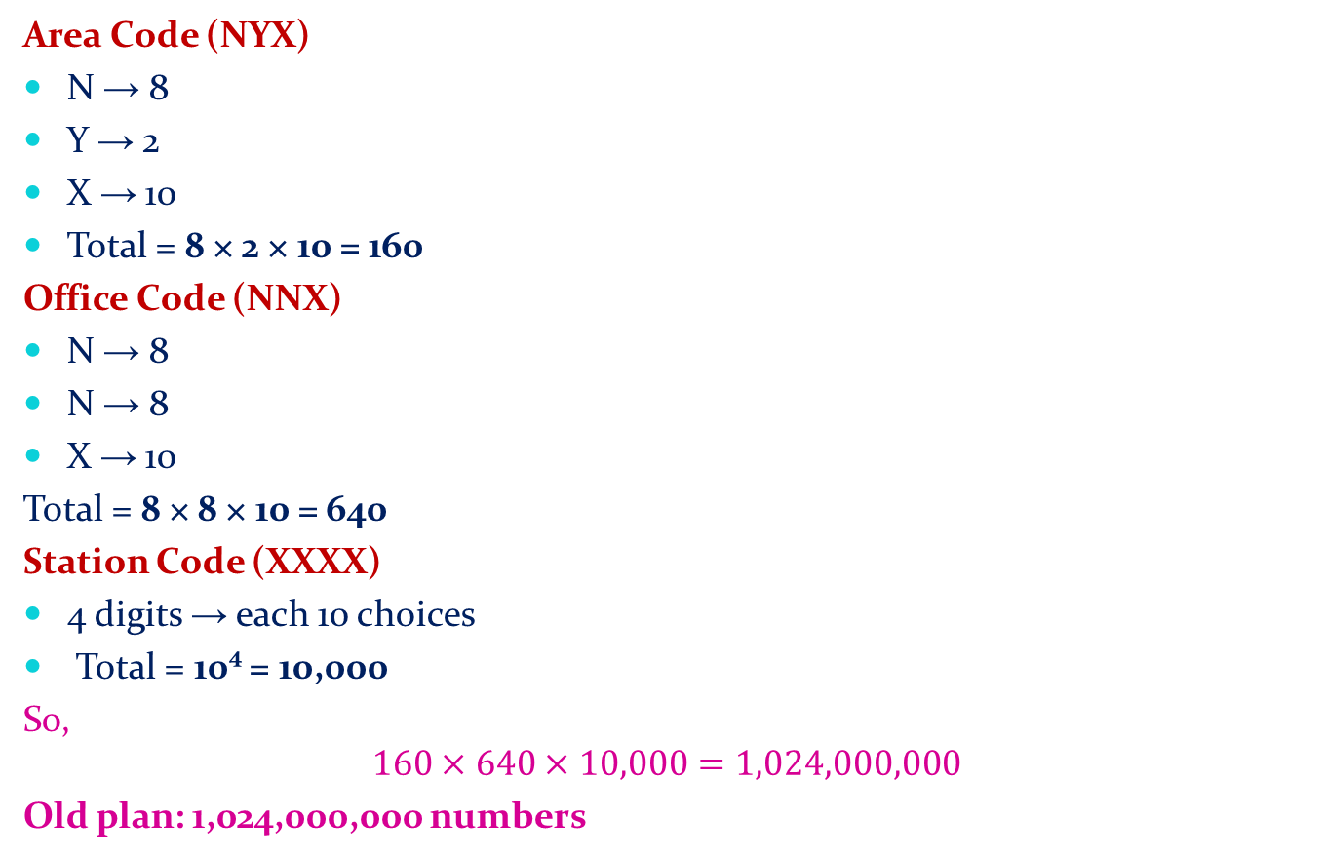
Telephone Numbering Plan…Continue
Area Code (NYX)
N → 8
Y → 2
X → 10
Total = 8 × 2 × 10 = 160
Office Code (NNX)
N → 8
N → 8
X → 10
Total = 8 × 8 × 10 = 640
Station Code (XXXX)
4 digits → each 10 choices
Total = 10⁴ = 10,000
So,
$$160×640×10,000=1,024,000,000$$
Old plan: 1,024,000,000 numbers

Slide 10
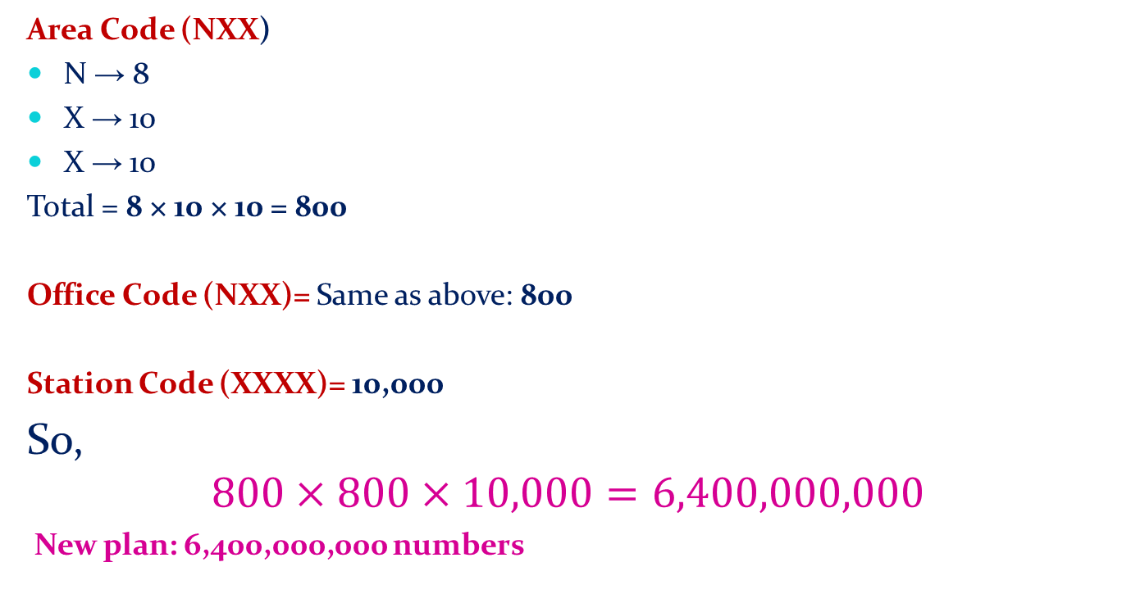
Telephone Numbering Plan…Continue
Area Code (NXX)
N → 8
X → 10
X → 10
Total = 8 × 10 × 10 = 800
Office Code (NXX)= Same as above: 800
Station Code (XXXX)= 10,000
So,
$$800×800×10,000=6,400,000,000$$
New plan: 6,400,000,000 numbers

Slide 11


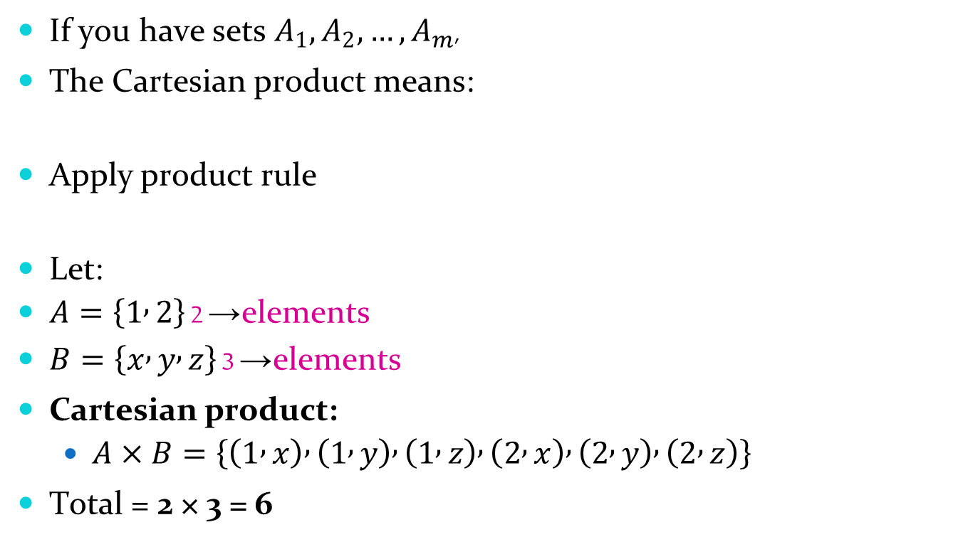
Product Rule in Terms of Sets
If you have sets $A_{1},A_{2},…,A_{m}$,
The Cartesian product means:
Apply product rule
Let:
$A=\left\{1 , 2\right\}$→ 2 elements
$B=\left\{x , y , z\right\}$→ 3 elements
Cartesian product:
$A×B=\left\{\left(1 , x\right) , \left(1 , y\right) , \left(1 , z\right) , \left(2 , x\right) , \left(2 , y\right) , \left(2 , z\right)\right\}$
Total = 2 × 3 = 6

Slide 12
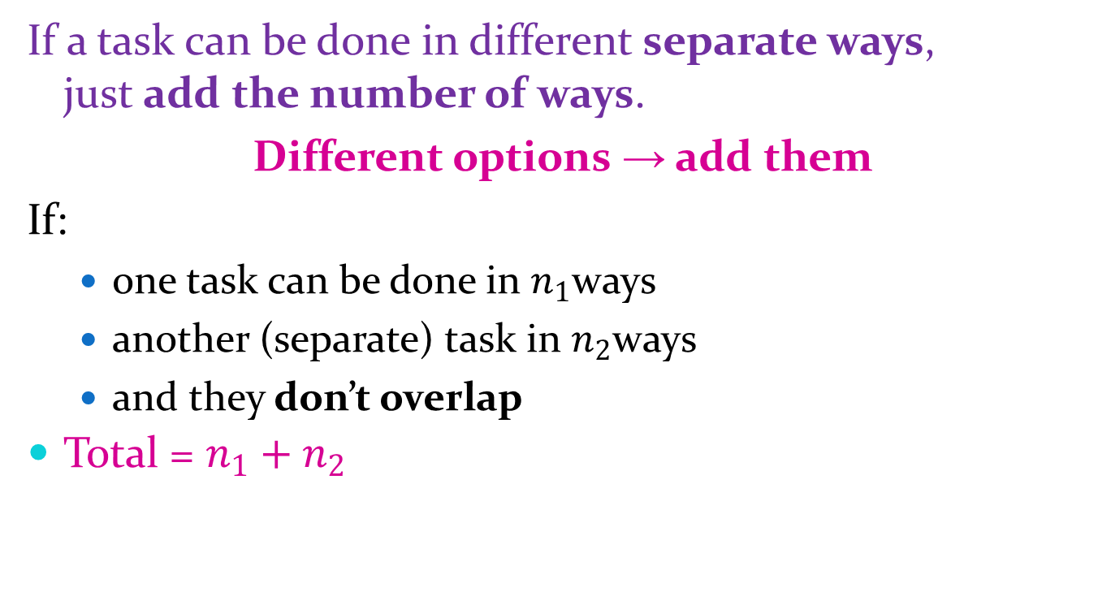
Basic Counting Principles: The Sum Rule
If a task can be done in different separate ways, just add the number of ways.
Different options → add them
If:
one task can be done in $n_{1}$ways
another (separate) task in $n_{2}$ways
and they don’t overlap
Total = $n_{1}+n_{2}$

Slide 13
Basic Counting Principles: The Sum Rule
Example: The mathematics department must choose either a student or a faculty member as a representative for a university committee. How many choices are there for this representative if there are 37 members of the mathematics faculty and 83 mathematics majors and no one is both a faculty member and a student.
Solution: By the sum rule it follows that there are
37 + 83 = 120 possible ways to pick a representative.

Slide 14
Combining the Sum and Product Rule
Use:
Sum rule ( + ) when you choose between cases (OR)
Product rule ( × ) when steps happen together (AND)

Slide 15
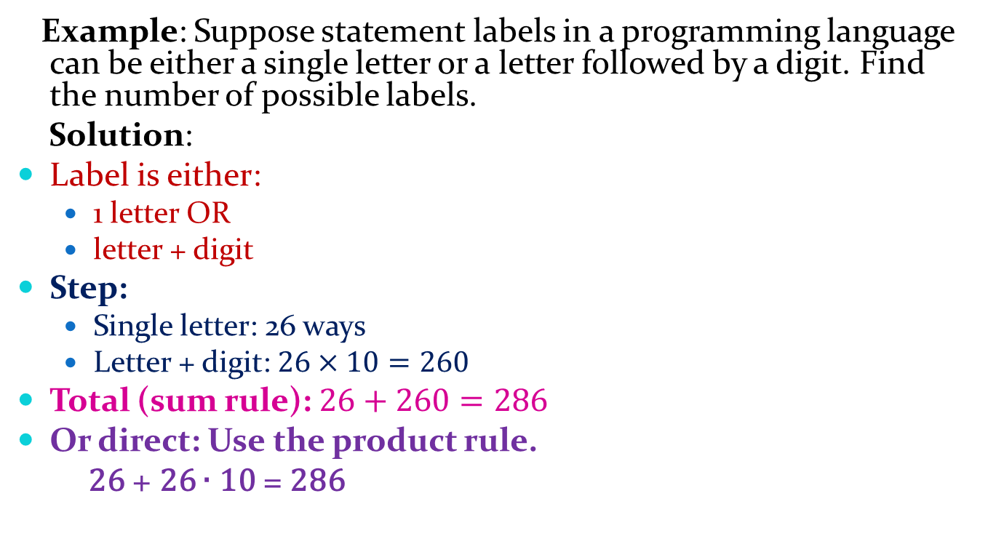
Combining the Sum and Product Rule
Example: Suppose statement labels in a programming language can be either a single letter or a letter followed by a digit. Find the number of possible labels.
Solution:
Label is either:
1 letter OR
letter + digit
Step:
Single letter: 26 ways
Letter + digit: $26×10=260$
Total (sum rule): $26+260=286$
Or direct: Use the product rule.
26 + 26 ∙ 10 = 286

Slide 16
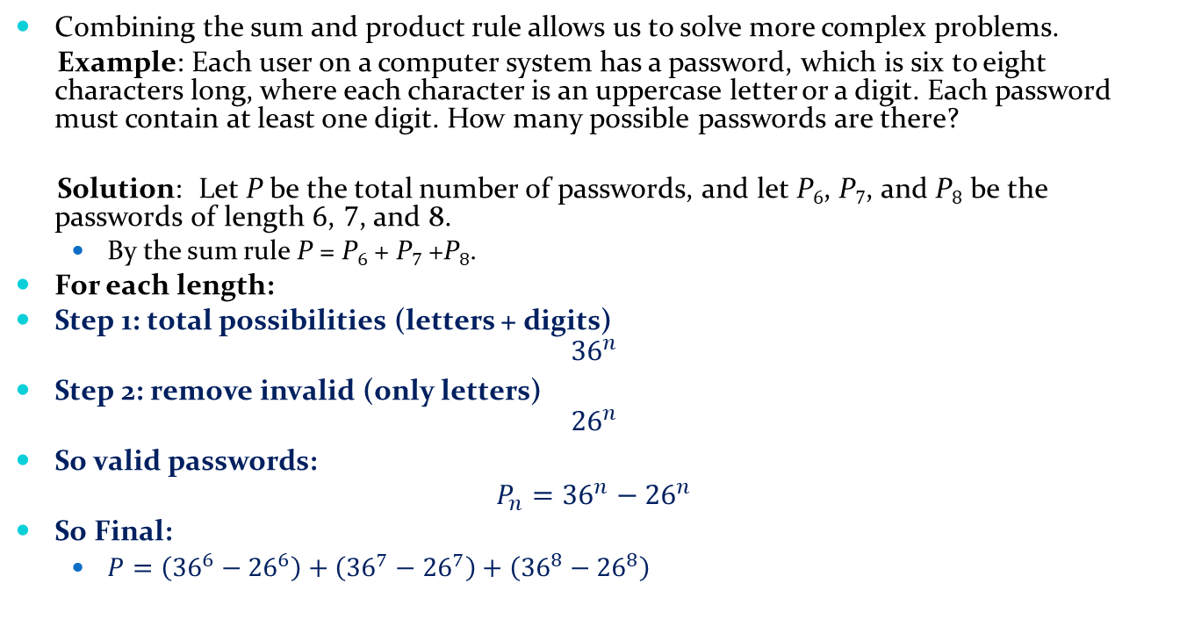
Counting Passwords
Combining the sum and product rule allows us to solve more complex problems.
Example: Each user on a computer system has a password, which is six to eight characters long, where each character is an uppercase letter or a digit. Each password must contain at least one digit. How many possible passwords are there?
Solution: Let P be the total number of passwords, and let P₆, P₇, and P₈ be the passwords of length 6, 7, and 8.
By the sum rule P = P₆ + P₇ +P₈.
For each length:
Step 1: total possibilities (letters + digits)
$${36}^{n}$$
Step 2: remove invalid (only letters)
$${26}^{n}$$
So valid passwords:
$$P_{n}={36}^{n}−{26}^{n}$$
So Final:
$P=\left({36}^{6}−{26}^{6}\right)+\left({36}^{7}−{26}^{7}\right)+\left({36}^{8}−{26}^{8}\right)$

Slide 17
Counting Passwords
By the sum rule P = P₆ + P₇ +P₈.
To find each of P₆, P₇, and P₈ , we find the number of passwords of the specified length composed of letters and digits and subtract the number composed only of letters. We find that:
P₆ = 36⁶ − 26⁶ =2,176,782,336 − 308,915,776 =1,867,866,560.
P₇ = 36⁷ − 26⁷ = 78,364,164,096 − 8,031,810,176 = 70,332,353,920.
P₈ = 36⁸ − 26⁸ = 2,821,109,907,456 − 208,827,064,576 =2,612,282,842,880.
Consequently, P = P₆ + P₇ +P₈ = 2,684,483,063,360.

Slide 18
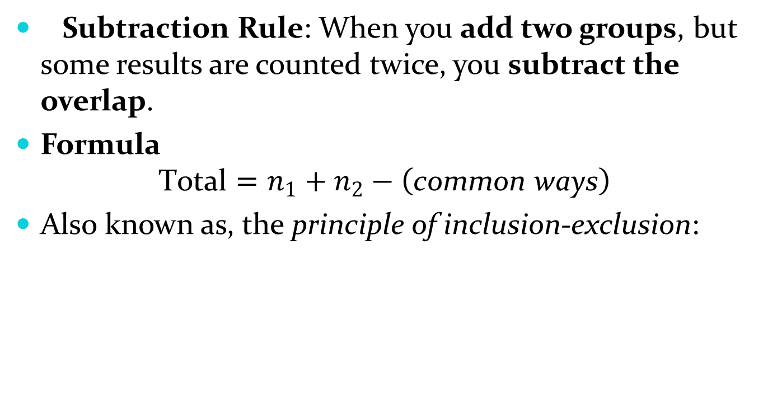
Basic Counting Principles: Subtraction Rule
Subtraction Rule: When you add two groups, but some results are counted twice, you subtract the overlap.
Formula
$$\text{Total}=n_{1}+n_{2}−\left(\text{common} \text{ways}\right)$$
Also known as, the principle of inclusion-exclusion:
Example:
Ways from set A = 10
Ways from set B = 8
Overlap (common ways) = 3
So, 10+8−3=15

Slide 19
The Pigeonhole Principle
Section 6.2

Slide 20
The Pigeonhole Principle
The core idea
If you have more things than containers, then some container must hold more than one thing.
Why this is true (no math first)
Imagine:
3 pigeonholes (boxes)
4 pigeons (objects)
Try to place them:
Put 1 pigeon in each hole → 3 pigeons used
1 pigeon is left
That pigeon must go into an already filled hole
So one hole has at least 2 pigeons
“You cannot evenly distribute too many things into too few places without overlap.”

Slide 21
The Pigeonhole Principle
Corollary 1: A function f from a set with k + 1 elements to a set with k elements is not one-to-one.
Proof: Use the pigeonhole principle.
Think of each output value in the codomain as a box.
Think of each input value in the domain as an object.
Place each input into the box of its output.
Since there are:
k + 1 inputs
only k output boxes
At least one box must contain two or more inputs.
This means:
Two different inputs have the same output.
Therefore, the function cannot be one-to-one.

Slide 22

The Generalized Pigeonhole Principle
Instead of just “2 in a box”, we ask:
how crowded must a box be?
Formula idea
If:
N objects
k boxes
Then at least one box has:
“On average each box gets N/k items, so at least one box gets that much or more.”

Slide 23

Example 1: Students in Classes
Suppose
50 students
6 classes
Calculate:
Round up:
Answer:
At least one class must have 9 students.
Because if every class had only 8 students:
But there are 50 students, so 2 extra students must go somewhere.

Slide 24
Example 2: Birth Months
100 people
12 months
100/12 = 8.33
Round up: 9 Answer
At least 9 people were born in the same month.

