Slide 1
An Introduction to Discrete Probability
Section 7.1

Slide 2
Probability
Probability is basically about answering:
“How likely is something to happen?”
For example:
What is the chance of getting heads when flipping a coin?
What is the chance of rolling a 6 on a die?
What is the chance it rains tomorrow?

Slide 3
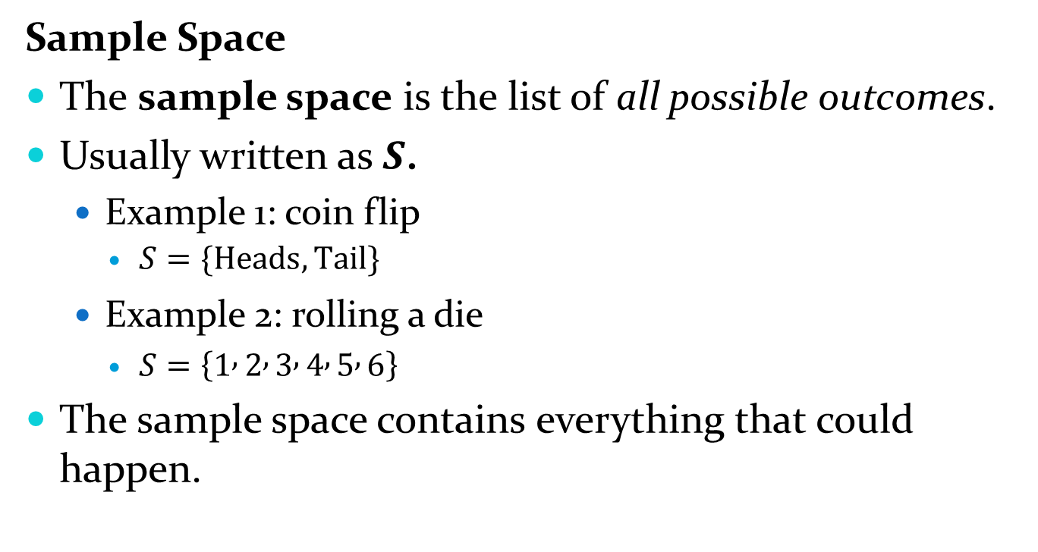
Sample Space
The sample space is the list of all possible outcomes.
Usually written as $S$.
Example 1: coin flip
$S=\{Heads, Tail\}$
Example 2: rolling a die
$S=\left\{1 , 2 , 3 , 4 , 5 , 6\right\}$
The sample space contains everything that could happen.

Slide 4
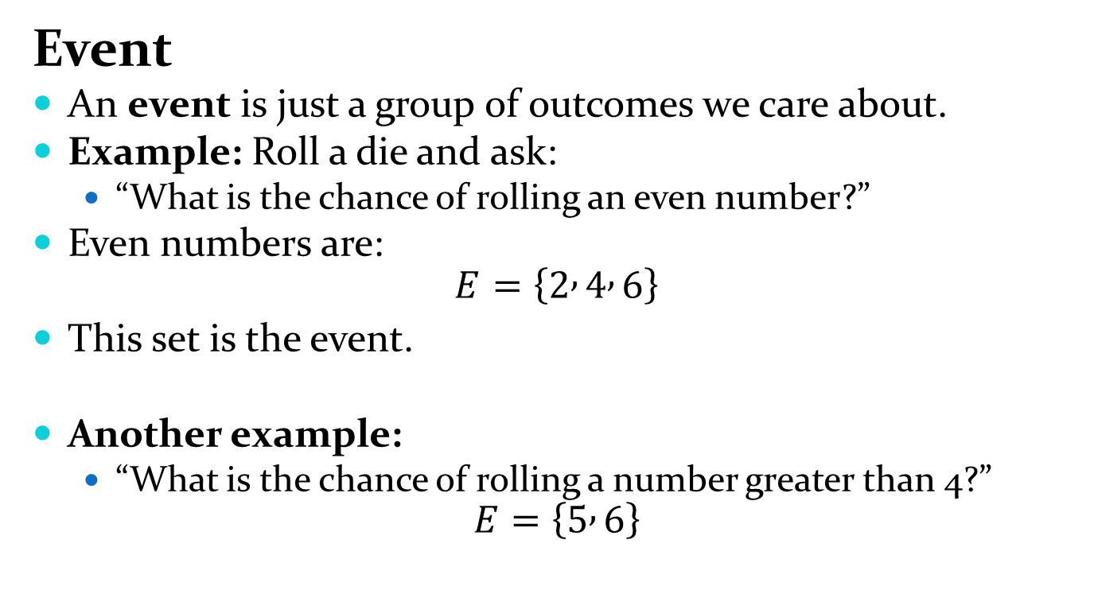
Event
An event is just a group of outcomes we care about.
Example: Roll a die and ask:
“What is the chance of rolling an even number?”
Even numbers are:
$$E=\left\{2 , 4 , 6\right\}$$
This set is the event.
Another example:
“What is the chance of rolling a number greater than 4?”
$$E=\left\{5 , 6\right\}$$

Slide 5
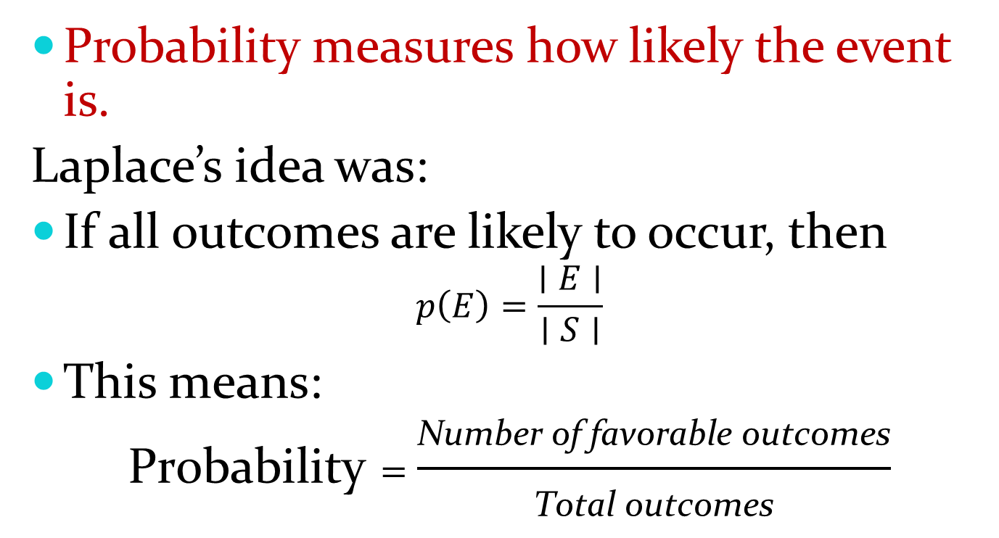
Probability measures how likely the event is.
Laplace’s idea was:
If all outcomes are likely to occur, then
$$p\left(E\right)=\frac{∣E∣}{∣S∣}$$
This means:
$$\text{Probability}=\frac{\text{Number} \text{of} \text{favorable} \text{outcomes}}{\text{Total} \text{outcomes}}$$

Slide 6
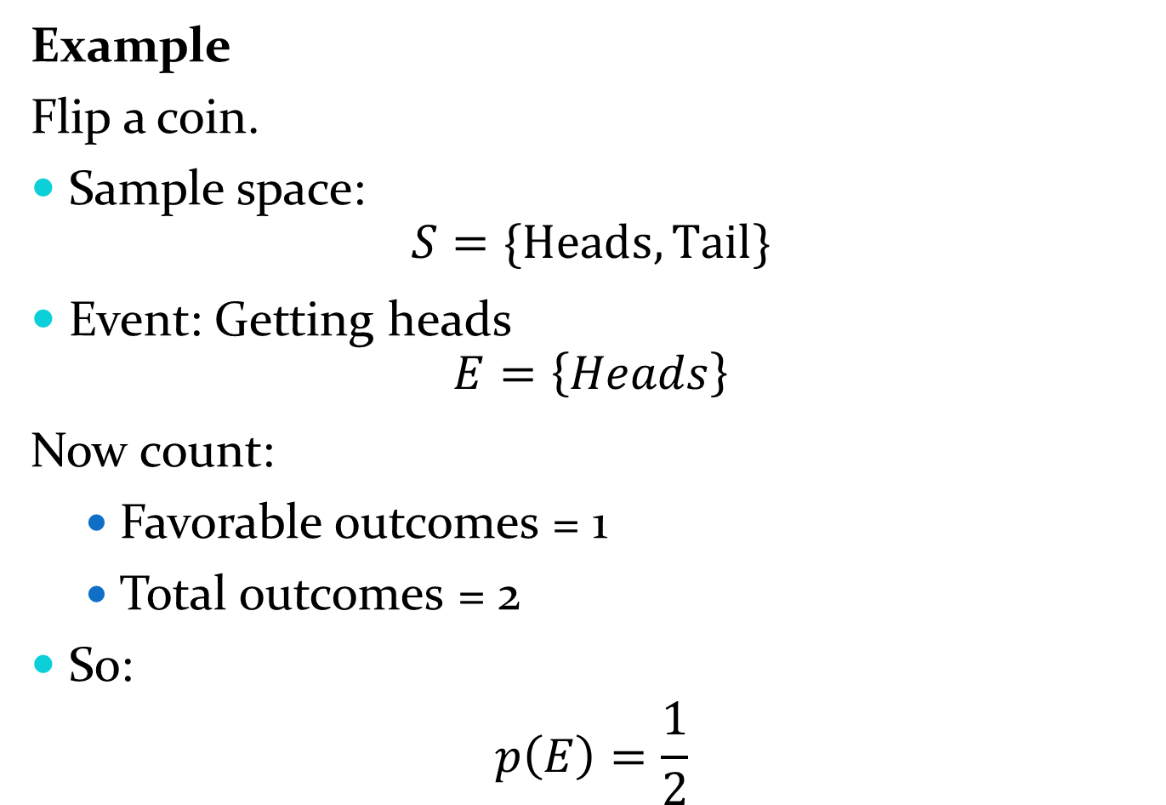
Example
Flip a coin.
Sample space:
$$S=\{Heads,Tail\}$$
Event: Getting heads
$$E=\left\{Heads\right\}$$
Now count:
Favorable outcomes = 1
Total outcomes = 2
So:
$$p\left(E\right)=\frac{1}{2}$$

Slide 7
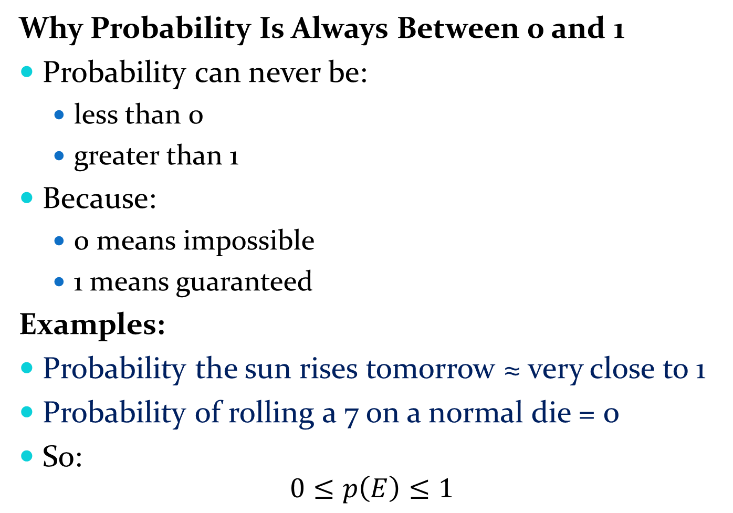
Why Probability Is Always Between 0 and 1
Probability can never be:
less than 0
greater than 1
Because:
0 means impossible
1 means guaranteed
Examples:
Probability the sun rises tomorrow ≈ very close to 1
Probability of rolling a 7 on a normal die = 0
So:
$$0≤p\left(E\right)≤1$$

Slide 8
Applying Laplace’s Definition
Example: An container contains four blue balls and five red balls. What is the probability that a ball chosen from the container is blue?

Slide 9
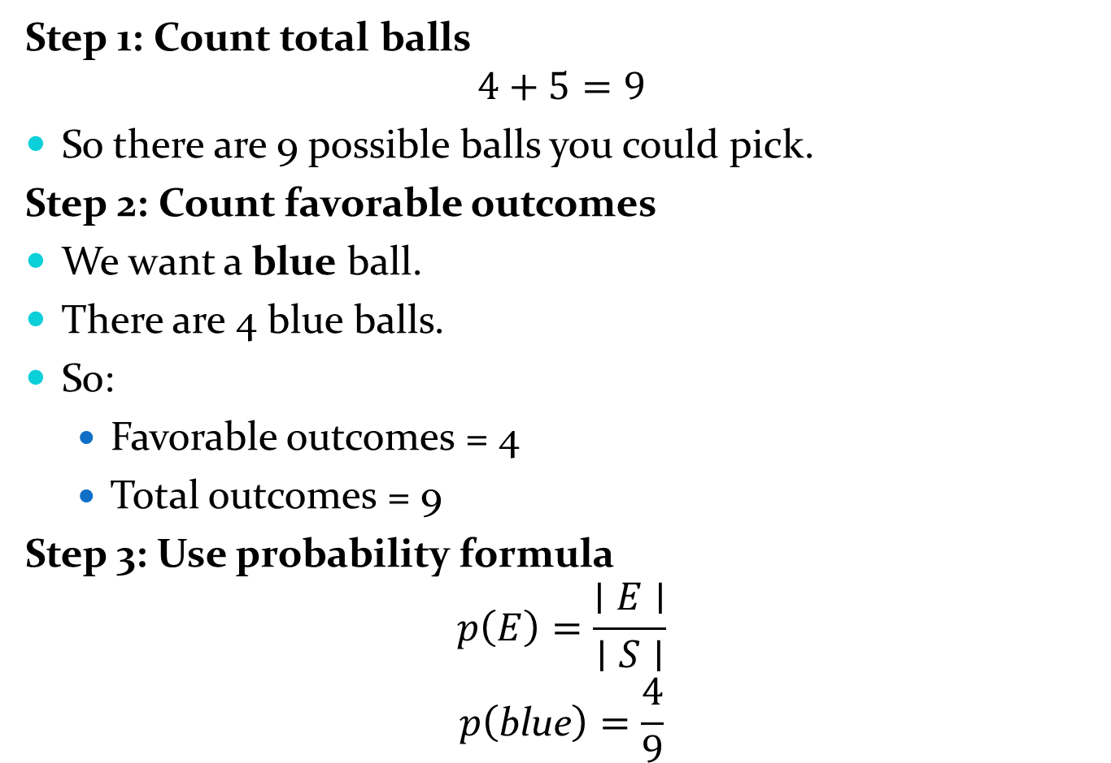
Step 1: Count total balls
$$4+5=9$$
So there are 9 possible balls you could pick.
Step 2: Count favorable outcomes
We want a blue ball.
There are 4 blue balls.
So:
Favorable outcomes = 4
Total outcomes = 9
Step 3: Use probability formula
$$p\left(E\right)=\frac{∣E∣}{∣S∣}$$
$$p\left(\text{blue}\right)=\frac{4}{9}$$

Slide 10
Applying Laplace’s Definition
Example: What is the probability that when two dice are rolled, the sum of the numbers on the two dice is 7?

Slide 11
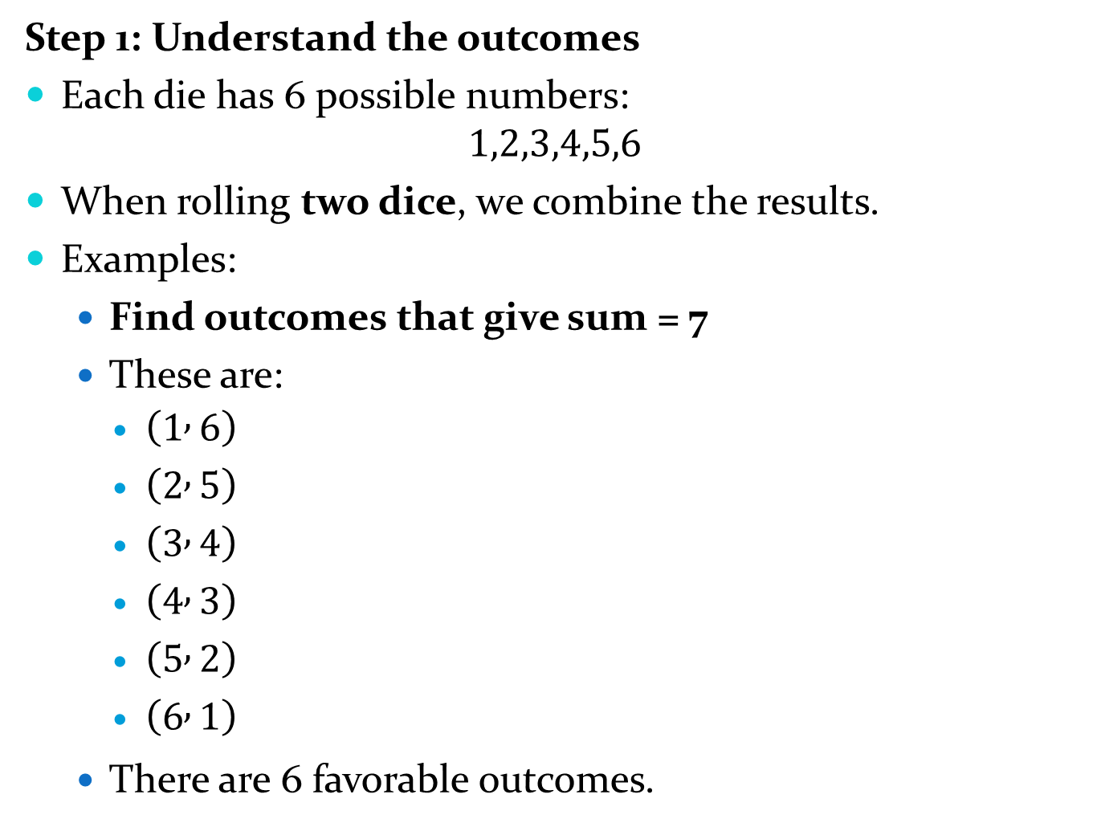
Step 1: Understand the outcomes
Each die has 6 possible numbers:
$$1,2,3,4,5,6$$
When rolling two dice, we combine the results.
Examples:
Find outcomes that give sum = 7
These are:
$\left(1 , 6\right)$
$\left(2 , 5\right)$
$\left(3 , 4\right)$
$\left(4 , 3\right)$
$\left(5 , 2\right)$
$\left(6 , 1\right)$
There are 6 favorable outcomes.

Slide 12
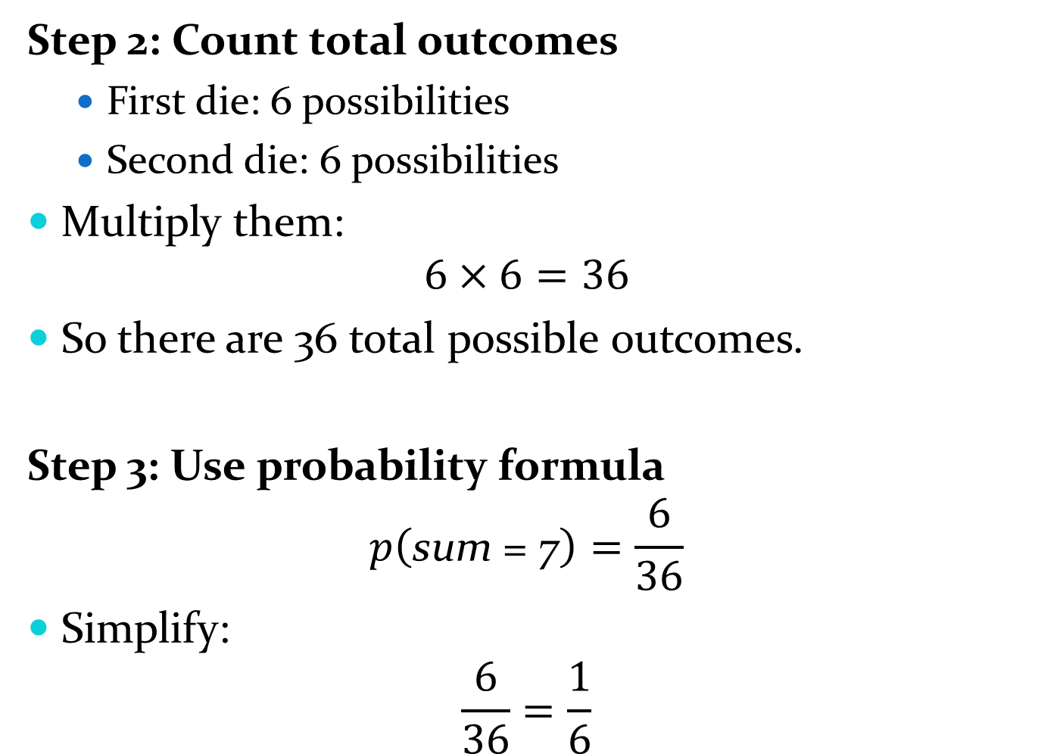
Step 2: Count total outcomes
First die: 6 possibilities
Second die: 6 possibilities
Multiply them:
$$6×6=36$$
So there are 36 total possible outcomes.
Step 3: Use probability formula
$$p\left(\text{sum}\text{ = }\text{7}\right)=\frac{6}{36}$$
Simplify:
$$\frac{6}{36}=\frac{1}{6}$$

Slide 13
Example 3: In a lottery, a machine randomly picks a 4-digit number. A player also chooses a 4-digit number.
The player wins the prize if:
all four digits match exactly
and the digits are in the correct order
What is the probability that the player wins the prize?

Slide 14
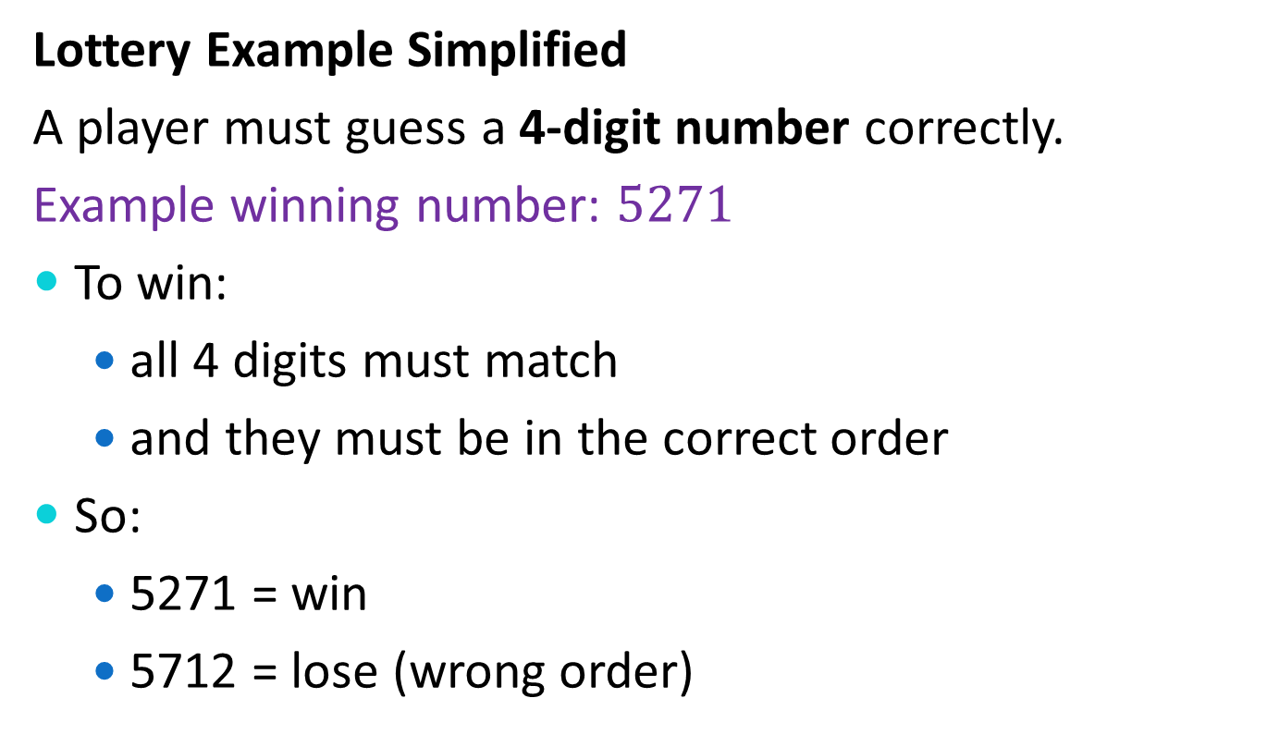
Lottery Example Simplified
A player must guess a 4-digit number correctly.
Example winning number: $5271$
To win:
all 4 digits must match
and they must be in the correct order
So:
5271 = win
5712 = lose (wrong order)

Slide 15
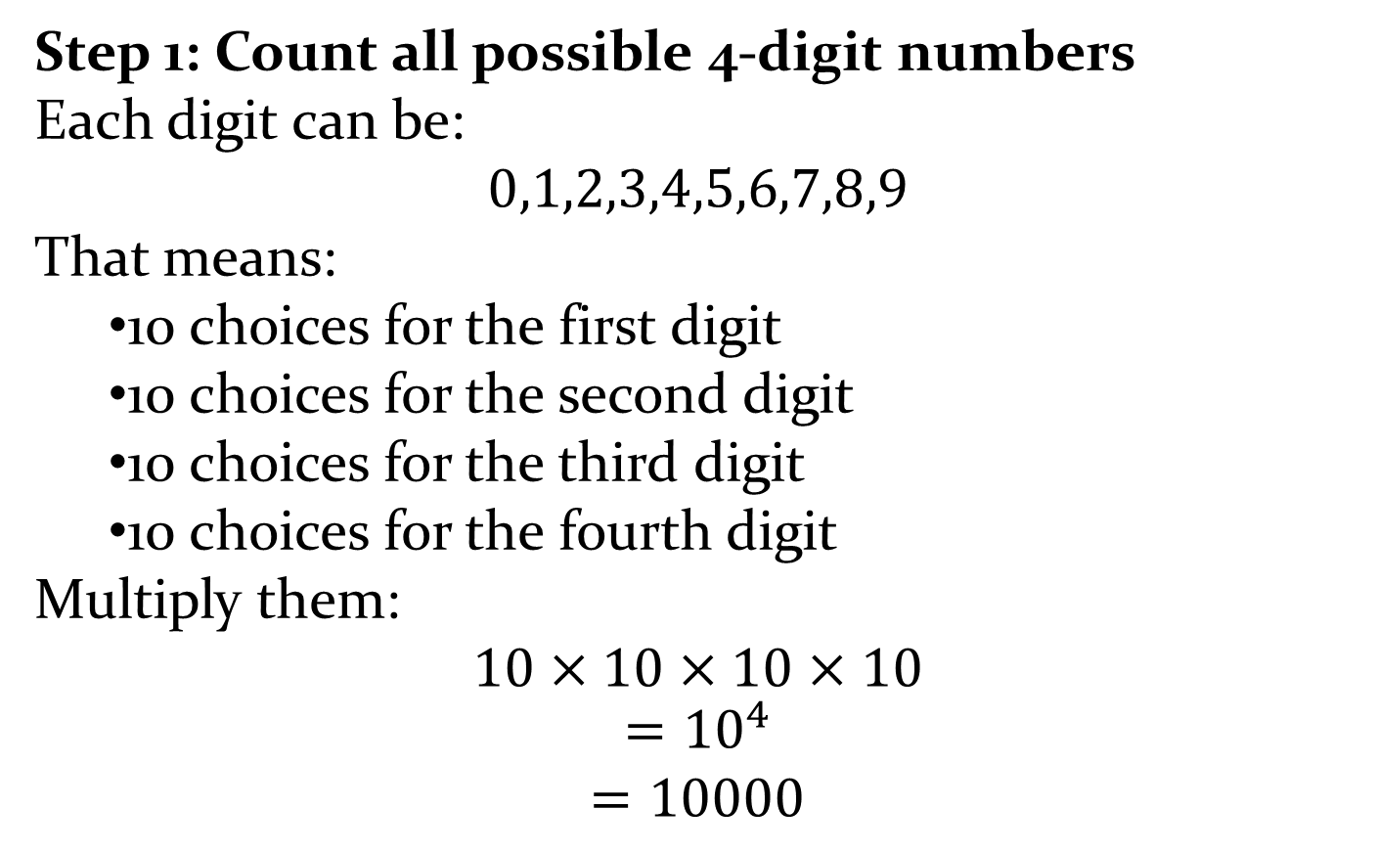
Step 1: Count all possible 4-digit numbers
Each digit can be:
$$0,1,2,3,4,5,6,7,8,9$$
That means:
10 choices for the first digit
10 choices for the second digit
10 choices for the third digit
10 choices for the fourth digit
Multiply them:
$$10×10×10×10$$
$$={10}^{4}$$
$$=10000$$

Slide 16
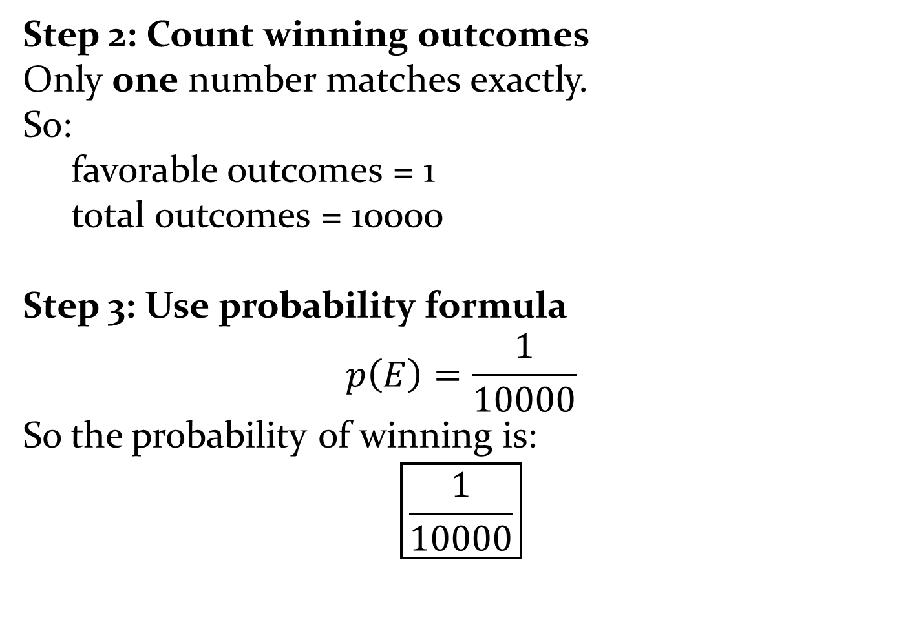
Step 2: Count winning outcomes
Only one number matches exactly.
So:
favorable outcomes = 1
total outcomes = 10000
Step 3: Use probability formula
$$p\left(E\right)=\frac{1}{10000}$$
So the probability of winning is:
$$\boxed{\frac{1}{10000}}$$

Slide 17
Question: In a lottery, a machine randomly picks a 4-digit number. A player also chooses a 4-digit number.
The player wins a small prize if exactly three digits match the winning number in the correct positions.
What is the probability that the player wins the small prize?

Slide 18
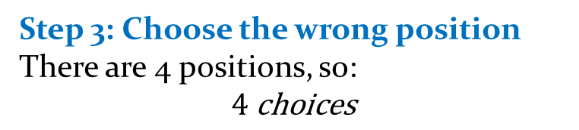
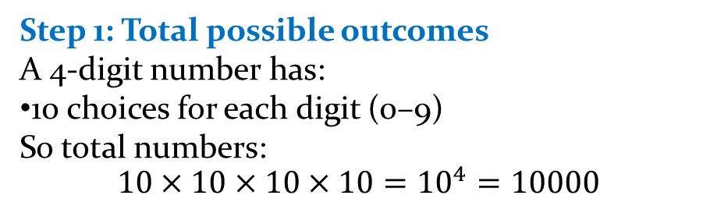
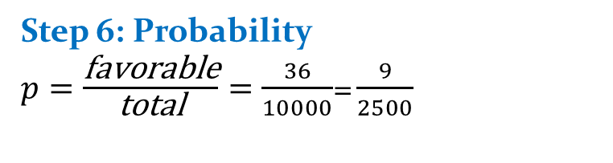
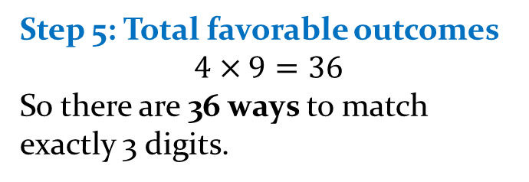
Step 1: Total possible outcomes
A 4-digit number has:
10 choices for each digit (0–9)
So total numbers:
$$10×10×10×10={10}^{4}=10000$$
Step 2: What does “exactly 3 digits match” mean?
It means:
Out of 4 positions, 3 digits are correct
1 digit is wrong
So we choose:
which 3 positions are correct
and the 1 wrong position
Step 5: Total favorable outcomes
$$4×9=36$$
So there are 36 ways to match exactly 3 digits.
Step 6: Probability
$p=\frac{\text{favorable}}{\text{total}}=\frac{36}{10000}$= $\frac{9}{2500}$
Step 3: Choose the wrong position
There are 4 positions, so:
$$4 \text{choices}$$
Step 4: Wrong digit choices
For the wrong position:
any digit except the correct one
so 9 choices

Slide 19
Applying Laplace’s Definition
Example: In a lottery, a player chooses 6 numbers from the numbers 1 to 40.
A machine also randomly selects 6 winning numbers from 1 to 40.
The order does not matter.
What is the probability that the player picks all 6 correct numbers?

Slide 20
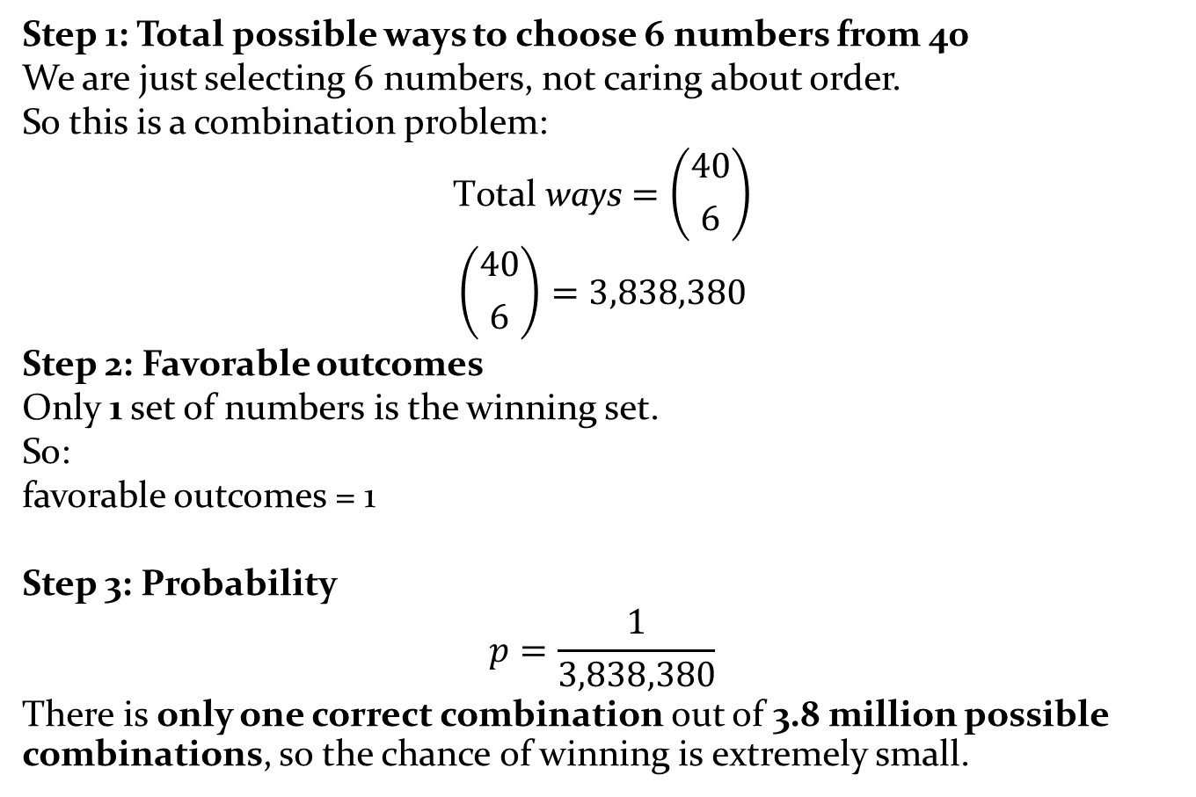
Step 1: Total possible ways to choose 6 numbers from 40
We are just selecting 6 numbers, not caring about order.
So this is a combination problem:
$$\text{Total} \text{ways}=\left({40 \atop 6}\right)$$
$$\left({40 \atop 6}\right)=3,838,380$$
Step 2: Favorable outcomes
Only 1 set of numbers is the winning set.
So:
favorable outcomes = 1
Step 3: Probability
$$p=\frac{1}{3,838,380}$$
There is only one correct combination out of 3.8 million possible combinations, so the chance of winning is extremely small.

Slide 21

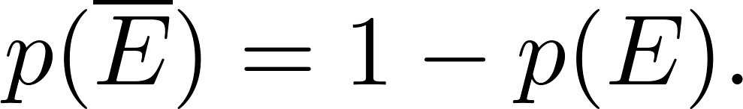
The Probability of Complements and Unions of Events
Theorem 1: Let E be an event in sample space S. The probability of the event = S − E, the complementary event of E, is given by
Proof: Using the fact that

Slide 22
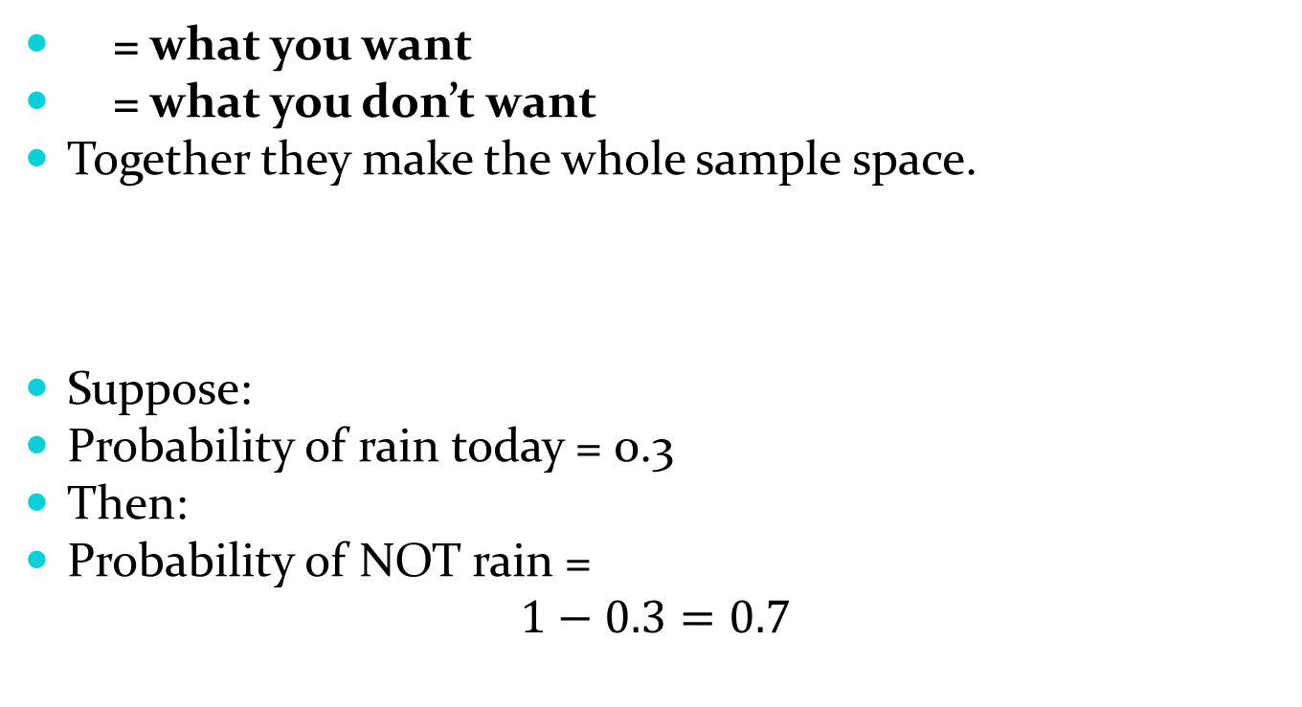
The Probability of Complements and Unions of Events
= what you want
= what you don’t want
Together they make the whole sample space.
Suppose:
Probability of rain today = 0.3
Then:
Probability of NOT rain =
$$1−0.3=0.7$$

Slide 23
The Probability of Complements and Unions of Events
Example: A fair coin is flipped once. What is the probability that the result is not heads?

Slide 24


The Probability of Complements and Unions of Events
Example: A fair coin is flipped once. What is the probability that the result is not heads?
Step 1: Possible outcomes
$$S=\left\{Heads,Tail\right\}$$
Step 2: Event we want
We want:
“not heads”
That means:
$$\left\{Tails\right\}$$
Step 3: Count probabilities
There are 2 equally likely outcomes:
Heads
Tails
So:
Probability of Heads = 1/2
Step 4: Use complement idea
Instead of directly thinking “not heads”, we do:
$$P\left(\text{not} \text{Heads}\right)=1−P\left(\text{Heads}\right)$$
$$=1−\frac{1}{2}$$
$$=\frac{1}{2}$$

Slide 25
The Probability of Complements and Unions of Events
Theorem 2: Let E₁ and E₂ be events in the sample space S. Then
Why do we subtract something?
Because:
If both events happen together, we count them twice
So we subtract the overlap once
Example
Suppose:
10 students like Math
8 students like Physics
3 students like both
Total students = 20
Notes:
Add both probabilities, but subtract the overlap so you don’t count it twice

Slide 26
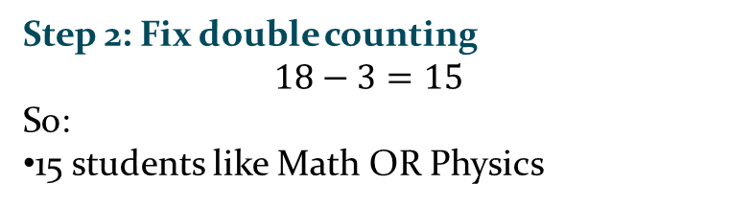
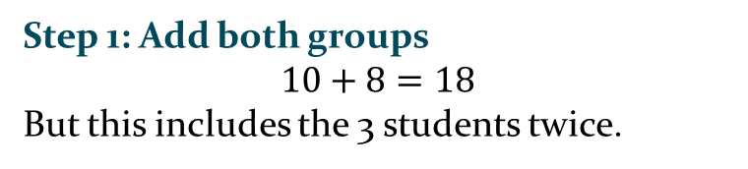
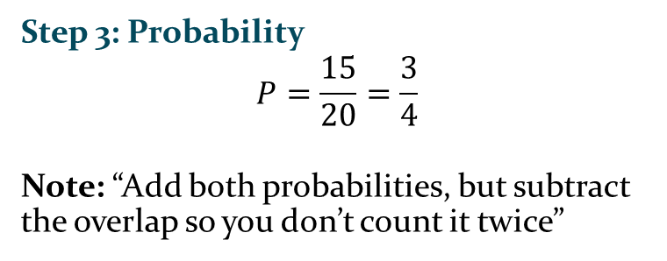
The Probability of Complements and Unions of Events
Example
Suppose:
10 students like Math
8 students like Physics
3 students like both
Total students = 20
Step 3: Probability
$$P=\frac{15}{20}=\frac{3}{4}$$
Note: “Add both probabilities, but subtract the overlap so you don’t count it twice”
Step 1: Add both groups
$$10+8=18$$
But this includes the 3 students twice.
Step 2: Fix double counting
$$18−3=15$$
So:
15 students like Math OR Physics

Slide 27
The Probability of Complements and Unions of Events
Example: A number is randomly chosen from 1 to 100.
What is the probability that the number is: divisible by 2 OR 5?

Slide 28

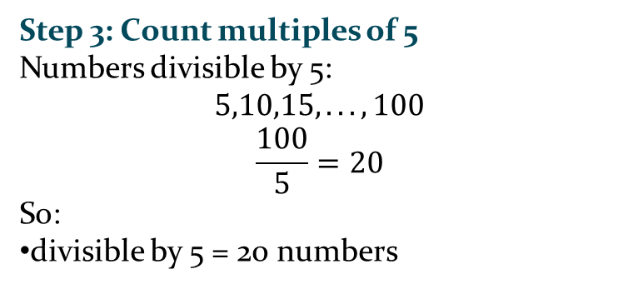

The Probability of Complements and Unions of Events
Example: A number is randomly chosen from 1 to 100.
What is the probability that the number is: divisible by 2 OR 5?
Step 1: Total outcomes
All numbers from 1 to 100:
$$S=100$$
Step 3: Count multiples of 5
Numbers divisible by 5:
$$5,10,15,...,100$$
$$\frac{100}{5}=20$$
So:
divisible by 5 = 20 numbers
Step 2: Count multiples of 2
Numbers divisible by 2:
$$2,4,6,...,100$$
$$\frac{100}{2}=50$$
So:
divisible by 2 = 50 numbers

Slide 29
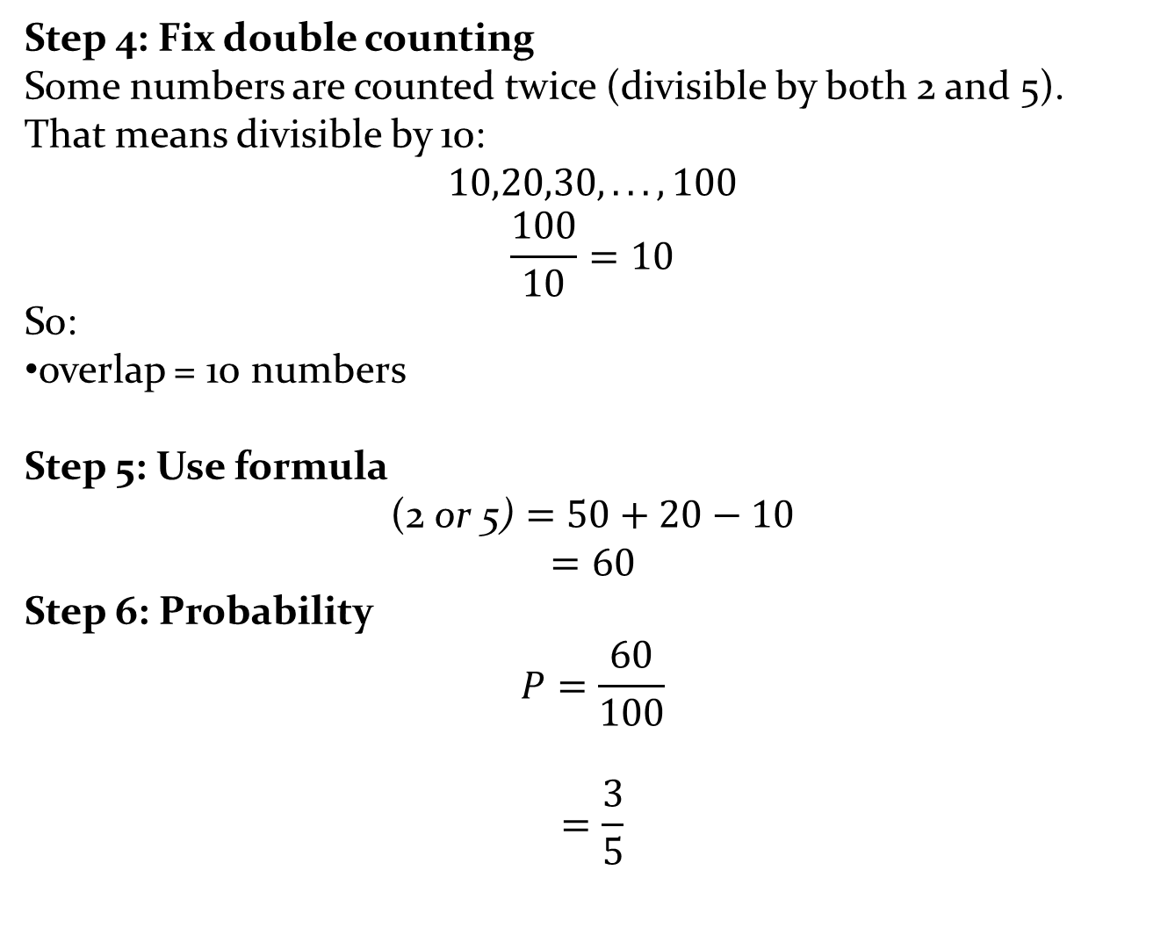
Step 4: Fix double counting
Some numbers are counted twice (divisible by both 2 and 5).
That means divisible by 10:
$$10,20,30,...,100$$
$$\frac{100}{10}=10$$
So:
overlap = 10 numbers
Step 5: Use formula
$$\text{(}\text{2} \text{or} \text{5}\text{)}=50+20−10$$
$$=60$$
Step 6: Probability
$$P=\frac{60}{100}$$
$$=\frac{3}{5}$$

