Slide 1
DISCRETE STRUCTURES
RELATIONS

Slide 2
WHY STUDY RELATIONS ?
We study relations because they help us understand and model connections between things in mathematics, computer science, and real life.
▶ In Mathematics: Relations help us study connections between numbers. For example: One number divides another (like 2 divides 6).
▶ In Computers: Relations describe connections such as:
A program and the variables it uses.
A programming language and its valid statements.
A database storing related information.
▶ In Real-World Problems: Relations help us solve practical problems, such as:
Finding which cities are connected by flights.
Deciding the correct order of tasks in a project.

Slide 3
STRUCTURES FOR REPRESENTING RELATIONS
▶ Relationships between elements of two sets are represented using the structure called a binary relation, which is just a subset of the Cartesian product of the Sets. Example: "Student studies Subject“, A = {Ali, Ahmed}
B = {Math, English} R = {(Ali, Math), (Ahmed, English)} This is a binary relation because:
It connects elements of two sets,
Each pair has 2 elements
R ⊆ A × B
▶ Relationships between elements of more than two sets arise in many contexts. These relationships can be represented by n-ary relations, which are collections of n-tuples. Example: (Student, Course, Grade), R = {(Ali, Math, 85), (Ahmed, English, 90)} -R involve more than two sets.
▶ Such relations are the basis of the relational data model, the most common way to store information in computer databases.

Slide 4
METHODS FOR REPRESENTING RELATIONS
▶ Two methods for representing relations:
Square Matrices
Directed Graphs (consisting of vertices and directed edges)

Slide 5
BINARY RELATIONS AND THEIR PROPERTIES
▶ The easiest way to show a relationship between two sets is by using ordered pairs like (a, b).
Because we use pairs of two elements, this is called a binary relation.
DEFINITION: Let A and B be sets. A binary relation from A to B is a subset of A × B.
▶ In other words, a binary relation from A to B is a set R of ordered pairs, where the first element of each ordered pair comes from A and the second element comes from B.
▶ We use the notation a R b to denote that (a, b) ∈ R and a ̸R b to denote that (a, b) ∉ R.
▶ Moreover, If (a, b) belongs to R, we say: “a is related to b by R”.
▶ Binary relations represent relationships between the elements of two sets

Slide 6
ORDERED PAIR & CARTESIAN PRODUCT
▶ The definition of a set explicitly disregards the order of the set elements, However, sometimes the order is important.
▶ This leads to the notion of an ordered pair of two elements x and y, denoted (x, y).
▶ The crucial property is:
(x, y) EQUALS TO (u, v) if and only if x = u and y = v
▶ If the order changes, the pair is different. Example:(1,2) ≠ (2,1)
This notion can be extended naturally to define an ordered n-tuple as the ordered counterpart of a set with n elements.
▶ Give two sets A and B, their cartesian product A×B is the set of all ordered pairs (x, y), such that x ∈ A and y ∈ B:
A × B = {(x, y) : x ∈ A, y ∈ B}
If A = {1,2},B = {a,b,c}Then:A × B ={(1,a), (1,b), (1,c), (2,a), (2,b), (2,c)}
NOTE:
If set A has m elements and set B has n elements then A ×B has m × n elements.
Notes:
Set → order does not matter Ordered pair → order matters Cartesian product → all possible ordered pairs from two sets

Slide 7
EXAMPLE A (ORDERED PAIR)
Find x and y given (2x, x + y) = (6, 2) SOLUTION:
Two ordered pairs are equal if and only if the corresponding components are equal. Hence, we obtain the equations:
2x = 6
x + y = 2
………………(1)
…………(2)
Solving equation (1) we get x = 3 and when the value is substituted
in (2) we get y = -1.

Slide 8
EXAMPLE B(CARTESIAN PRODUCT)
Let A = {1, 2}, B = {a,b,c} then find AxB,BxA,AxA,BxB.
SOLUTION:
A ×B = {(1,a), (1,b), (1,c), (2,a), (2, b), (2, c)}
B ×A = {(a,1), (a,2), (b, 1), (b, 2), (c, 1), (c, 2)}
A ×A = {(1, 1), (1,2), (2, 1), (2, 2)}
B ×B = {(a,a), (a,b), (a,c), (b,a), (b, b), (b, c), (c,a), (c,b),(c,c)}
REMARK:
▶ A × B ≠ B × A for non-empty and unequal sets A and B.
▶ A × φ = φ × A = φ
▶ | A × B| = |A| × |B|
If ∣𝐴∣=2, ∣𝐵∣=3 so ∣𝐴×𝐵∣=6

Slide 9
EXAMPLE C (BINARY RELATION)
Let A = {1, 2},B = {1, 2, 3}, List any five binary relations. SOLUTION:
A × B = {(1, 1), (1, 2), (1, 3), (2, 1), (2, 2), (2, 3)}
The Binary Relations over A x B are: R1={(1,1), (1, 3), (2, 2)}
R2={(1, 2), (2, 1), (2, 2), (2, 3)}
R3={(1, 1)}
R4= A × B
R5= ∅
▶ All being subsets of A × B are relations from A to B.
Notes:
A Binary Relation from A to B is: Any subset of A × B
That means:
First find A × B Then choose ANY pairs from it That chosen set is a relation

Slide 10
DOMAIN & RANGE OF RELATIONS
DOMAIN OF A RELATION:
The domain of a relation R from A to B is the set of all first
elements of Dom(R).
Symbolically:
the ordered pairs which belong to R denoted
Dom (R) = {a ∈A| (a,b) ∈R}
RANGE OF A RELATION:
The range of A relation R from A to B is the set of all second elements of the ordered pairs which belong to R denoted Ran(R).
Symbolically:
Ran(R) = {b ∈B|(a,b) ∈ R}
If: R = {(1,2),(1,3),(2,3)}
Domain: All first elements, Dom(R) = {1,2}
Range: All second elements, Ran(R) = {2,3}

Slide 11
EXAMPLE D
Let A = {1, 2}, B = {1, 2, 3}, Define a binary relation R from A to B as follows: R = {(a, b) ∈A × B | a < b}
Then
Find the ordered pairs in R.
Find the Domain and Range of R.
Is 1R3, 2R2?
SOLUTION:
Given A = {1, 2}, B = {1, 2, 3}, then
A × B = {(1,1), (1,2), (1,3), (2,1), (2,2), (2,3)}
R = {(a, b) ∈ A × B | a < b}
R = {(1,2), (1,3), (2,3)}
Dom(R) = {1,2} and Ran(R) = {2, 3}
Since (1,3) ∈ R so 1R3, But (2, 2) ∉R so 2 is not related.

Slide 12
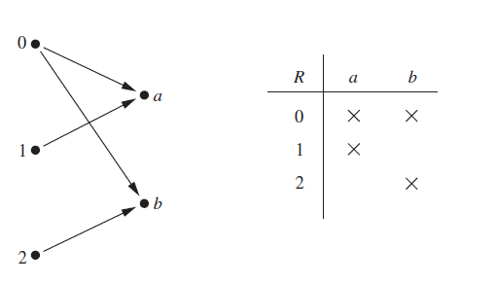
EXAMPLE E
Let A = {0, 1, 2} and B = {a, b}.
Then {(0, a), (0, b), (1, a), (2, b)} is a relation from A to B. This means, for instance, that 0Ra, but that 1 ̸R b & also 2 ̸R a.
Relations can be represented graphically, as shown in the figure below, using arrows to represent ordered pairs. Another way to represent this relation is to use a table, which is also shown in the figure.

Slide 13
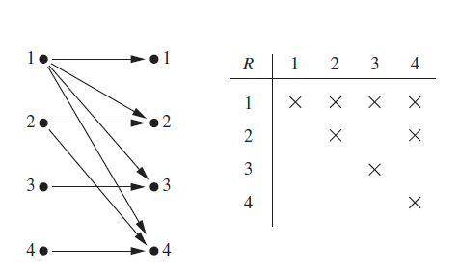
EXAMPLE F
Let A be the set {1, 2, 3, 4}. Which ordered pairs are in the relation R = {(a, b) ∣ a divides b}?
SOLUTION: Because (a, b) is in R if and only if a and b are positive integers not exceeding 4 such that a divides b, we see that
R = {(1, 1), (1, 2), (1, 3), (1, 4), (2, 2), (2, 4), (3, 3), (4,4)}.
▶ The pairs in this relation are displayed both graphically and in tabular form in the figure.

Slide 14
Let A be the set {1, 2, 3, 4}. Which ordered pairs are in the relation R = {(a, b) ∣ a ≤ b}?
R = {(1,1),(1,2),(1,3),(1,4),(2,2),(2,3),(2,4),(3,3),(3,4),(4,4)}.
▶ represent R graphically and in tabular form.

Slide 15
EXERCISE A
Consider these relations on the set of integers:
R1 = {(a, b) ∣ a ≤ b},
R2 = {(a, b) ∣ a > b},
R3 = {(a, b) ∣ a = b or a = −b}, R4 = {(a, b) ∣ a = b},
R5 = {(a, b) ∣ a = b + 1},
R6 = {(a, b) ∣ a + b ≤ 3}.
Which of these relations contain each of the pairs (1, 1), (1, 2), (2, 1), (1,−1),
and (2, 2)?
List the ordered pairs in the relation R from A = {0, 1, 2, 3, 4} to B =
{0, 1, 2, 3}, where (a, b) ∈ R if and only if
a) a = b.
c) a > b.
e) gcd(a, b) = 1.
b) a + b = 4.
d) a ∣ b.
f ) lcm(a, b) = 2.
List all the ordered pairs in the relation R = {(a, b) ∣ a divides b} on the set {1, 2, 3, 4, 5, 6}.
Display this relation graphically.
Display this relation in tabular form.

Slide 16


RELATIONS ON A SET
▶ Relations from a set A to itself are of special interest. DEFINITION: A relation on a set A is a relation from A to A. In other words, a relation on a set A is a subset of A × A.
EXAMPLE:
How many relations are there on a set with n elements?
SOLUTION:
A relation on a set A is a subset of A × A.
Because A × A has n² elements when A has n elements, and a
set with m elements has 2^{m} subsets, there are subsets of A × A. Thus, there are relations on a set with n elements.
For example, there are
{a, b, c}.
relations on the set

Slide 17
RELATIONS ON A SET
Let:
A = {1,2}
Then: n = 2
Step 1: A × A has: 2² = 4 elements
Those are: (1,1), (1,2), (2,1), (2,2) So m = 4
Step 2: Number of subsets = 2⁴ = 16
So there are 16 relations.

Slide 18
PROPERTIES OF RELATIONS
There are several properties that are used to classify relations on a set.
A relation R on a set A is called
reflexive if for all a ∈ A, aRa. Every element is related to itself.
symmetric if for all a, b ∈ A, aRb implies bRa. If (a,b) ∈ R then (b,a) must also be in R
antisymmetric if for all a, b ∈ A, aRb and bRa implies a = b. If:(a,b) ∈ R and (b,a) ∈ R Then: a = b
transitive if for all a, b, c ∈ A, aRb and bRc implies aRc. If:(a,b) ∈ Rand (b,c) ∈ R Then:(a,c) must also be in R

Slide 19
REFLEXIVE RELATION
A relation R on a set A is called reflexive if (a, a) ∈ R for every element a ∈ A.
(a,a) ∈ R
Every element is related to itself.
Example A = {1,2,3}
If R = {(1,1),(2,2),(3,3),(1,2)}
This is reflexive because:
(1,1)
(2,2)
(3,3)
All elements relate to themselves.
If one is missing?
If (3,3) is missing → NOT reflexive.

Slide 20
REFLEXIVE RELATION
EXAMPLE G
Consider the following relations on {1, 2, 3, 4}:
▶ R1 = {(1, 1), (1, 2), (2, 1), (2, 2), (3, 4), (4, 1), (4, 4)},
▶ R2 = {(1, 1), (1, 2), (2, 1)},
▶ R3 = {(1, 1), (1, 2), (1, 4), (2, 1), (2, 2), (3, 3), (4, 1), (4, 4)},
▶ R4 = {(2, 1), (3, 1), (3, 2), (4, 1), (4, 2), (4, 3)},
▶ R5 = {(1, 1), (1, 2), (1, 3), (1, 4), (2, 2), (2, 3), (2, 4), (3, 3), (3, 4), (4, 4)},
▶ R6 = {(3, 4)}.
Which of these relations are reflexive? SOLUTION:
▶ The relations R3 and R5 are reflexive because they both contain all pairs of the form (a, a), namely, (1, 1), (2, 2), (3, 3), and (4, 4).
▶ The other relations are not reflexive because they do not contain all of these ordered pairs. In particular, R1, R2, R4, and R6 are not reflexive because (3, 3) is not in any of these relations.

Slide 21
SYMMETRIC & ANTISYMMETRIC RELATION
A relation R on a set A is called symmetric if (b, a) ∈ R whenever (a, b) ∈ R, for all a, b ∈ A.
AND
A relation R on a set A such that for all a, b ∈ A, if (a, b) ∈ R and (b, a) ∈ R, then a = b is called antisymmetric.
A symmetric relation: A relation R on a set A is symmetric if: (𝑎,𝑏)∈𝑅 ⇒ (𝑏,𝑎)∈𝑅 Meaning: Whenever a is related to b, b must also be related to a.
Let 𝐴={1,2,3} so 𝑅={(1,2),(2,1),(2,3),(3,2)} So R is symmetric
An antisymmetric relation: A relation R on A is antisymmetric if: (𝑎,𝑏)∈𝑅 and (𝑏,𝑎)∈𝑅⇒ 𝑎=𝑏 Meaning: If both directions happen, then a and b must be the same element.
Let 𝐴={1,2,3}, 𝑅={(1,1),(2,2),(3,3),(1,2)} Notice: (1,2) is there (2,1) is NOT there So no two different numbers point to each other.

Slide 22
EXAMPLE I
Consider the following relations on {1, 2, 3, 4}:
▶ R2 = {(1, 1), (1, 2), (2, 1)},
▶ R3 = {(1, 1), (1, 2), (1, 4), (2, 1), (2, 2), (3, 3), (4, 1), (4, 4)},
▶ R4 = {(2, 1), (3, 1), (3, 2), (4, 1), (4, 2), (4, 3)},
▶ R5 = {(1, 1), (1, 2), (1, 3), (1, 4), (2, 2), (2, 3), (2, 4), (3, 3), (3, 4), (4, 4)},
▶ R6 = {(3, 4)}.
Which of these relations are Symmetric and antisymmetric ?
SOLUTION:
▶ The relations R2 and R3 are symmetric, because in each case (b, a) belongs to the relation whenever (a, b) does. For R2, the only thing to check is that both (2, 1) and (1, 2) are in the relation. For R3, it is necessary to check that both (1, 2) and (2, 1) belong to the relation, and (1, 4) and (4, 1) belong to the relation.
▶ R4, R5, and R6 are all antisymmetric. For each of these relations there is no pair of elements a and b with a ≠ b such that both (a, b) and (b, a) belong to the relation. This is done by finding a pair (a, b) with a ≠ b such that (a, b) and (b, a) are both in the relation.

Slide 23
EXAMPLE J
Is the “divides” relation on the set of positive integers
symmetric?
SOLUTION:
This relation is not symmetric because 1/ 2, are 2 ̸ 1 are not related.

Slide 24
TRANSITIVE RELATION
A relation R on a set A is called transitive if whenever (a, b) ∈ R and (b, c)∈ R, then (a, c) ∈ R, for all a, b, c ∈ A.
If two-step paths exist, the shortcut must exist. If no two-step path exists, nothing can go wrong.
NOTE:
Transitivity only requires that when a chain exists, the resulting pair (a,c) is in the relation.
If no chain exists, there’s nothing to check → automatically OK

Slide 25
TRANSITIVE RELATION
A relation R on a set A is called transitive if whenever (a, b) ∈ R and (b, c)
∈ R, then (a, c) ∈ R, for all a, b, c ∈ A.
EXAMPLE K
Consider the following relations on {1, 2, 3, 4}:
▶ R1 = {(1, 1), (1, 2), (2, 1), (2, 2), (3, 4), (4, 1), (4, 4)},
▶ R2 = {(1, 1), (1, 2), (2, 1)},
▶ R3 = {(1, 1), (1, 2), (1, 4), (2, 1), (2, 2), (3, 3), (4, 1), (4, 4)},
▶ R4 = {(2, 1), (3, 1), (3, 2), (4, 1), (4, 2), (4, 3)},
▶ R5 = {(1, 1), (1, 2), (1, 3), (1, 4), (2, 2), (2, 3), (2, 4), (3, 3), (3, 4), (4, 4)}.
Which of these relations are transitive ? SOLUTION:
R4 and R5 are transitive. For each of these relations, we can show that it is transitive by verifying that if (a, b) and (b, c) belong to this relation, then (a, c) also does. For instance, R4 is transitive, because of (3, 2) and (2, 1), (4, 2) and
(2, 1), (4, 3) and (3, 1), and (4, 3) and (3, 2) are the only such sets of pairs, and
(3, 1), (4, 1), and (4, 2) belong to R4.
R1 is not transitive because (3, 4) and (4, 1) belong to R1, but (3, 1) does not.
R2 is not transitive because (2, 1) and (1, 2) belong to R2, but (2, 2) does not.
R3 is not transitive because (4, 1) and (1, 2) belong to R3, but (4, 2) does not. Transitivity means: ALL possible chains must satisfy the rule.

Slide 26
EXERCISE B
▶ Is the “divides” relation on the set of positive integers transitive?
▶ For each of these relations on the set {1, 2, 3, 4}, decide whether it is reflexive, whether it is symmetric, whether it is antisymmetric, and whether it is transitive.
{(2, 2), (2, 3), (2, 4), (3, 2), (3, 3), (3, 4)}
{(1, 1), (1, 2), (2, 1), (2, 2), (3, 3), (4, 4)}
{(2, 4), (4, 2)}
{(1, 2), (2, 3), (3, 4)}
{(1, 1), (2, 2), (3, 3), (4, 4)}
{(1, 3), (1, 4), (2, 3), (2, 4), (3, 1), (3, 4)}
▶ Determine whether the relation R on the set of all people is reflexive, symmetric, antisymmetric, and/or transitive, where (a, b) ∈ R if and only if
a is taller than b.
a and b were born on the same day.
a has the same first name as b.
a and b have a common grandparent.

Slide 27
Combining Relations
Given two relations R₁ and R₂, we can combine them using basic set operations to form new relations such as R₁ ∪ R₂, R₁ ∩ R₂, R₁ − R₂, and R₂ − R₁.
Example: Let A = {1,2,3} and B = {1,2,3,4}. The relations R₁ = {(1,1),(2,2),(3,3)} and R₂ = {(1,1),(1,2),(1,3),(1,4)} can be combined using basic set operations to form new relations:
Take all pairs that are in R1 OR in R2
R₁ ∪ R₂ ={(1,1),(1,2),(1,3),(1,4),(2,2),(3,3)}
Take only pairs that are in BOTH R1 AND R2 R₁ ∩ R₂ ={(1,1)}
Take pairs that are in R1 but NOT in R2 R₁ − R₂ ={(2,2),(3,3)}
Take pairs that are in R2 but NOT in R1 R₂ − R₁ ={(1,2),(1,3),(1,4)}

Slide 28
Composition
Composition means linking two relations through a common middle element.
Let R₁ connect set A to set B.
Let R₂ connect set B to set C.
To form the composition R₂ ∘ R₁ (read: “R₂ after R₁”):
If R₁ connects x to y,
And R₂ connects y to z,
Then the composition connects x to z.
Match the middle element (y), & connect the first to the last.
Let the sets be:
A = {1, 2}, B = {a, b}, C = {X, Y}
R₁ = { (1, a), (2, b) }
R₂ = { (a, X), (b, Y) }
(R₂ ∘ R₁)= { (1, X), (2, Y) }

Slide 29
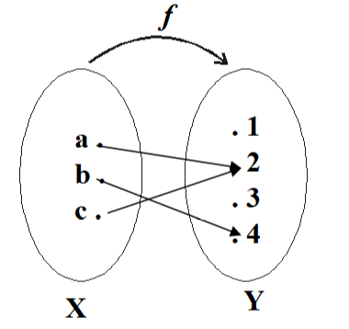
RELATIONS AND FUNCTIONS
A relation is just any set of ordered pairs like: (x, y)
A function is a special kind of relation.
Since a function is made of ordered pairs too, every function is automatically a relation.
But not every relation is a function
A function must follow two strict rules:
Every input must have an output.
Each input can have only one output.

Slide 30
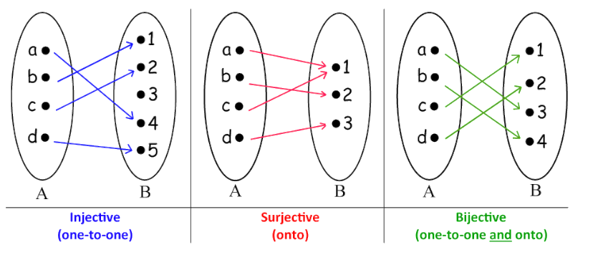

Slide 31
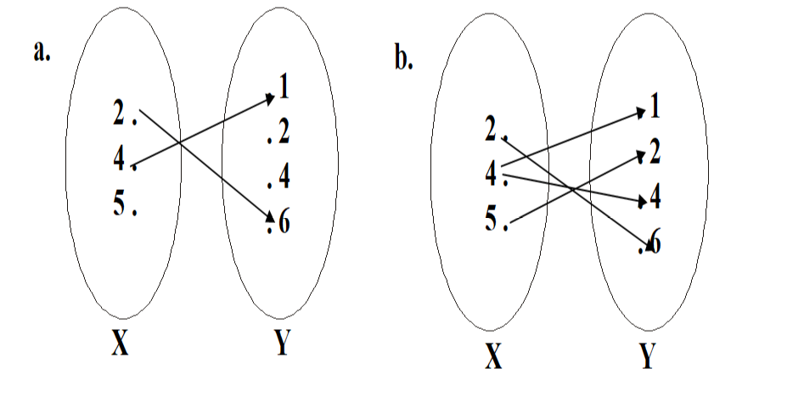
FUNCTIONS & NONFUNCTIONS
The relation given in the diagram (a) is Not a function because there is no arrow coming out of 5∈X to any element of Y.
The relation in the diagram (b) is Not a function, because there are two arrows coming out of 4∈X. i.e.,4∈X is not related to a unique element of Y.

Slide 32
REPRESENTING RELATIONS
▶ There are many ways to represent a relation between finite sets.
▶ As we have seen previously, one way is to list its ordered pairs.
Another way to represent a relation is to use a table.
▶ Now we will discuss two alternative methods for representing relations. One method uses zero–one matrices. The other method uses pictorial representations called directed graphs.

Slide 33
REPRESENTING RELATIONS USING MATRICES
A relation between finite sets can be shown using a matrix of 0s and 1s.
Suppose: A = {a₁, a₂, …, aₘ} & B = {b₁, b₂, …, bₙ}
▶ The relation R can be represented by the matrix M_{R} = [m_{ij}], where
Rows → elements of A
Columns → elements of B
For each position (i, j):
Put 1 if aᵢ is related to bⱼ
Put 0 if aᵢ is not related to bⱼ
1 if (a_{i}, b_{j}) ∈ R,
0 if (a_{i}, b_{j}) ∉ R.
m_{ij} =

Slide 34
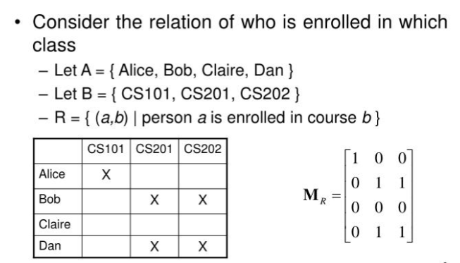

Slide 35
EXAMPLE N
Let A = {1, 2, 3} and B = {x, y}, Let R be a relation from A to B defined as R ={(1,y), (2,x), (2,y), (3,x)}
x
1 ⎡0
y
1⎤
₁⎥
M = 2 ⎢1
⎥
^{0⎥}⎦3×2
⎢
3 ⎢⎣1

Slide 36
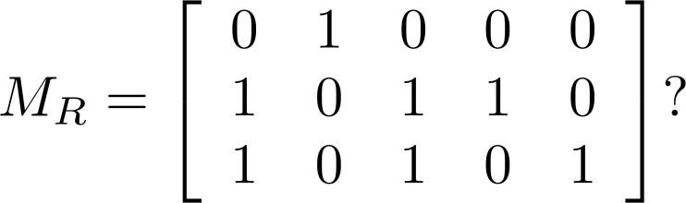
Examples of Representing Relations Using Matrices (cont.)
Example 3: Let A = {a₁,a₂, a₃} and B = {b₁,b₂, b₃,b₄, b₅}. Which ordered pairs are in the relation R represented by the matrix
Solution:
R = {(a₁, b₂), (a₂, b₁),(a₂, b₃), (a₂, b₄),(a₃, b₁), {(a₃, b₃), (a₃, b₅)}.

Slide 37
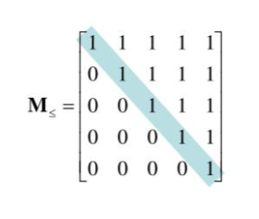
Matrices of Relations on Sets
If R is a reflexive relation, all the elements on the main diagonal of M_{R} are equal to 1.

Slide 38
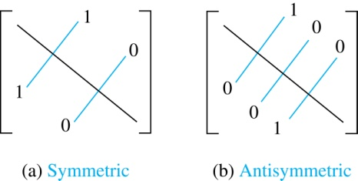
Matrices of Relations on Sets
R is a symmetric relation If aᵢ is related to aⱼ, then aⱼ is related to aᵢ.
In the matrix: If position (i, j) is 1, then position (j, i) must also be 1.
So the matrix looks mirrored across the diagonal.
R is a symmetric relation,
if and only if m_{ij} = 1 whenever m_{ji} = 1.

Slide 39
Matrices of Relations on Sets
The matrix of an antisymmetric relation has the property that if 𝑚𝑖𝑗=1 with 𝑖≠𝑗, then 𝑚𝑗𝑖=0 ​
OR Either 𝑚𝑖𝑗=0 or 𝑚𝑗𝑖=0 when 𝑖≠𝑗
In other words:
If i ≠ j, at least one of the two entries must be 0.

Slide 40
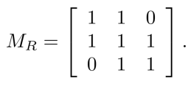
Matrices of Relations on Sets
Suppose that the relation R on a set is represented by the matrix
Is R reflexive, symmetric, and/or antisymmetric?
Solution:
Because all the diagonal elements are equal to 1, R is reflexive.
Because MR is symmetric, R is symmetric and not antisymmetric because both m1,2 and m2,1 are 1.

Slide 41
REPRESENTING RELATIONS USING Directed Graph (Digraph)
A directed graph (or digraph) has:
A set of vertices (points or nodes) called V.
A set of edges (arrows) called E.
Each edge is an ordered pair like (a, b), meaning an arrow from a to b.
The vertex a is the start (initial vertex) of the arrow.
The vertex b is the end (terminal vertex) of the arrow.
If an edge goes from a vertex back to itself, like (a, a), it’s called a loop.
In short:
Vertices = points
Edges = arrows between points
Loop = arrow that starts and ends at the same point

Slide 42
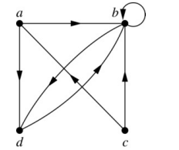
REPRESENTING RELATIONS USING Directed Graph (Digraph)
A drawing of the directed graph with
vertices a, b, c, and d, and
edges (a, b), (a, d), (b, b), (b, d), (c, a), (c, b), (d, b) is shown here.

Slide 43
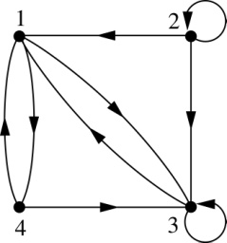
REPRESENTING RELATIONS USING Directed Graph (Digraph)
Example : What are the ordered pairs in the relation represented by this directed graph?
Solution: The ordered pairs in the relation are
(1, 3), (1, 4), (2, 1), (2, 2), (2, 3), (3, 1), (3, 3), (4, 1), and (4, 3)

Slide 44
EXAMPLE O
For the relation matrix.
1 2 3
1 ⎡1 0 1⎤
M = 2 ⎢1 0
⎢ ⎥
3 ⎣0 1 1 ⎦
₀⎥
▶ List the set of ordered pairs represented by M.
▶ Draw the directed graph of the relation.
SOLUTION:
The relation corresponding to the given Matrix is
▶ R = {(1,1), (1,3), (2,1) ,(3,2), (3,3)}
and its Directed graph is given below
1
2
3

Slide 45
Determining which Properties a Relation has from its Digraph
1. Reflexive: Every vertex must have a loop.
That means:
For every element x
The pair (x, x) must exist
In the graph: Every vertex must have a small circle (loop) on itself.
If even one vertex does not have a loop, Then it is NOT reflexive.
2. Symmetric
If there is an arrow from x to y, there must also be an arrow from y to x.
So If (x, y) exists, then (y, x) must also exist.
In the graph: Every arrow must have a matching arrow going back.
Example: x → y y → x
If one direction is missing, Then it is NOT symmetric.
3. Antisymmetric
If x → y exists (and x ≠ y), then y → x must NOT exist.
So you cannot have arrows both ways
between two different vertices.
If you see: x → y and y → x
and x ≠ y, then it is NOT antisymmetric.
4. Transitive: This means:
If you can go from x → y and from y → z then you must also be able to go from x → z.
So if: x → y y → z
Then (x → z) must also be present.
If that direct arrow is missing Then it is NOT transitive.

Slide 46
DIRECTED GRAPH OF A REFLEXIVE RELATION
The directed graph of every reflexive relation includes an arrow from every point to the point itself (i.e., a loop).
EXAMPLE Q
Let A = {1, 2, 3, 4} and define relations R₁, A by
R₁ = {(1, 1), (3, 3), (2, 2), (4, 4)}
R₂ = {(1, 1), (1, 4), (2, 2), (3, 3), (4, 3)}
R₃ = {(1, 1), (1, 2), (2, 1), (2, 2), (3, 3), (4, 4)}
R₄ = {(1, 4), (2, 2), (2, 3), (4, 1), (3, 3)}
Then their directed graphs are:
R₂, R₃, and R₄ on

Slide 47
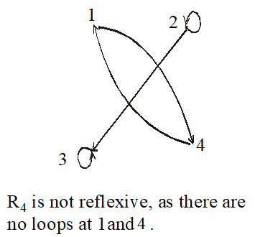

1
2
1
2
4 3
R₁ is reflexive because at every point of the set A we have a loop in the graph.
4 3
R₂ is not reflexive, as there is no loop at 4.
1
2
1
2
4
3
4
3
R₄ is not reflexive, as there are
R₃ is reflexive
no loops at 1and 3.

Slide 48
GRAPH OF A SYMMETRIC RELATION
For a symmetric directed graph whenever there is an arrow going from one point of the graph to a second, there is an arrow going from the second point back to the first.
EXAMPLE S
Let A = {1, 2, 3, 4} and define relations R₁, R₂, R₃, and R₄on A by the directed graphs:
R₁ = {(1, 1), (1, 3), (2, 4), (3, 1), (4,2)}
R₂ = {(1, 1), (2, 2), (3, 3), (4, 4)}
R₃ = {(2, 2), (2, 3), (3, 4)}
R₄= {(1, 1), (2, 2), (3, 3), (4, 3), (4, 4)}

Slide 49







2
1
1
2
4
4
R₂ is symmetric Because reversing any pair gives the same pair, which is already in the relation.
3
3
R₁ is symmetric
1
1
2
2
4
3
4 3
R₄ is not symmetric since there is an arrow from 4 to 3 but no arrow from 3 to 4 But R4 is antisymmetric.
R₃ is not symmetric since there are arrows from 2 to 3 and from 3 to 4 but not conversely But R3 is antisymmetric.

Slide 50
DIRECTED GRAPH OF A TRANSITIVE RELATION
For a transitive directed graph, whenever there is an arrow going from one point to the second, and from the second to the third, there is an arrow going directly from the first to the third.
EXAMPLE W
Let A = {1, 2, 3, 4} and define relations R₁, R₂ and R₃ on A by the directed graphs:
R₁ = {(1, 1), (1, 2), (1, 3), (2, 3)}
R₂ = {(1, 2), (1, 4), (2, 3), (4, 3)}
R₃ = {(2, 1), (2, 4), (2, 3), (4,3)}

Slide 51
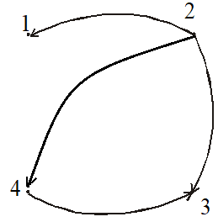
1
1
2
2
4
4
3
3
R₁ is transitive
R₂ is not transitive since there is an arrow from 1 to 2 and from 2
to 3 but no arrow from 1 to 3 directly
2
1
4
3
R₃ is transitive

Slide 52
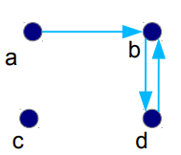
Determining which Properties a Relation has from its Digraph
• Reflexive? No, there are no loops
• Symmetric? No, there is an edge from a to b, but not from b to a
• Antisymmetric? No, there is an edge from d to b and b to d
● Transitive? No, there are edges from a to c and from c to b, but there is no edge from a to d

