Slide 1
ECO346
ASSIGNMENT 01
PSLM DATA
ANALYSIS
Education spending and literacy patterns
in Rural Balochistan
DATA VISUALIZATION
TECHNIQUES FOR ECONOMISTS
Faiza Batool • FA24-BEDS-086

Slide 2
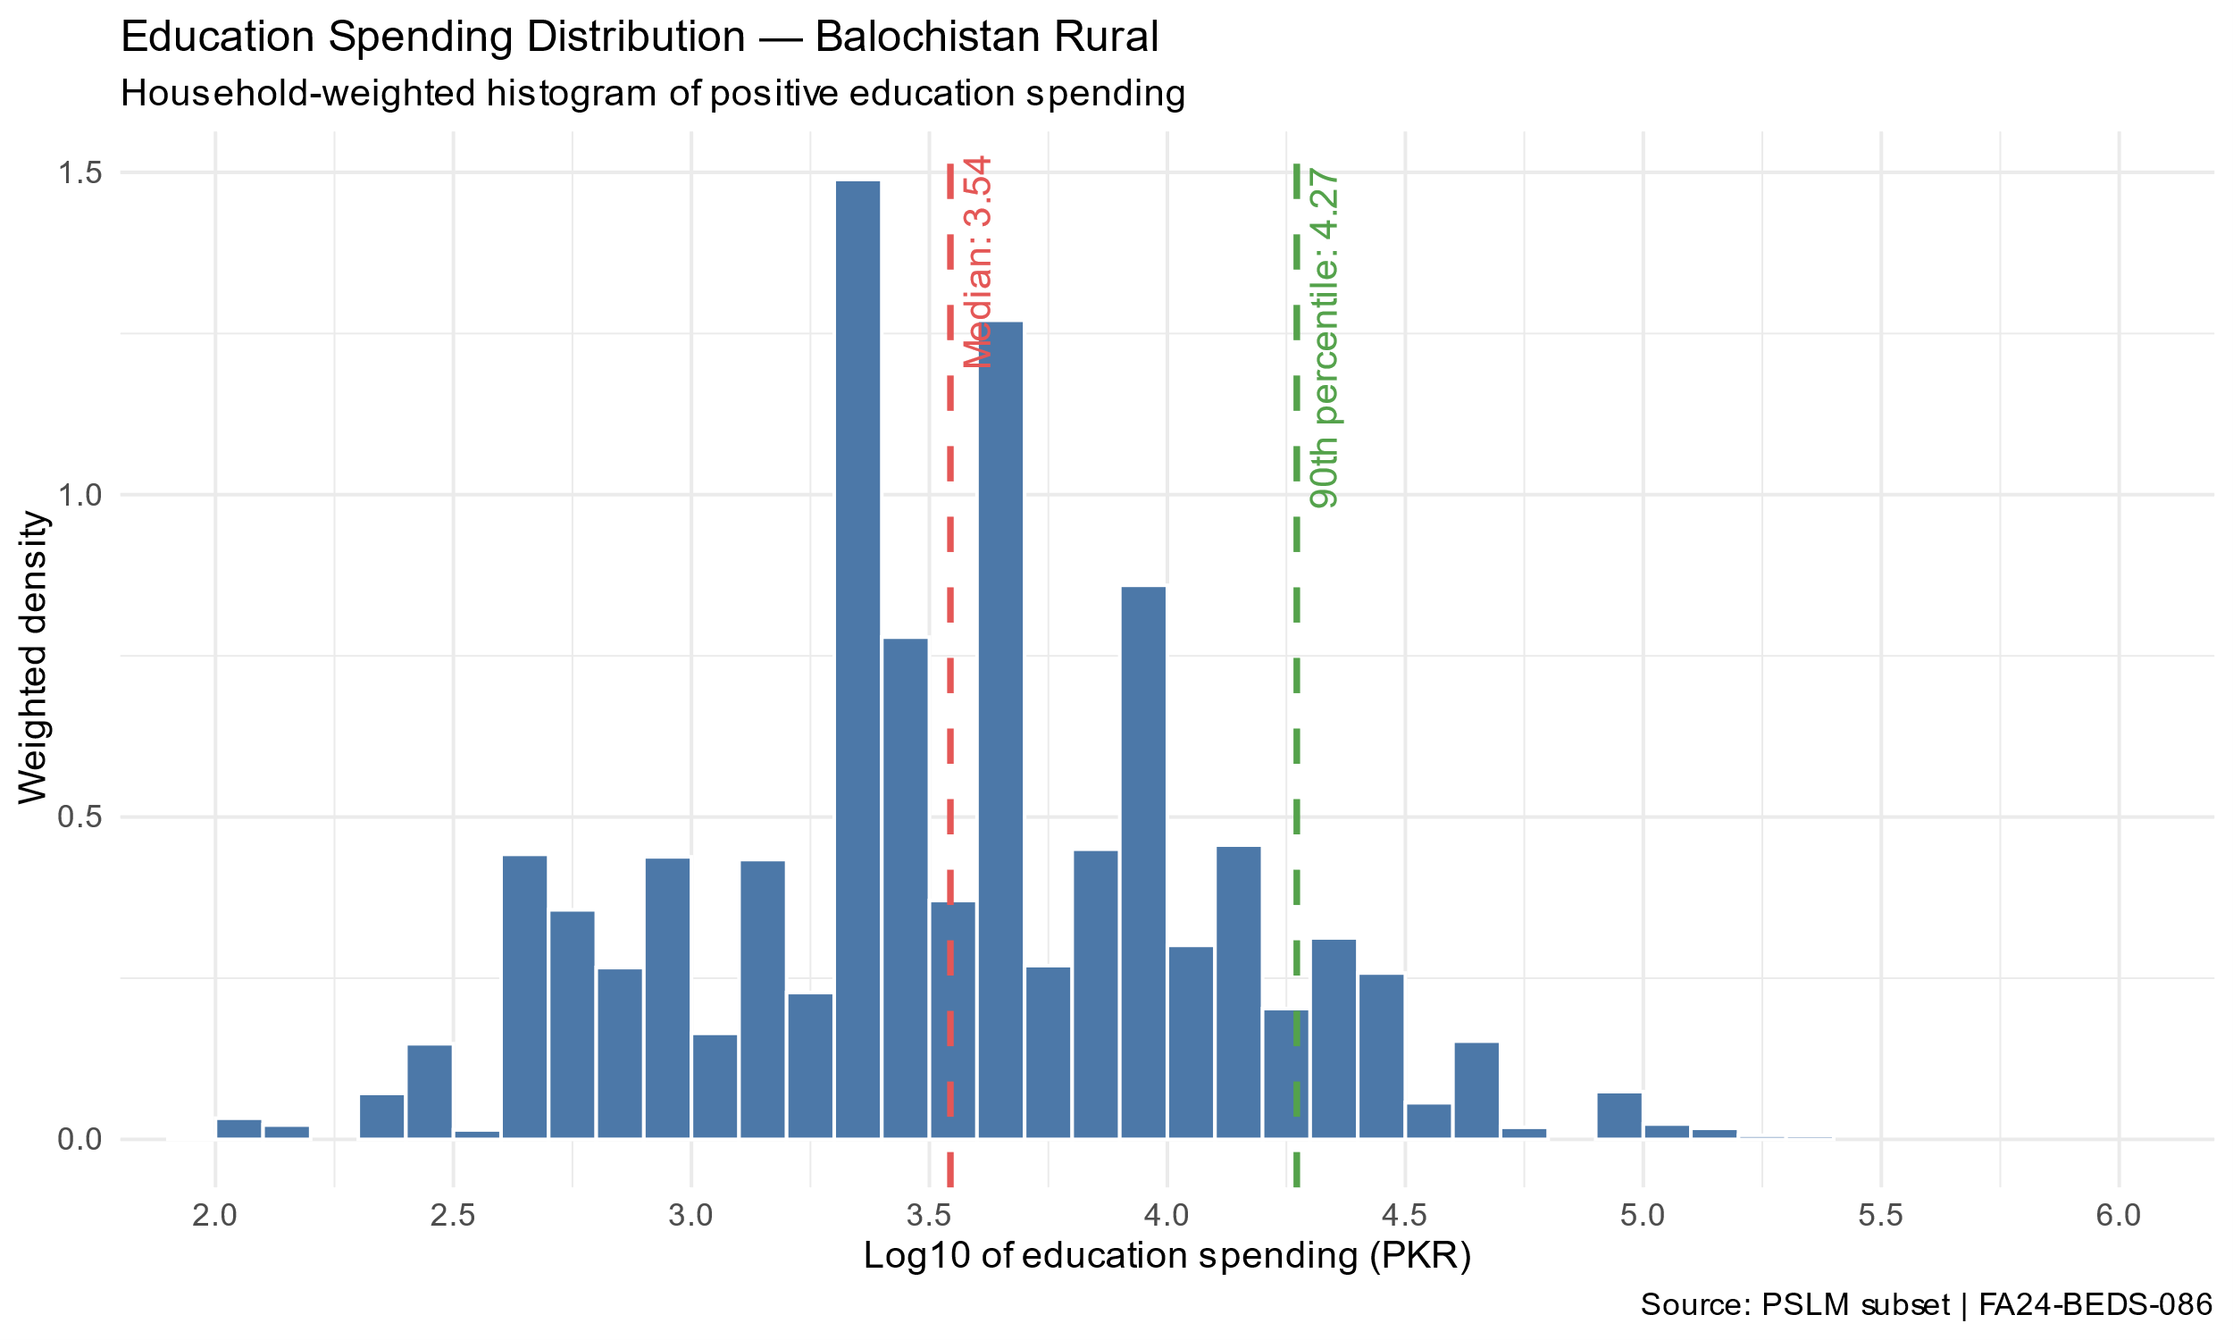
QUESTION 2 • WEIGHTED DISTRIBUTION
Household-Weighted Education Spending — Balochistan Rural
WEIGHTED MEDIAN 3.54
90TH PERCENTILE 4.27
INTERPRETATION
The histogram shows the household-weighted distribution of positive education spending on a logarithmic scale. The weighted median and 90th percentile help describe typical spending and higher-spending households.
02 / 05

Slide 3
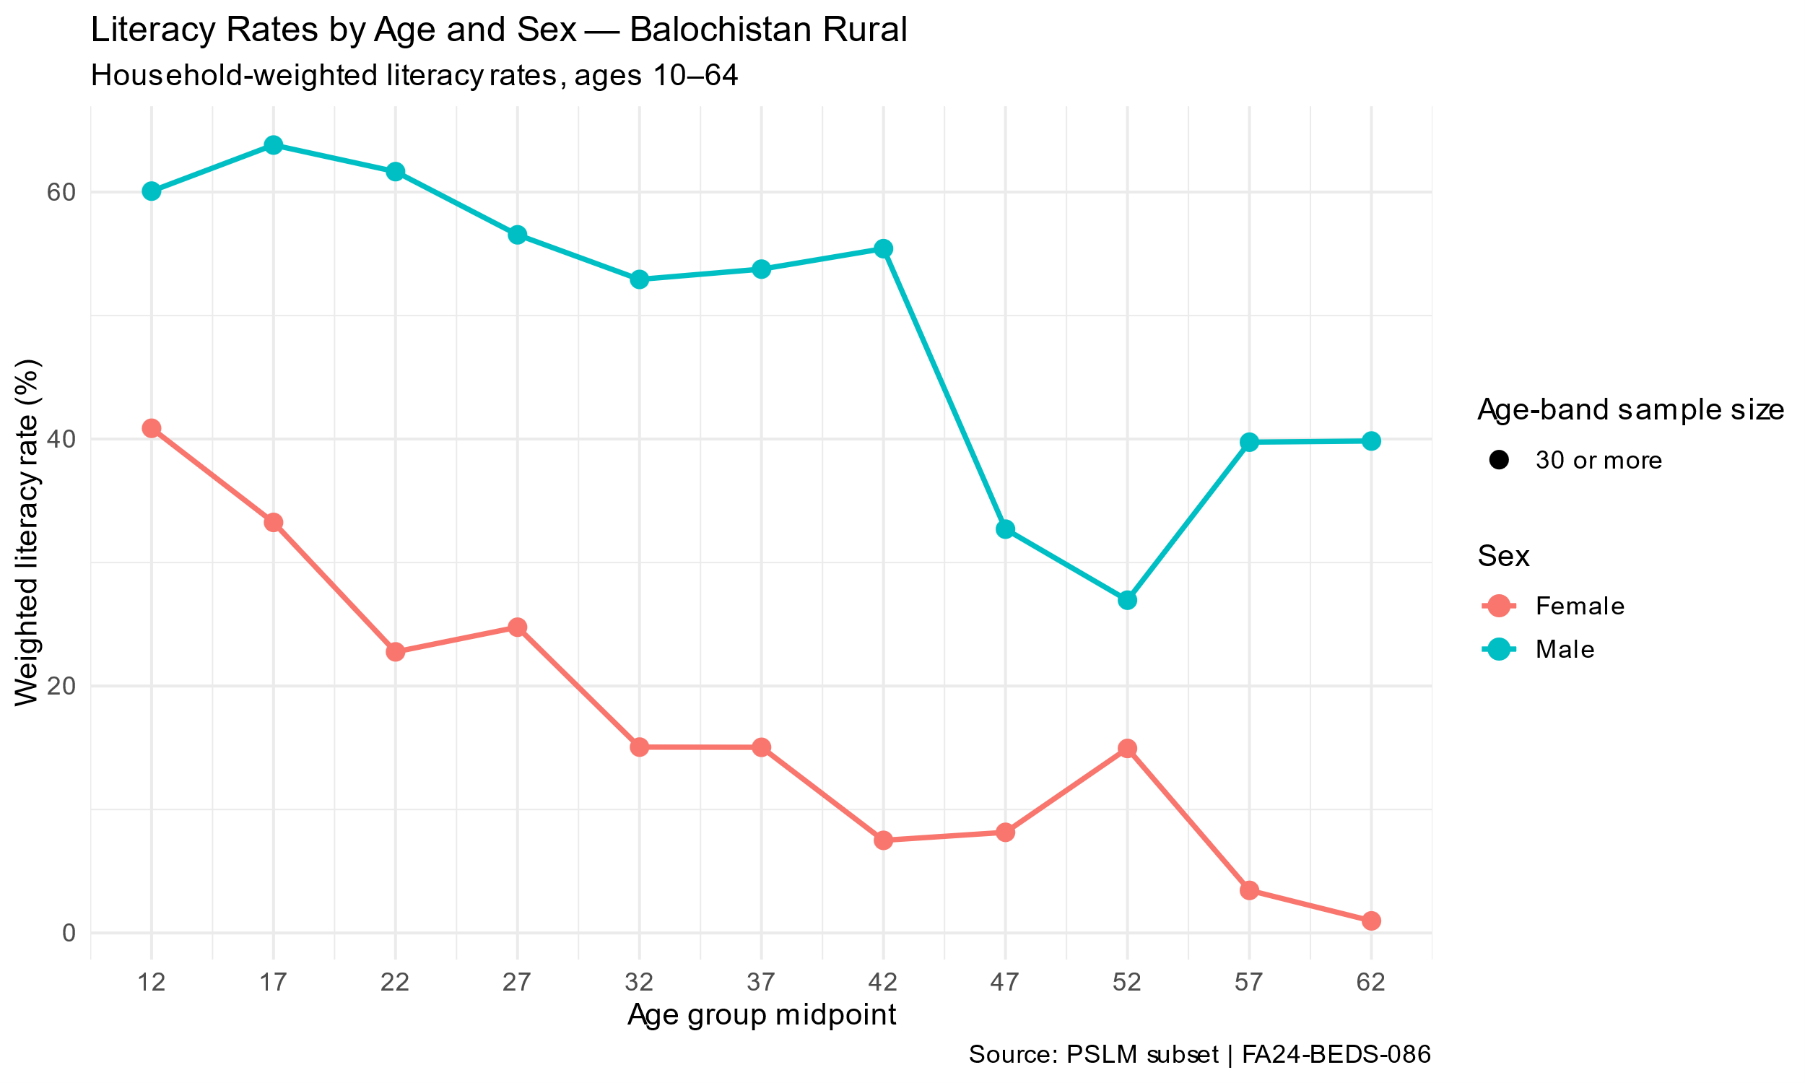
QUESTION 3 • WEIGHTED LITERACY
Household-Weighted Literacy Rates by Age and Sex — Balochistan Rural
INTERPRETATION
Male literacy rates are higher than female literacy rates across all age groups in rural Balochistan. The largest gender gap occurs among individuals aged 40–44, where male literacy is approximately 55.4% compared with 7.5% for females, a difference of 47.9 percentage points
03 / 05

Slide 4
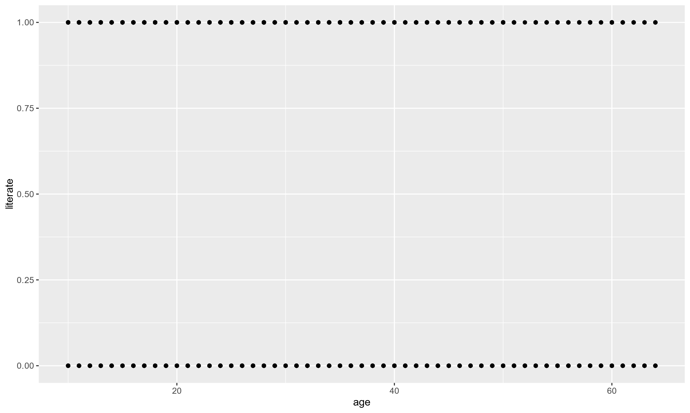
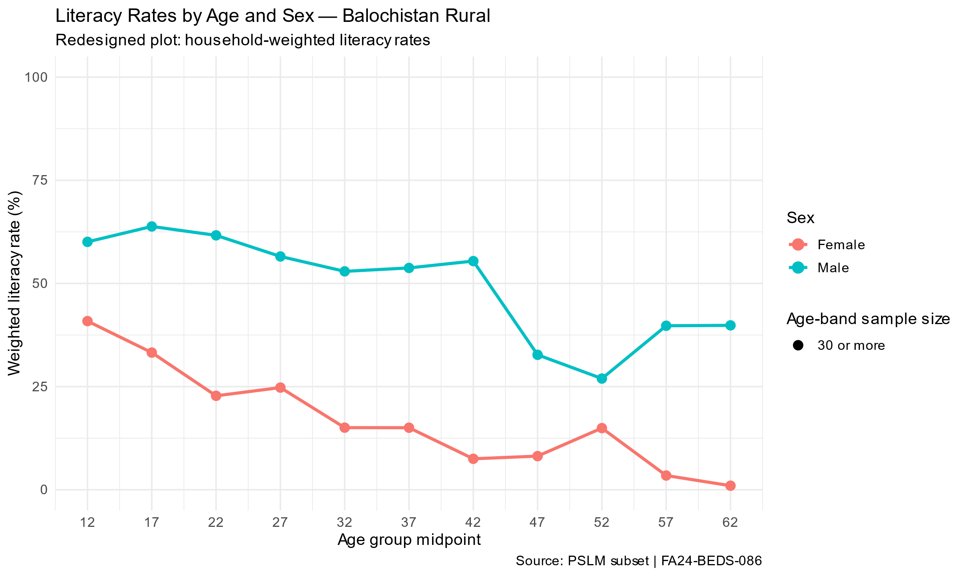
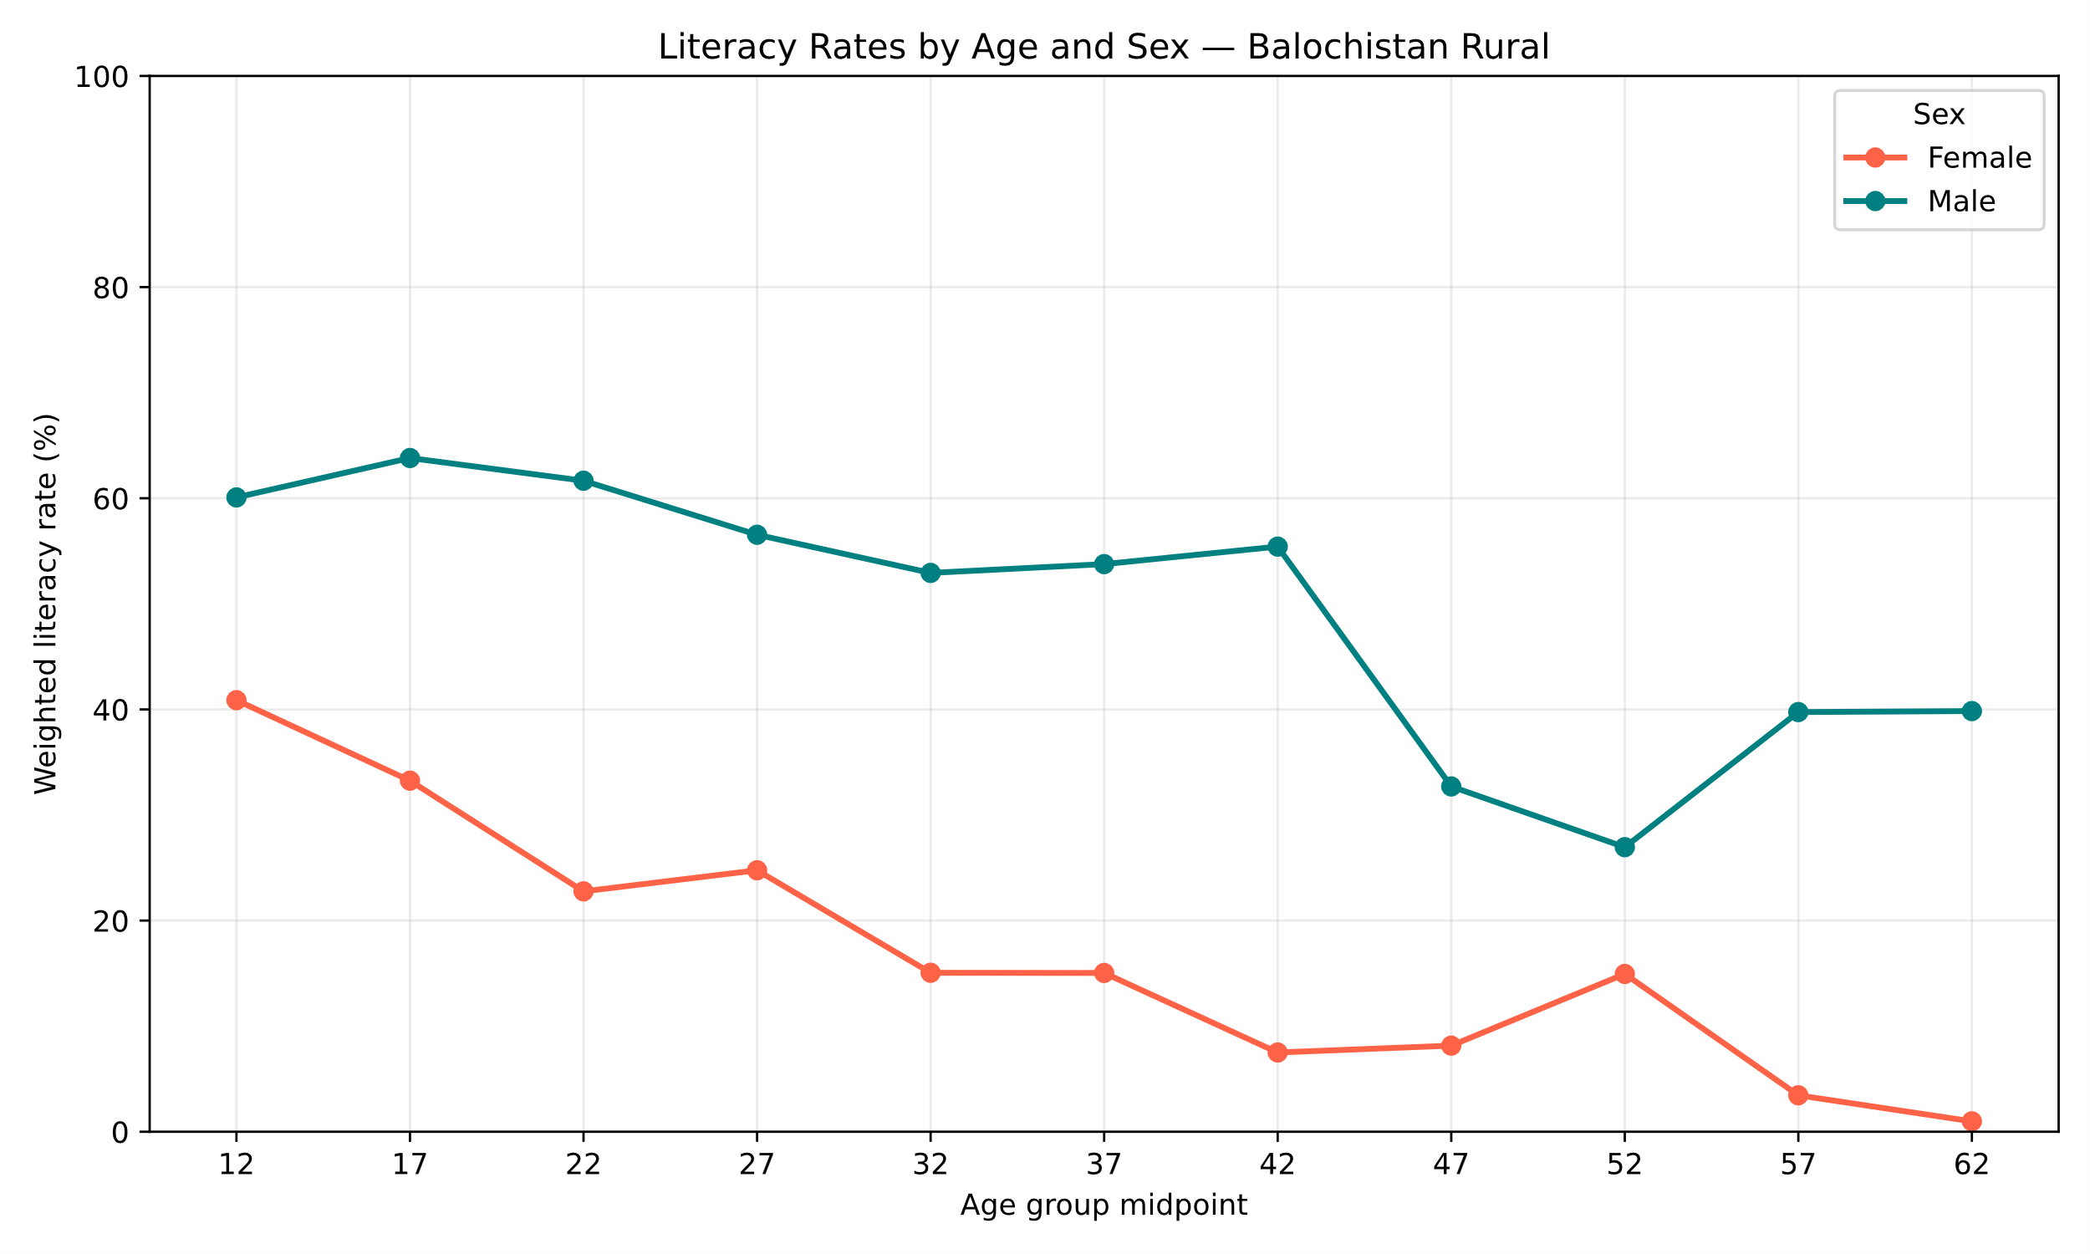
QUESTIONS 4–5 • REDESIGN AND REPRODUCTION
Visualization Redesign and Python Reproduction
Q4 / BEFORE
Q4 / AFTER
Q5 / PYTHON
INSERT ORIGINAL GRAPH
05_python_literacy.svg
Before: The default scatterplot was redesigned into a household-weighted literacy line graph.
After: The improved graph uses separate colors for males and females, five-year age groups, clear axis labels, and a legend. This makes gender differences easier to understand.
Python: The literacy analysis was reproduced using Python with pandas and matplotlib. The Python results agree with the R results to one decimal place, supporting the reproducibility of the analysis.
04 / 05

Slide 5
ECO346 / DATA VISUALIZATION TECHNIQUES FOR ECONOMISTS
THANK YOU
PSLM DATA ANALYSIS • BALOCHISTAN RURAL
FA24-BEDS-086 | Faiza Batool
05 / 05

