Slide 1
SUPPLEMENTAL RESTRAINT SYSTEM
BY:
Faisal Khan.
Vinay Saavarkar.

Slide 2
History:
An American inventor, John W. Hetrick, an industrial engineer and member of the U.S. Navy, designed (1952) and patented (1953) the original safety cushion commonly referred to as an airbag.
Ford and GM experimented in 1971 and 1973 respectively.
Mercedes-Benz introduced airbag in 1981 on S-Class.

Slide 3
Concept…
Moving objects have momentum.
Stopping an objects momentum requires force acting over a period of time.
Supplemental Restraint System helps to stop the passenger while doing as little damage to him or her as possible.
Airbag has to work within a fraction of a second.

Slide 4
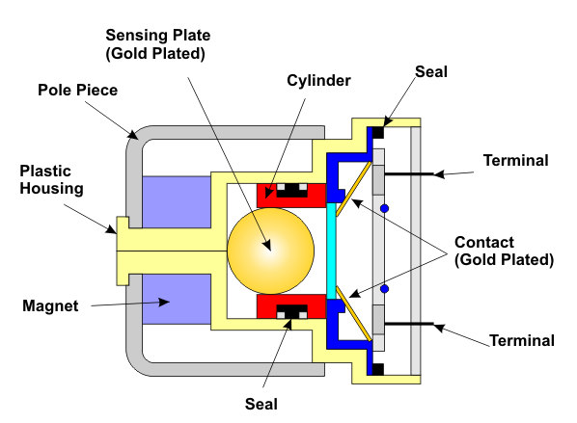
CRASH SENSOR:

Slide 5
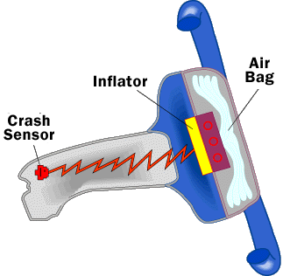
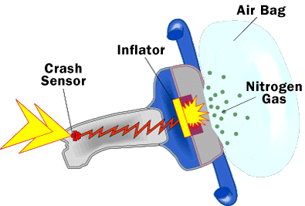
Airbag…

Slide 6
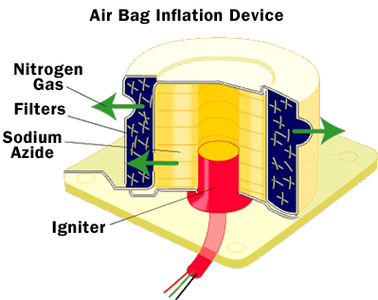
How airbag works?

Slide 7
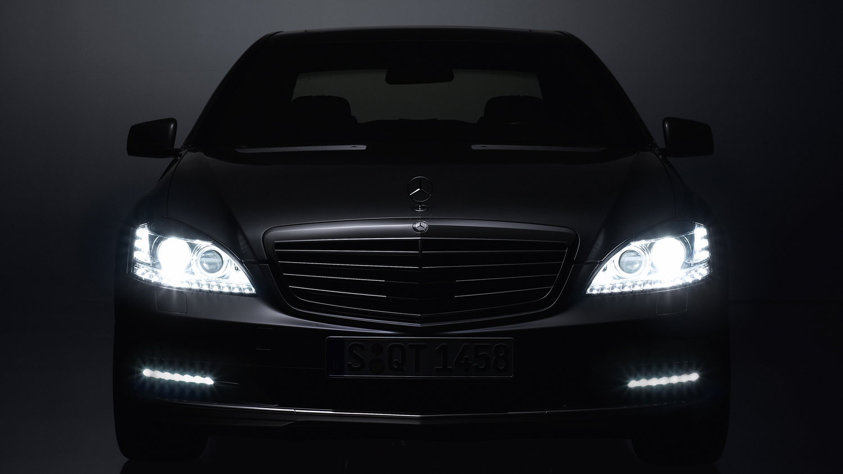
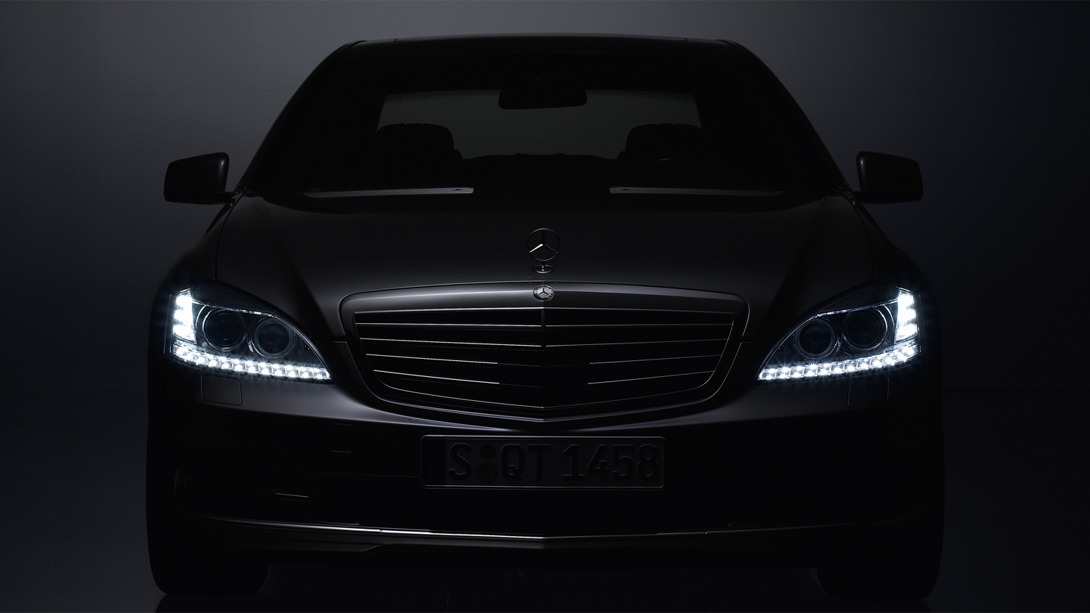

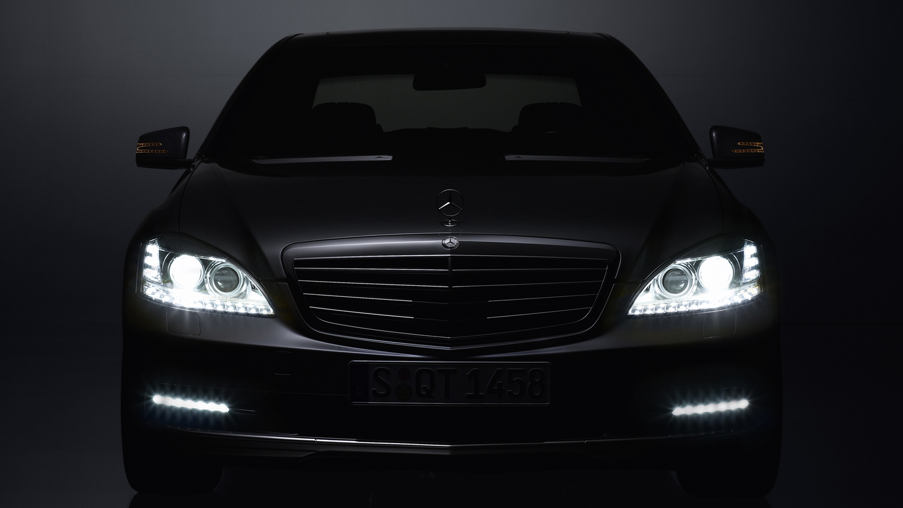
THANK YOU
Sales Training – Jan 2010
Slide <number>
Imran Patel

