Slide 1
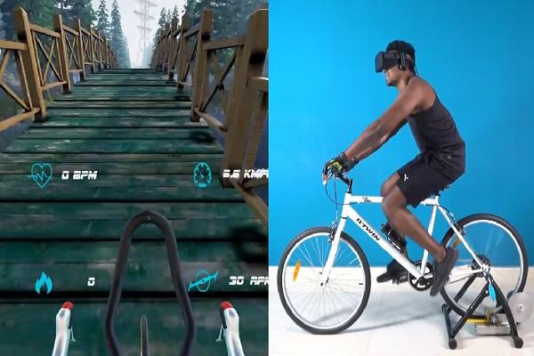

Slide 2
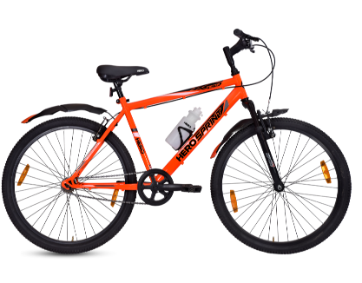
gyroscope sensor
(To detect the angle
Of handle)
Speedometer
(To calculate the speed)
Arduino
(To send data from the sensor to mobile)

Slide 3
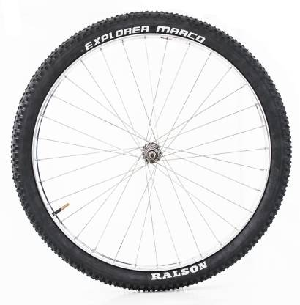
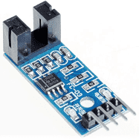

Slide 4
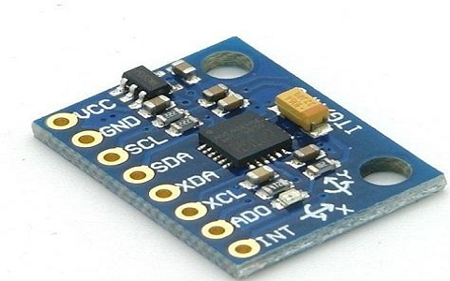
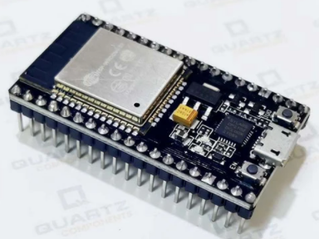
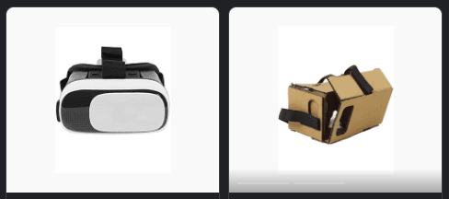
Components needed
Node MCU/arduino
Speedo meter
Gyro sensor
Wires and 3d printer
VR box

