Slide 1


Customer Shopping Behavior Analysis
3,900 purchases — 18 features — goal: spending patterns, segments, product & subscription insights

Slide 2

Dataset Summary
Rows & Columns
Key Features
Rows: 3,900 · Columns: 18
Demographics, purchase details, behavior, shipping, discounts
Missing Data
Review Rating: 37 nulls

Slide 3
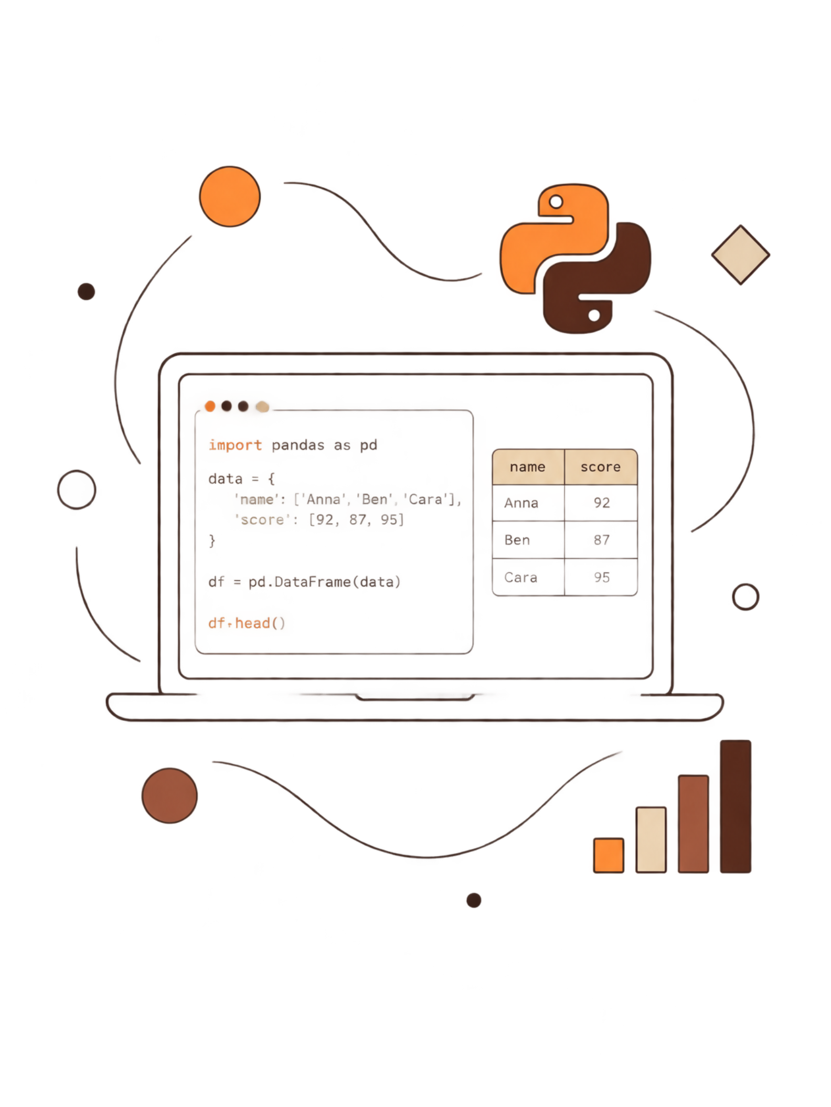
EDA & Preparation (Python)
01
Load & Inspect
pandas, df.info(), df.describe()
02
Missing Values
Imputed Review Rating by category median
03
Standardize & Engineer
snake_case columns; age_group; purchase_frequency_days
04
Cleanup
Dropped promo_code_used (redundant with discount_applied)

Slide 4
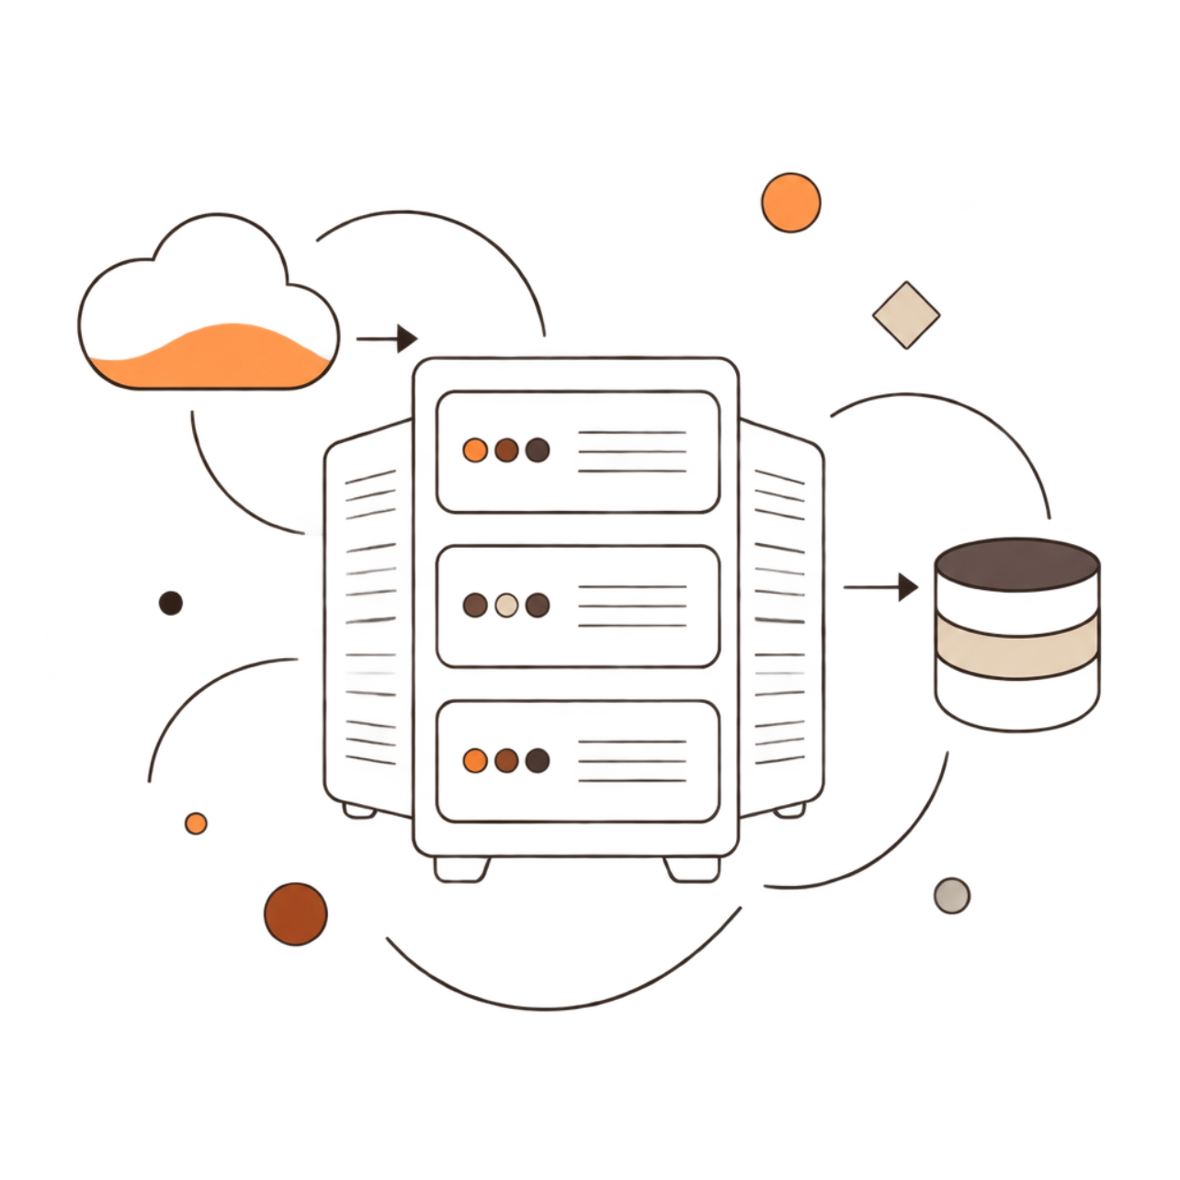

Database Integration
Cleaned DataFrame loaded to PostgreSQL for business queries
SQL used for structured revenue and segmentation analysis

Slide 5



Revenue by Gender
Female
Revenue: 75,191
Male
Revenue: 157,890

Slide 6

Discounts & High Spenders
Identified discount users who spent above average — 839 rows examined
Sample High-Spenders
Customer examples: purchases 64,73,90,...

Slide 7


Top Products & Discount-Dependent Items
Top Rated
Discount-Dependent
Gloves 3.86 · Sandals 3.84 · Boots 3.82 · Hat 3.80 · Skirt 3.78
Hat 50% · Sneakers 49.66% · Coat 49.07% · Sweater 48.17% · Pants 47.37%

Slide 8

Shipping & Subscription Insights
Avg purchase: Standard $58.46 · Express $60.48
Subscribers: 1,053 (avg spend $59.49, revenue 62,645) · Non-subscribers: 2,847 (avg $59.87, revenue 170,436)

Slide 9





Segmentation & Repeat Buyers
Loyal
3,116 customers
New
83 customers
Returning
701 customers
Repeat Buyers
>5 purchases: Yes 958 · No 2,518

Slide 10


Business Recommendations
Boost Subscriptions — exclusive benefits
Customer Loyalty Programs — reward repeat buyers
Review Discount Policy — balance uplift and margins
Product Positioning — highlight top-rated & best-sellers
Targeted Marketing — focus high-revenue age groups & express-shipping users
Dashboard built in Power BI for interactive insights

