Slide 1

Sales Performance Analysis
Reliance Retail

Slide 2
Situation Overview
Sales scale exists, but performance is uneven across formats and regions. Revenue concentration in select formats and regions indicates opportunities for optimization.
Revenue Growth
Quarterly revenue shows significant variation with Q4 reaching ₹294Cr
Regional Differences
Performance varies sharply by region and format type
Profitability Gap
High revenue does not translate to high profitability across all locations

Slide 3
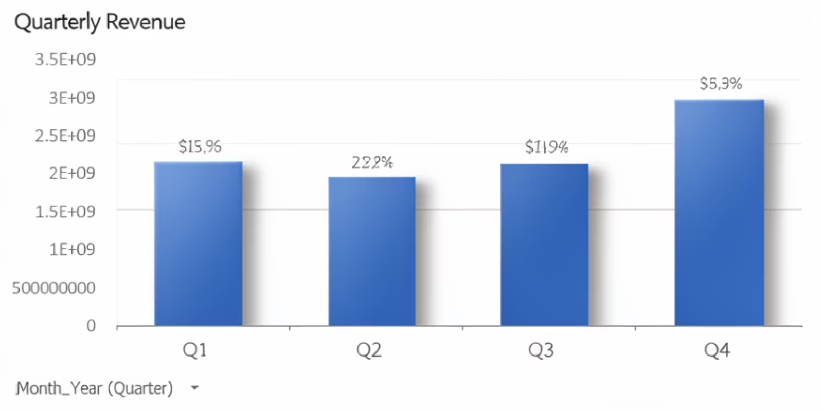
Quarterly Revenue Trend
Q4 shows strong performance with ₹294Cr revenue, while Q2 lagged at ₹197Cr. Q1 and Q3 maintained steady
performance around ₹210Cr.

Slide 4
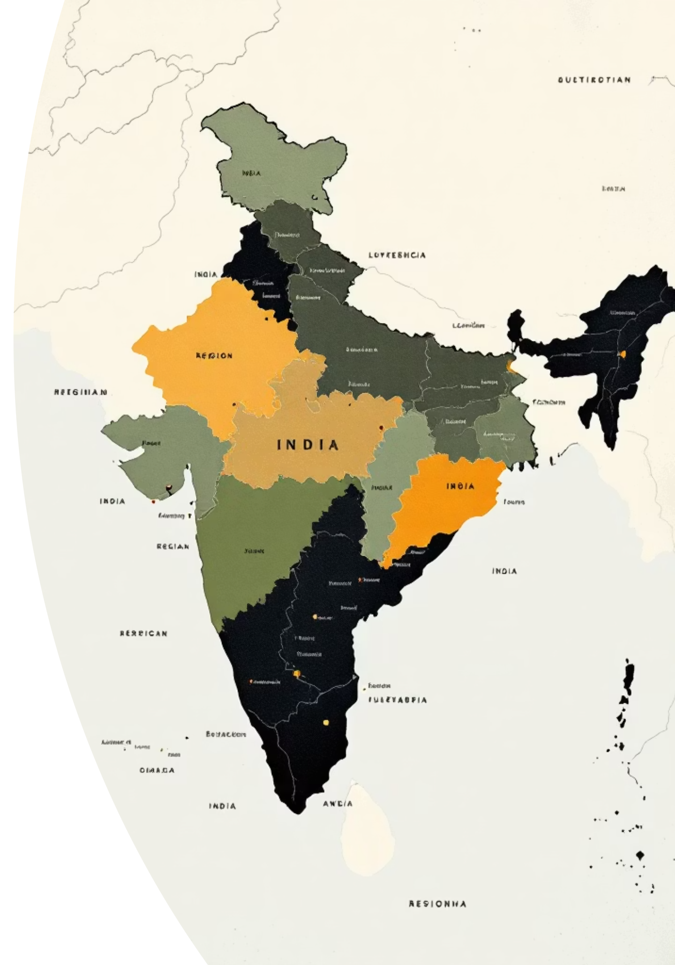
Regional Performance Analysis
North Region
Reliance Fresh performs well with strong customer traction
East Region
Smart Bazaar shows strong performance in the region
West Region
Reliance format leads performance with solid revenue generation
South Region
Reliance Trends performs well, showing regional strength

Slide 5
Regional Analysis

Slide 6

Revenue vs Profitability
The Disconnect
High revenue does not mean high profitability. Net margin varies sharply by region and format.
Operating costs and management effectiveness are diluting profit margins despite strong top-line performance.

Slide 7
What Drives Sales Variation?
Key Analytical Evidence
+4.09
+6.58
+1.98
Customer Count
Staff Productivity
Revenue/Sqft
Revenue correlation with customer traffic
Revenue correlation with employee efficiency
Revenue correlation with space utilization
Effectiveness, not spend, is the issue. Staff productivity shows the strongest correlation with revenue generation.

Slide 8




Root Causes Identified
Operational, Not Demand-Related
Low Space
Underutilized floor area limiting revenue potential
Excess HR Cost
High operating costs diluting profits
Weak Management
Regional drag due to unmanaged seasonality

Slide 9
Operational Challenges
Seasonality Unmanaged
High Operating Costs
Low ROI Marketing Spend
Q2 doesn't perform well compared to Q1, Q3, and Q4. Gross margin relatively stable.
Operating costs dilute profits despite stable gross margins.
Marketing spend in some formats shows low return on investment.

Slide 10
Strategic Resolution
Key Actions
01
02
03
Reduce HR Costs
Optimize Logistics
Boost Revenue
Lower HR cost by 5% through optimization
Reduce transportation cost by 3%
Increase revenue in Reliance Fresh and Smart Express by 6%
04
05
Focus on High Margin
Improve Weak Stores
Apparel and personal care should be increased further for more profit
West and North show loss-making or weak stores requiring improvement

Slide 11




Key Takeaways
Operational Excellence
High-Margin Categories
Focus on effectiveness over spend to drive profitability
Apparel and personal care need increased focus for higher profits
Cost Optimization
Reduce HR and transportation costs while improving store performance

