Slide 1










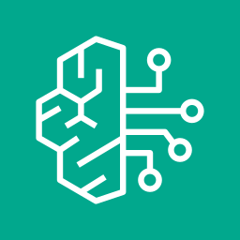


One Touch Resolve - AWS Architecture
One Touch Resolve
AWS CDS Agentic AI Partner Hackathon 2026
Multi-party claims orchestration · AWS Communication Developer Services + Amazon Bedrock AgentCore
AWS Cloud · one CDK stack · Region us-east-1
1 · AWS Communication Developer Services — communications backbone
EUM Social
WhatsApp — FNOL media
AWS End User Messaging Social
EUM RCS / SMS
cards · RCS->SMS fallback
AWS End User Messaging
Amazon SES
coverage / settlement
Amazon SES
Channel router
right channel per party
2 · Ingest & Dispatch
media
Amazon SNS
topic per channel
Dispatcher
normalize-dedupe-invoke
Amazon S3
FNOL photos/video
Dedupe table
idempotency · TTL
outbound CDS
3 · Multi-Agent Orchestration — Amazon Bedrock AgentCore (Runtime · Memory · Strands · Nova)
FNOL media -> Nova vision
AgentCore Memory
state by actor_id
MULTI-PARTY COMMIT GATE · HUMAN APPROVAL
Blocks advance until all required parties COMMIT · re-plans on BLOCKED · then PENDING_APPROVAL: adjuster Approve/Hold - no payout without a human (code-enforced)
CLOSED · RE-PLAN · OPEN · APPROVE
Supervisor
plans-reconciles-re-plans
A2A
Sub-agents x4
Claimant-Repair-Parts-Lien
Tools (Lambda)
open-estimate-settle
InvokeModel
persist
4 · State, Persistence & Observability
Bedrock · Nova
triage + tool-calling
3 CDS
WhatsApp-RCS/SMS-SES
coe-claims
source of truth · PITR
CloudWatch
DLQ + error alarms
IAM least-priv
scoped send-ddb-bedrock
coe-fleet
managed rental fleet
1+4
supervisor + sub-agents
1 gate
commit + human approval
1 CDK
one-command deploy
re-skin
swap roster -> vertical
ARROW KEY
Inbound / control
Agent (A2A) calls
Bedrock InvokeModel
Outbound CDS / persist
© 2026 · One Touch Resolve · Confidential

Slide 2
