Slide 1

ANTI SLEEP DEVICE
Owing to today’s fast paced world, the stress load has increased and has made it difficult for us to focus on one task. We, are constantly busy and always tired.
So, to address this issue, we have come up with a Anti-sleep Device. This system alerts the user if he/she falls asleep at the wheel thereby, avoiding accidents and saving lives.
The purpose of a sleepiness detection device is to warn of unexpected sleepiness.The alarm continues for a minimum of 4 seconds so that the driver wakes and get ready to steady the vehicle he drives. Thus, we can control the major accidents.

Slide 2

OUR PREVIOUS MODEL
Whenever the user uses this device like while driving, if his head tilts more than 30 degree, the tilt sensor detects and transistor drives the buzzer to sound an intermediate beep and LED’s start glowing. When the driver comes back to his normal position tilt sensor senses that and the buzzer and LED switches off.
Drawback:
The device worked only if the user tilts his head downwards, so even if the user tilts down his head for other purposes, the alarm would turn on.
If the person sleeps without bending his head, the sensor could not sense it.

Slide 3
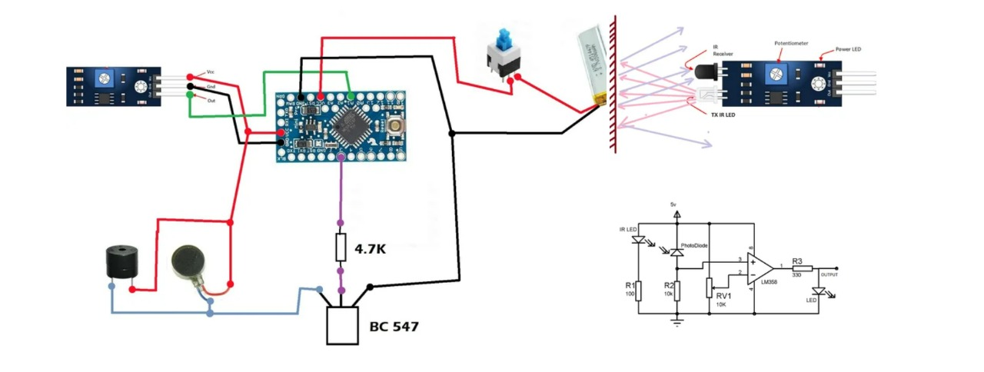
Additions made
Due to the drawbacks we came up with some additions in our project.
We have added
IR sensor
Arduino Pro Mini
Glass frame

Slide 4
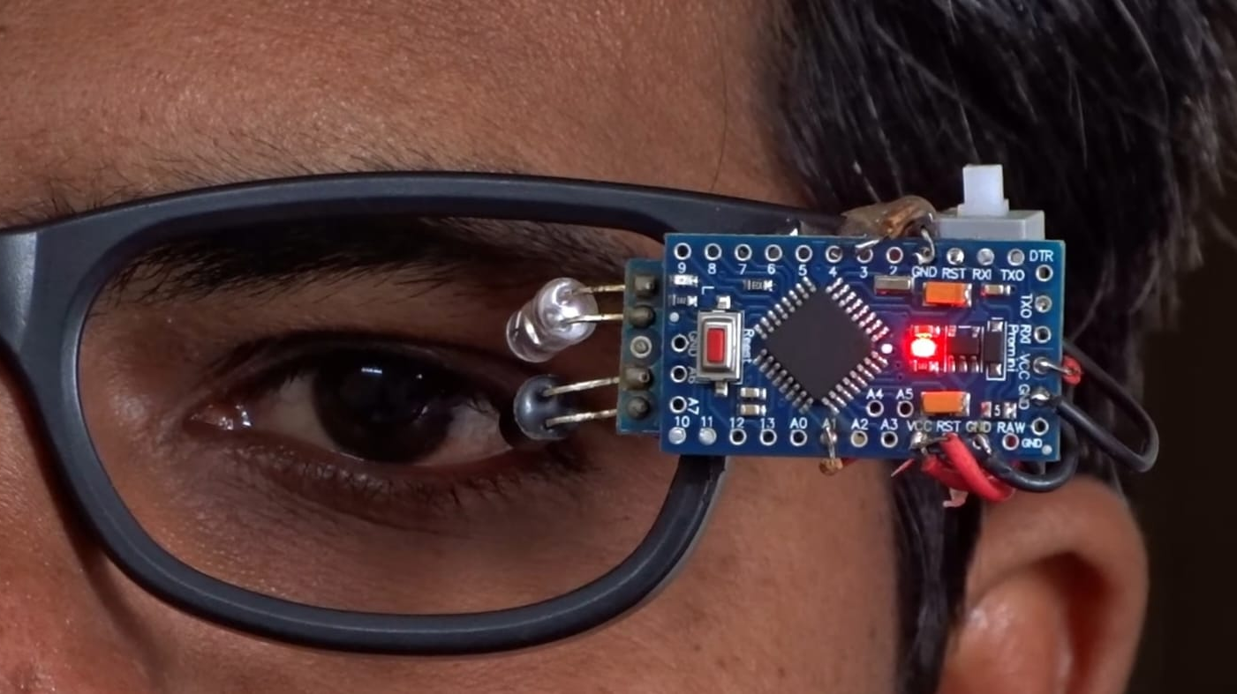
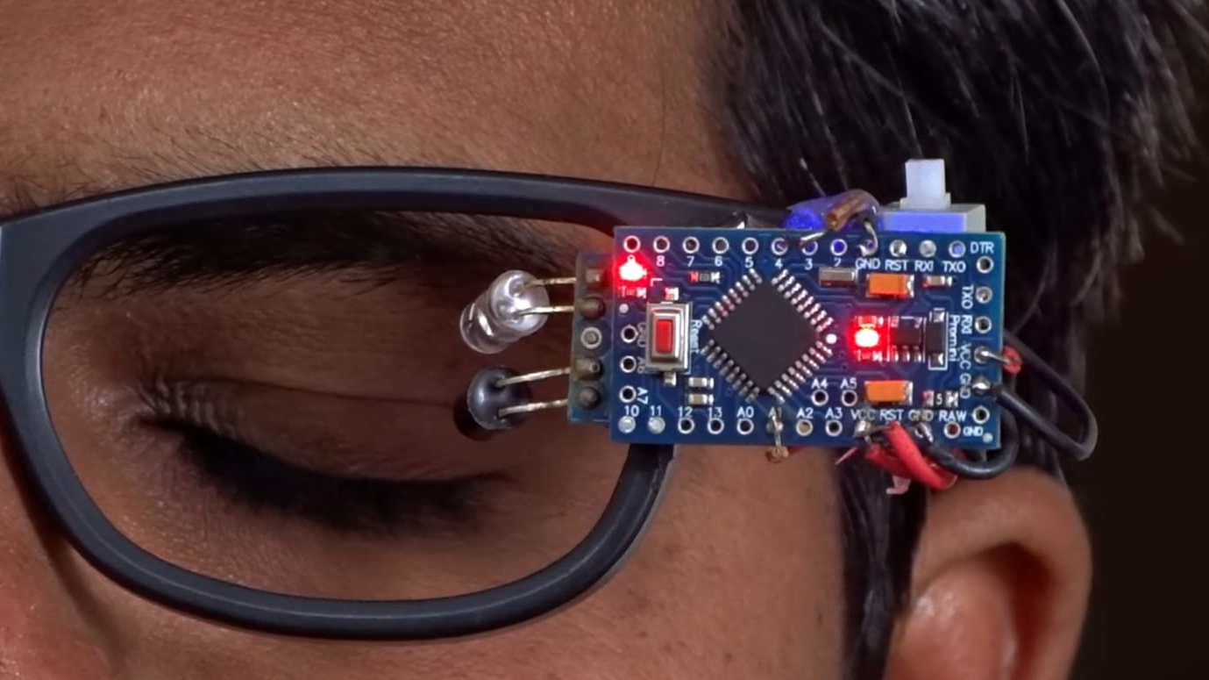
Updated model
The new model works based on the eye sensor. Whenever the user closes his eyes for more than 4 seconds the sensor starts to beep. The Arduino manages the delay for activating the buzzer after sensor input.

Slide 5

Thank you

