Slide 1

Comparative Analysis of PyTorch ANN and Keras CNN Models
This presentation compares PyTorch ANN and Keras CNN models for regression and classification tasks.
FS
by Faizan Sajid

Slide 2
Dataset Description
California Housing
CIFAR-10
20,640 samples, 8 features, median house value target
60,000 images, 10 classes, RGB images (32x32x3)

Slide 3

Model Details
PyTorch ANN (Reg)
PyTorch ANN (Class)
8 features, 4 hidden layers, ReLU activation
Flattened images, 4 hidden layers, ReLU activation
Keras CNN (Class)
Conv2D, MaxPooling2D, Dense layers, Softmax

Slide 4

Training Configurations
1
Learning Rate
2
Batch Size
PyTorch ANN (Reg): 0.01, PyTorch ANN (Class): 0.001, Keras CNN: 0.0001
64 for all models
3
Epochs
4
Optimizer
PyTorch ANN (Reg): 100, PyTorch ANN (Class): 20, Keras CNN: 20
Adam for all models

Slide 5
Performance Metrics
California Housing
CIFAR-10
MSE: 22.5, MAE: 3.4
PyTorch ANN: Accuracy: 82.4%, Keras CNN: Accuracy: 88.7%

Slide 6
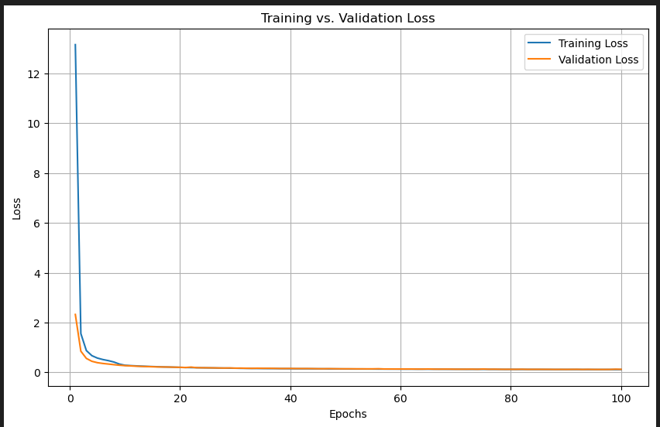
Learning Curves
1
Training and Validation Loss
California Housing
2

Slide 7
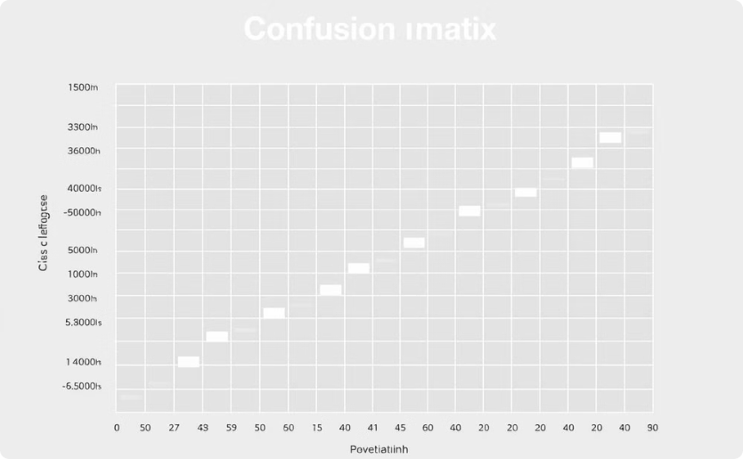
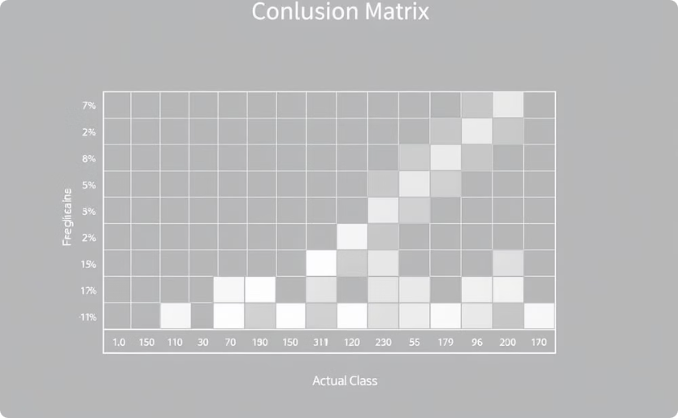
Confusion Matrix
PyTorch ANN
Keras CNN
Class-wise predictions
Class-wise predictions

Slide 8
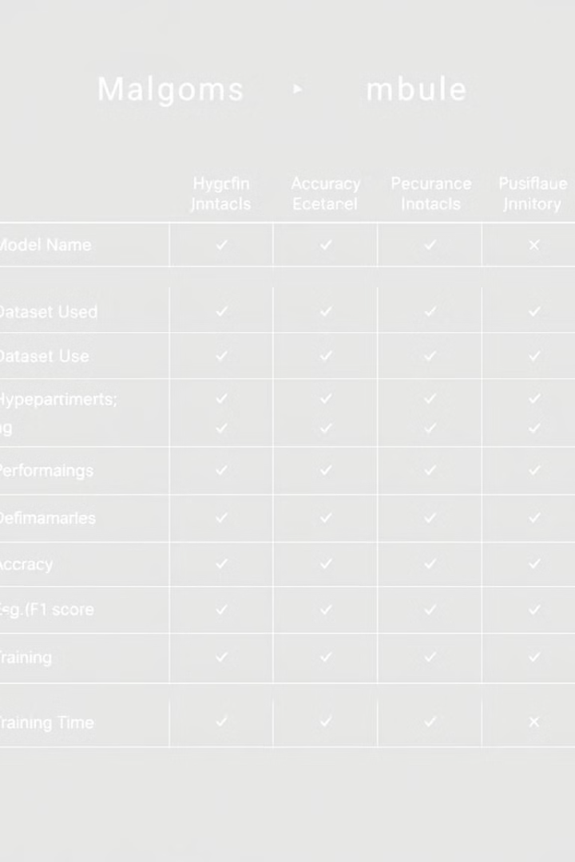
Comparative Table
Model
Dataset/Task
Key Hyperparams
Final Metric
Training Time
PyTorch ANN (Reg)
California Housing
LR=0.01, Epoch=100
MSE=0.35; MAE=0.52
~5 min
PyTorch ANN (Class)
CIFAR-10
LR=0.001, Epoch=20
Accuracy=31.4%
~10 min
Keras CNN (Class)
CIFAR-10
LR=0.0001, Epoch=20
Accuracy=64.7%
~8 min

Slide 9



Discussion
Strengths
Weaknesses
PyTorch ANN (Reg): Simple, effective for tabular data. Keras CNN: Superior performance for image classification.
PyTorch ANN (Class): Limited performance on images. Keras CNN: Higher computational cost.

Slide 10



Conclusion
Keras CNN outperformed PyTorch ANN for CIFAR-10 classification.
1
2
Regression tasks require careful feature scaling and model tuning.
Future work: Experiment with advanced CNN architectures and hyperparameter optimization.
3

