Slide 1
BSIT 5th
Lecture 2

Slide 2
WHAT IS LAW OF RETURNS??
The law of returns operates in the short period. It explains the production behavior of the firm with one factor variable while other factors are kept constant.
It is implied in the fact that the quantitative definiteness of the effects brought about by any economic good is a necessary condition of its being an economic good.

Slide 3

PRODUCTION FUNCTION
 A given output can be produces with many different combinations of factors of production (land labor and organizations) or inputs.
 The output, thus, is a function of inputs. The functional relationship that exits between physical inputs and physical output of a firm is called production function.

Slide 4


TYPES OF LAW OF RETURNS
 The laws of returns are categorized into two types.
 1) The law of variable proportion seeking to analyze production in the short period.
 2) The law of returns to scale seeking to analyze production in long period.

Slide 5
LAW OF VARIABLE PROPORTIONS
 It is also known as law of Diminishing Returns.
 According to Stigler, “ As equal increments of one input are added, the inputs of other productive services being held constant, beyond a certain point, the resulting increments of produce will decrease i.e. marginal product will diminish”.

Slide 6
 According to Samuelson,” An increase in some inputs relative to other fixed inputs will in a given state of technology cause output to increase, but after a point, the extra output resulting from the same addition of extra inputs will become less”.
 Three stages of the law:
 1)increasing returns
 2)diminishing returns
 3) negative returns

Slide 7
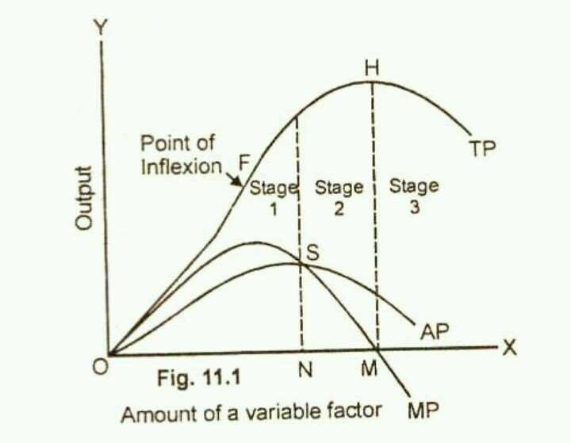
THESE STAGES CAN BE EXPLAINED USING GRAPH:

Slide 8
 1) Stage of increasing return – In this stage as a variable resource (labor) is added to fixed inputs of other resources, the total product increases up to a point at an increasing rate as shown in graph.
 2) Stage of diminishing return – In stage 2, the total production continues to increase at a diminishing rate until it reaches its maximum point (H) where the second stage ends .In this stage both marginal product (MP) and average product of the variable factor are diminishing but are positive.

Slide 9
 Stage of negative returns – In the third stage, the total production declines. The TP, curve slopes downward ( from point H onward) . The MP curve falls to zero at point L2 and then it is negative. It goes below to the x-axis with the increase in the use of variable factor (labor).

Slide 10
LAW OF RETURNS TO SCALE
 The law of returns to scale operates in the long period. It explains the production behavior of the firm with all variable factors.
 The law of returns to scale describes the relationship between variable inputs and output when all the inputs , or factors are increased in the same proportion.

Slide 11
TYPES OF LAWS OF RETURNS TO SCALE
 There are three types of Returns to Scale. They are:
 1) increasing returns to scale
 2) constant returns to scale
 3) diminishing returns to scale

Slide 12
 1) INCREASING RETURNS TO SCALE-
If the output of a firm increases more than in proportion to an equal percentage increase in all inputs, the production is said to be exhibit increasing returns to scale.
 2) CONSTANT RETURNS TO SCALE –
When all inputs are increased by a certain percentage, the output increases by the same percentage, the production function is said to be exhibit constant returns to scale.

Slide 13
 DIMINISHING RETURNS TO SCALE –
The term ‘diminishing’ returns to scale refers to scale where output increases in a smaller proportion then the increase in all inputs.
 For example, if a firm increases inputs by 100% but the output decreases by less than 100%, the firm is said to be exhibit decreasing returns to scale.

