Slide 1
Int. To economics

Slide 2
Unemployment
Unemployment is a term referring to individuals who are employable and seeking a job but are unable to find a job.
“people who donot have job, actively looking for work”

Slide 3
If we talk about unemployment, we start with idea of the labor force.
Total population
L=E+U
In Labor Force
Out of the labor Force
Unable to be employed
In Schools
House keeping
Or
Other (inactive person)
Unemployed
Employed
Looking for Work

Slide 4
Labour force
Out of the labour force: (economically inactive person)
person out of the labour force are the person aged 15 and over, who are neither employed nor unemployed(they are neither working nor seeking work)during the reference period. those are not in labour force. Such as ,housewife, retire people, students etc.
In labour force:
all member of particular organization or country who are able to work, viewed collectively.

Slide 5
Labor force is divided into two Groups,
Those employed
Those unemployed but looking for work we call them unemployed

Slide 6
Unemployment Rate
It is defined as the percentage of unemployed workers in total labor force.
The unemployment rate is the percentage of people in the labour force who are unemployed. Consequently, measuring the unemployment rate requires identifying who is in the labour force.
Workers are considered unemployed if they currently do not work, despite the fact that they are able and willing to do so. the total labor force consist of all employed and unemployed people within the economy.
L=E+U
labor force= employed + unemployed

Slide 7
Under employment
the condition in which people in labor force are employed at less than the full time or regular jobs or at jobs inadequate with respect to their training or economic need.
Example:
Some one is graduated in electrical engineer but get a job as clerk in any factory
Underemployment occurs when a job does not use an employee's full capabilities. This may include not giving them enough hours, such as having them work part-time hours when they wish to work full time. ... Unemployment is when a person is actively looking for a job but experiences an extended period without getting hired.

Slide 8
Types of Unemployment
Frictional unemployment
Seasonal unemployment
cyclical unemployment
Structural unemployment

Slide 9
Frictional unemployment
Frictional unemployment is the result of voluntary employment transitions within an economy. ... Workers choosing to leave their jobs in search of new ones and workers entering the workforce for the first time constitute frictional unemployment.

Slide 10
Seasonal unemployment
Seasonal unemployment occurs when people are unemployed at certain times of the year, because they work in industries where they are not needed all year round.
Examples of industries where demand, production and employment are seasonal include tourism and leisure, farming, construction and retailing.

Slide 11
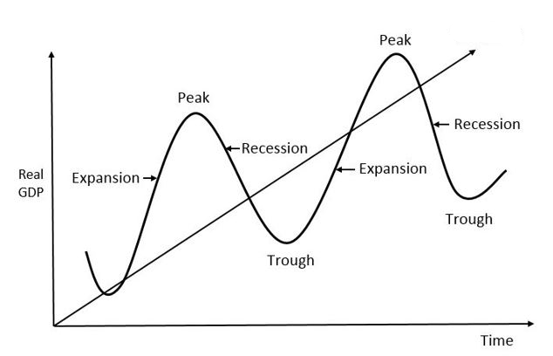
Cyclical unemployment
Cyclical unemployment is a type of unemployment which is related to the cyclical trends in the industry or the business cycle. ... Cyclical unemployment is directly related to the macro-economic situation in the economy. It would rise at a time of recession, while reduce when the economy starts recovering.

Slide 12
Structural unemployment
Structural unemployment is caused by a mismatch of skills between the unemployed and available jobs. ...
Example
The US car manufacturing firm (General Motors) closed down due to strong international competition. Car workers become unemployed but were not qualified to gain jobs in areas of labour vacancies, such as teaching, doctors, electricians, IT – mostly in other parts of the country. Due to the decline of the car industry, in 2009, unemployment in Detroit rose to 29% (compared to the national rate of 9.8%).

