Slide 1

RSA Encryption

Slide 2
What is Cryptography?
Keeping info. secure from unintended audiences
  Secure electronic transactions, wireless communications, passwords, etc.
Encryption: plaintext ciphertext
Decryption: ciphertext plaintext
Key-based encryption:
  Secret
  Public
Notes:
The art and science of keeping info. secure from unintended audiences
Use a key to:
Encrypt: UNREADABLE data to READABLE code
Decrypt: READABLE code to UNREADABLE data

Slide 3
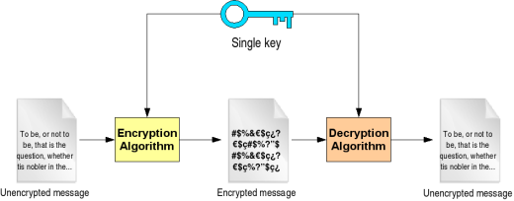
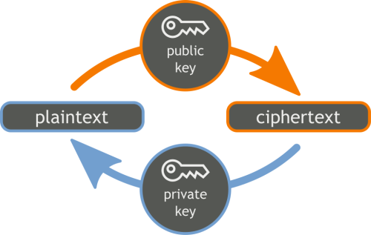
Secret Key
(Symmetric)
Public Key (Asymmetric)
1 Key = encrypt & decrypt
  Advantage: Fast
  Disadvantage: Not safe
Two separate keys
  1 public key to encrypt
  1 private key to decrypt
Notes:
Traditional cryptography
Imagine a bank having to hand out different keys to each customer. It would be difficult to manage because we would have to exchange a single key between receiver and sender
To solve key management problem the concept of public key cryptography introduced
Need for sender & receiver to share “secret key” is eliminated
Anyone can use public key, but only sole possession of private key can encrypt

Slide 4







Message: Hello
Message: 13472
Message: Hello
Decryption Key
Encryption key
Alice
Bob
Notes:
Note: Both Alice and bob have access to encryption key (in fact, everyone in the world has access to encryption key), but only Alice has possession of decryption key

Slide 5
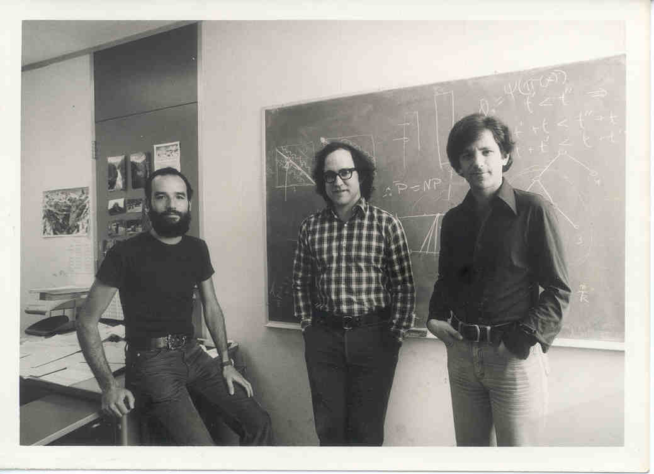
RSA Encryption
Rivest, Ron
Shamir, Adi
Adleman, Leonard
Most commonly used cryptosystem
Notes:
In 1977 Rivest, Shamir, & Adleman from MIT published one of the first public key encryption system
Trap door function is a one-way function which is easy to compute in one direction, but difficult to compute in the opposite direction
The only way to eliminate difficulty is if you have secret key called the trap door

Slide 6
Prime Numbers
Given two large prime numbers, p and q, we already know:
  Simple: Find product N, where N= p*q
  Difficult: Factor N, when p and q are unknown
439 * 541 =
237499
Easy
? * ?
203477
Hard
=
Notes:
Mutliplication can be considered as one way functions
RSA encryption relies on the fact that prime factorization is computationally very hard.

Slide 7
Generating Keys
Public Key
Private Key
Let n = p* q
Find Φ(n)= (p-1)(q-1)
Choose e such that
gcd(e, Φ(n))=1
Choose two large prime integers p,q
Find Φ(n)= (p-1)(q-1)
Find d such that d is multiplicative inverse of
e.d(modΦ(n))=1
  de ≣ 1(mod Φ(n))

Slide 8
Example
Message: “Hi” = 89
p = 11 q = 13
n = 11 * 13 = 143
Φ(143) = (11 – 1)(13 – 1) = 120
Set e = 7
d = 103

Slide 9
Public Key n = 143 e = 7
Secret Key p = 11 p = 13 Φ(n) = 120 d = 103
Hi = 89
89 = Hi
67
89
Hi
67
Hi
Bob
Alice

Slide 10
Digital Signature
Alice send message to bob
Bob wants to verify sender
{msg}private key Alice
Bob decrypt message with public key of Alice
{{msg}private key Alice}public key Alice
With public key of Alice anyone can decrypt message

Slide 11
Solution
Alice
Encryption
C = {{msg}private key Alice}Public key of Bob
Bob
Decryption
msg ={{C} Private key of Bob}} public key of Alice

