Slide 1

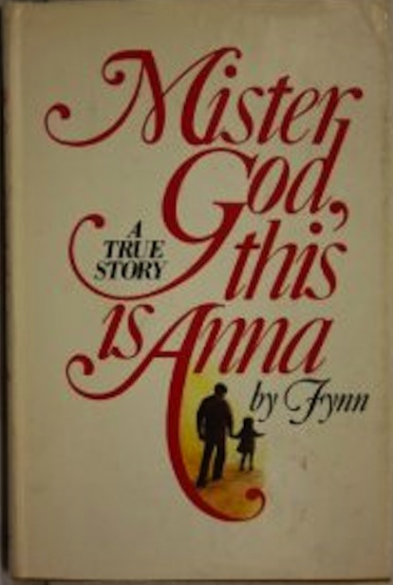
Book Review
Mister God, this is Anna..
by - Fynn.

Slide 2
A story of Spirituality in Childhood
There are some books which do not need a review. They are just brilliant in itself. Mister God, This is Anna is one such book. A book that will make you laugh, cry and make you think, rather rethink, all that you think! As Vernon Sproxton in the introduction to the book calls it an Ah!Book. As per him Ah!books are those which induce a fundamental change in the reader’s consciousness.
Anna, Mister God, Fynn and Black night
“The difference from a person and an angel is easy. Most of an angel is in the inside and most of a person is on the outside." These are the words of six- year old Anna, sometimes called Mouse, Hum, or Joy. At five years, Anna knew absolutely the purpose of being, knew the meaning of love, and was a personal friend and helper of Mister God. At six, Anna was a theologian, mathematician, philosopher, poet, and gardener. If you asked her a question you would always get answer in due course. On some occasions the answer would be delayed for weeks or months; but eventually, in her own good time, the answer would come: direct, simple, and much to the point.” ― Fynn, Mister God, This Is Anna
"Do you like the darkness?"
"My reason for preferring the darkness is that in the dark you have to describe yourself. In the daylight other people describe you.
“The sun is nice but it lights things up so much that you can't see very far... The night time is better. It stretches your soul to the stars.”

Slide 3
Beautiful Conversation
The book is Anna’s story. Anna was only four when Fynn (Sydney Hopkins’ pseudonym), the author, who himself was just 16 years old found her wandering the streets of London’s docklands. Anna who had been neglected and abandoned by her parents readily agrees when Fynn offers to take her to his home. From then starts a journey of friendship, love, life!.’
The impact of this extraordinary child on Fynn’s family and his neighbourhood friends was to be immense. Nobody who met Anna could remain the same: this intelligent, lively, precocious little chatterbox would completely disarm adult preconceptions with her innocent world view. Her outpourings on life, mathematics, science and her mentor, Mister God will leave you spellbound, making you sit back and wonder at her genius.
‘Mister God can know things and people from the inside, too. We only know them from the outside . . . So you see, Fynn, people can’t talk about Mister God from the outside; you can only talk about Mister God from the inside of him.’
‘You see, everybody has got a point of view, but Mister God hasn’t. Mister God has only points to view. .
“. . . People can only love outside and can only kiss outside, but Mister God can love you right inside, and Mister God can kiss you right inside, so it’s different. Mister God ain’t like us; we are a little bit like Mister God, but not much yet.”
"Dear Mister God, this is Anna talking,"

Slide 4
More From Book
The conversation went as follows:
"Do you believe in God?"
"Yes."
"Do you know what God is?"
"Yes."
"What is God then?"
"He's God!"
"Do you go to church?"
"No."
"Why not?"
"Because I know it all!"
"What do you know?"
"I know to love Mister God and to love people and cats and dogs and spiders and trees"– and the catalogue went on – "with all of me".
… Anna had bypassed all the non essentials and distilled centuries of learning into one sentence: "And God said love me, love them, and love it, and don't forget to love yourself."
"At five years Anna knew absolutely the purpose of being, knew the meaning of love and was a personal friend and helper of Mister God. At six Anna was a theologian, mathematician, philosopher, poet and gardener. If you asked her a question you would always get an answer—in due course. On some occasions the answer would be delayed for weeks or months; but eventually, in her own good time, the answer would come: direct, simple and much to the point." Anna lives her life complete, she is involved with everything. The gist of the book is the philosophy of a child who has the wisdom to comprehend more than what would be expected of her.
It does not matter if you believe in God or not, Anna's lessons go beyond religion, but loved every word of this book. It gives the reader new insight to life and happiness. Mister God, This is Anna is one of those books you will read again and again and still find something new each time. Mister God, This is Anna will change your life, and you will want that change to pass to those you love. This book will not disappoint you.

Slide 5
The End
"She never made eight years, she died by an accident. She died with a grin on her beautiful face. She died saying, 'I bet Mister God lets me into heaven for this', and I bet he did too."The ending of the book describes Anna's death and Fynn's bitterness about it. He visits Anna's grave and sees it to be a riot of flowers. At that moment he lets go of his angst against God. The answer he realizes is 'Anna is in my middle'. This particular reference is to a conversation between Anna and Fynn. God is part of everybody and everybody is part of God. Fynn walks away from her graveyard enlightened. While this book focuses a lot on the importance of religion and "Mister God" in Anna's life, this book is really about faith. Mister God, This Is Anna is a book about seeing beauty in things that may not identify as "beautiful" and about the absolute and pure faith Anna bestows to Mister God.
He is the Glory of Glories
O SON OF BEING!
I loved thy creation, hence I created thee. Wherefore, do thou love Me, that I may name thy name and fill thy soul with the spirit of life.

