Slide 1


SMART INDIA HACKATHON 2026
TITLE PAGE
Problem Statement ID – SIH26035
Problem Statement Title – Development of a Software Program/Application for Generation of Test Reports for Non-Automatic Weighing Instruments (NAWI) as per OIML Recommendation R-76
Theme – Smart Vehicles (as listed against SIH26035 on the SIH portal)
PS Category – Software
Team ID – [Team ID]
Team Name (Registered on portal) – [Team Name]

Slide 2
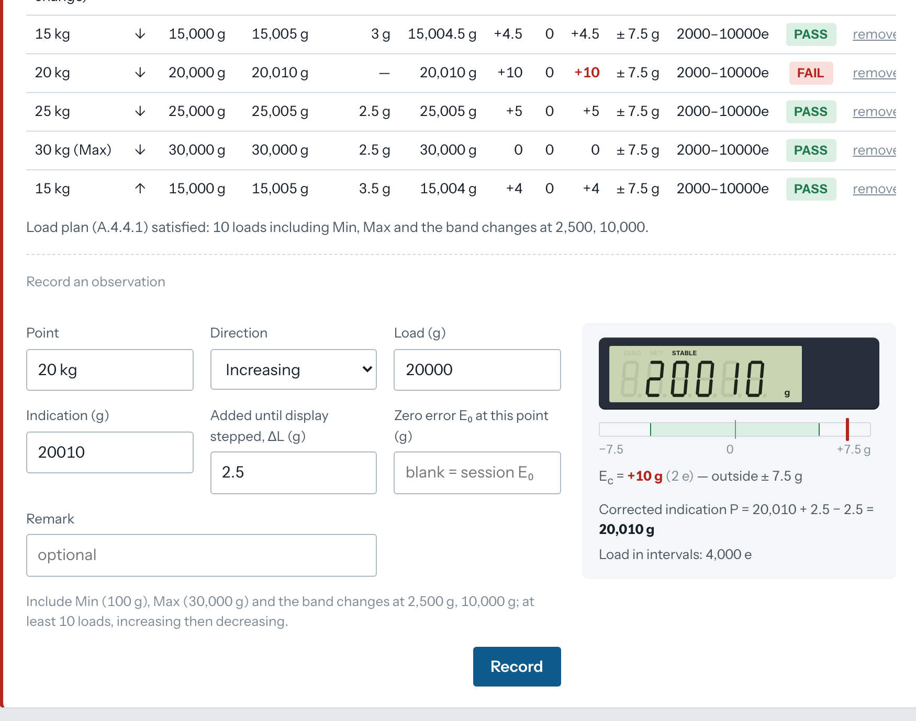
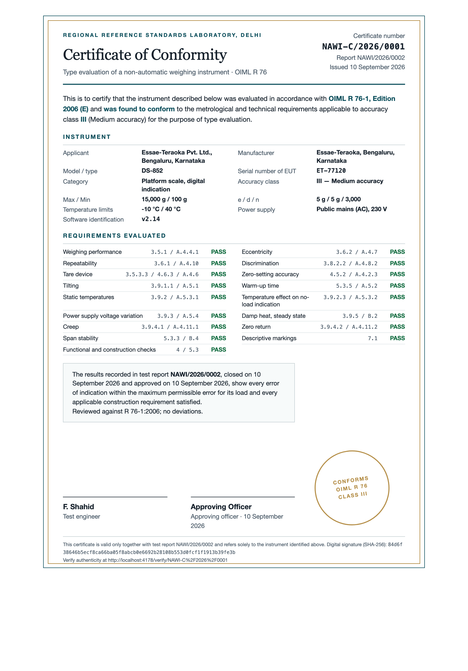
NAWI TestBench: OIML R 76 test reports computed to the clause
[Team Name]
Proposed Solution (Describe your Idea/Solution/Prototype)
A working web application for type-evaluation laboratories: register the instrument, record every OIML R 76 observation as the indicator shows it, and receive the computed verdicts, the standardised report and the certificate.
Detailed explanation of the proposed solution
Instrument register with full R 76 particulars; Table 3 admissibility (n, Min, d ≤ e) checked as you type
17 tests as data-entry forms: weighing, eccentricity, repeatability, discrimination, tare, zero, tilting, warm-up, temperature, zero drift, voltage, damp heat, creep, zero return, span stability, markings and functional checklists
Lab environment (temperature, humidity, pressure, voltage, frequency) logged at start, during and end of testing
Engine derives the MPE band, applies P = I + ½e − ΔL and Ec = E − E0, and decides pass / fail per point, per test, per evaluation
Report as HTML, PDF and editable Word; certificate of conformity when the full battery passes and an approver signs
How it addresses the problem
Replaces spreadsheets and printed MPE tables: no band look-ups, no transcription, no arithmetic by hand
Uniform report across all centres; every verdict carries its R 76 clause; searchable repository with role-based access and audit trail
Innovation and uniqueness of the solution
The standard is data: a versioned rule-set file, so a revised R 76 is a new file and old reports stay reproducible
Live indicator readout shows the corrected error against ± MPE before a reading is saved; metrological validation refuses impossible entries
SHA-256 signed approval, numbered certificate, public verification page
Recording a reading: corrected error shown against ± MPE live
Certificate issued after a passing battery is approved and signed

Slide 3
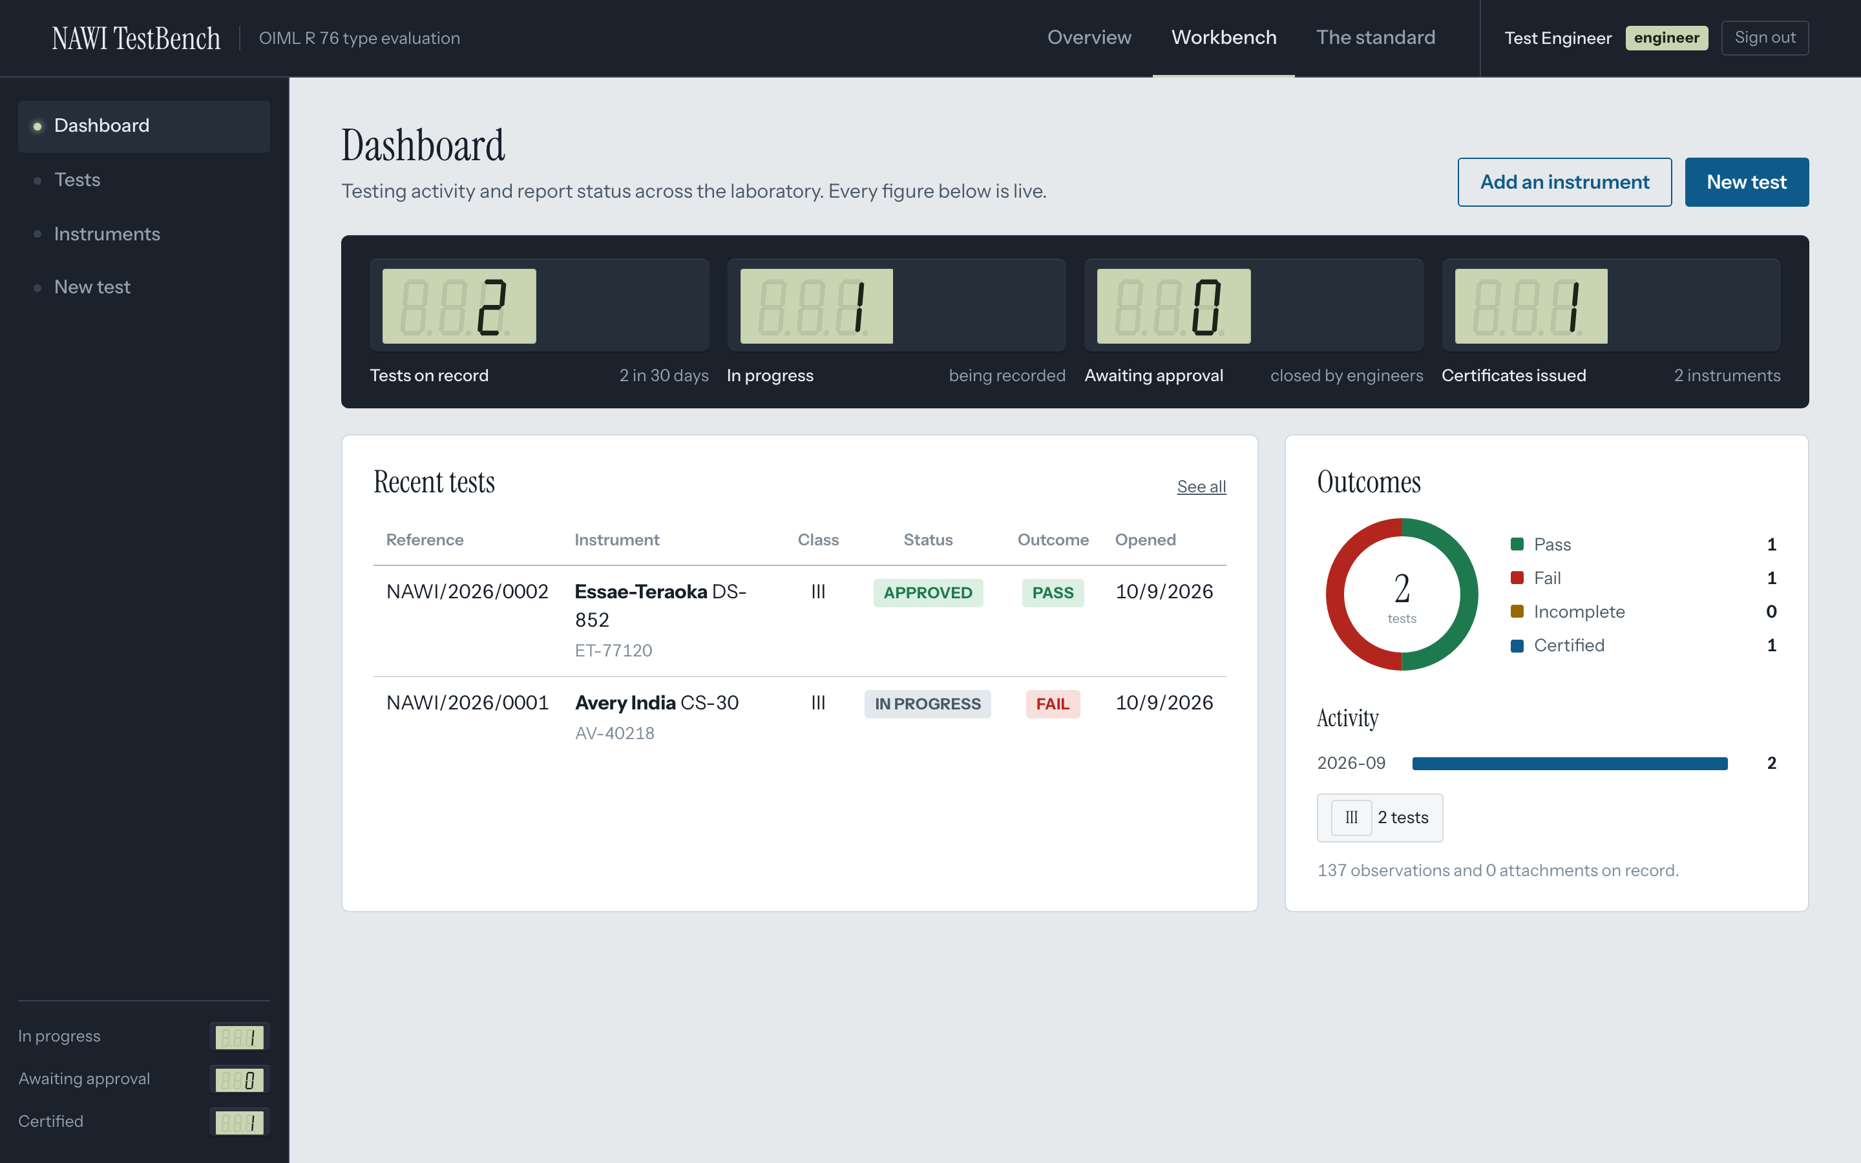
TECHNICAL APPROACH
[Team Name]
Technologies used
Node.js 20 + Express 4 REST API, role checks on every route
SQLite (better-sqlite3, WAL) instruments, tests, observations, environment, checklists, attachments, users, audit
Vanilla HTML, CSS, JavaScript + SVG workbench, MPE envelope chart, seven-segment LCD readout, no build step
Rule set as versioned JSON classes, MPE bands, supply rules, 17 test definitions with clauses
Pure evaluation engine changeover point, zero correction, per-test criteria, load-plan and completeness checks; 47 hand-worked unit tests (node:test)
Exports HTML report, PDF via headless Chromium, DOCX via an in-house OOXML writer (zlib only), JSON
Security scrypt password hashing, HttpOnly cookie sessions, SHA-256 report signatures, public /verify endpoint
Standards OIML R 76-1:2006 (E) constants clause by clause; R 76-2:2007 report layout
Working prototype: dashboard with live readouts, outcomes and repository
Methodology and process for implementation
Register instrument
particulars, Table 3 check
Open test
purpose, rule set, lab, environment
Record observations
validation, live MPE readout
Evaluate
MPE band, Ec, per-test criteria
Close
observations frozen
Approve and sign
SHA-256, approver role
Report and certificate
PDF, DOCX, verify page
Every save re-runs the engine, so verdicts, the error envelope and the completeness list update together. Reports are always recomputed from the stored raw observations against the rule set they were opened under.

Slide 4
FEASIBILITY AND VIABILITY
[Team Name]
Analysis of the feasibility of the idea
Working prototype already covers the complete R 76 battery, workflow, exports and certificate
Two runtime dependencies; runs on any laboratory PC or a small server, offline if needed
Every constant traced to a clause of R 76-1:2006 and locked by 47 hand-worked tests
Report time falls from hours of spreadsheet work to minutes of data entry
Instrument-wise history and search replace paper files without changing how labs test
Potential challenges and risks
Multi-interval and multiple-range instruments (e1, e2, e3) need per-range MPE handling
OIML R 76 is under revision; limits or test procedures may change
Labs hold years of results in spreadsheets that must be brought across
PDF rendering depends on a Chromium browser being present on the server
Laboratory data is sensitive: access, integrity and long-term reproducibility must hold
Strategies for overcoming these challenges
Rule set is data: a new edition is a new JSON file; reports pin the version they were judged under
Range-aware evaluation is an extension of the same engine; tests guard existing behaviour
CSV and JSON import for legacy observations; JSON export for integration with portals
DOCX and HTML exports work without Chromium; PDF path is auto-detected or configured
Roles, scrypt passwords, audit trail, signed approvals and a public verification page; TLS at the proxy

Slide 5
IMPACT AND BENEFITS
[Team Name]
Potential impact on the target audience
Department of Consumer Affairs and Legal Metrology laboratories: one uniform, clause-referenced report format across every test centre; faster model approvals
Test engineers: no manual band look-up or arithmetic; impossible readings refused at entry; the live readout shows the verdict before the point is saved
Approving officers: review a complete, computed record; sign once; certificate issued automatically when the battery passes
Manufacturers and applicants: predictable turnaround, editable Word report for their records, verifiable certificate number
Consumers and traders: instruments in the market have passed a consistently judged evaluation
Benefits of the solution (social, economic, environmental, etc.)
Social: fair transactions and consumer protection under the Legal Metrology Act, 2009, rest on approvals that are computed the same way everywhere
Economic: report preparation cut from hours to minutes; fewer repeat tests caused by calculation errors; shorter time to market for approved instruments
Governance: traceable verdicts with clause references, immutable observations, audit trail, signed approvals and public certificate verification
Environmental: paperless records and reports; digital repository replaces physical files at each centre
Future-proof: a revised OIML R 76 is a new rule-set file, not new software; JSON exports integrate with national portals

Slide 6
RESEARCH AND REFERENCES
[Team Name]
Details / Links of the reference and research work
OIML R 76-1:2006 (E), Non-automatic weighing instruments. Part 1: Metrological and technical requirements. Tests. https://www.oiml.org/en/files/pdf_r/r076-1-e06.pdf
OIML R 76-2:2007 (E), Part 2: Test report format. https://www.oiml.org/en/files/pdf_r/r076-2-e07.pdf
The Legal Metrology Act, 2009 and the Legal Metrology (General) Rules, 2011, Department of Consumer Affairs. https://consumeraffairs.gov.in/pages/legal-metrology-act
Smart India Hackathon 2026, Problem Statement SIH26035, Ministry of Consumer Affairs, Food and Public Distribution. https://www.sih.gov.in
OIML Certification System (OIML-CS) and the use of OIML certificates for R 76 instruments. https://www.oiml.org/en/oiml-cs
Clauses implemented: 3.2 Table 3 (classification), 3.5 and Table 6 (MPE), 3.5.3.2 and A.4.4.3 (changeover point, zero correction), 3.6 (eccentricity, repeatability), 3.8.2.2 (discrimination), 3.9.1 to 3.9.4 (tilting, temperature, power supply, creep, zero return), 4.5 and 4.6 (zero and tare devices), 5.3.3 and B.4 (span stability), 5.3.5 and A.5.2 (warm-up), B.2 (damp heat), 7.1 (descriptive markings).
Prototype documentation: docs/architecture.md, docs/calculation-methodology.md and docs/deployment.md in the project repository.

