Slide 1

PRINTOUT
Students send their files from their phone. You print them.
printout-w5pr.onrender.com

Slide 2
TODAY
What slows the counter down
Students queue up holding a pen drive, waiting for a free machine
Files come over WhatsApp and get lost among other chats
You ask every student: how many copies? colour? both sides?
Mistakes mean reprinting — your paper and your toner
Everyone arrives at the same time between classes
Printout takes all of that off the counter and puts it on the student’s phone.

Slide 3
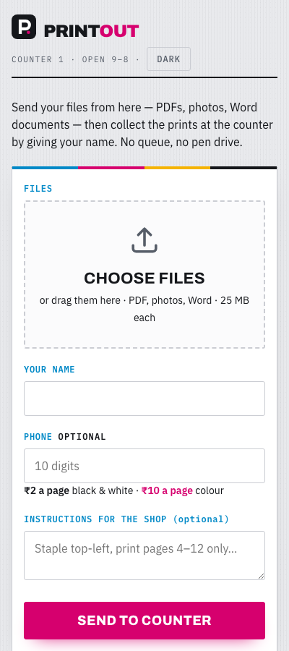
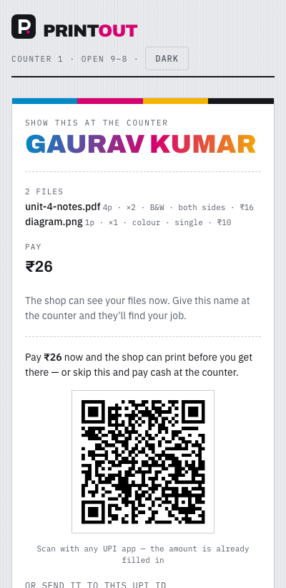
HOW IT WORKS
Four steps, start to finish
1
Student scans your QR poster
It opens the website on their phone.
2
They add files and choose settings
Copies, colour or B&W, one side or both — per file.
3
The job appears on your screen
Instantly, with everything already decided.
4
You print and they collect
They give their name at the counter.

Slide 4
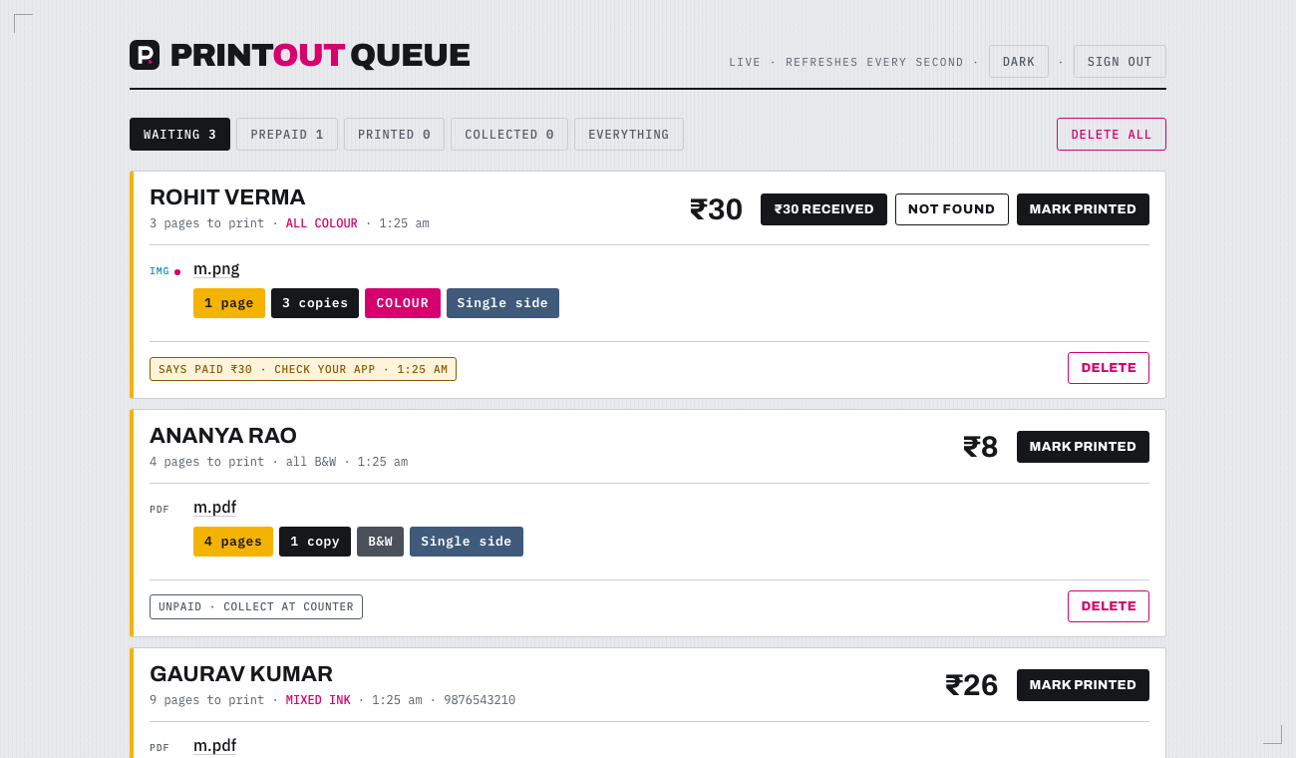
YOUR SCREEN
The queue
printout-w5pr.onrender.com/shop.html
Opens on a computer or your phone
Needs your password — students cannot see it
New orders appear on their own, every second
Nothing to install

Slide 5
READING A JOB
Everything you need is on the card
GAURAV KUMAR
The name the student gives at the counter
₹26
What to collect from them
4 pages · 2 copies
How much paper it needs
COLOUR
Print this file in colour — pink label
BOTH SIDES
Print on both sides — blue label
MIXED INK
This order has colour and B&W files together

Slide 6
WHAT YOU PRESS
Three buttons, that is all
MARK PRINTED
Press once you have printed it. The job turns blue and waits for pickup.
COLLECTED
Press when the student has taken their prints and paid.
DELETE
Clears the job and its files. Asks twice. Use it to tidy up finished work.
The tabs at the top — Waiting, Prepaid, Printed, Collected — sort the same jobs.

Slide 7
MONEY
Who has paid, and who has not
UNPAID
Collect cash when they come. Print when they are standing there.
SAYS PAID — CHECK YOUR APP
The student sent money by UPI. Check Paytm, then press ₹ received.
PAID
Money confirmed. You can print now, even if they come later.
Important: a student can tap “I have paid” without paying. Only press ₹ received after you see the money in your app.

Slide 8
PRICES
The bill adds itself up
The website counts the pages inside every PDF
Price = pages × copies × your rate
Right now: ₹2 a page black & white, ₹10 a page colour
Photos count as one page each
Word files cannot be counted — those say “+ quote”, so you price them by hand
Rates can be changed whenever you want
4 pages × 2 copies × ₹2
= ₹16

Slide 9
TO START
What you need
Any phone, tablet or computer with internet
The queue link, saved as a bookmark
Your password — keep it to yourself
The QR poster stuck up at the counter
Your UPI ID set on the website, so payments reach you
Scan. Send. Collect.
Print the A4 poster and stick it where students queue. That is the only thing they need to see.

Slide 10
IN SHORT
Less asking. Less reprinting.
No pen drives at the counter
No asking how many copies, or colour or not
Students can pay before they arrive, so prints are ready
You keep a record of every job of the day
Nothing to install, and nothing to pay for
Questions? Ask Farhan.

