Slide 1
Food Recipes Distribution Center for Venues
APPLIED DATA SCIENCE CAPSTONE
IBM DATA SCIENCE PROFESSIONAL CERTIFICATE
18-JAN-2019

Slide 2
Essence
Part 1: Problem Description
There is a Food recipes distributer in one of the boroughs of Toronto (Scarborough). This distributer provides services for different venues such as: Different types of Restaurants, Bakery, Breakfast Spot, newly started food center and Café with fresh and high-quality recipes. The distributer wants to build a warehouse for the recipes it buys from villagers and farmers inside the borough, so that they will support more customers and also bring better "Quality of Service" to the old customers.
For example, if the warehouse is close to those old and famous restaurants, then the vegetables and other recipes would be delivered to the restaurant in the right time and there would be no delay so the restaurant cooks can start their job from the morning and the Quality of Service will be high and this distributer will gain more reputation and income.
The distributer should build this warehouse where it is closest to its customers in order to minimize the cost of transpotation in addition to the example above. which neighborhood (in that borough) would be a better choice for the distributer to build the warehouse in that neighborhood. Finding the right neighborhood is our mission and our distribution system will provide this distributor with a sorted list of neighborhoods in which the first elemnt of the list will be the best suggested neighborhood.

Slide 3
Essence
Part 2: Data Requirement
1- We will need geo-locational information about that specific borough and the neighborhoods in that borough. We specifically and technically mean the latitude and longitude numbers of that borough. We assume that it is "Scarborough" in Toronto. This is easily provided for us by the distributor, because the distributor has already made up his mind about the borough. The Postal Codes that fall into that borough (Scarborough) would also be sufficient fo us. I fact we will first find neighborhoods inside Scarborough by their corresponding Postal Codes.
2- We will need data about different venues in different neighborhoods of that specific borough. In order to gain that information we will use "Foursquare" locational information. By locational information for each venue we mean basic and advanced information about that venue. For example there is a venue in one of the neighborhoods. As basic information, we can obtain its precise latitude and longitude and also its distance from the center of the neighborhood. But we are looking for advanced information such as the category of that venue and whether this venue is a popular one in its category or maybe the average price of the services of this venue
image is retrieved
from google.com

Slide 4
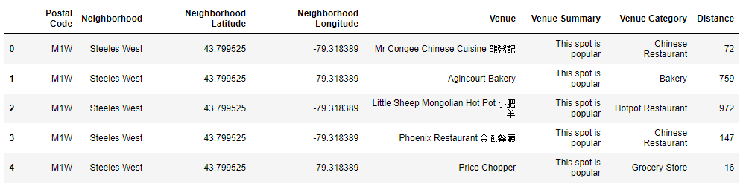
Needed Dataframe

Slide 5
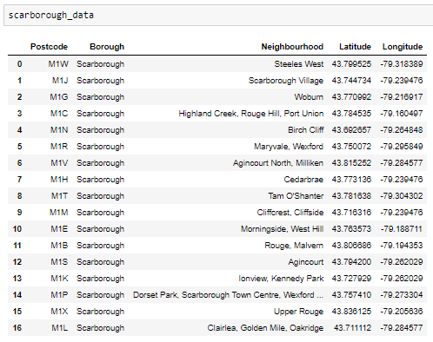
MAIN ARTICLE
Part 1: Identifying Postal Codes (and then Neighborhoods) in "Scarborough"

Slide 6
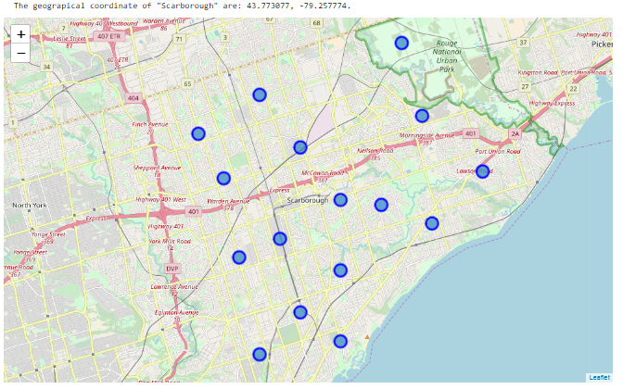
MAIN ARTICLE
Part 1: Identifying Postal Codes (and then Neighborhoods) in "Scarborough"

Slide 7
MAIN ARTICLE
Part 2: Connecting to Foursquare and Retrieving Locational Data for Each Venue in Every Neighborhood
After finding the list of neighborhoods, we then connect to the Foursquare API to gather information about venues inside each and every neighborhood. For each neighborhood, we have chosen the radius to be 1000 meter. It means that we have asked Foursquare to find venues that are at most 1000 meter far from the center of the neighborhood.

Slide 8
MAIN ARTICLE
Part 3: Processing the Retrieved Data and Creating a DataFrome for All the Venues inside the Scarborough
When the data is completely gathered, we will perform processing on that raw data to find our desirable features for each venue. Our main feature is the category of that venue. After this stage, the column "Venue's Category" wil be One-hot encoded and different venues will have different feature-columns. After On-hot encoding we will integrate all restaurant columns to one column "Total Restaurants" and all food joint columns to "Total Joints" column.

Slide 9
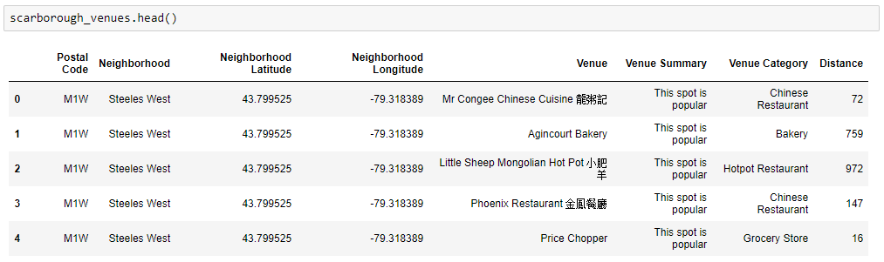
MAIN ARTICLE
Part 3: Processing the Retrieved Data and Creating a DataFrome for All the Venues inside the Scarborough

Slide 10
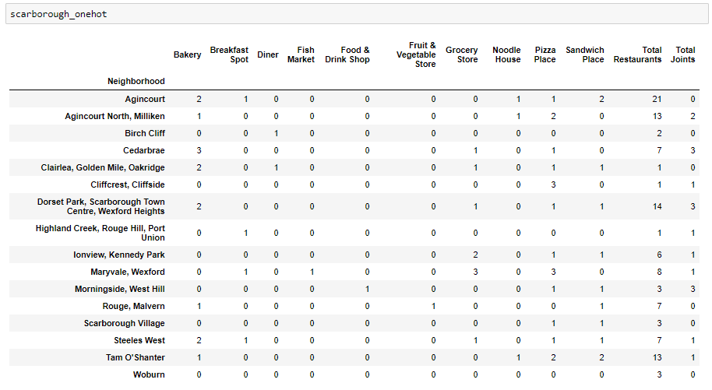
Now, the dataset is fully ready to be used for machine learning (and statistical analysis) purposes.

Slide 11
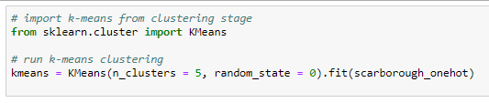
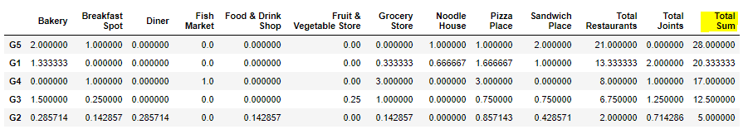
MAIN ARTICLE
Part 4: Applying one of Machine Learning Techniques (K-Means Clustering)

Slide 12
DECISION MAKING AND REPORTING RESULTS
Now, we focus on the centers of clusters and compare them for their "Total Restaurants" and their "Total Joints". The group which its center has the highest "Total Sum" will be our best recommendation to the contractor. {Note: Total Sum = Total Restaurants + Total Joints.} This algorithm although is pretty straightforward yet is strongly powerful.

Slide 13
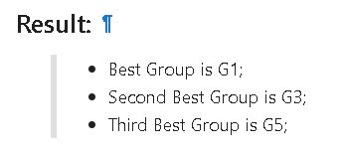
DECISION MAKING AND REPORTING RESULTS

Slide 14
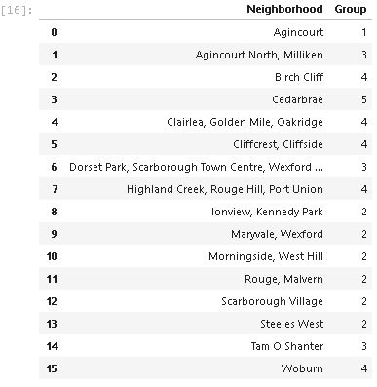
DECISION MAKING AND REPORTING RESULTS

Slide 15
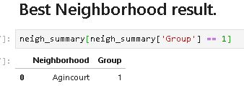
DECISION MAKING AND REPORTING RESULTS

Slide 16
Thank you
Image is from: https://contenthub-static.grammarly.com/blog/wp-content/uploads/2017/10/thank-you-760x400.jpg

