Slide 1
Traffic signal & lane detection

Slide 2
Introduction
Environment detection for vehicles is a complex task that involves many sub-processes.
Our project is sub-component of this complex task
This project detects traffic signals on video capture & lane markings using OpenCV and Python

Slide 3
Approach for traffic signal detection
Notes:
Detect colored image convert it to HSV, define upper and lower bounds for H,S,V in order to turn desired region white and background as black.
Closing Morphological operation is applied on the region of interested (ROI) to form a proper circle, fills gaps in the boundary.
Guassian Blur is used to smooth the image and reduce noise.
Circular Hough Transform is used to detect circular parts(traffic light) in image within specific limit.

Slide 4
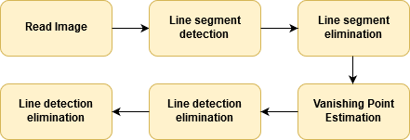
Approach for lane detection
Notes:
In this project, I have made significant progress in lane detection. I have extracted the Edge Drawing (ED) lines from the images. For extracting ED lines, first of all I apply the Gaussian filter to smooth the image. Then I calculate the gradient map of the image along with the direction map. Then I compute the anchor points which are pixels with a very high probability of being edge elements. The anchors correspond to pixels where the gradient operator produces maximal values. Then I connect the anchors by drawing edges between them. This is known as edge drawing. I have implemented Smart Routing algorithm for edge drawing. Finally, I extract the line segments from the chain of edge pixels using least square line fitting method.

Slide 5
Demo

Slide 6
References
Traffic Light Detection, http://www.ijsce.org/attachments/File/ICCIN-2K14/16-ICCIN-2k14.pdf
An Efficient Lane Detection Algorithm for Lane Departure Detection, http://ieeexplore.ieee.org/document/6629593/
Traffic Light Detection using Hough Transform, http://ieeexplore.ieee.org/stamp/stamp.jsp?arnumber=7437004
Vanishing Point Estimation Method , http://ieeexplore.ieee.org/document/6424684/
A Novel Lane Detection System with Efficient Ground Truth Generation, http://ieeexplore.ieee.org/stamp/stamp.jsp?arnumber=6097058

