Slide 1
KIET GROUP OF INSTITUTIONS, GHAZIABAD
CSE (AI/AIML) Department | Project (BCS-753) | 7th Semester
Multilingual Mental-Health Risk and Sentiment Analyzer
Screening sentiment, emotion and stress-related language in English, Hindi and Hinglish, with a working web application and an IEEE-format research paper
Team members
Faisal Arif Ansari
Paras Tiwari
Prateek Rawat
Lakshay Mishra
Research and screening tool only. It does not diagnose any mental-health condition.
Notes:
Introduce the team and the project. One sentence on scope: the system screens text for sentiment, emotion and stress-related language in English, Hindi and Romanized Hindi. It is a research tool and not a diagnostic system.

Slide 2
How this presentation maps to the evaluation
# | Assessment component | Where it is covered | Evidence shown
1 | Technical approach finalized and validated | Slides 4, 6-8 | Literature, alternatives compared, validation protocol
2 | Implementation (minimum 70%) | Slides 10-15 | Component status, live web app screenshots
3 | Results analysis, discussion and validation | Slides 17-22 | 3-seed test results, 95% CIs, published baselines
4 | Presentation | Whole deck | Live demo of the web app (slides 11-15)
5 | Team work and individual contribution | Slide 24 | Work packages and owners
6 | Project management, cost and scalability | Slides 25-26 | Timeline, measured compute, latency, scaling plan
7 | Ethics, environment, sustainability, safety | Slide 28 | Privacy design, safety layer, compute footprint
8 | Research paper quality and plagiarism | Slide 29 | 7-page IEEE paper, 37 verified references
9 | Submission readiness and communication | Slides 29-30 | Paper, public code, reproducibility guide
Notes:
Each rubric component is mapped to the slides that answer it, so the panel can check them one by one.

Slide 3



Problem and scope
Indian social-media text mixes English, Hindi in Devanagari and Hindi typed in Roman letters (Hinglish), often in one sentence.
Most mental-health NLP tools are trained and tested on English only. Their behaviour on Hinglish is rarely measured.
Goal: one service that reports sentiment, emotion and a stress-language signal, with language ID, calibrated probabilities and token-level explanations.
Research question: what explains the English to Hinglish accuracy gap, and which change closes it?
3
tasks: sentiment, emotion, stress language
3
language and script tags: en-Latn, hi-Deva, hi-Latn
4
Scope: screening and research only. The "risk" output means stress-related language in a post, as labelled in Dreaddit. It is not a clinical diagnosis.
public datasets, no private data collected
Notes:
Motivation: code-mixed Hinglish is common online but most tools are English-only. Our question is why accuracy drops on Hinglish and what fixes it.

Slide 4
What earlier research did, and the gap we target
Rubric 1
Prior work | What it showed | Gap addressed in this project
Turcan & McKeown, 2019 (Dreaddit) | Reddit stress dataset; BERT-base F1 0.8065 on the official test set | English only; we reuse its test set to compare directly
Khanuja et al., 2021 (MuRIL) | BERT pre-trained on Indian languages, including transliterated text | Not tested on Hinglish social-media sentiment with stress tasks
Nayak & Joshi, 2022 (HingBERT) | Hinglish pre-training: HingRoBERTa 66.43 vs XLM-R 61.57 F1 (GLUECoS) | We test whether the gain holds on new Hinglish data
Barbieri et al., 2022 (UMSAB) | Multilingual tweet sentiment; Hindi XLM-Twitter 56.39 | Same Hindi test file reused for context
Muhammad et al., 2025 (BRIGHTER) | Multi-label emotion data for many languages, incl. Hindi | Used for the emotion task (English and Hindi)
Liu et al., 2019; Pruksachatkun et al., 2020 | Multi-task training helps some task pairs and hurts others | Untested for unrelated mental-health datasets; we ablate it
Guo et al., 2017; Sundararajan et al., 2017 | Temperature scaling; Integrated Gradients explanations | Explanation faithfulness on Hinglish is rarely measured
Notes:
These are the papers we build on. All published numbers are read from the papers' own tables. The right column says what we add.

Slide 5
Technical approach
1
Data, architecture, alternatives compared and how each choice was validated

Slide 6
Datasets and split integrity
Rubric 1
Task | Dataset | Languages | Train / Val / Test
Sentiment (3 classes) | UMSAB tweets (English, "hindi") + Hinglish YouTube comments | en-Latn, hi-Latn | 5,854 / 1,121 / 2,213
Emotion (6 labels) | BRIGHTER (English, Hindi) | en-Latn, hi-Deva | 4,622 / 880 / 3,769
Stress language (binary) | Dreaddit (Reddit posts) | en-Latn | 2,391 / 425 / 715
Integrity checks we added
Frozen splits: SHA-1 hash per text and a SHA-256 manifest; a check script confirms anyone gets the same splits.
Exact and near-duplicate removal across train, validation and test.
Group splits by Reddit post and YouTube video, so one thread never spans two splits.
Fixed a dedup bug that wrongly removed 4,002 Hindi texts (Devanagari vowel signs were being stripped).
Each task comes from a different dataset and population, so results are reported per task and per language.
Notes:
Explain that splits are frozen by hash so results are reproducible. Mention the Devanagari dedup bug: it is a real error we found and fixed before training the final models.

Slide 7
System architecture
Rubric 1
Input text
web UI, API, CSV
Privacy masking
emails, phones, URLs, @mentions
Language + script ID
char n-gram + lingua
Tokenizer
max 128 tokens
Design choices
MuRIL encoder (238 M parameters)
mean + max pooling, shared dense layer
One shared encoder, three task heads; single-task versions use the same code with one head.
Masked loss: English emotion data has no "disgust" label, so that label is skipped for English rows.
Outputs go to a FastAPI service and a 9-page web UI.
Two lighter models (TF-IDF + LogReg, BiLSTM) share the same API.
Sentiment head
3 classes, cross-entropy
Emotion head
6 labels, masked BCE
Stress head
binary, cross-entropy
Temperature scaling
fit on validation
Safety layer + IG
notices, explanations
Notes:
Walk the pipeline left to right: masking, language ID, tokenizer, encoder, three heads, calibration, then the safety layer and explanations before the response goes out.

Slide 8
Alternatives compared and validation
Rubric 1
Option | Why it was tried | Outcome
TF-IDF + logistic regression | Fast, interpretable baseline | Kept as baseline
Multi-task BiLSTM | Small neural model, no pre-training | Kept as baseline
Multi-task MuRIL | Indian-language pre-training | Served model in the app
Single-task MuRIL | Check whether sharing helps | Better stress ranking
HingRoBERTa (sentiment) | Pre-trained on Roman-script Hinglish | Best sentiment model
256 tokens, head+tail input | 23.6% of stress posts exceed 128 tokens | Rejected on validation
Validation protocol
3 random seeds (13, 21, 42) per configuration; mean and s.d. reported.
Model selection on validation only. The test set is used once, for comparisons fixed in advance.
Paired bootstrap, 1,000 resamples, 95% confidence intervals.
Calibration checked with ECE and Brier score.
Original single run reproduced exactly with seed 13.
Notes:
We did not pick the best number on the test set. Every choice was made on validation, and the test set was used once for comparisons we wrote down before running them.

Slide 9
Implementation and live demo
2
What is built, and the working web application on real inputs

Slide 10

Implementation status
Rubric 2
Data pipeline
download, cleaning, dedup, frozen splits
Language ID
en / hi-Deva / hi-Latn classifier
21
training runs on CPU (7 configurations x 3 seeds)
4 model families
TF-IDF, BiLSTM, MuRIL, HingRoBERTa
Training engine
multi-seed, resumable every 10 min
2,893 lines of Python in src/, 809 in scripts/, 713 in tests/
Calibration
temperature scaling, tuned thresholds
Evaluation
bootstrap CIs, error analysis
Not done yet
Explanations
Integrated Gradients per token
Web app + API
FastAPI, 9 pages, batch CSV
Transliteration / spelling normalisation
Learning-rate grid and XLM-R control (need a GPU)
Manual error taxonomy (sheet ready)
Sarvam adapter tested with mocks only
Privacy + safety
no text logged, PII masking, notices
Tests
68 unit tests, all passing
Notes:
All core components work end to end. The right panel lists what is not done, so the panel sees the honest status.

Slide 11
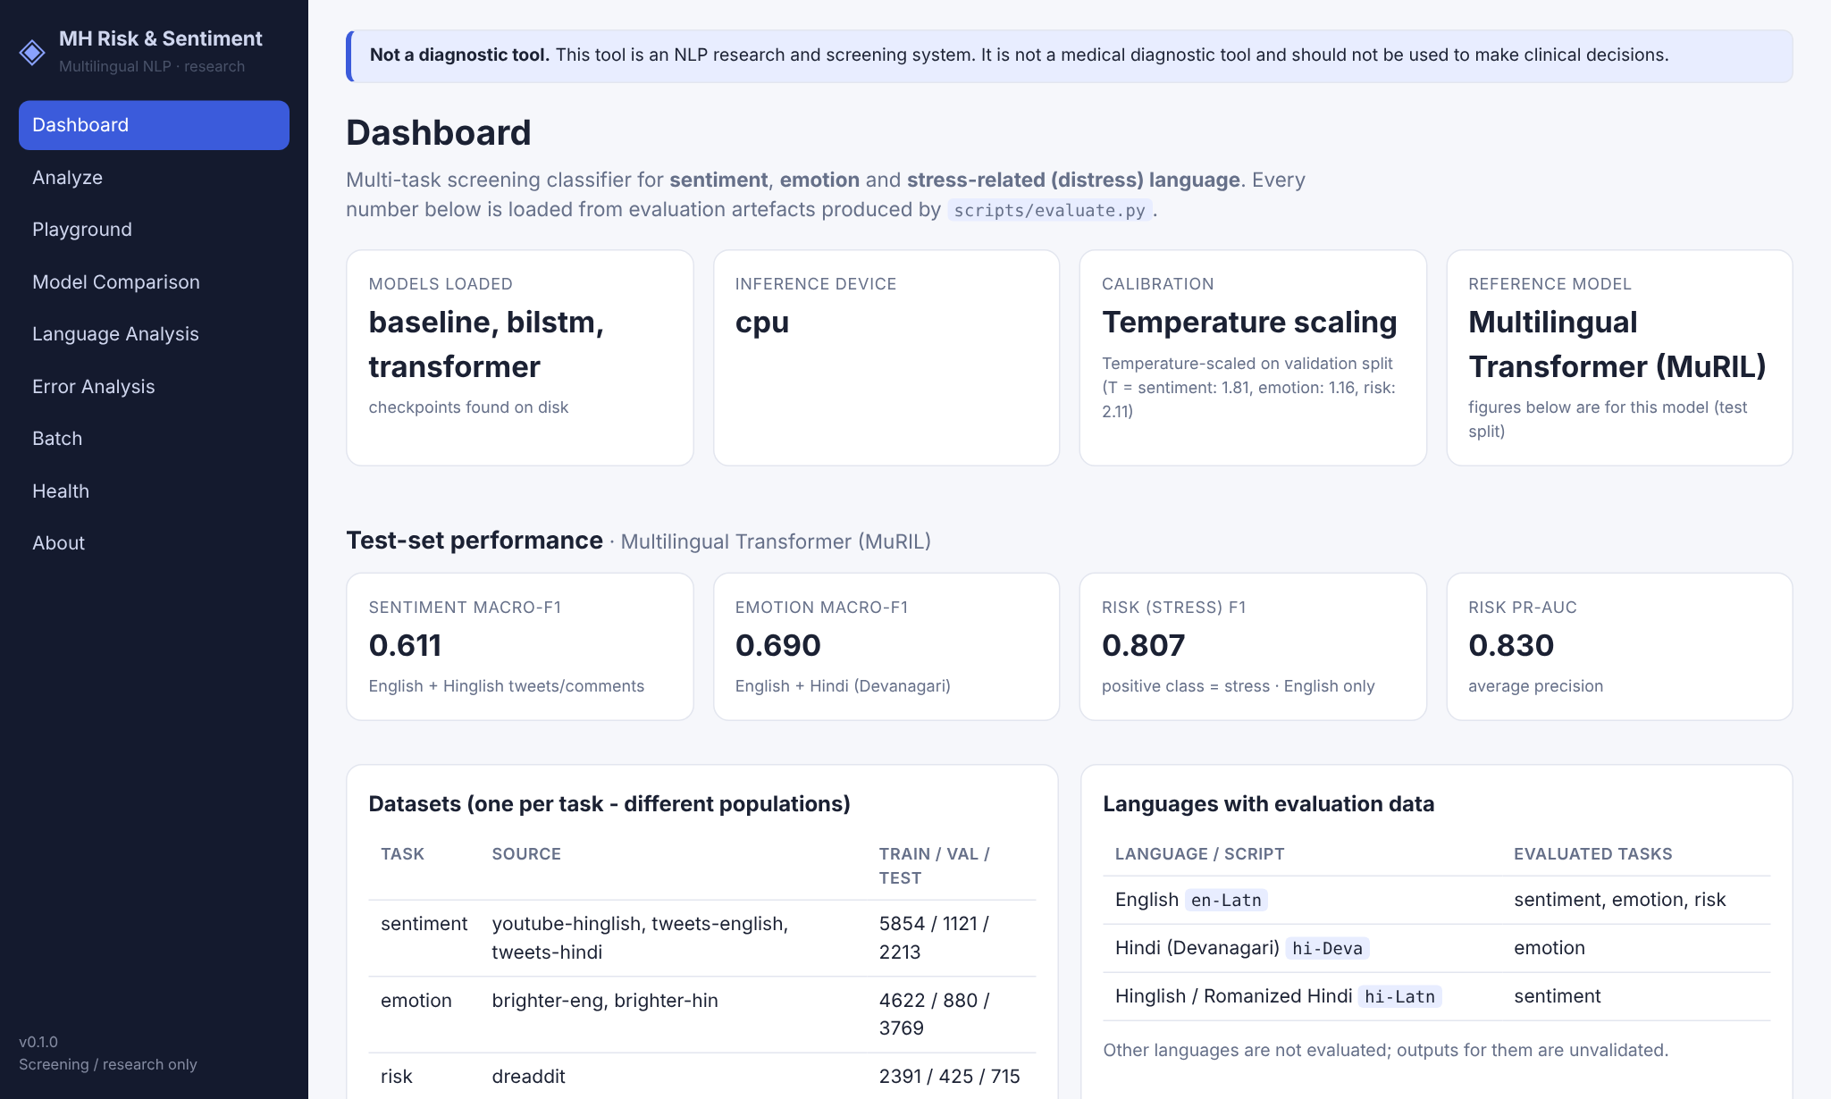
Live web app: dashboard
Rubric 2
Shows which models loaded from disk (TF-IDF, BiLSTM, MuRIL) and the device.
Test metrics are read from evaluation files, never typed in by hand.
A banner on every page says the tool is not diagnostic.
Run locally with one command: uvicorn src.app.main:app_factory --factory
Notes:
Screenshot from the running application on a 4-core CPU. The dashboard numbers here are from the original single-seed MuRIL checkpoint that the app serves.

Slide 12
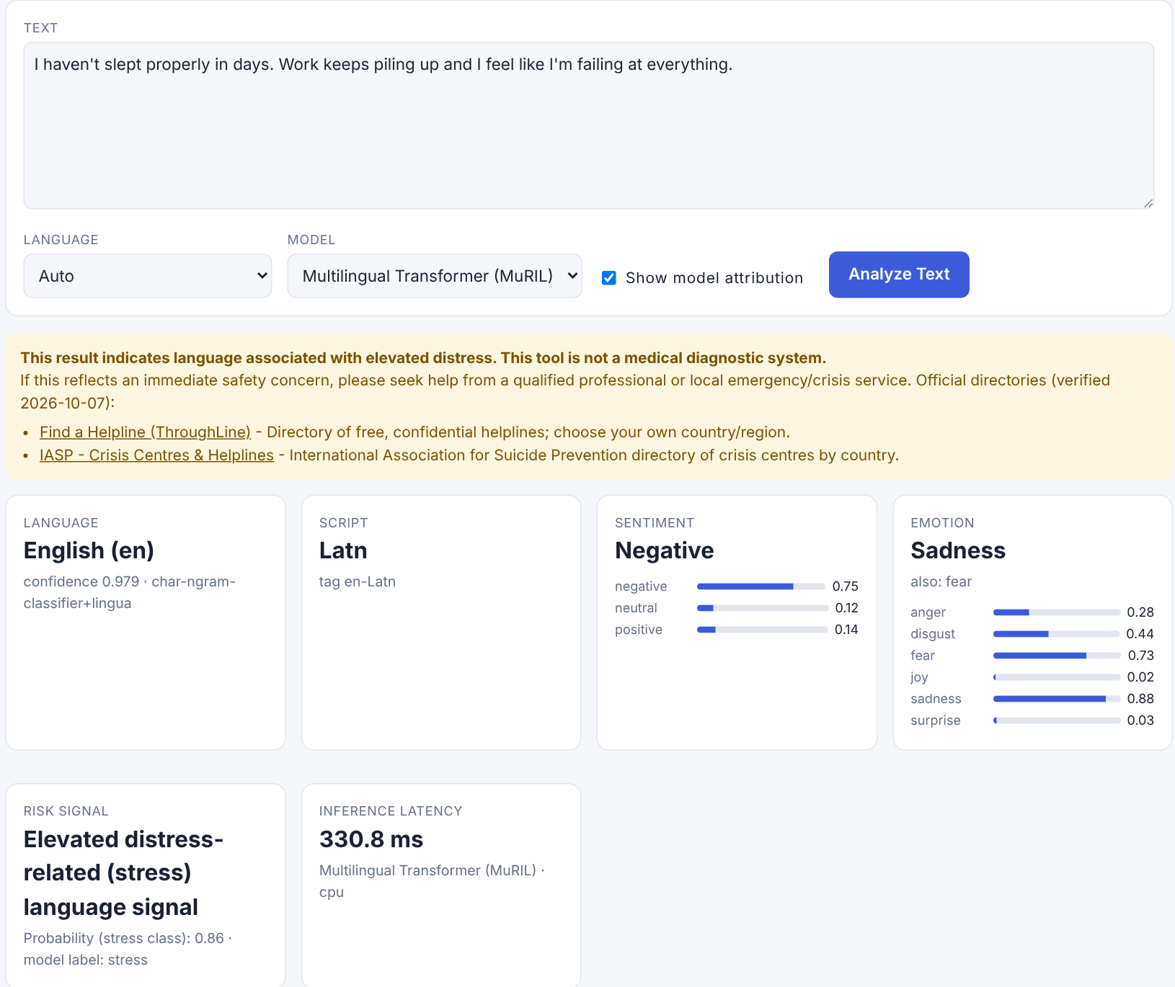
Live example 1: English post
Rubric 2
Input: "I haven't slept properly in days. Work keeps piling up and I feel like I'm failing at everything."
Language: English, confidence 0.979
Sentiment: Negative (0.75)
Emotion: Sadness 0.88, fear 0.73
Stress signal: Elevated, probability 0.86
Response: Safety notice with official helpline directories
Notes:
Live inference with the MuRIL model. The stress probability is a model output, not a clinical probability. When the signal is elevated, the app shows directories of helplines instead of hard-coded numbers.

Slide 13
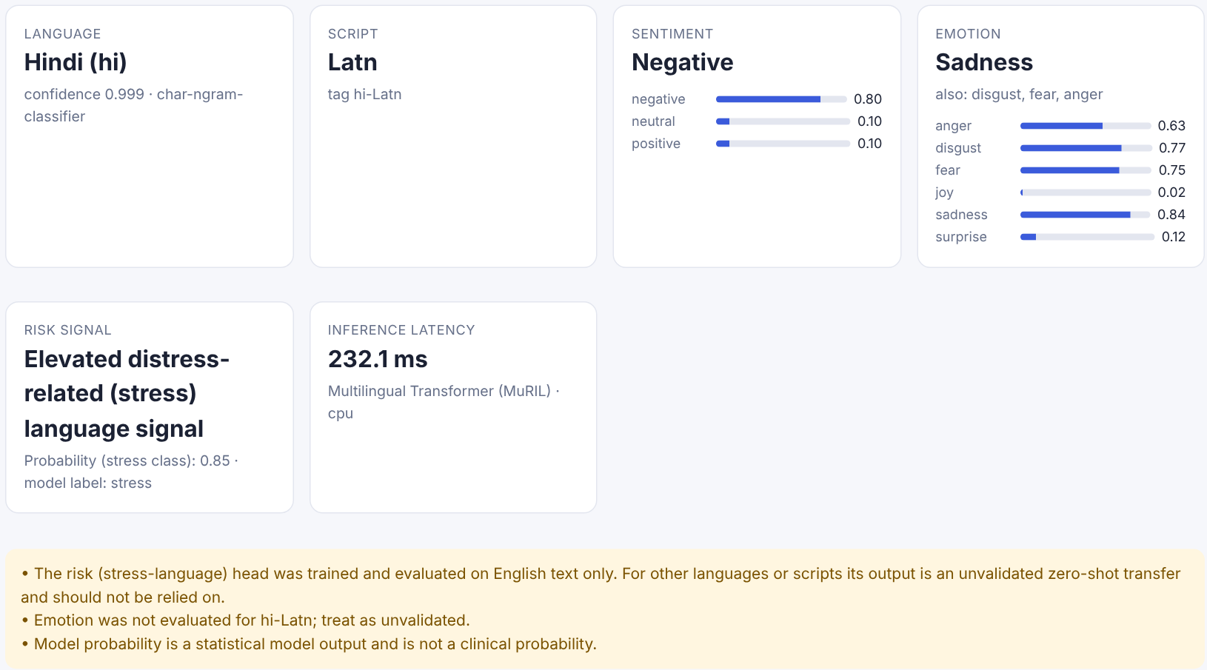
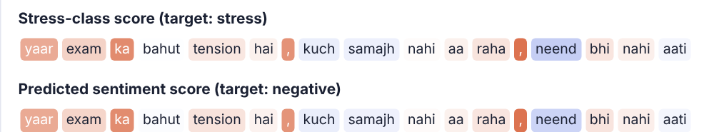
Live example 2: Hinglish post with explanation
Rubric 2
Input: "yaar exam ka bahut tension hai, kuch samajh nahi aa raha, neend bhi nahi aati"
Detected as Romanized Hindi (hi-Latn), confidence 0.999.
The app warns that the stress head was trained on English only, so this output is unvalidated for Hinglish.
Token attribution below: blue pushes toward the label, orange away. Our deletion test found it only weakly faithful for Hinglish (58% of examples).
Notes:
This example shows the per-language warnings. The system tells the user which outputs were never validated for this language.

Slide 14
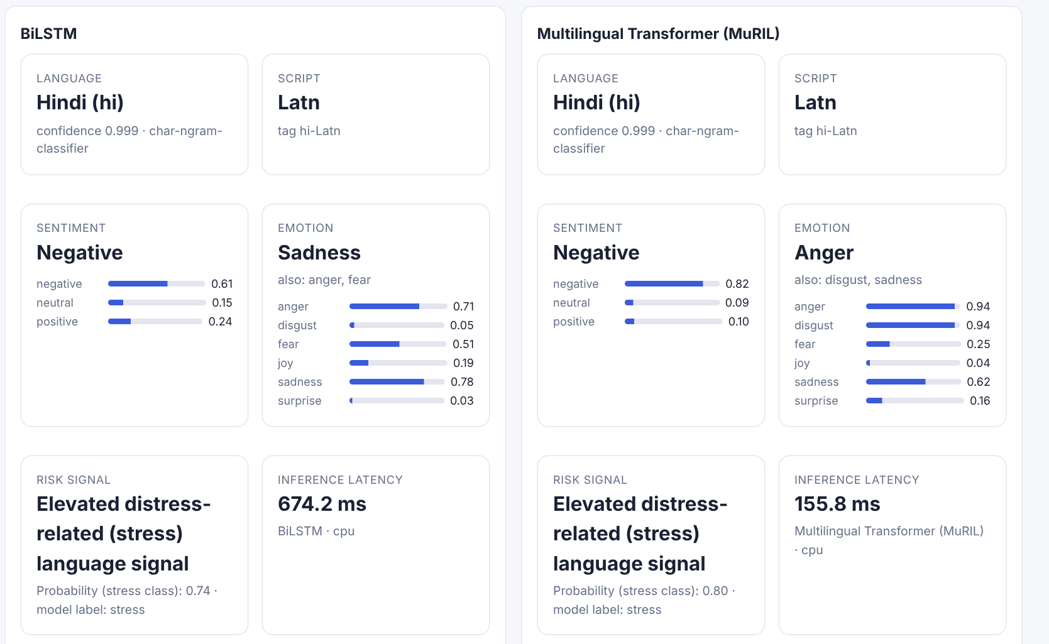
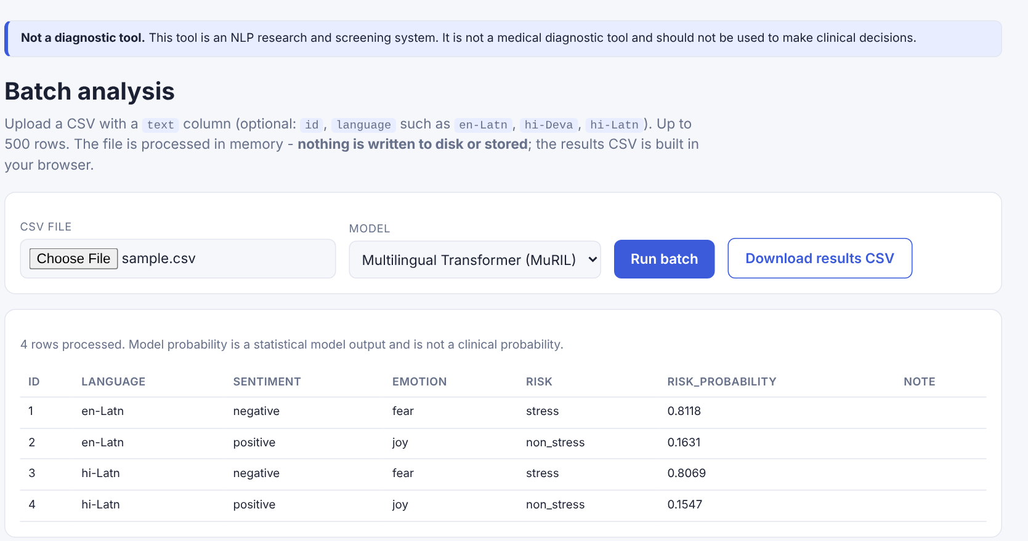
Model playground and batch analysis
Rubric 2
A 4-row CSV (2 English, 2 Hinglish) processed in memory; nothing is written to disk. Up to 500 rows per file.
Same Hinglish sentence through BiLSTM and MuRIL side by side. Both flag stress; their emotion outputs differ (sadness vs anger).
Notes:
The playground lets a user compare models on the same input. Batch mode is for researchers who need many predictions at once; results download as CSV built in the browser.

Slide 15
Anyone can clone and run it
Rubric 2
git clone https://github.com/faizdevx/
Multilingual-Mental-Health-Risk-.git
pip install -r requirements.txt
python -m pytest -q # 68 tests
python scripts/download_data.py
python scripts/prepare_data.py
python scripts/train_baseline.py
uvicorn src.app.main:app_factory --factory
Measured latency (median, 30 requests, 4-core CPU)
10.5 ms
TF-IDF + LogReg
11.7 ms
BiLSTM
124.5 ms
MuRIL transformer
Step-by-step guide in README.md: install, check, data, training, app, reproducing experiments.
End-to-end HTTP time for all three heads, without explanations.
Notes:
The repository is public and the README walks a new user from clone to running app. Trained weights are not in git because of size, so a new user trains the small models in minutes or the transformer in hours on CPU.

Slide 16
Results and validation
3
Test-set results, mean of 3 seeds, with paired bootstrap 95% confidence intervals

Slide 17
Headline test results
Rubric 3
Model | Sentiment macro-F1 | Emotion macro-F1 | Stress F1 | Stress PR-AUC | Stress ECE
Multi-task MuRIL (baseline) | 0.603 ± 0.008 | 0.684 ± 0.011 | 0.796 ± 0.014 | 0.852 ± 0.029 | 0.035 ± 0.002
Single-task MuRIL | 0.606 ± 0.003 | 0.682 ± 0.002 | 0.799 ± 0.005 | 0.875 ± 0.010 | 0.062 ± 0.023
Single-task HingRoBERTa | 0.648 ± 0.013 | - | - | - | -
+0.056
+0.023
0
Hinglish sentiment macro-F1 from HingRoBERTa, 95% CI [+0.032, +0.079]
stress PR-AUC from training stress alone, CI [+0.008, +0.038]
tasks that gained from multi-task sharing
Notes:
Mean plus or minus standard deviation over seeds 13, 21 and 42 on the test sets. Bold green marks the best value per column where the difference is statistically supported.

Slide 18
Hinglish pre-training narrows the gap
Rubric 3
Hinglish: 0.556 to 0.611, +0.056 [+0.032, +0.079].
Gains on both Hinglish sources: tweets +0.054, YouTube +0.071.
English unchanged: +0.020 [-0.002, +0.044].
English to Hinglish gap: 0.128 to 0.093.
Contamination check: 0 test texts found in HingRoBERTa's 52.9 M-line pre-training corpus.
Notes:
Same splits, seeds and hyper-parameters; only the encoder changes. This matches the HingBERT paper's effect size (+4.86 there, +5.6 here) on independent data.

Slide 19
Multi-task sharing did not help
Rubric 3
Sharing
Only stress PR-AUC changed significantly: -0.023 [-0.038, -0.008]. The three datasets come from different platforms and annotators, so the tasks interfere.
Negative result: longer input
Head+tail 256 tokens lowered validation macro-F1 by 0.020 [-0.037, -0.003]. Plain 256 tokens made no difference. Neither went to test.
Notes:
Multi-task training costs less (one 238 M model instead of three) but gives no accuracy gain. The truncation idea from Sun et al. 2019 did not carry over to short Reddit posts.

Slide 20
Reliability: abstention and explanations
Rubric 3
Abstain on low-confidence inputs
0.783 to 0.828
stress macro-F1 on the 83% of inputs the model answers
0.647 to 0.702
HingRoBERTa sentiment macro-F1 at 74% coverage
Cut-off chosen on validation (20th percentile of confidence) and applied unchanged to test. Low confidence describes the text, not the person.
Explanations are faithful for English stress (92% of examples) but weak for Hinglish (58%). The app's explanation note says so.
Notes:
Two reliability checks. Abstention trades coverage for accuracy. The deletion test removes the top 20% of tokens chosen by Integrated Gradients and compares with random deletion.

Slide 21
Comparison with published research
Rubric 3
Task and dataset | Published (source) | Ours (test, 3 seeds) | Comparable? | Reading
Stress, Dreaddit | BERT-base F1 0.8065 (Turcan & McKeown, 2019) | F1 0.798 (single-task MuRIL) | Yes, same 715-post test set | On par
Hinglish sentiment | HingRoBERTa +4.86 over XLM-R (Nayak & Joshi, 2022) | +5.6 over MuRIL | Different data | Effect replicated
Hindi tweets, UMSAB | XLM-Twitter 56.39 (Barbieri et al., 2022) | HingRoBERTa 0.616 | Same test file, different training mix | About 5 points above
English tweets, UMSAB | XLM-Twitter 70.63 | HingRoBERTa 0.704 | Partly | On par
Emotion, BRIGHTER English | RoBERTa baseline 0.708 | 0.639 to 0.645 | Partly | Below
Emotion, BRIGHTER Hindi | RoBERTa baseline 0.855 | 0.768 to 0.770 | Partly | Below
Emotion is our weakest task: 3 epochs on CPU and less training data, since validation was carved from train.
Notes:
Published numbers are taken from each paper's own result table. Only the Dreaddit row is a like-for-like comparison; the others are context.

Slide 22




Limitations we report
Rubric 3
Compute
Language coverage
CPU only: 3 seeds, 3 epochs, no learning-rate search. Best epoch was often the last, so models may be under-trained.
Stress labels exist for English only. Hindi in Devanagari has emotion labels only; Hinglish has sentiment only.
Data quality
Clinical meaning
Hinglish data is small and noisy. The tweets-hindi validation split scores near chance for every model; cause unknown.
Stress is a crowd-annotated label on Reddit posts. It is not a clinical status and was not validated on other populations.
Notes:
We list these because they limit what the results can claim. Each one is also in the paper and the README.

Slide 23
Team, planning and scalability
4
Who did what, how resources were used, and how the system scales

Slide 24
Team work and individual contribution
Rubric 5
Faisal Arif Ansari
Paras Tiwari
Prateek Rawat
Lakshay Mishra
Work package | Main output | Owner(s)
Literature review and dataset survey | Related work, 37 verified references
Data pipeline and split integrity | Download, cleaning, dedup, frozen splits
Baselines (TF-IDF, BiLSTM) and language ID | 3 baseline models, langid classifier
Transformer experiments | 21 runs: MuRIL, HingRoBERTa, ablations
Evaluation and statistics | Bootstrap CIs, calibration, faithfulness
Web app, API, privacy and safety | FastAPI service, 9-page UI, tests
Research paper and presentation | IEEE paper, README, this deck
Notes:
Fill in the owner column before presenting. Each member should be ready to explain their own work package in detail.

Slide 25
Timeline, resources and cost
Rubric 6
7 Oct
22 Oct
22-24 Oct
24 Oct
26 Oct
System built: data pipeline, 3 models, web app
Research audit, experiment plan, frozen splits
21 CPU training runs with resumable snapshots
Results, conclusion, IEEE paper
Clone-and-run guide for anyone
Resource | What we used | Cash cost
Compute | One 4-core CPU, 16 GB RAM; at least 23.3 h of recorded training time for 21 runs | Rs 0
GPU | None. Kaggle GPU requests never attached, so training was made resumable instead | Rs 0
Software | PyTorch, Transformers, scikit-learn, FastAPI (open source) | Rs 0
Data | 4 public datasets; no new data collected from people | Rs 0
Storage | 940 MB of checkpoints (MuRIL 914 MB, others 13 MB each) | Rs 0
Notes:
Dates come from the git history. The 23.3 hours is a lower bound because resumed runs only record time for the last process. Risk handling: restarts were frequent, so we added a snapshot every 10 minutes.

Slide 26
Scalability
Rubric 6
~8 texts/s
How it scales
The API keeps no per-user state, so more replicas behind a load balancer add throughput linearly. Servers needed is roughly peak texts per second divided by 8.
High-volume, low-stakes traffic can go to the 13 MB TF-IDF model, about 12 times faster than MuRIL.
New languages need labelled data per task; the code is language-agnostic, the claims are not.
Planned, not yet measured: GPU serving, batched inference, 8-bit quantisation.
MuRIL, one process on 4 CPU cores (from 124.5 ms median)
~85 texts/s
TF-IDF or BiLSTM on the same machine (10.5-11.7 ms)
500 rows
per batch CSV upload, processed in memory
Notes:
Throughput figures are derived from our measured latency, sequential requests, single process. The planned optimisations have not been benchmarked.

Slide 27
Ethics and research paper
5
Responsible design, and the state of the paper

Slide 28





Ethics, privacy, safety and sustainability
Rubric 7
Not diagnostic
Privacy
Safety response
Disclaimers on every page and response. "Risk" is defined as stress-related language only.
Submitted text is never logged or stored. Logs keep a whitelist of metadata. Emails, phones, URLs and @mentions are masked.
Elevated signals show official helpline directories (checked 7 Oct 2026). No hard-coded phone numbers that could go stale.
Fairness
Data ethics
Environment
Metrics reported per language. Outputs for languages without evaluation data are labelled unvalidated.
Public datasets only; raw Reddit and Twitter text is not redistributed. Dreaddit's licence is unverified and flagged.
CPU only, no GPU hours. Reused pre-trained encoders. 13 MB models available for low-energy serving.
Notes:
Privacy is tested: a unit test sends a marker string through every endpoint and checks it never reaches the logs.

Slide 29
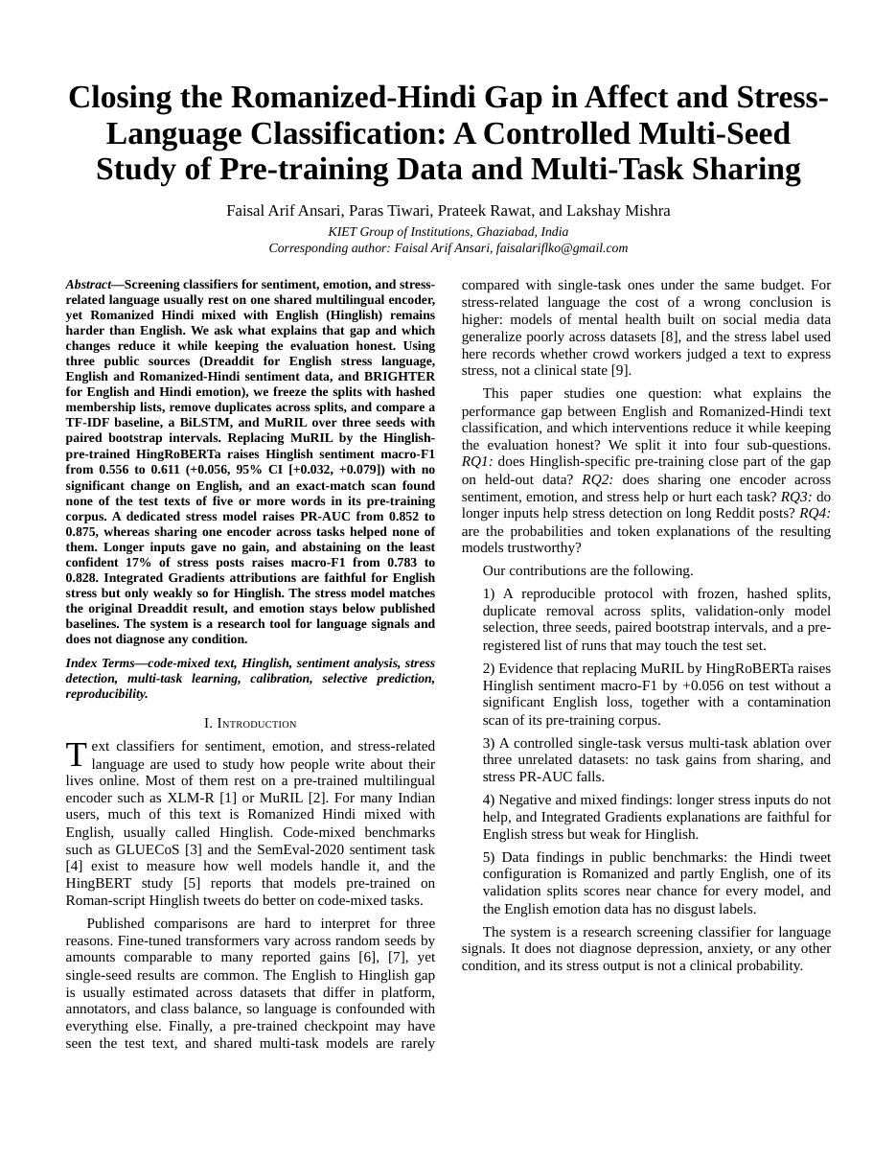
Research paper and submission readiness
Rubric 8, 9
Closing the Romanized-Hindi Gap in Affect and Stress-Language Classification: A Controlled Multi-Seed Study of Pre-training Data and Multi-Task Sharing
IEEE conference format, 7 pages, 8 tables, 4 figures.
37 references, each checked against arXiv, ACL Anthology or Crossref.
Every number traced to a run file in the public repository.
Contributions: Hinglish pre-training gain, multi-task ablation, truncation negative result, language-dependent explanation faithfulness, two data-quality findings.
Done Paper PDF and source
Done Public code, frozen splits, run logs
Done Reproducibility guide in README
To do Plagiarism report (institute tool)
To do Target venue chosen
Notes:
The plagiarism report has not been generated yet; it should be run through the institute's tool before submission. The text was written for this project and all sources are cited.

Slide 30
Conclusion and next steps
What we showed
Next steps, in order
Hinglish pre-training improved Hinglish sentiment by +0.056 and closed 27% of the gap.
Multi-task sharing gave no gain and hurt stress ranking; a separate stress model raised PR-AUC to 0.875.
Our stress model matches the original Dreaddit result (F1 0.798 vs 0.8065).
A working, privacy-preserving web app that anyone can clone and run.
Train emotion longer; try RemBERT
Learning-rate grid and 5 seeds on a GPU
Hand-check the tweets-hindi validation labels
Finish the manual Hinglish error taxonomy
Test transliteration to Devanagari
Serve HingRoBERTa for Hinglish in the app
Notes:
Close with the two findings and the next steps, which follow from the limitations.

Slide 31
Thank you
Questions and live demo
github.com/faizdevx/Multilingual-Mental-Health-Risk-
Faisal Arif Ansari | Paras Tiwari | Prateek Rawat | Lakshay Mishra
KIET Group of Institutions, Ghaziabad

