Slide 1
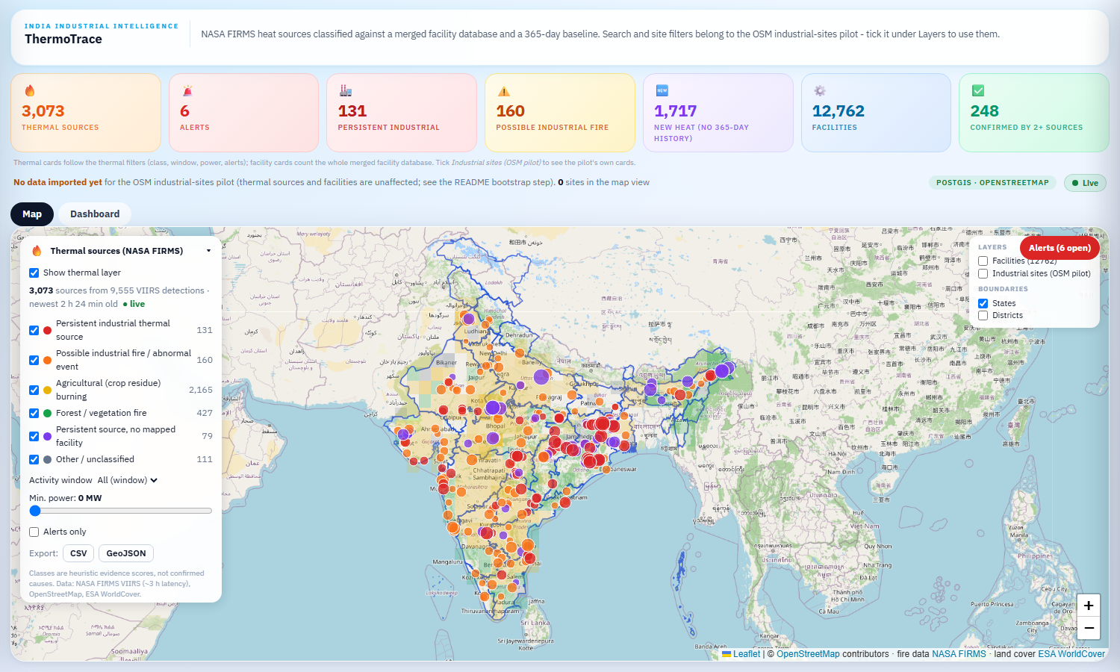
Which heat is an industrial fire?
1 / 6 - PROBLEM
3,073
thermal sources, one snapshot
9 %
industrial heat
34
documented industrial fires, 2016-2025
- Satellites flag thousands of heat sources every day. In one 3-hour snapshot of India: 3,073 sources, 2,165 of them crop burning and 427 forest fires.
- Only about 1 in 10 is industrial (291), and almost all of those are routine: coal seams, flares, kilns, furnaces.
- An analyst needs the few that are abnormal, a reason for each, and proof before anyone is sent.
NASA FIRMS VIIRS, 2026-10-16. A detection is evidence that a place was hot, not a confirmed fire.

Slide 2
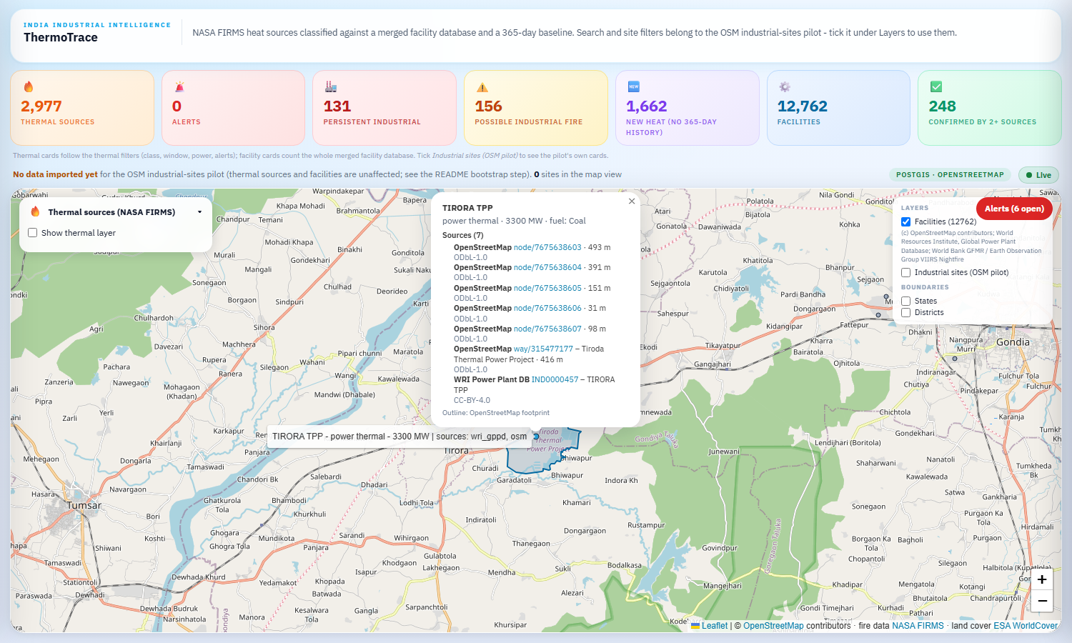
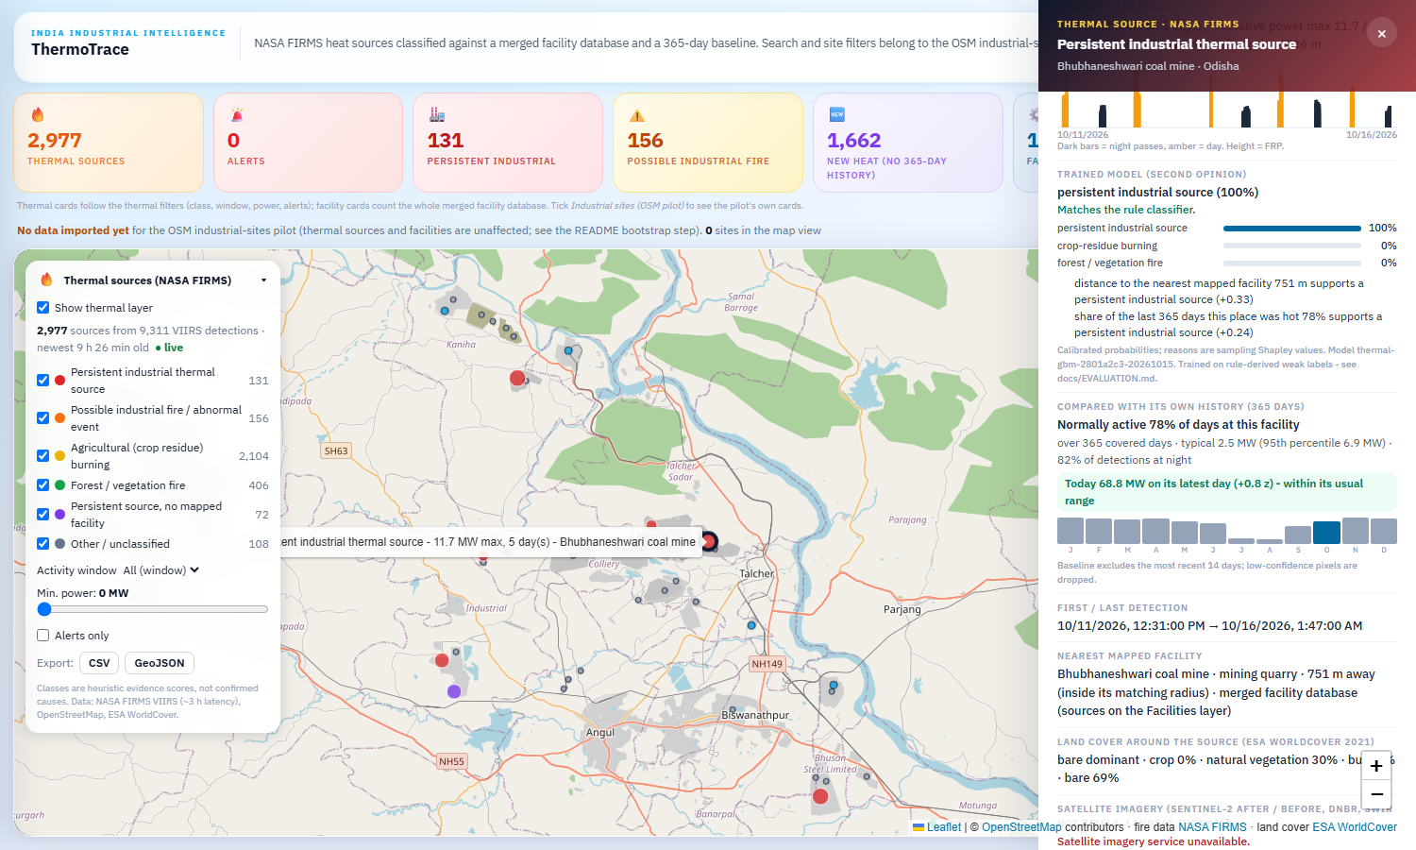
Public data, joined and kept honest
2 / 6 - DATA
- Heat: NASA FIRMS VIIRS (S-NPP, NOAA-20/21), 375 m, about 3 h behind the satellite, plus a 365-day archive of 1.9 M detections.
- Place: 12,762 facilities merged from OpenStreetMap, WRI power plants and VIIRS flare sites, each with its source and licence; ESA WorldCover land cover.
- Normal: a 365-day baseline per facility and per 1 km cell, so a source is compared with its own history.
- Proof: Sentinel-2 and Landsat scenes for the day of the detection (burn index, SWIR hot pixels, surface temperature).
- Labels: 3,247 rule-derived units and 34 verified incidents (source text confirms event, place and date).
Rule-derived labels are weak labels; the verified incidents are the independent check.

Slide 3
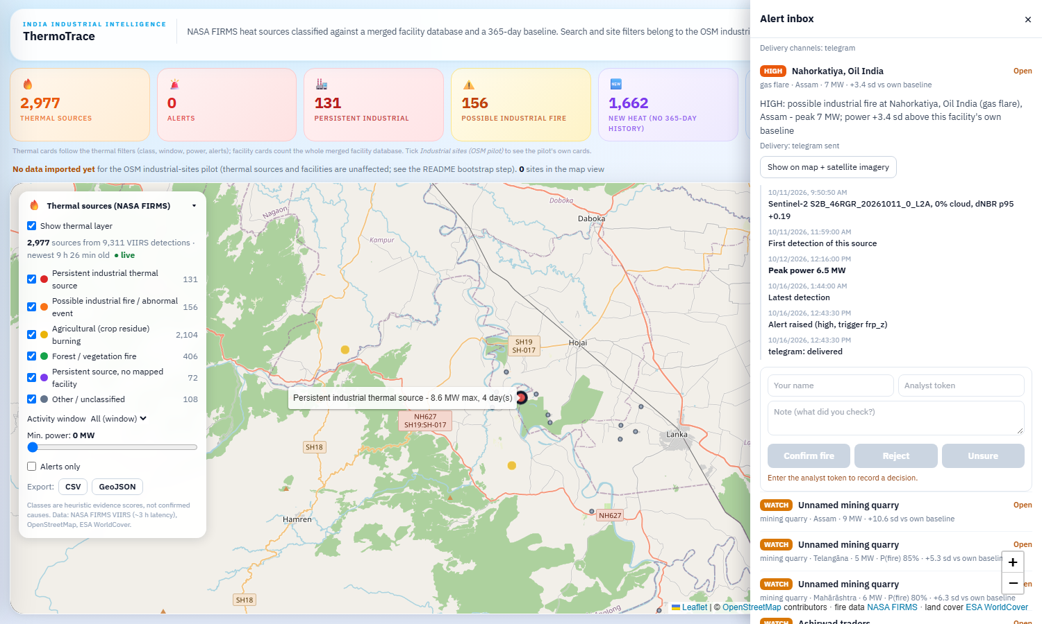
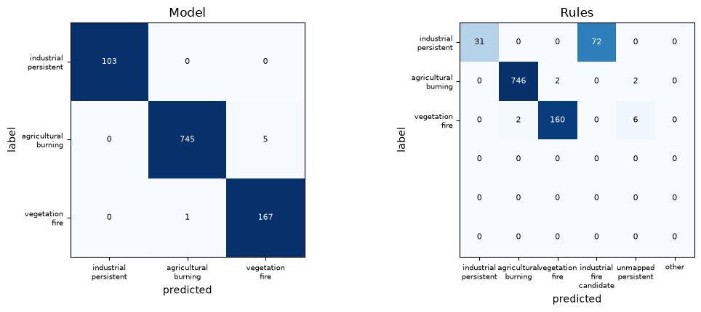
A model that explains itself, and the rules as a fallback
3 / 6 - MODEL
- Gradient-boosted trees on 41 features: heat behaviour, facility distance and kind, land cover, the baseline z-score, season.
- Calibrated probabilities; the top reasons per source come from sampling-Shapley values, in words.
- The rule classifier stays as baseline and fallback, and as the source of the fire-candidate score the alerts use.
- Alert = P(industrial fire) high, or a source at a known facility 3 sd above its own baseline; one alert per facility per 6 h; a cropland-by-day veto.
- Analysts confirm or reject in an inbox; every decision lands in the labels table for the next model.
Rules in docs/EVALUATION.md and the README; model card in the dashboard tab.

Slide 4
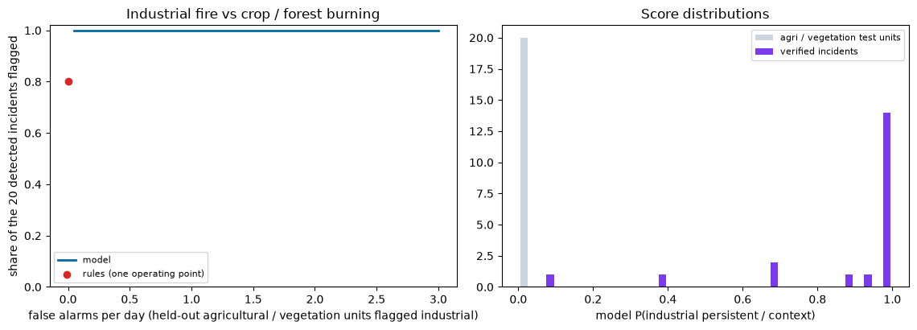
What the numbers say, and what they do not
4 / 6 - ACCURACY
0.993
model macro-F1, held-out regions and months (95% CI 0.987-0.998)
0.809
rule classifier (0.763-0.848)
0.633
model that sees only the heat itself
- The labels are rule-derived, so 0.993 is agreement with the labelling rules, not real-world accuracy. The 0.633 is the part the satellite signal earns alone.
- Independent check: VIIRS saw 20 of 34 documented industrial fires; at 0.25 false alarms per day the model flags all 20, the rules 16.
- Replaying every verified incident through the live pipeline: 22 have a detection and only 5 raise an alert (15% of all 34).
- Misses are mostly refineries that are always hot, and a 54 MW event with no mapped facility.
docs/EVALUATION.md, docs/REPLAY.md. Small samples; single digits per location tier.

Slide 5
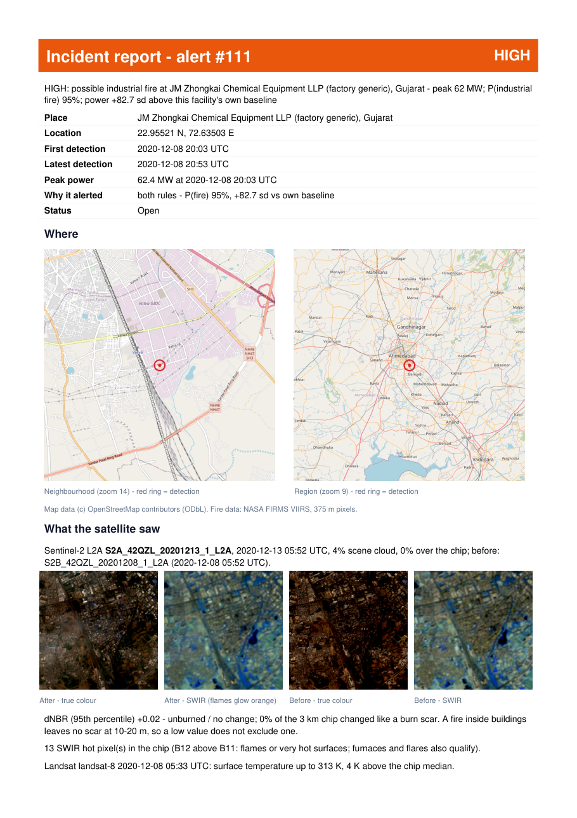
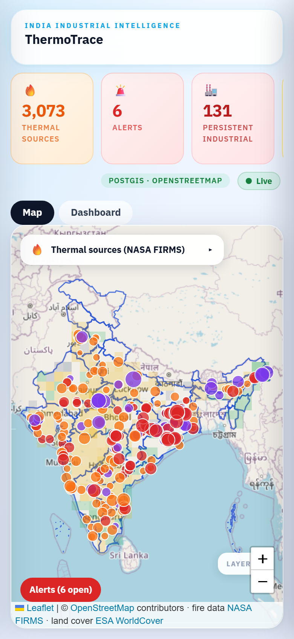
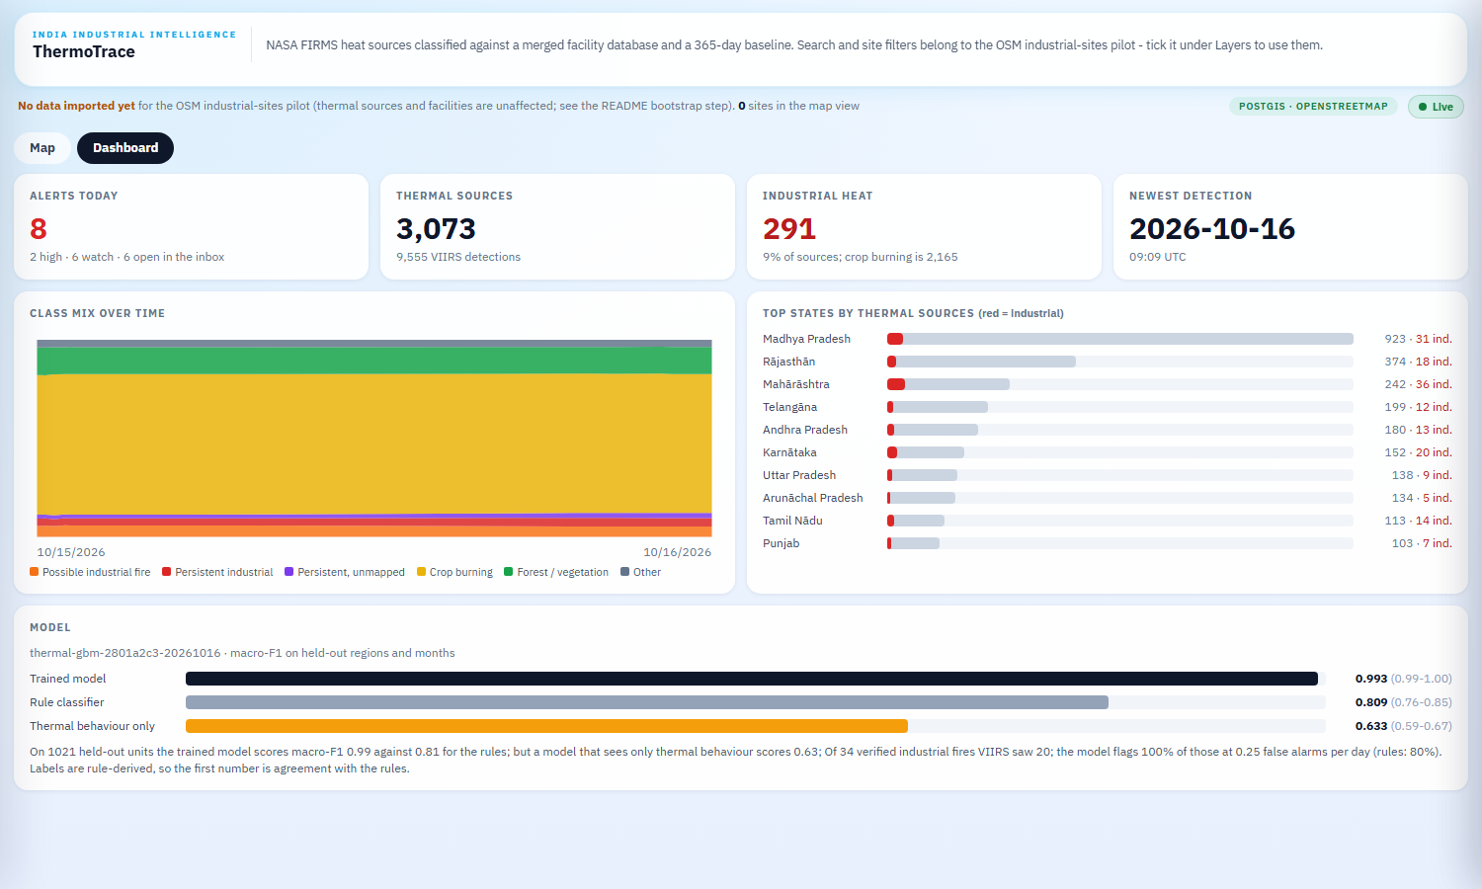
Live demo
5 / 6 - DEMO
- National view: heat-density grid for crop and forest fires, points for industrial sources; facilities are a separate toggle.
- Dashboard tab: alerts today, class mix over time, top states, model card.
- Alert inbox: timeline, imagery, Confirm / Reject / Unsure; one click to a PDF incident report.
- Replay: Vatva GIDC 2020-12-09 through the same pipeline on a virtual clock; the analyst's decision lands in labels.
Video: docs/demo/thermotrace_overview.mp4 (2 min) and docs/demo/thermotrace_replay_demo.mp4 (4 min).

Slide 6
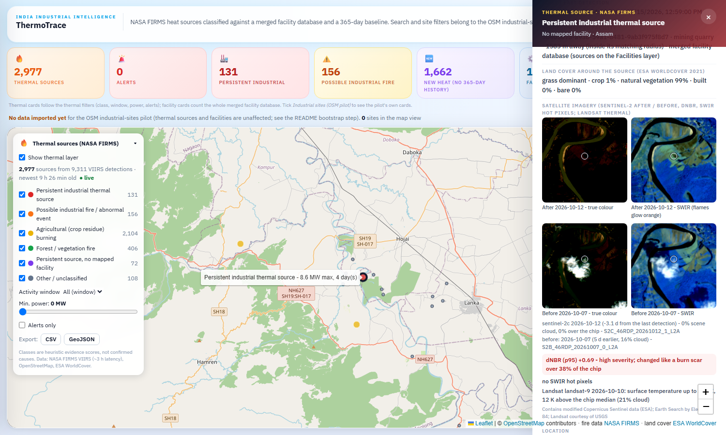
Impact, and what is still hard
6 / 6 - IMPACT
5 / 22
detected incidents that alert
0
industrial alerts on the Punjab burning peak (6,746 sources)
- For a control room: a short list of abnormal industrial heat with reasons, imagery and a report, instead of thousands of dots.
- Every claim carries its limits: weak labels, 375 m pixels, one cycle every 3 h, a refinery fire looks like its flare.
- Honest hit rate: 5 of 22 detected incidents alert today. Next: a rule for large new sources with no mapped facility, more verified incidents, and Sentinel-2 evidence at alert time for every alert.
- Open items: public hosting (scripts and checks are ready, no VM yet), real Telegram credentials, Global Energy Monitor trackers.
github.com/faizdevx/ThermoTrace

