Slide 1
- Decisions and Loops - Introduction to pre-defined functions
CS 200 – Introduction to Programming

Slide 2
Learning Outcomes
Be able to use do-while loops in simple programs and appreciate the difference between while and do-while loop
Understand short-circuit evaluation
Be able to write multi-way if condition and switch statement
Start understanding pre-defined functions in C++

Slide 3
do-while loop
A variation of the while loop.
A do-while loop is always executed at least once
The body of the loop is first executed
The boolean expression is checked after the body has been executed
Syntax:
do { statements to repeat }
while (boolean_expression);

Slide 4
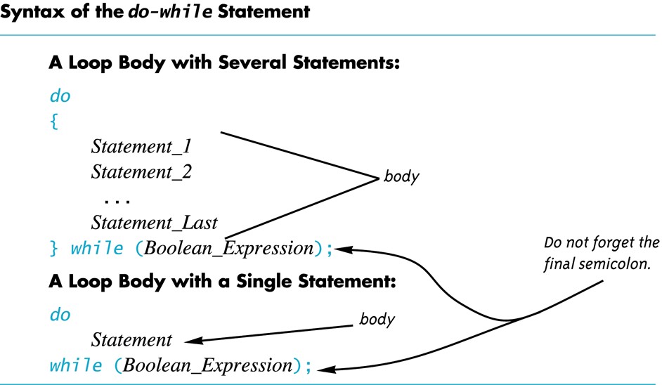

Slide 5
Increment/Decrement
Unary operators require only one operand
+ in front of a number such as +5
- in front of a number such as -5
++ increment operator
Adds 1 to the value of a variable x ++; is equivalent to x = x + 1;
-- decrement operator
Subtracts 1 from the value of a variable x --; is equivalent to x = x – 1;

Slide 6
Infinite Loops
Loops that never stop are infinite loops
The loop body should contain a line that will eventually cause the boolean expression to become false
Example: Print the odd numbers less than 12 x = 1; while (x != 12) { cout << x << endl; x = x + 2; }
Better to use this comparison: while ( x < 12)

Slide 7
Short-Circuit Evaluation
Some boolean expressions do not need to be completely evaluated
if x is negative, the value of the expression (x >= 0) && ( y > 1) can be determined by evaluating only (x >= 0)
C++ uses short-circuit evaluation
If the value of the leftmost sub-expression determines the final value of the expression, the rest of the expression is not evaluated

Slide 8
Using Short-Circuit Evaluation
Short-circuit evaluation can be used to prevent run time errors
Consider this if-statement if ((kids != 0) && (pieces / kids >= 2) ) cout << "Each child may have two pieces!";
If the value of kids is zero, short-circuit evaluation prevents evaluation of (pieces / 0 >= 2)
Division by zero causes a run-time error

Slide 9
Multiway Branches
A branching mechanism selects one out of a number of alternative actions
The if-else-statement is a branching mechanism
Branching mechanisms can be a subpart of another branching mechanism
An if-else-statement can include another if-else-statement as a subpart

Slide 10
Nested Statements
A statement that is a subpart of another statement is a nested statement
When writing nested statements it is normal to indent each level of nesting
Example: if ( x < y) cout << x << " is less than " << y; else cout << y << " is less than " << x;
indented

Slide 11
Nested if-else Statements
Use care in nesting if-else-statements
Example: To design an if-else statement to warn a driver when fuel is low, but tells the driver to bypass pit stops if the fuel is close to full. Other wise there should be no output. Pseudocode: if fuel gauge is below ¾ then: if fuel gauge is below ¼ then: issue a warning otherwise (gauge > ¾) then: output a statement saying don't stop

Slide 12
Braces and Nested Statements
Braces in nested statements are like parenthesis in arithmetic expressions
Braces tell the compiler how to group things
Use braces around substatements

Slide 13
Multi-way if-else-statements
An if-else-statement is a two-way branch
Three or four (or more) way branches can be designed using nested if-else-statements
Example: The number guessing game with the number stored in variable number, the guess in variable guess. How do we give hints?

Slide 14
Nested if-else Syntax
A Multiway if-else statement is written as
if (Boolean_Expression_1) Statement_1 else if ( Boolean_Expression_2) Statement_2 … else if (Boolean_Expression_n) Statement _n else Statement_For_All_Other_Possibilities

Slide 15
The switch-statement
The switch-statement is an alternative for constructing multi-way branches

Slide 16
switch-statement Syntax
switch (controlling expression) { case Constant_1: statement_Sequence_1 break; case Constant_2: Statement_Sequence_2 break; . . . case Constant_n: Statement_Sequence_n break; default: Default_Statement_Sequence }

Slide 17
The Controlling Statement
A switch statement's controlling statement must return one of these types
A bool value
An enum constant
An integer type
A character
The value returned is compared to the constant values after each "case"
When a match is found, the code for that case is used

Slide 18
The break Statement
The break statement ends the switch-statement
Omitting the break statement will cause the code for the next case to be executed!
Omitting a break statement allows the use of multiple case labels for a section of code
case 'A': case 'a': cout << "Excellent."; break;
Runs the same code for either 'A' or 'a'

Slide 19
The default Statement
If no case label has a constant that matches the controlling expression, the statements following the default label are executed
If there is no default label, nothing happens when the switch statement is executed
It is a good idea to include a default section

Slide 20
More About C++ Loop Statements
A loop is a program construction that repeats a statement or sequence of statements a number of times
The body of the loop is the statement(s) repeated
Each repetition of the loop is an iteration
Loop design questions:
What should the loop body be?
How many times should the body be iterated?

Slide 21
Class Exercise
Write a program for a state that computes tax according to the rate schedule:
No tax on first $15,000 of income
5% tax on each dollar from $15,001 to $25,000
10% tax on each dollar over $25,001 to $50,000
15% tax on each dollar over $50,001 to $75,000
20% tax on each dollar over $75,001 to $100,000
25% tax on each dollar over $100,001

Slide 22
Designing Loops
Designing a loop involves designing
The body of the loop
The initializing statements
The conditions for ending the loop

Slide 23
Pre-defined functions

Slide 24
Predefined Functions
C++ comes with libraries of predefined functions
Example: sqrt function
the_root = sqrt(9.0);
returns, or computes, the square root of a number
The number, 9, is called the argument
the_root will contain 3.0

Slide 25
Function Calls
sqrt(9.0) is a function call
It invokes, or sets in action, the sqrt function
The argument (9), can also be a variable or an expression
A function call can be used like any expression
bonus = sqrt(sales) / 10;
cout << “The side of a square with area “ << area << “ is “ << sqrt(area);

Slide 26
Function Call Syntax
Function_name (Argument_List)
Argument_List is a comma separated list: (Argument_1, Argument_2, … , Argument_Last)
Example:
side = sqrt(area);
cout << “2.5 to the power 3.0 is “ << pow(2.5, 3.0);

Slide 27
Function Libraries
Predefined functions are found in libraries
The library must be “included” in a program to make the functions available
An include directive tells the compiler which library header file to include.
To include the math library containing sqrt(): #include <cmath>
Newer standard libraries, such as cmath, also require the directive using namespace std;

Slide 28
Other Predefined Functions
abs(x) --- int value = abs(-8);
Returns absolute value of argument x
Return value is of type int
Argument is of type x
Found in the library cstdlib
fabs(x) --- double value = fabs(-8.0);
Returns the absolute value of argument x
Return value is of type double
Argument is of type double
Found in the library cmath

Slide 29
