Slide 1
Introduction to Programming CS 200
Session 1
Title: What is going on?

Slide 2
The Ideal Way to Do Computing
The ideal way to ask computer to do something is to order it in a natural language e.g.
I want to view this webpage
Calculate my annual tax
etc.
However, today’s computer’s are not intelligent enough to understand our orders in natural language.

Slide 3
Ambiguity
The tourist saw the astronomer with the telescope
The tourist used the telescope to see the astronomer.
The astronomer that the tourist saw had a telescope.

Slide 4
Ambiguity
Put the box on the table by the window in the kitchen
Put the box onto the table that is by the window in the kitchen.
Take the box that is on the table and put it by the window in the kitchen.
Take the box off the table that is by the window and put it in the kitchen.

Slide 5
Where We Are in Computers?
At the very basic level computers use the concept of an electrical pulse.
Low voltage is represented as 0
High voltage is represented as 1
To instruct a computer we need ask the computer in the language of 0s and 1s commonly known as machine language.
For instance 73 in a number in natural language in the language of 0s and 1s, it becomes 1001001

Slide 6
Machine Language: Our First Interaction with the Computer
machine language.
10110011 00011001
01111010 11010001 10010100
10011111 00011001
01011100 11010001 10010000
10111011 11010001 10010110
Finding an average of two numbers
Not very intuitive way of working
Not possible for humans to achieve a lot using machine language

Slide 7
One Step Beyond – Assembly Language
One level above machine language is assembly language
MOV 0, SUM
MOV NUM, AC
ADD SUM, AC
STO SUM, TOT
More understandable but still very difficult for many of us.
An assembler translates assembly language into machine language.

Slide 8
Another Step – High-level Languages
High-level languages is another level above machine language.
X = (Y + Z) / 2
Much more understandable.
A compiler translates high-level language into assembly language.

Slide 9
Where are we going?
Te next step in computing is to use natural language over a high-level language.
But we are many many years away from it.
A lot of research needs to be carried out before we actually see this.
Until then our task is to use high-level languages in its best possible ways

Slide 10
What is Programming?
When we say “programming” we are actually referring to the science of transforming our intentions in a high-level programming language.

Slide 11
Many Aspects of Programming
Programming is controlling
computer does exactly what you tell it to
Programming is teaching
computer can only “learn” to do new things if you tell it how
Programming is problem solving
always trying to make computer do something useful — i.e., finding an optimal travel route
Programming is creative
must find a good solution out of many possibilities
Programming is modelling
describe salient (relevant) properties and behaviors of a system of components (objects)
Programming is abstraction
identify important features without getting lost in detail
Programming is concrete
must provide detailed instructions to complete task

Slide 12
What are we doing in this course?
Learn programming in a high-level programming language.
Programming has many paradigms
Procedural
Object-Oriented
Functional
Logic
We will study Programming using ‘C++’, an extremely popular high-level object-oriented programming language.

Slide 13
Introduction to C++
Where did C++ come from?
Derived from the C language
C was derived from the B language
B was derived from the BCPL language
Why the ‘++’?
++ is an operator in C++ and results in a cute pun

Slide 14
C++ History
C developed by Dennis Ritchie at AT&T Bell Labs in the 1970s.
Used to maintain UNIX systems
Many commercial applications written in c
C++ developed by Bjarne Stroustrup at AT&T Bell Labs in the 1980s.
Overcame several shortcomings of C
Incorporated object oriented programming
C remains a subset of C++

Slide 15
Object-Oriented Programming
OOP: Now the dominant way to program, yet it is almost 40 years old! (Simula ’67 and Smalltalk ’72 were the first OOPLs)
Dr. Alan Kay received ACM's Turing Award, the "Nobel Prize of Computing,“ in 2003 for Smalltalk, the first complete dynamic OOPL
It was slow to catch on, but since the mid-90’s everybody’s been doing it!
OOP emphasizes objects, which often reflect real-life objects
have both properties and capabilities
i.e., they can perform tasks: “they know how to...”

Slide 16
The Computer Onion
hardware
(PC)
Linux/DOS
Redhat/Windows
your C++ Program

Slide 17
Programming Tools
Key Tools for Programming
Editors: Allows user to enter the program. Notepad, Emacs, etc are all editors.
Compilers: Translates the program into target code (in machine language).
Debuggers: Allows a programmer to run the program to see the execution of the program and correct any errors.
Profilers: Used to evaluate program’s performance.
Integrated Development Environment (IDE): Combines editor, compiler, debugger and profiler or a subset into one tool.
Common C++ IDEs are Visual Studio, Dev C++, Turbo C++, and many more.
We will use Dev C++ IDE for the labs in this course.

Slide 18
A Word of Caution
IDEs, editors, debuggers, and other programming tools do not write program themselves. They merely provide some help in writing a program.
Therefore,
THERE IS NO SHORTCUT TO PROGRAMMING SKILLS AND EXPERIENCE.

Slide 19
How to Learn Programming
Everybody learns programming at their own pace.
So do not be impressed by the person sitting next to you because he coded a given program in 20 minutes and you are taking more than an hour.
Speed programming does not necessarily mean quality of the final output.

Slide 20
How to Learn Programming (cont’d)
In a Nutshell
Writing a good description of the problem.
Breaking down the given problem into small pieces.
Turning small pieces into pseudo-code.
Deciding the integration mechanism of the pieces.
Writing the program for each piece.
Integrating all the pieces together.

Slide 21
Scare of Programming?
Why most students are afraid of programming
Paradigm Change
Programming is totally different paradigm. You are working on something and you cannot even touch the final output you can only feel it. It is different then other subjects like Physics, Chemistry, Biology, etc.
Peer Pressure
Some people are naturally good in programming so others think that this is a natural ability and they cannot learn it.

Slide 22
Scare of Programming? (cont’d)
Lack of Understanding in Fundamental Concepts
Some people start programming without a clue of what is going on behind the scene in the computer. As a result they have a flawed understanding from day one of their programming experience
Time Factor: Programming takes a lot of time
Programming may take a lot of time at the start but once a person is comfortable with the concepts and has mastered the basic skills it is just like any other profession.

Slide 23
A Word of Advice
Without good command on programming any qualification in Computer Science, Computer Engineering, Information Technology and Software Engineering is “worthless”.
There is an acute shortage of programmers in the global software market and with time this shortage is increasing.

Slide 24
CS 200 - Who is it for?
Students who want to learn and polish their programming skills
Core for Computer Science and Electrical Engineering students
Open to any other student on space available basis as there is no pre-requisite for this course

Slide 25
Learning Outcomes
Enabling Knowledge: The process of designing algorithmic solutions to computable problems; the syntax and control structures of a programming language i.e. C++, which enable you to code these algorithmic solutions using standard coding conventions
Critical Thinking and Analysis: Ability to analyze the requirements for solving simple algorithmic problems.

Slide 26
Learning Outcomes (cont’d)
Problem Solving: Ability to design and implement programs to solve simple algorithmic computing problems, based on analysis of the requirements.
Communication: Ability to explain key concepts of algorithmic design, in written form, to IT specialists.
Responsibility: Ability to apply relevant standards and ethical considerations to writing computer programs. Developing an awareness of the role and responsibility the individual has with regard to their own learning.

Slide 27
Administrative Stuff
Class Timings
Lectures MW 9:30 AM – 11:20AM (75mins class)
Recitation W 5:00 PM – 6:50 PM
Lab 1 – R 8:00 AM – 10:50AM
Lab 2 – F 2:00 PM – 4:50 PM
Lab Enrollment Issue
Course Website
http://lms.lums.edu.pk
Teaching Fellow
Kamran Nishat
Teaching Assistants

Slide 28
Office Hours
Mondays and Wednesdays
11:00 AM – 12:30 PM
Take an appointment if this time does not suit you.
TF/TA office hours will be posted on the website as soon as they finalize their class schedule.

Slide 29
Reading Material
Textbook
Problem Solving with C++, (6th or 7th Edition) Walter Savitch, Addison-Wesley ISBN 321531345. ©2009.
Reference Material
http://www.cplusplus.com

Slide 30
Grading
Laboratory Sessions: 20%
Homework Assignments: 20%
Quizzes: 10%
Midterm: 20%
Final Exam: 30%

Slide 31
Schedule
Week | Topic
1 | Abstract Model of a Computer and Basics of C++ | Chapter 1 and 2
2 | Flow of Control | Chapter 3
3 | Functions and APIs | Chapter 4 and 5
4 | Streams and File I/O | Chapter 6
5 | Arrays and Vectors | Chapter 7 and 8
6 | Pointers | Chapter 9
7 | Namespaces, Pointers and Linked Lists | Chapter 12 and 13
8 | Classes and Objects | Chapter 10
9 | Friends and Overloaded Operators | Chapter 11
10 | Inheritance | Chapter 15
11 | Exception Handling | Chapter 16
12 | Recursion | Chapter 14
13 | Templates | Chapter 17
14 | Standard Template Library | Chapter 18

Slide 32
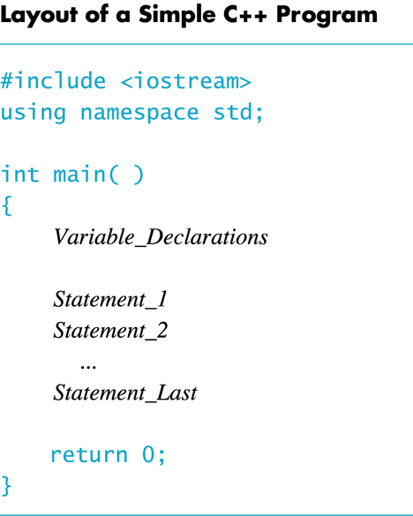

Slide 33
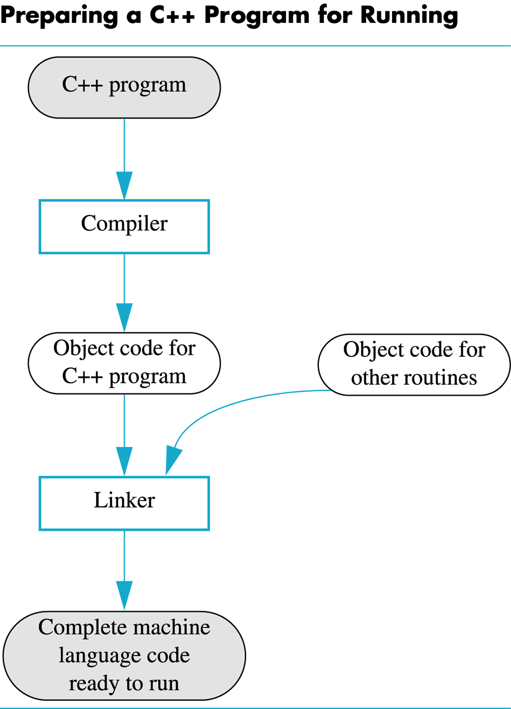

Slide 34
