Slide 1
Session 10 Strings and vectors
CS 200 – Introduction to Programming

Slide 2
An Array Type for Strings
C-strings can be used to represent strings of characters
C-strings are stored as arrays of characters
C-strings use the null character '\0' to end a string
The Null character is a single character
To declare a C-string variable, declare an array of characters: char s[11];

Slide 3
C-string Details
Declaring a C-string as char s[10] creates space for only nine characters
The null character terminator requires one space
A C-string variable does not need a size variable
The null character immediately follows the last character of the string
Example:
s[0] | s[1] | s[2] | s[3] | s[4] | s[5] | s[6] | s[7] | s[8] | s[9]
H | i |  | M | o | m | ! | \0 | ? | ?

Slide 4
C-string Declaration
To declare a C-string variable, use the syntax: char Array_name[ Maximum_C_String_Size + 1];
+ 1 reserves the additional character needed by '\0'

Slide 5
Initializing a C-string
To initialize a C-string during declaration: char my_message[20] = "Hi there.";
The null character '\0' is added for you
Another alternative: char short_string[ ] = "abc"; but not this: char short_string[ ] = {'a', 'b', 'c'};

Slide 6
C-string error
This attempt to initialize a C-string does not cause the \0 to be inserted in the array
char short_string[ ] = {'a', 'b', 'c'};

Slide 7
Don't Change '\0'
Do not to replace the null character when manipulating indexed variables in a C-string
If the null character is lost, the array cannot act like a C-string
Example: int index = 0; while (our_string[index] != '\0') { our_string[index] = 'X'; index++; }
This code depends on finding the null character!

Slide 8
Assignment With C-strings
This statement is illegal: a_string = "Hello";
This is an assignment statement, not an initialization
The assignment operator does not work with C-strings

Slide 9
Assignment of C-strings
A common method to assign a value to a C-string variable is to use strcpy, defined in the cstring library
Example: #include <cstring> … char a_string[ 11]; strcpy (a_string, "Hello"); Places "Hello" followed by the null character in a_string

Slide 10
A Problem With strcpy
strcpy can create problems if not used carefully
strcpy does not check the declared length of the first argument
It is possible for strcpy to write characters beyond the declared size of the array

Slide 11
A Solution for strcpy
Many versions of C++ have a safer version of strcpy named strncpy
strncpy uses a third argument representing the maximum number of characters to copy
Example: char another_string[10]; strncpy(another_string, a_string_variable, 9); This code copies up to 9 characters into another_string, leaving one space for '\0'

Slide 12
== Alternative for C-strings
The = = operator does not work as expected with C-strings
The predefined function strcmp is used to compareC-string variables
Example: #include <cstring> … if (strcmp(c_string1, c_string2)) cout << "Strings are not the same."; else cout << "String are the same.";

Slide 13
strcmp's logic
strcmp compares the numeric codes of elements in the C-strings a character at a time
If the two C-strings are the same, strcmp returns 0
0 is interpreted as false
As soon as the characters do not match
strcmp returns a negative value if the numeric code in the first parameter is less
strcmp returns a positive value if the numeric code in the second parameter is less
Non-zero values are interpreted as true

Slide 14
More C-string Functions
The cstring library includes other functions
strlen returns the number of characters in a string int x = strlen( a_string);
strcat concatenates two C-strings
The second argument is added to the end of the first
The result is placed in the first argument
Example: char string_var[20] = "The rain"; strcat(string_var, "in Spain"); Now string_var contains "The rainin Spain"

Slide 15
The strncat Function
strncat is a safer version of strcat
A third parameter specifies a limit for the number of characters to concatenate
Example:
char string_var[20] = "The rain"; strncat(string_var, "in Spain", 11);
Display 8.1 (1)
Display 8.1 (2)

Slide 16
C-strings as Arguments and Parameters
C-string variables are arrays
C-string arguments and parameters are used just like arrays
If a function changes the value of a C-string parameter, it is best to include a parameter for the declared size of the C-string
If a function does not change the value of a C-string parameter, the null character can detect the end of the string and no size argument is needed

Slide 17
C-string Output
C-strings can be output with the insertion operator
Example: char news[ ] = "C-strings"; cout << news << " Wow." << endl;

Slide 18
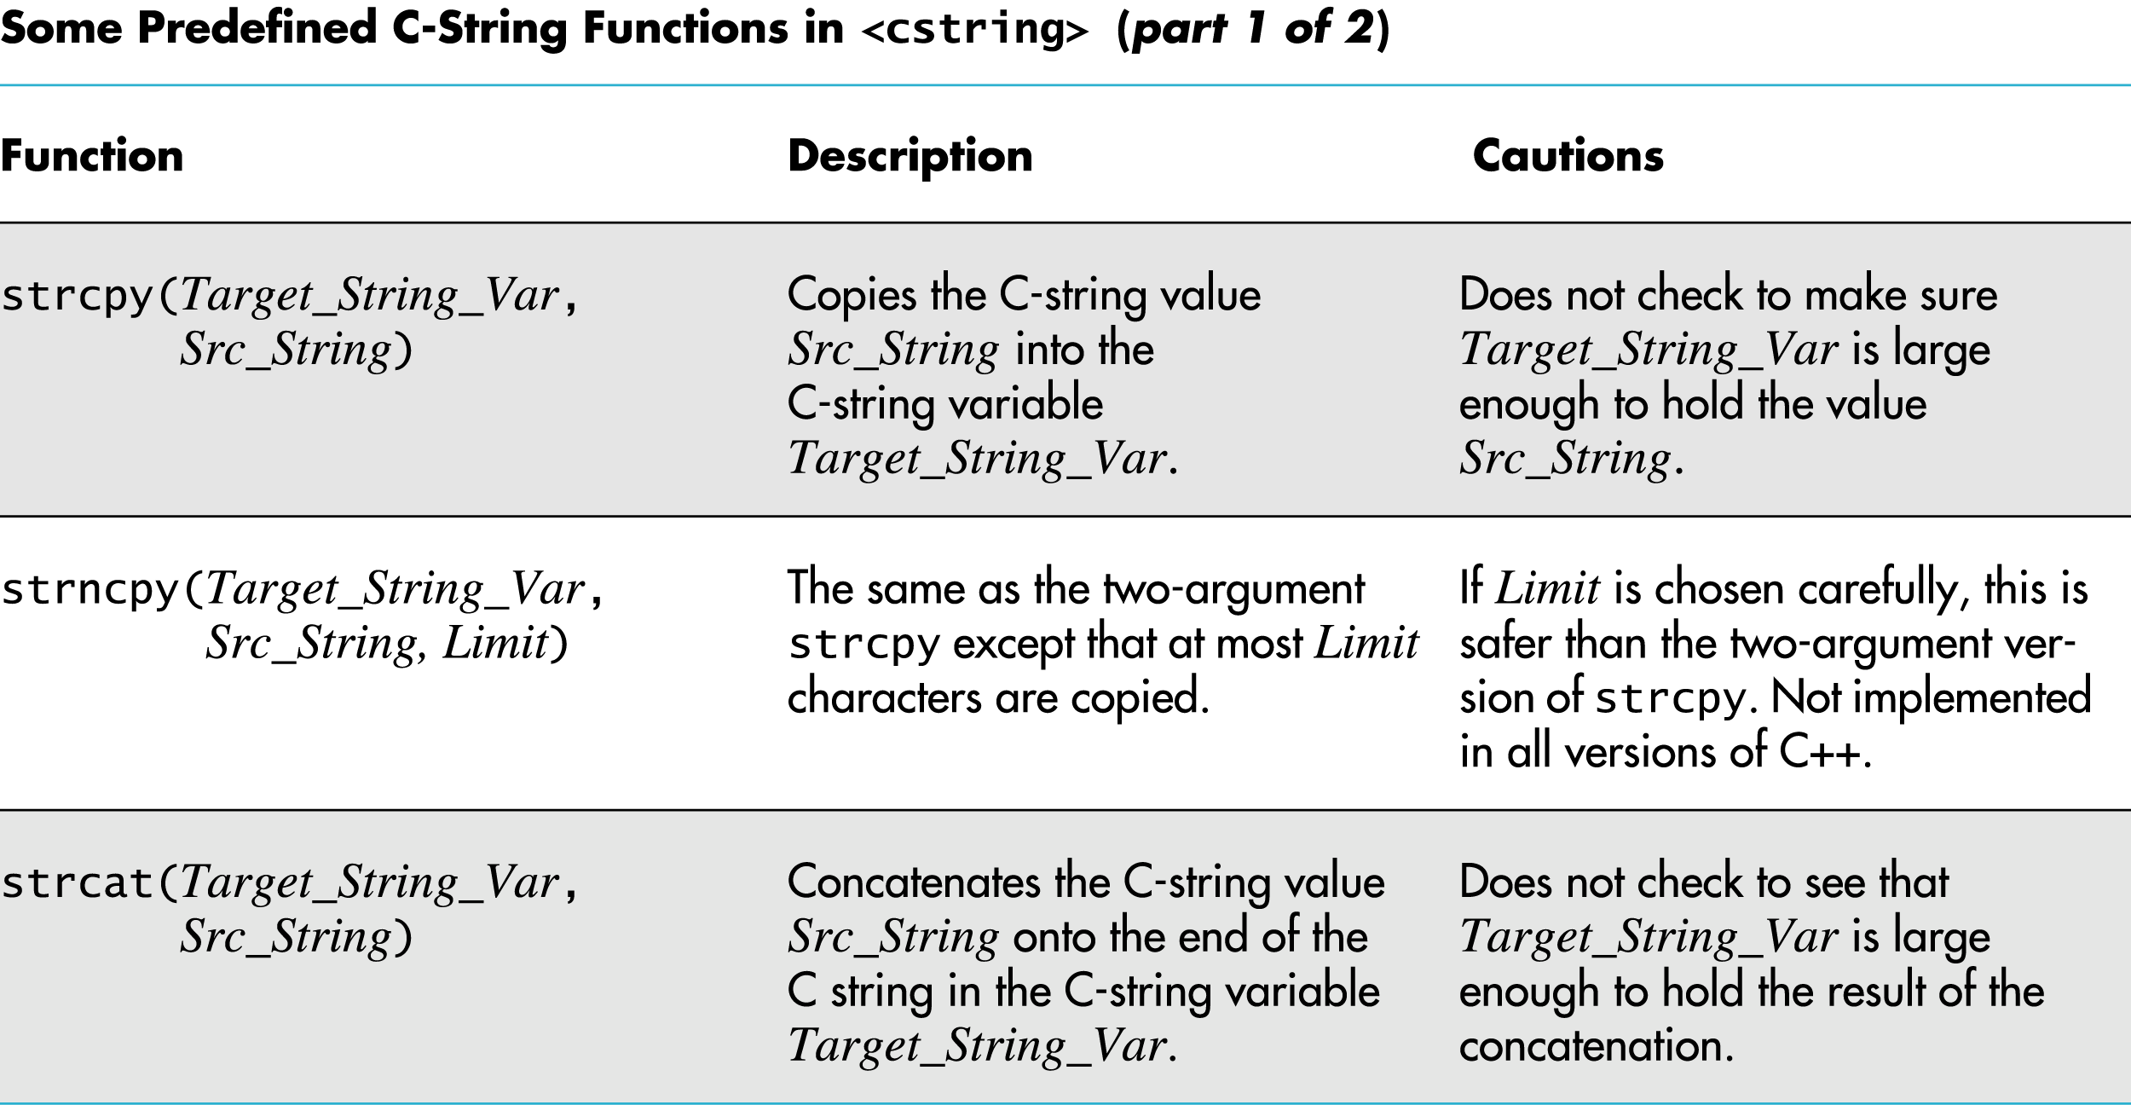
Display 8.1 (1/2)
Back
Next

Slide 19
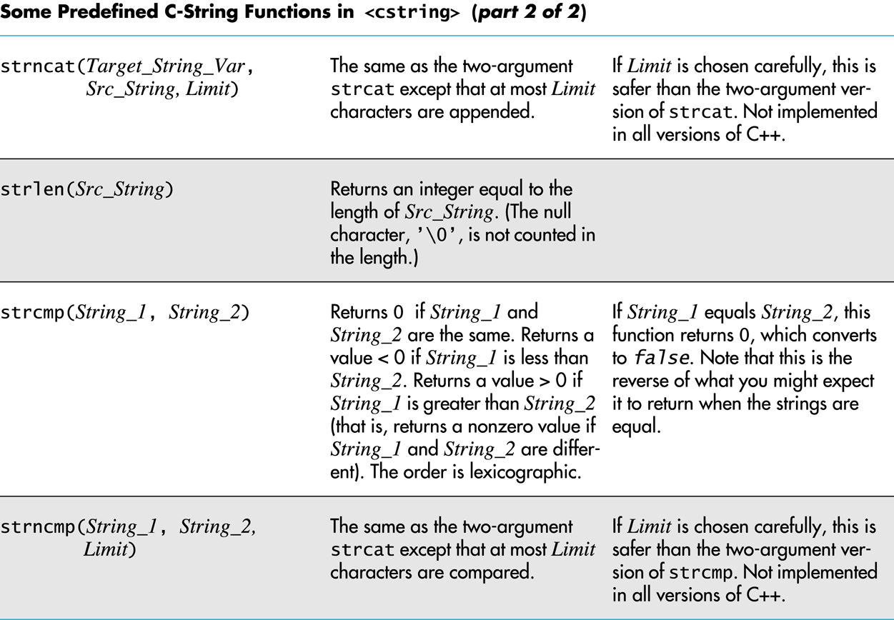
Display 8.1 (2/2)
Back
Next

Slide 20
C-string Input
The extraction operator >> can fill a C-string
Whitespace ends reading of data
Example: char a[80], b[80]; cout << "Enter input: " << endl; cin >> a >> b; cout << a << b << "End of Output"; could produce: Enter input: Do be do to you! DobeEnd of Output

Slide 21
Reading an Entire Line
Predefined member function getline can read an entire line, including spaces
getline is a member of all input streams
getline has two arguments
The first is a C-string variable to receive input
The second is an integer, usually the size of the first argument specifying the maximum number of elements in the first argument getline is allowed to fill

Slide 22
Using getline
The following code is used to read an entire line including spaces into a single C-string variable
char a[80]; cout << "Enter input:\n"; cin.getline(a, 80); cout << a << End Of Output\n"; and could produce: Enter some input: Do be do to you! Do be do to you!End of Output

Slide 23
getline syntax
Syntax for using getline is cin.getline(String_Var, Max_Characters + 1);
cin can be replaced by any input stream
Max_Characters + 1 reserves one element for the null character

Slide 24
C-String to Numbers
"1234" is a string of characters
1234 is a number
When doing numeric input, it is useful to read input as a string of characters, then convert the string to a number
Reading money may involve a dollar sign
Reading percentages may involve a percent sign

Slide 25
C-strings to Integers
To read an integer as characters
Read input as characters into a C-string, removing unwanted characters
Use the predefined function atoi to convert the C-string to an int value
Example: atoi("1234") returns the integer 1234 atoi("#123") returns 0 because # is not a digit

Slide 26
C-string to long
Larger integers can be converted using the predefined function atol
atol returns a value of type long

Slide 27
C-string to double
C-strings can be converted to type double using the predefined function atof
atof returns a value of type double
Example: atof("9.99") returns 9.99 atof("$9.99") returns 0.0 because the $ is not a digit

Slide 28
Library cstdlib
The conversion functions atoi atol atof are found in the library cstdlib
To use the functions use the include directive #include <cstdlib>

Slide 29
Numeric Input
We now know how to convert C-strings to numbers
How do we read the input?
Function read_and_clean, in Display 8.2…
Reads a line of input
Discards all characters other than the digits '0' through '9'
Uses atoi to convert the "cleaned-up" C-string to int
Display 8.2 (1)
Display 8.2 (2)

Slide 30
Confirming Input
Function get_int, from Display 8.3…
Uses read_and_clean to read the user's input
Allows the user to reenter the input until the user is satisfied with the number computed from the input string
Display 8.3 (1)
Display 8.3 (2)

Slide 31
8.2
The Standard string Class

Slide 32
The Standard string Class
The string class allows the programmer to treat strings as a basic data type
No need to deal with the implementation as with C-strings
The string class is defined in the string library and the names are in the standard namespace
To use the string class you need these lines: #include <string> using namespace std;

Slide 33
Assignment of Strings
Variables of type string can be assigned with the = operator
Example: string s1, s2, s3; … s3 = s2;
Quoted strings are type cast to type string
Example: string s1 = "Hello Mom!";

Slide 34
Using + With strings
Variables of type string can be concatenated with the + operator
Example: string s1, s2, s3; … s3 = s1 + s2;
If s3 is not large enough to contain s1 + s2, more space is allocated

Slide 35
string Constructors
The default string constructor initializes the string to the empty string
Another string constructor takes a C-string argument
Example: string phrase; // empty string string noun("ants"); // a string version // of "ants"

Slide 36
Mixing strings and C-strings
It is natural to work with strings in the following manner string phrase = "I love" + adjective + " " + noun + "!";
It is not so easy for C++! It must either convert the null-terminated C-strings, such as "I love", to strings, or it must use an overloaded + operator that works with strings and C-strings
Display 8.4

Slide 37
I/O With Class string
The insertion operator << is used to output objects of type string
Example: string s = "Hello Mom!"; cout << s;
The extraction operator >> can be used to input data for objects of type string
Example: string s1; cin >> s1;
>> skips whitespace and stops on encountering more whitespace

Slide 38
getline and Type string
A getline function exists to read entire lines into a string variable
This version of getline is not a member of the istream class, it is a non-member function
Syntax for using this getline is different than that used with cin: cin.getline(…)
Syntax for using getline with string objects: getline(Istream_Object, String_Object);

Slide 39
getline Example
This code demonstrates the use of getline with string objects
string line; cout "Enter a line of input:\n"; getline(cin, line); cout << line << "END OF OUTPUT\n"; Output could be: Enter some input: Do be do to you! Do be do to you!END OF OUTPUT

Slide 40
Character Input With strings
The extraction operator cannot be used to read a blank character
To read one character at a time remember to use cin.get
cin.get reads values of type char, not type string
The use of getline, and cin.get for string input are demonstrated in
Display 8.5 (1)
Display 8.5 (2)

Slide 41
Another Version of getline
The versions of getline we have seen, stop reading at the end of line marker '\n'
getline can stop reading at a character specified in the argument list
This code stops reading when a '?' is read string line; cout <<"Enter some input: \n"; getline(cin, line, '?');

Slide 42
getline Returns a Reference
getline returns a reference to its first argument
This code will read in a line of text into s1 and a string of non-whitespace characters into s2: string s1, s2; getline(cin, s1) >> s2;
cin >> s2;
returns

Slide 43
Member Function length
The string class member function length returns the number of characters in the string object:
Example: int n = string_var.length( );

Slide 44
Member Function at
at is an alternative to using [ ]'s to access characters in a string.
at checks for valid index values
Example: string str("Mary"); cout << str[6] << endl; cout << str.at(6) << endl; str[2] = 'X'; str.at(2) = 'X';
Equivalent
Equivalent
Other string class functions are found in
Display 8.7

Slide 45
Comparison of strings
Comparison operators work with string objects
Objects are compared using lexicographic order (Alphabetical ordering using the order of symbols in the ASCII character set.)
= = returns true if two string objects contain the same characters in the same order
Remember strcmp for C-strings?
<, >, <=, >= can be used to compare string objects

Slide 46
string Objects to C-strings
Recall the automatic conversion from C-string to string: char a_c_string[] = "C-string"; string_variable = a_c_string;
strings are not converted to C-strings
Both of these statements are illegal:
a_c_string = string_variable;
strcpy(a_c_string, string_variable);

Slide 47
Converting strings to C-strings
The string class member function c_str returns the C-string version of a string object
Example: strcpy(a_c_string, string_variable.c_str( ) );
This line is still illegal a_c_string = string_variable.c_str( ) ;
Recall that operator = does not work with C-strings

Slide 48
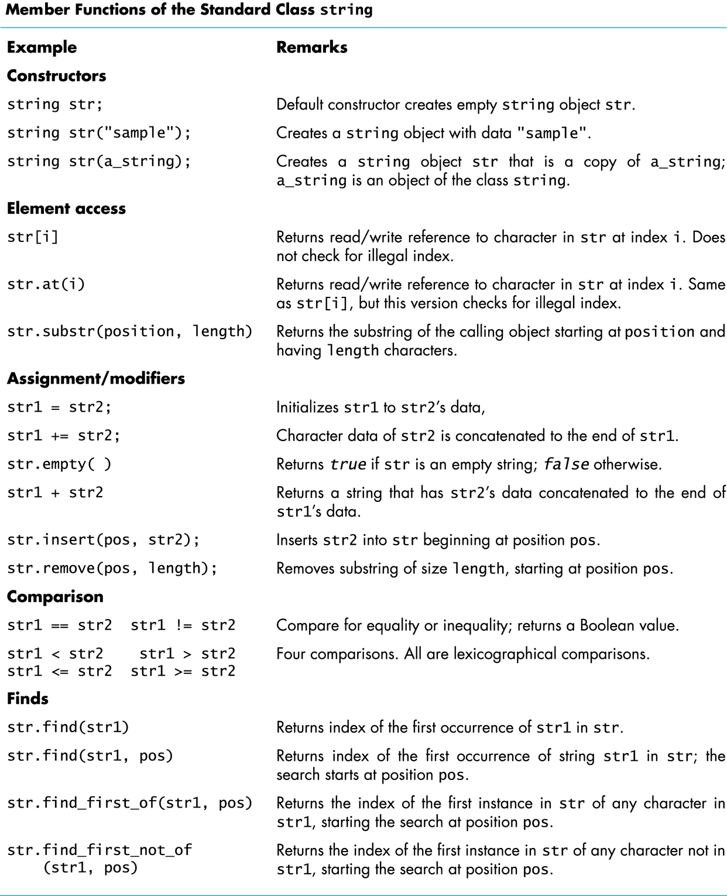
Display 8.7
Back
Next

Slide 49
Section 8.2 Conclusion
Can you
Show how a string object can be used like a C-string?
Write code to read an entire line into a string object?
Use the string function at to access individual characters in a string object?
Write code to convert a string to a C-string?

Slide 50
Where to find programming problems?
http://uva.onlinejudge.org/
https://projecteuler.net/

Slide 51
8.3
Vectors

Slide 52
Vectors
Vectors are like arrays that can change size as your program runs
Vectors, like arrays, have a base type
To declare an empty vector with base type int: vector<int> v;
<int> identifies vector as a template class
You can use any base type in a template class: vector<string> v;

Slide 53
Accessing vector Elements
Vectors elements are indexed starting with 0
[ ]'s are used to read or change the value of an item: v[i] = 42; cout << v[i];
[ ]'s cannot be used to initialize a vector element

Slide 54
Initializing vector Elements
Elements are added to a vector using the member function push_back
push_back adds an element in the next available position
Example: vector<double> sample; sample.push_back(0.0); sample.push_back(1.1); sample.push_back(2.2);

Slide 55
The size Of A vector
The member function size returns the number of elements in a vector
Example: To print each element of a vector given the previous vector initialization: for (int i= 0; i < sample.size( ); i++) cout << sample[i] << endl;

Slide 56
The Type unsigned int
The vector class member function size returns an unsigned int
Unsigned int's are nonnegative integers
Some compilers will give a warning if the previous for-loop is not changed to: for (unsigned int i= 0; i < sample.size( ); i++) cout << sample[i] << endl;

Slide 57
Alternate vector Initialization
A vector constructor exists that takes an integer argument and initializes that number of elements
Example: vector<int> v(10); initializes the first 10 elements to 0 v.size( ) would return 10
[ ]'s can now be used to assign elements 0 through 9
push_back is used to assign elements greater than 9

Slide 58
Vector Initialization With Classes
The vector constructor with an integer argument
Initializes elements of number types to zero
Initializes elements of class types using the default constructor for the class

Slide 59
The vector Library
To use the vector class
Include the vector library #include <vector>
Vector names are placed in the standard namespace so the usual using directive is needed: using namespace std;
Display 8.9

Slide 60
vector Issues
Attempting to use [ ] to set a value beyond the size of a vector may not generate an error
The program will probably misbehave
The assignment operator with vectors does an element by element copy of the right hand vector
For class types, the assignment operator must make independent copies

Slide 61
vector Efficiency
A vector's capacity is the number of elements allocated in memory
Accessible using the capacity( ) member function
Size is the number of elements initialized
When a vector runs out of space, the capacity is automatically increased
A common scheme is to double the size of a vector
More efficient than allocating smaller chunks of memory

Slide 62
Controlling vector Capacity
When efficiency is an issue
Member function reserve can increase the capacity of a vector
Example: v.reserve(32); // at least 32 elements v.reserve(v.size( ) + 10); // at least 10 more
resize can be used to shrink a vector
Example: v.resize(24); //elements beyond 24 are lost

Slide 63
Section 8.3 Conclusion
Can you
Declare and initialize a vector of 10 doubles?
Write code to increase the size of a vector in at least two different ways?
Describe the difference between a vector's size and its capacity?

Slide 64
Chapter 8 -- End

Slide 65
Display 8.1 (1/2)
Back
Next

Slide 66
Display 8.1 (2/2)
Back
Next

Slide 67
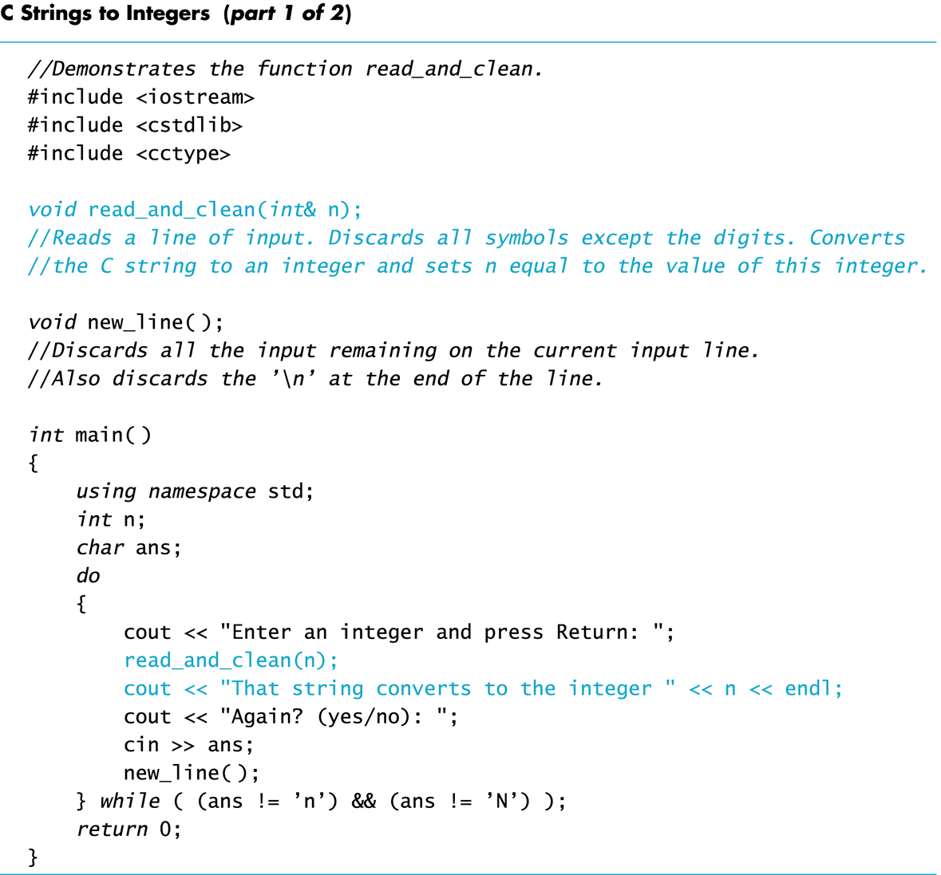
Display 8.2 (1/2)
Back
Next

Slide 68
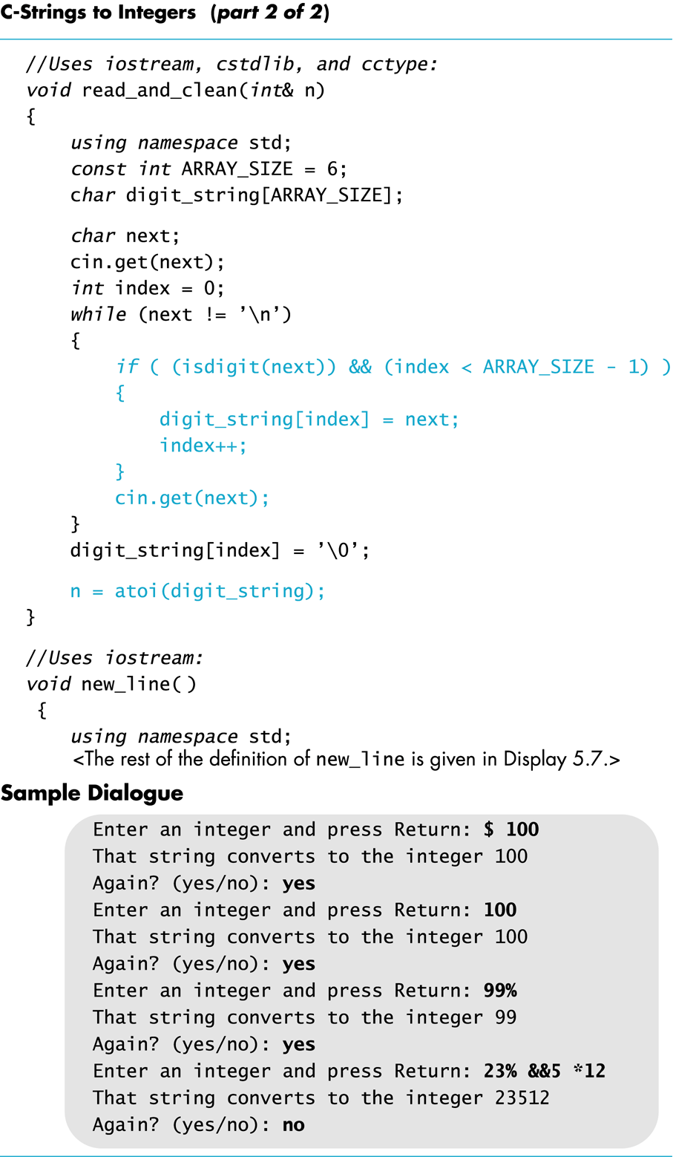
Display 8.2 (2/2)
Back
Next

Slide 69
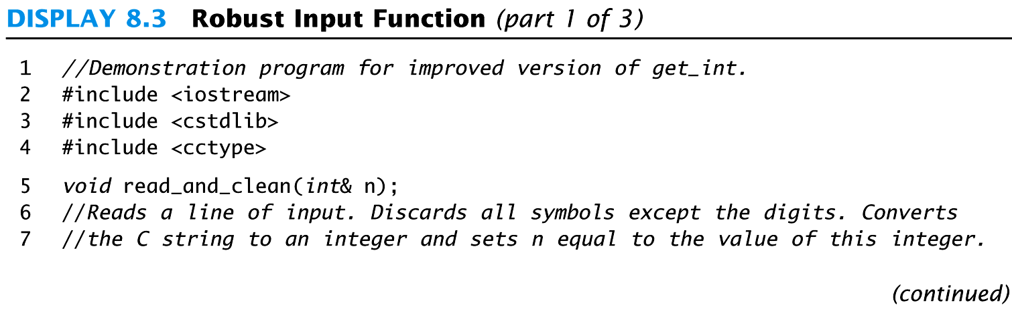
Display 8.3 (1/3)
Back
Next

Slide 70
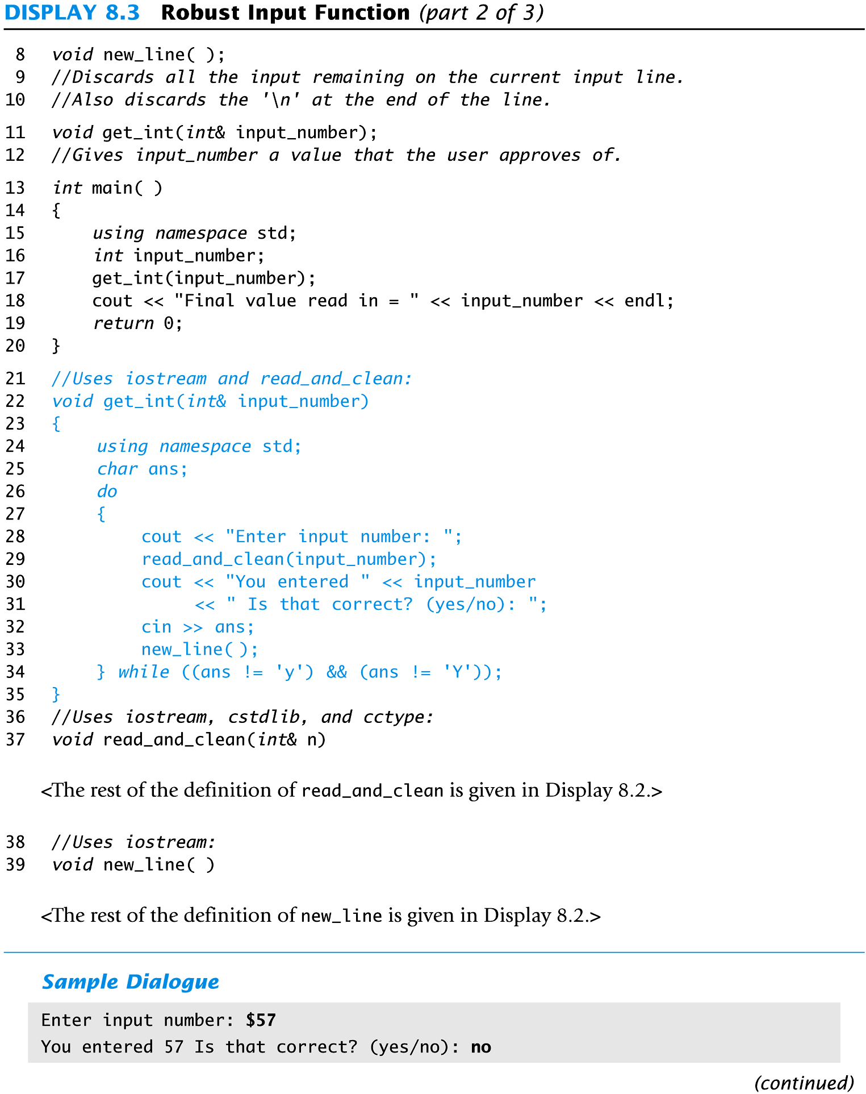
Display 8.3 (2/3)
Back
Next

Slide 71
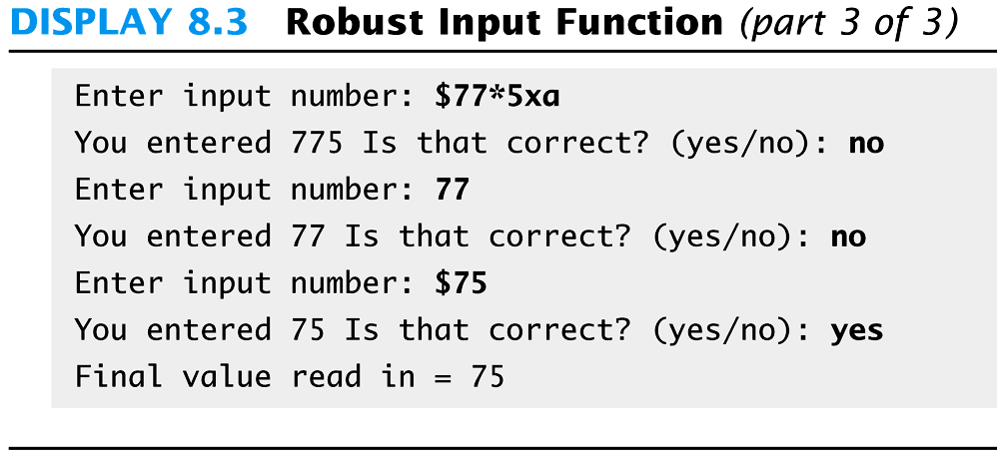
Display 8.3 (3/3)
Back
Next

Slide 72
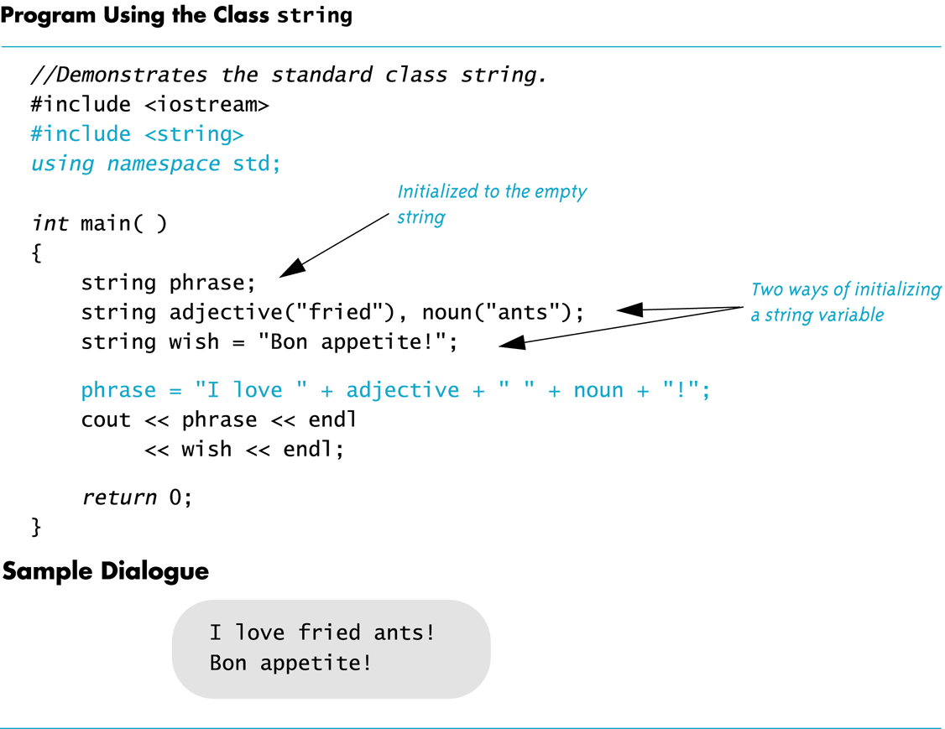
Display 8.4
Back
Next

Slide 73
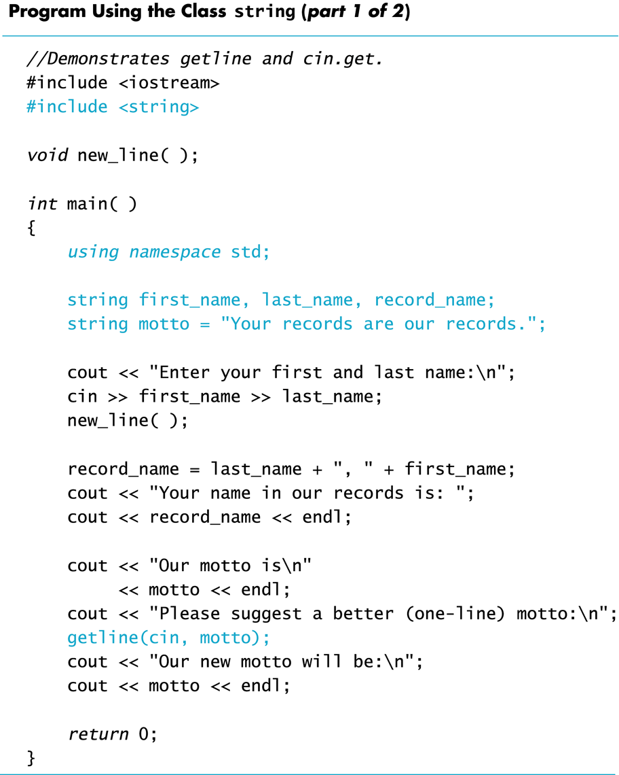
Display 8.5 (1/2)
Back
Next

Slide 74
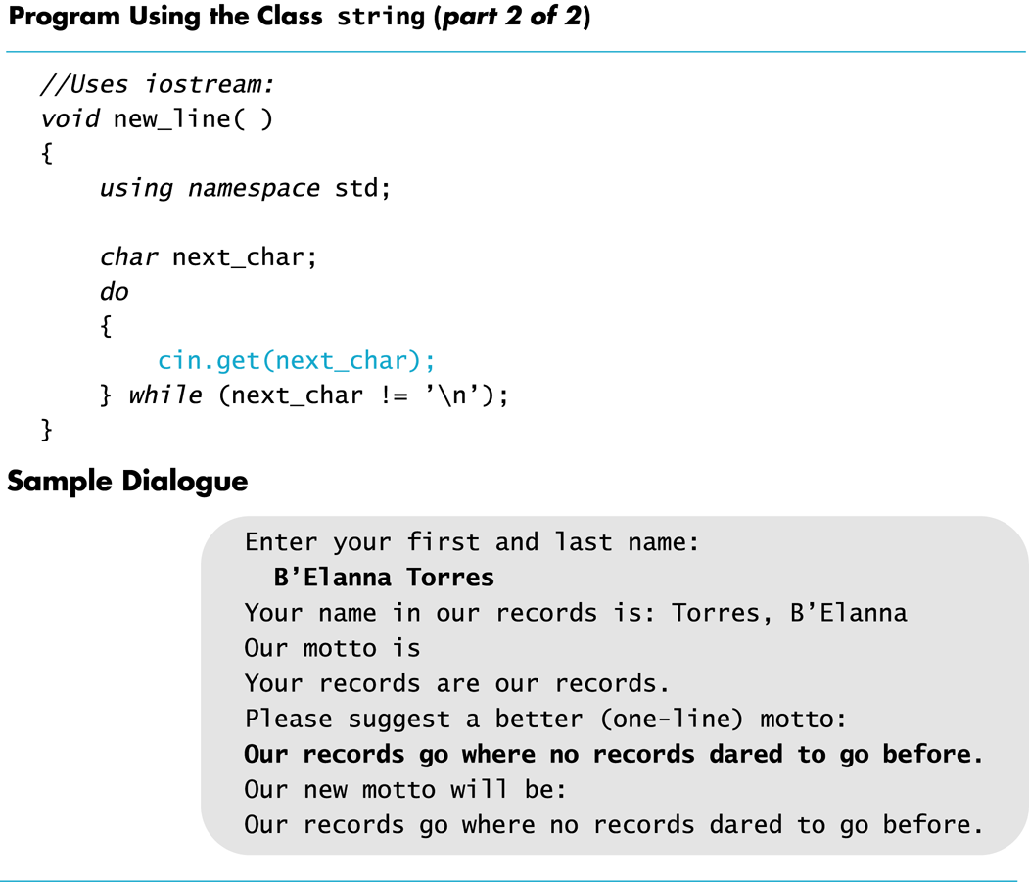
Display 8.5 (2/2)
Back
Next

Slide 75
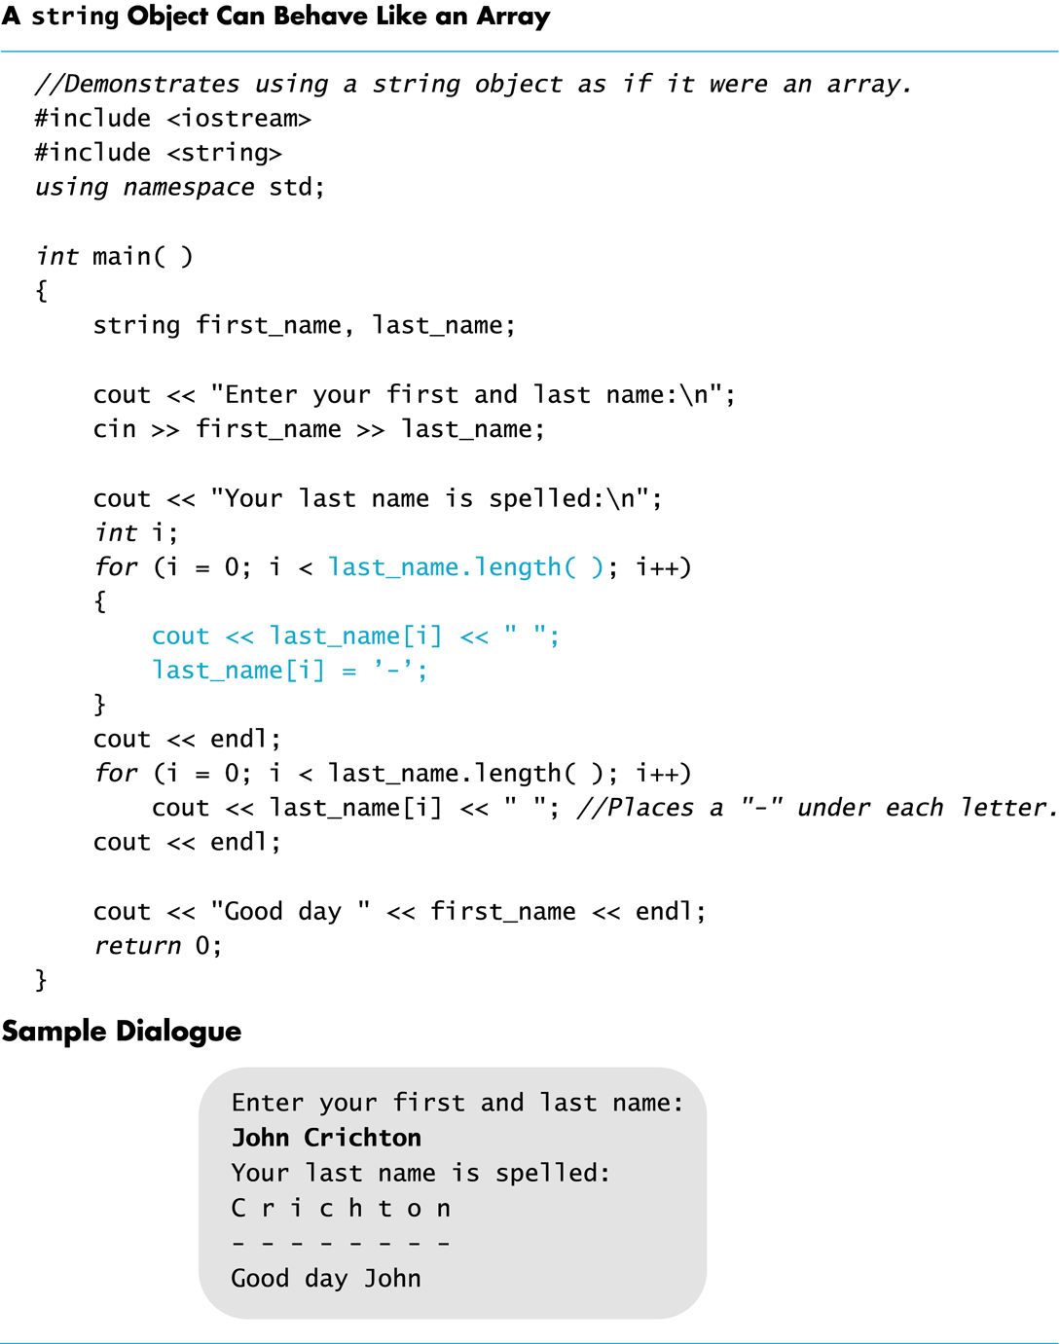
Display 8.6
Back
Next

Slide 76
Display 8.7
Back
Next

Slide 77
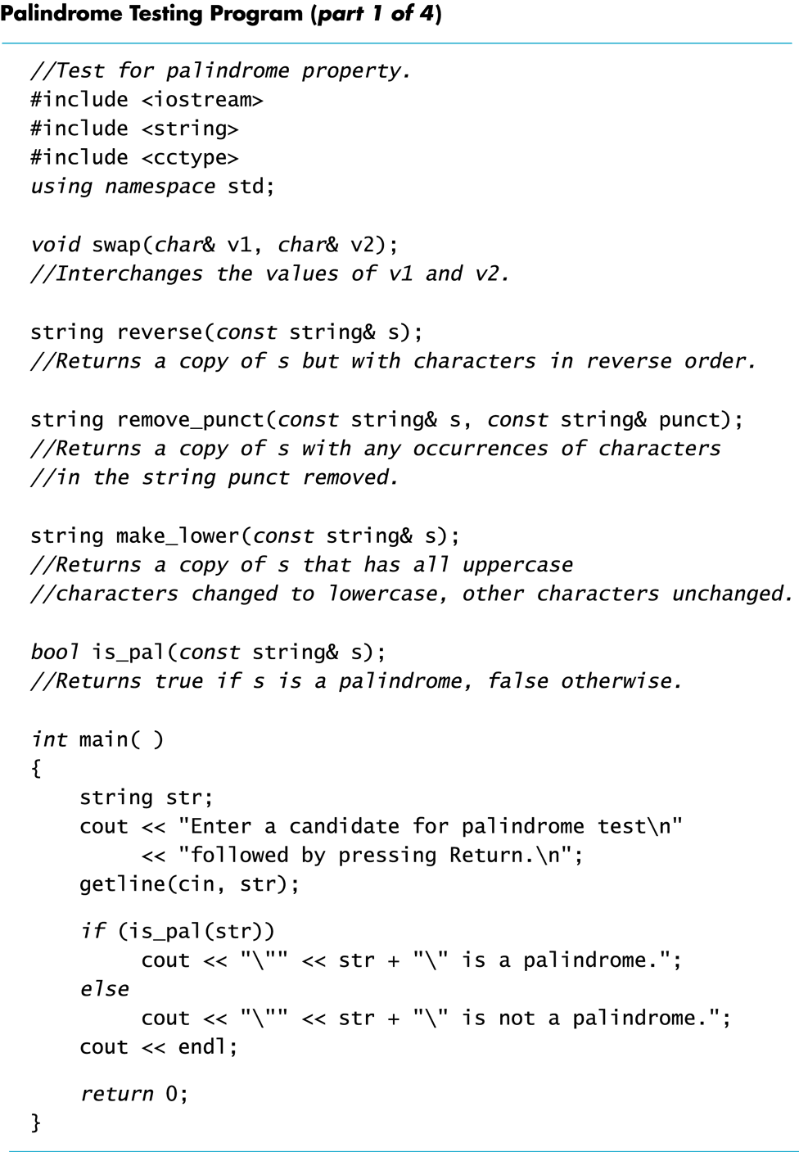
Display 8.8 (1/4)
Back
Next

Slide 78
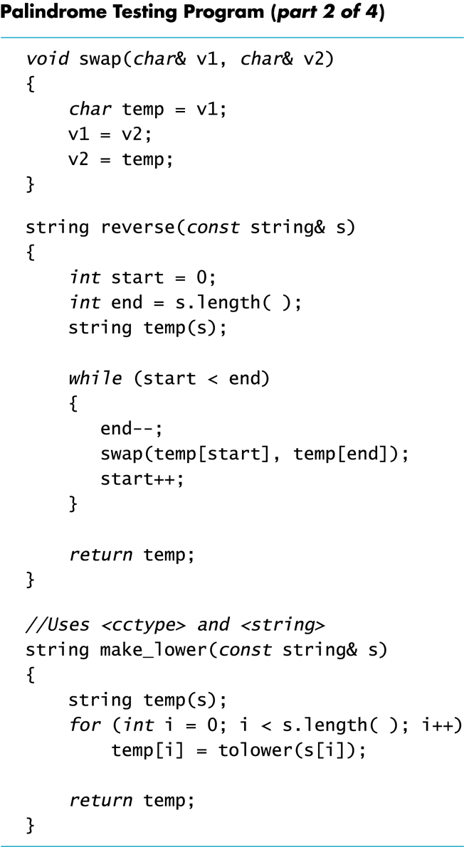
Display 8.8 (2/4)
Back
Next

Slide 79
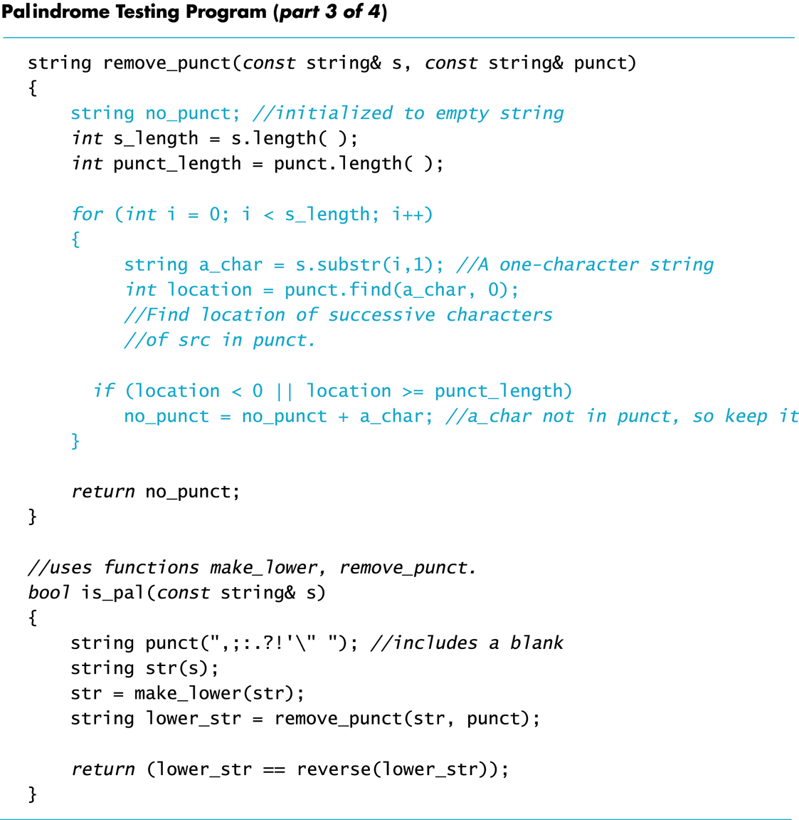
Display 8.8 (3/4)
Back
Next

Slide 80
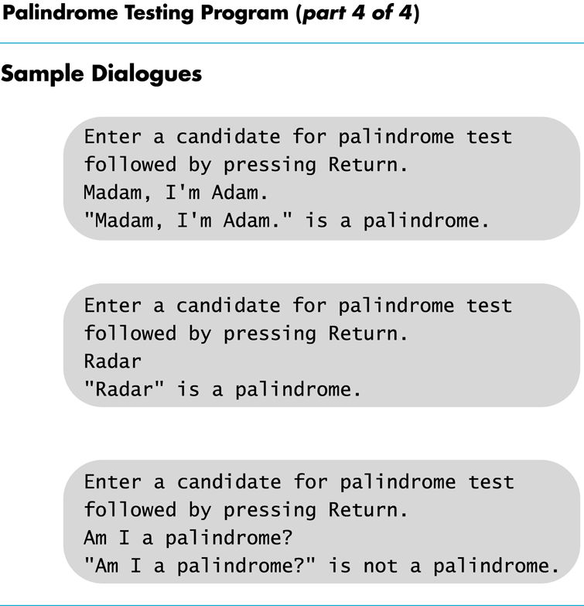
Display 8.8 (4/4)
Back
Next

Slide 81
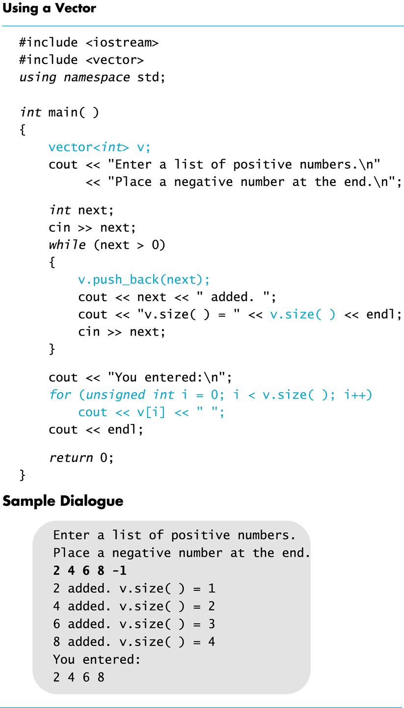
Display 8.9
Back
Next

