Slide 1
Session 11 Vectors and Intro to Pointers
CS 200 – Introduction to Programming

Slide 2
8.3
Vectors

Slide 3
Vectors
Vectors are like arrays that can change size as your program runs
Vectors, like arrays, have a base type
To declare an empty vector with base type int: vector<int> v;
<int> identifies vector as a template class
You can use any base type in a template class: vector<string> v;

Slide 4
Accessing vector Elements
Vectors elements are indexed starting with 0
[ ]'s are used to read or change the value of an item: v[i] = 42; cout << v[i];
[ ]'s cannot be used to initialize a vector element

Slide 5
Initializing vector Elements
Elements are added to a vector using the member function push_back
push_back adds an element in the next available position
Example: vector<double> sample; sample.push_back(0.0); sample.push_back(1.1); sample.push_back(2.2);

Slide 6
The size Of A vector
The member function size returns the number of elements in a vector
Example: To print each element of a vector given the previous vector initialization: for (int i= 0; i < sample.size( ); i++) cout << sample[i] << endl;

Slide 7
The Type unsigned int
The vector class member function size returns an unsigned int
Unsigned int's are nonnegative integers
Some compilers will give a warning if the previous for-loop is not changed to: for (unsigned int i= 0; i < sample.size( ); i++) cout << sample[i] << endl;

Slide 8
Alternate vector Initialization
A vector constructor exists that takes an integer argument and initializes that number of elements
Example: vector<int> v(10); initializes the first 10 elements to 0 v.size( ) would return 10
[ ]'s can now be used to assign elements 0 through 9
push_back is used to assign elements greater than 9

Slide 9
Vector Initialization With Classes
The vector constructor with an integer argument
Initializes elements of number types to zero
Initializes elements of class types using the default constructor for the class

Slide 10
The vector Library
To use the vector class
Include the vector library #include <vector>
Vector names are placed in the standard namespace so the usual using directive is needed: using namespace std;
Display 8.9

Slide 11
vector Issues
Attempting to use [ ] to set a value beyond the size of a vector may not generate an error
The program will probably misbehave
The assignment operator with vectors does an element by element copy of the right hand vector
For class types, the assignment operator must make independent copies

Slide 12
vector Efficiency
A vector's capacity is the number of elements allocated in memory
Accessible using the capacity( ) member function
Size is the number of elements initialized
When a vector runs out of space, the capacity is automatically increased
A common scheme is to double the size of a vector
More efficient than allocating smaller chunks of memory

Slide 13
Controlling vector Capacity
When efficiency is an issue
Member function reserve can increase the capacity of a vector
Example: v.reserve(32); // at least 32 elements v.reserve(v.size( ) + 10); // at least 10 more
resize can be used to shrink a vector
Example: v.resize(24); //elements beyond 24 are lost

Slide 14
Section 8.3 Conclusion
Can you
Declare and initialize a vector of 10 doubles?
Write code to increase the size of a vector in at least two different ways?
Describe the difference between a vector's size and its capacity?

Slide 15
Chapter 8 -- End

Slide 16
9
Pointers

Slide 17
Pointers
A pointer is the memory address of a variable
Memory addresses can be used as names for variables
If a variable is stored in three memory locations, the address of the first can be used as a name for the variable.
When a variable is used as a call-by-reference argument, its address is passed

Slide 18
Pointers Tell Where To Find A Variable
An address used to tell where a variable is stored in memory is a pointer
Pointers "point" to a variable by telling where the variable is located

Slide 19
Declaring Pointers
Pointer variables must be declared to have a pointer type
Example: To declare a pointer variable p that can "point" to a variable of type double: double *p;
The asterisk identifies p as a pointer variable

Slide 20
Multiple Pointer Declarations
To declare multiple pointers in a statement, use the asterisk before each pointer variable
Example: int *p1, *p2, v1, v2; p1 and p2 point to variables of type int v1 and v2 are variables of type int

Slide 21
The address of Operator
The & operator can be used to determine the address of a variable which can be assigned to a pointer variable
Example: p1 = &v1; p1 is now a pointer to v1 v1 can be called v1 or "the variable pointed to by p1"

Slide 22
The Dereferencing Operator
C++ uses the * operator in yet another way with pointers
The phrase "The variable pointed to by p" is translated into C++ as *p
Here the * is the dereferencing operator
p is said to be dereferenced

Slide 23
A Pointer Example
v1 = 0; p1 = &v1; *p1 = 42; cout << v1 << endl; cout << *p1 << endl; output: 42 42
v1 and *p1 now refer to the same variable

Slide 24
Pointer Assignment
The assignment operator = is used to assign the value of one pointer to another
Example: If p1 still points to v1 (previous slide) then p2 = p1; causes *p2, *p1, and v1 all to name the same variable

Slide 25
Caution! Pointer Assignments
Some care is required making assignments to pointer variables
p1= p3; // changes the location that p1 "points" to
*p1 = *p3; // changes the value at the location that // p1 "points" to
Display 9.1

Slide 26
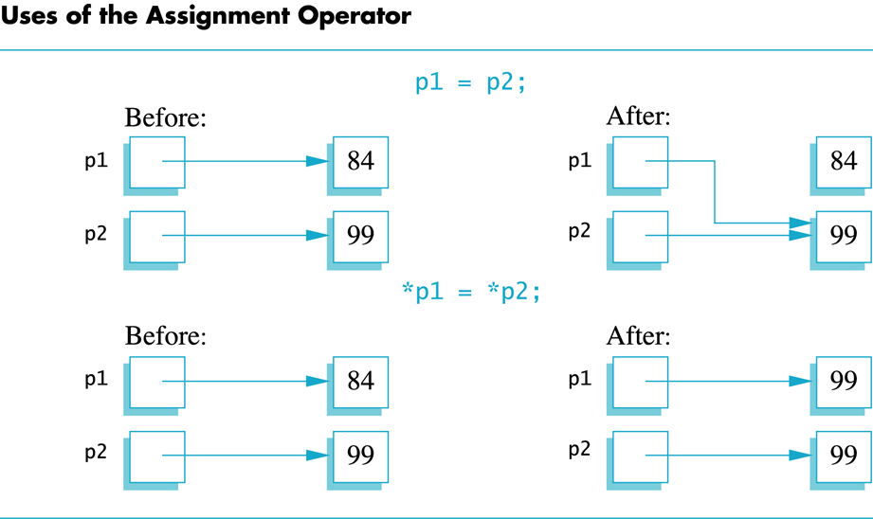
Display 9.1
Back
Next

Slide 27
The new Operator
Using pointers, variables can be manipulated even if there is no identifier for them
To create a pointer to a new "nameless" variable of type int: p1 = new int;
The new variable is referred to as *p1
*p1 can be used anyplace an integer variable can cin >> *p1; *p1 = *p1 + 7;

Slide 28
Dynamic Variables
Variables created using the new operator are called dynamic variables
Dynamic variables are created and destroyed while the program is running
Additional examples of pointers and dynamic variables are shown in An illustration of the code in Display 9.2 is seen in
Display 9.2
Display 9.3

Slide 29
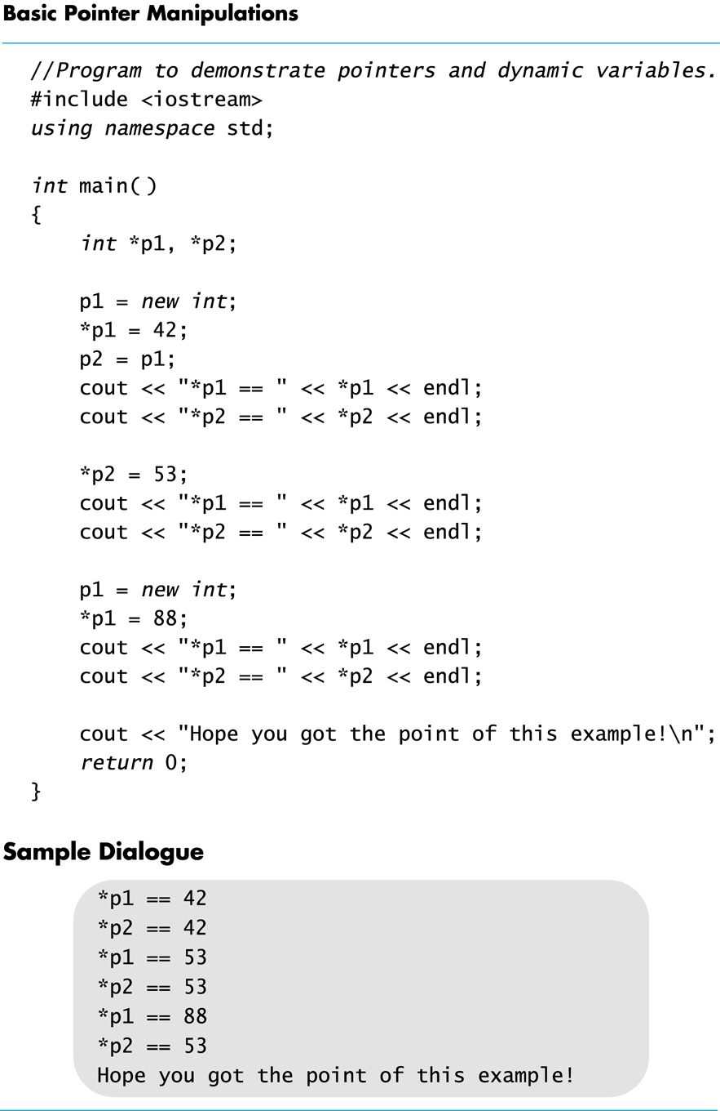
Display 9.2
Back
Next

Slide 30
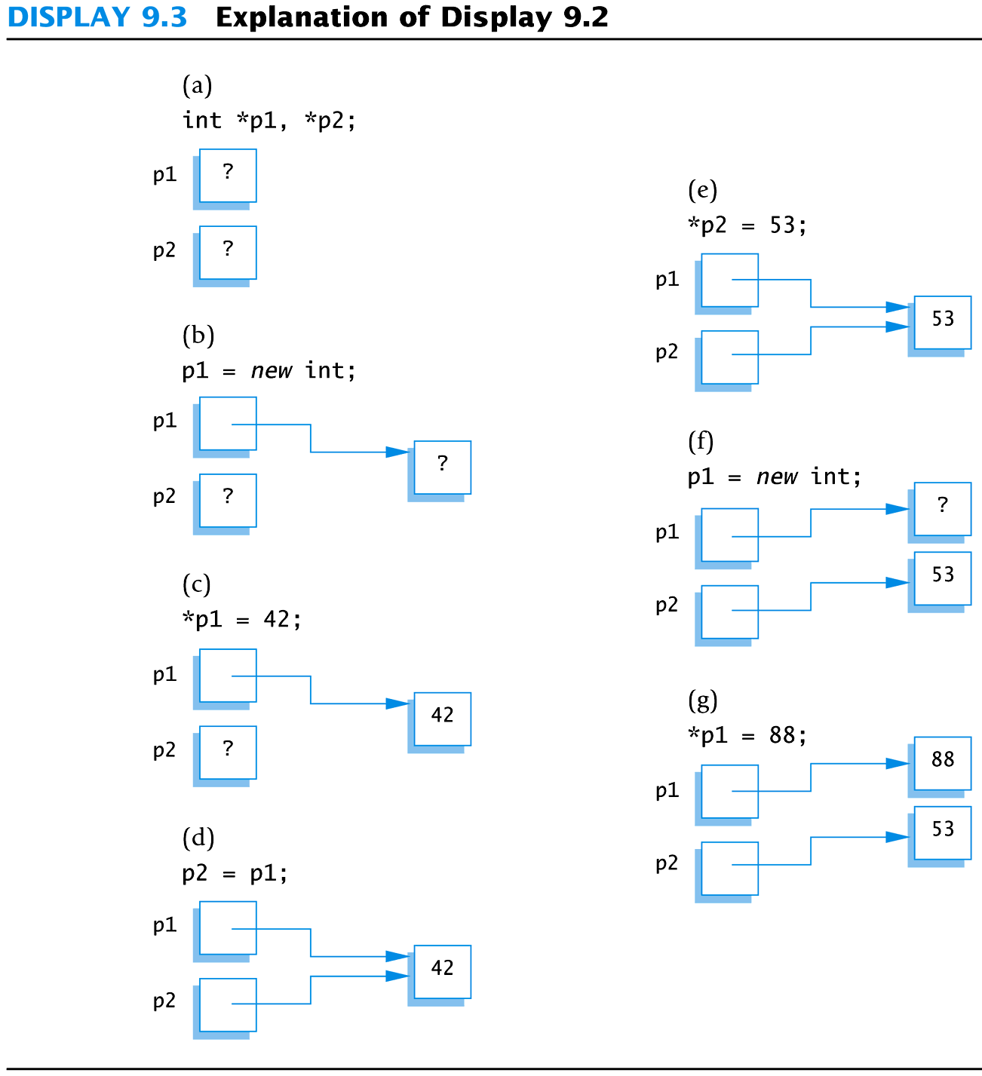
Display 9.3
Back
Next

Slide 31
new and Class Types
Using operator new with class types calls a constructor as well as allocating memory
If MyType is a class type, then MyType *myPtr; // creates a pointer to a // variable of type MyType myPtr = new MyType; // calls the default constructor myPtr = new MyType (32.0, 17); // calls Mytype(double, int);

Slide 32
Basic Memory Management
An area of memory called the freestore is reserved for dynamic variables
New dynamic variables use memory in the freestore
If all of the freestore is used, calls to new will fail
Unneeded memory can be recycled
When variables are no longer needed, they can be deleted and the memory they used is returned to the freestore

Slide 33
The delete Operator
When dynamic variables are no longer needed, delete them to return memory to the freestore
Example: delete p; The value of p is now undefined and the memory used by the variable that p pointed to is back in the freestore

Slide 34
Dangling Pointers
Using delete on a pointer variable destroys the dynamic variable pointed to
If another pointer variable was pointing to the dynamic variable, that variable is also undefined
Undefined pointer variables are called dangling pointers
Dereferencing a dangling pointer (*p) is usually disasterous

Slide 35
Automatic Variables
Variables declared in a function are created by C++ and destroyed when the function ends
These are called automatic variables because their creation and destruction is controlled automatically
The programmer manually controls creation and destruction of pointer variables with operators new and delete

Slide 36
Global Variables
Variables declared outside any function definition are global variables
Global variables are available to all parts of a program
Global variables are not generally used

Slide 37
Type Definitions
A name can be assigned to a type definition, then used to declare variables
The keyword typedef is used to define new type names
Syntax: typedef Known_Type_Definition New_Type_Name;
Known_Type_Definition can be any type

Slide 38
Defining Pointer Types
To avoid mistakes using pointers, define a pointer type name
Example: typedef int* IntPtr; Defines a new type, IntPtr, for pointer variables containing pointers to int variables
IntPtr p; is equivalent to int *p;

Slide 39
Multiple Declarations Again
Using our new pointer type defined as typedef int* IntPtr;
Prevent this error in pointer declaration: int *P1, P2; // Only P1 is a pointer variable
with IntPtr P1, P2; // P1 and P2 are pointer // variables

Slide 40
Pointer Reference Parameters
A second advantage in using typedef to define a pointer type is seen in parameter lists
Example: void sample_function(IntPtr& pointer_var); is less confusing than void sample_function( int*& pointer_var);

Slide 41
Section 9.1 Conclusion
Can you
Declare a pointer variable?
Assign a value to a pointer variable?
Use the new operator to create a new variable in the freestore?
Write a definition for a type called NumberPtr to be a type for pointers to dynamic variables of type int?
Use the NumberPtr type to declare a pointer variable called my_point?

Slide 42
9.2
Dynamic Arrays

Slide 43
Dynamic Arrays
A dynamic array is an array whose size is determined when the program is running, not when you write the program

Slide 44
Pointer Variables and Array Variables
Array variables are actually pointer variables that point to the first indexed variable
Example: int a[10]; typedef int* IntPtr; IntPtr p;
Variables a and p are the same kind of variable
Since a is a pointer variable that points to a[0], p = a; causes p to point to the same location as a

Slide 45
Pointer Variables As Array Variables
Continuing the previous example: Pointer variable p can be used as if it were an array variable
Example: p[0], p[1], …p[9] are all legal ways to use p
Variable a can be used as a pointer variable except the pointer value in a cannot be changed
This is not legal: IntPtr p2; … // p2 is assigned a value a = p2 // attempt to change a
Display 9.4

Slide 46
Creating Dynamic Arrays
Normal arrays require that the programmer determine the size of the array when the program is written
What if the programmer estimates too large?
Memory is wasted
What if the programmer estimates too small?
The program may not work in some situations
Dynamic arrays can be created with just the right size while the program is running

Slide 47
Creating Dynamic Arrays
Dynamic arrays are created using the new operator
Example: To create an array of 10 elements of type double: typedef double* DoublePtr; DoublePtr d; d = new double[10];
d can now be used as if it were an ordinary array!
This could be an integer variable!

Slide 48
Dynamic Arrays (cont.)
Pointer variable d is a pointer to d[0]
When finished with the array, it should be deleted to return memory to the freestore
Example: delete [ ] d;
The brackets tell C++ a dynamic array is being deleted so it must check the size to know how many indexed variables to remove
Forgetting the brackets, is not legal, but would tell the computer to remove only one variable
Display 9.5 (1)
Display 9.5 (2)

Slide 49
Pointer Arithmetic (Optional)
Arithmetic can be performed on the addresses contained in pointers
Using the dynamic array of doubles, d, declared previously, recall that d points to d[0]
The expression d+1 evaluates to the address of d[1] and d+2 evaluates to the address of d[2]
Notice that adding one adds enough bytes for one variable of the type stored in the array

Slide 50
Pointer Arthmetic Operations
You can add and subtract with pointers
The ++ and - - operators can be used
Two pointers of the same type can be subtracted to obtain the number of indexed variables between
The pointers should be in the same array!
This code shows one way to use pointer arithmetic: for (int i = 0; i < array_size; i++) cout << *(d + i) << " " ; // same as cout << d[i] << " " ;

Slide 51
Multidimensional Dynamic Arrays
To create a 3x4 multidimensional dynamic array
View multidimensional arrays as arrays of arrays
First create a one-dimensional dynamic array
Start with a new definition: typedef int* IntArrayPtr;
Now create a dynamic array of pointers named m: IntArrayPtr *m = new IntArrayPtr[3];
For each pointer in m, create a dynamic array of int's
for (int i = 0; i<3; i++) m[i] = new int[4];

Slide 52
A Multidimensial Dynamic Array
The dynamic array created on the previous slide could be visualized like this:
m
IntArrayPtr's
IntArrayPtr *
int's

Slide 53
Deleting Multidimensional Arrays
To delete a multidimensional dynamic array
Each call to new that created an array must have a corresponding call to delete[ ]
Example: To delete the dynamic array created on a previous slide: for ( i = 0; i < 3; i++) delete [ ] m[i]; //delete the arrays of 4 int's delete [ ] m; // delete the array of IntArrayPtr's
Display 9.6 (1)
Display 9.6 (2)

Slide 54
Section 9.2 Conclusion
Can you
Write a definition for pointer variables that will be used to point to dynamic arrays? The array elements are of type char. Call the type CharArray.
Write code to fill array "entry" with 10 numbers typed at the keyboard? int * entry; entry = new int[10];

Slide 55
Chapter 9 -- End

Slide 56
Display 9.1
Back
Next

Slide 57
Display 9.2
Back
Next

Slide 58
Display 9.3
Back
Next

Slide 59
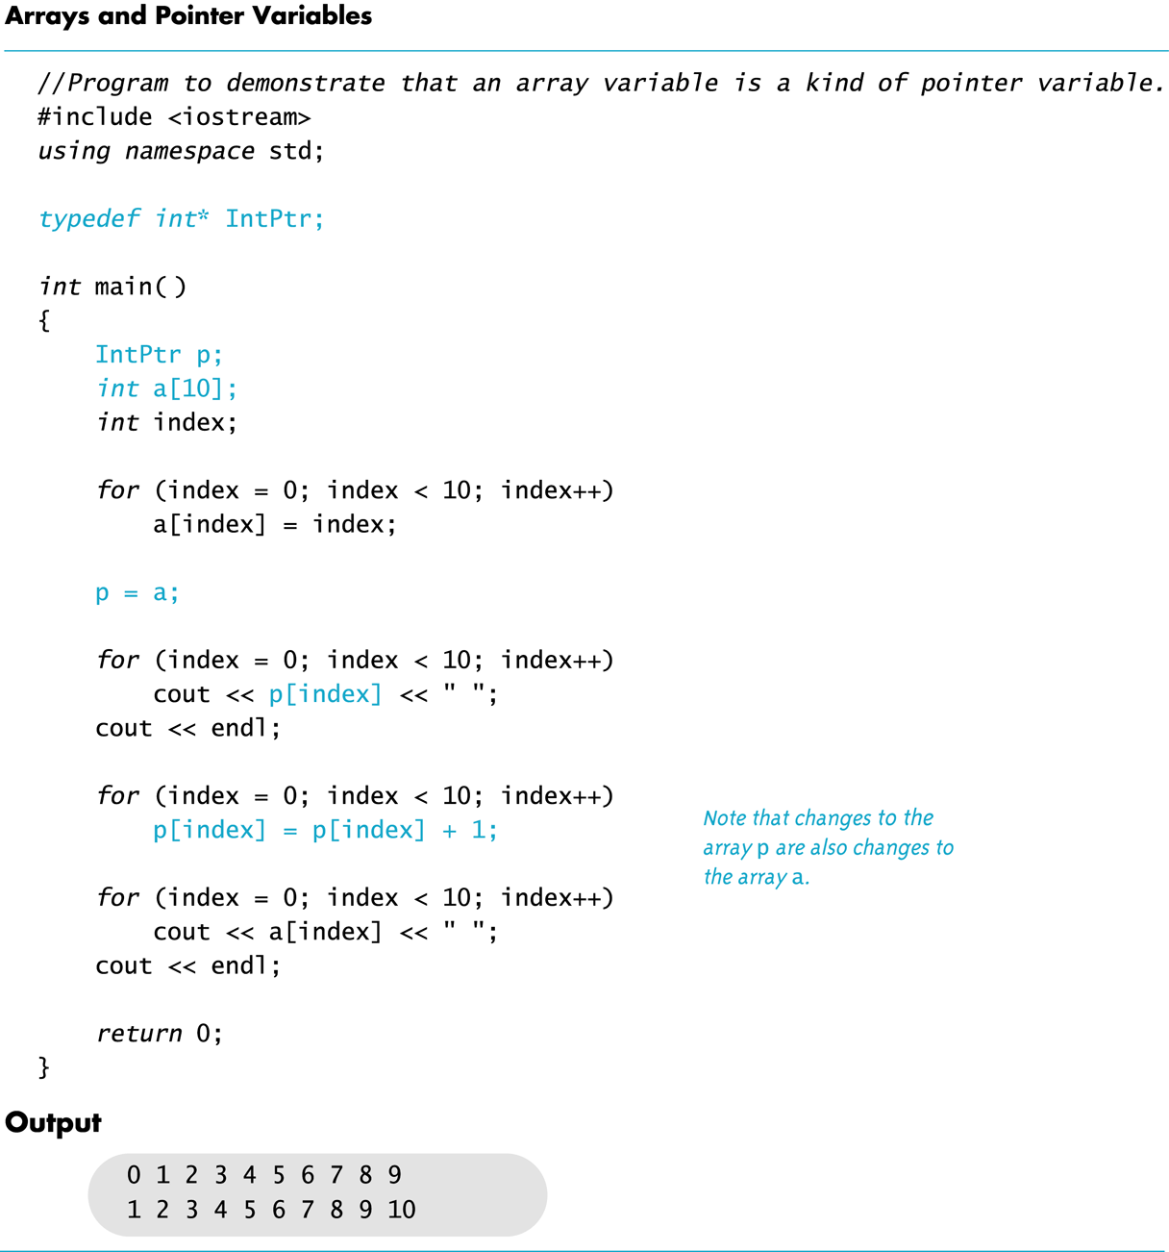
Display 9.4
Back
Next

Slide 60
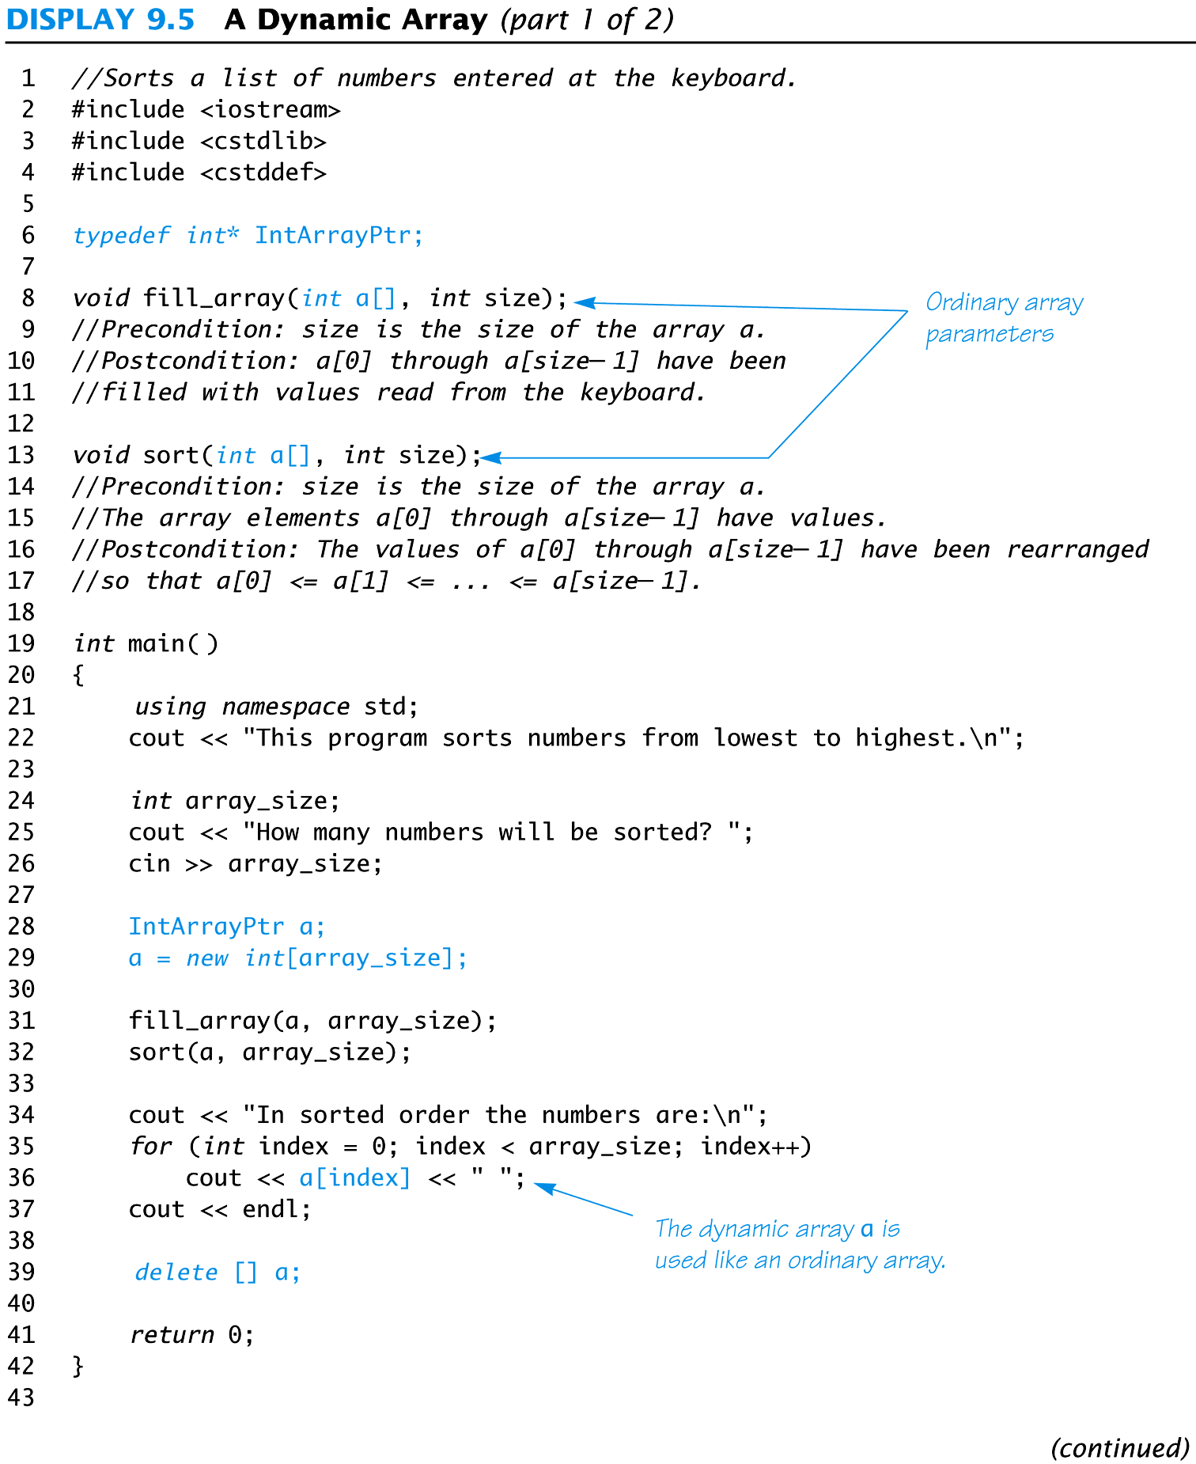
Display 9.5 (1/2)
Back
Next

Slide 61
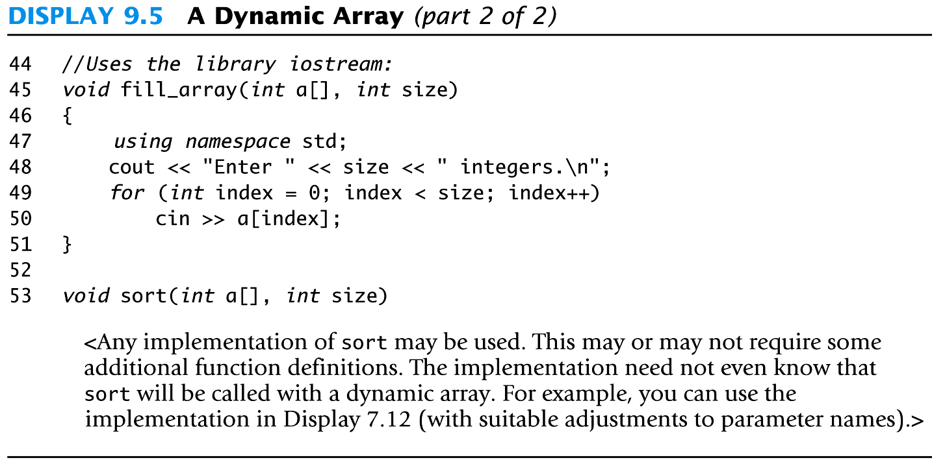
Display 9.5 (2/2)
Back
Next

Slide 62
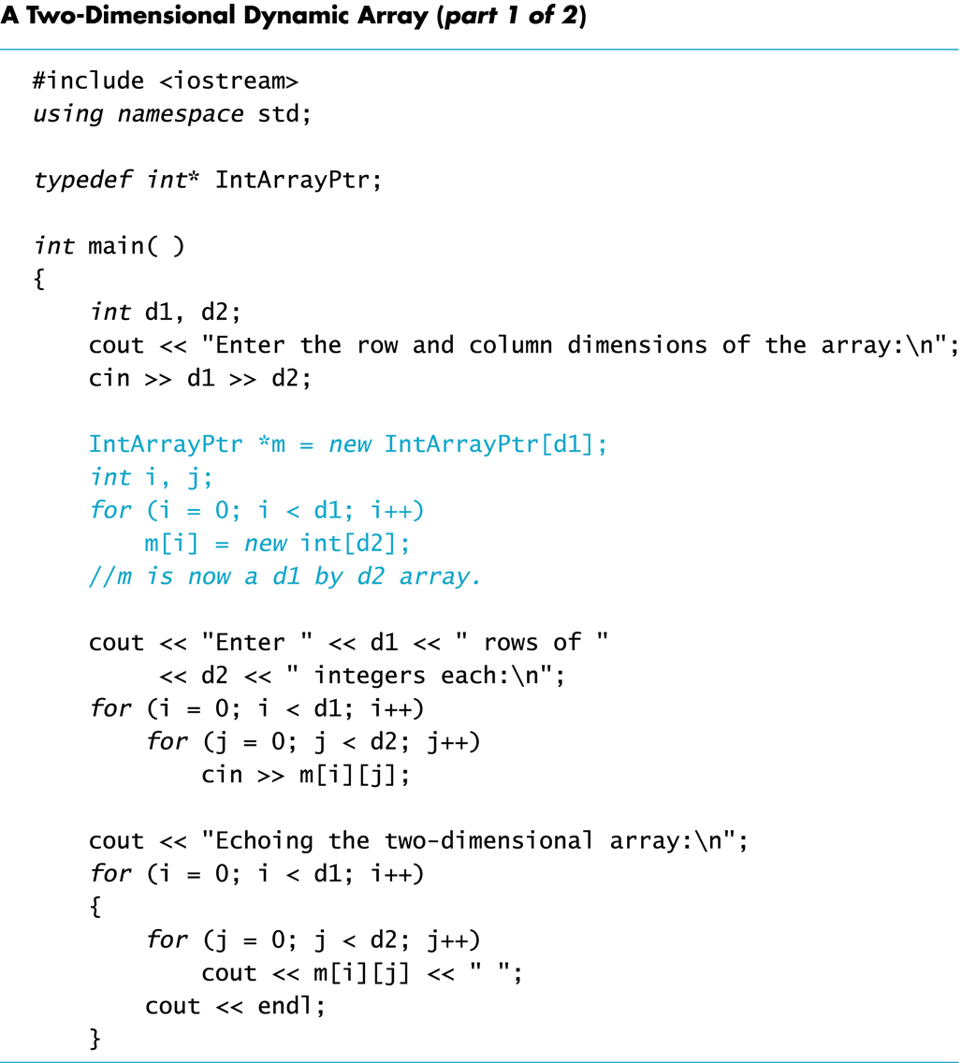
Display 9.6 (1/2)
Back
Next

Slide 63
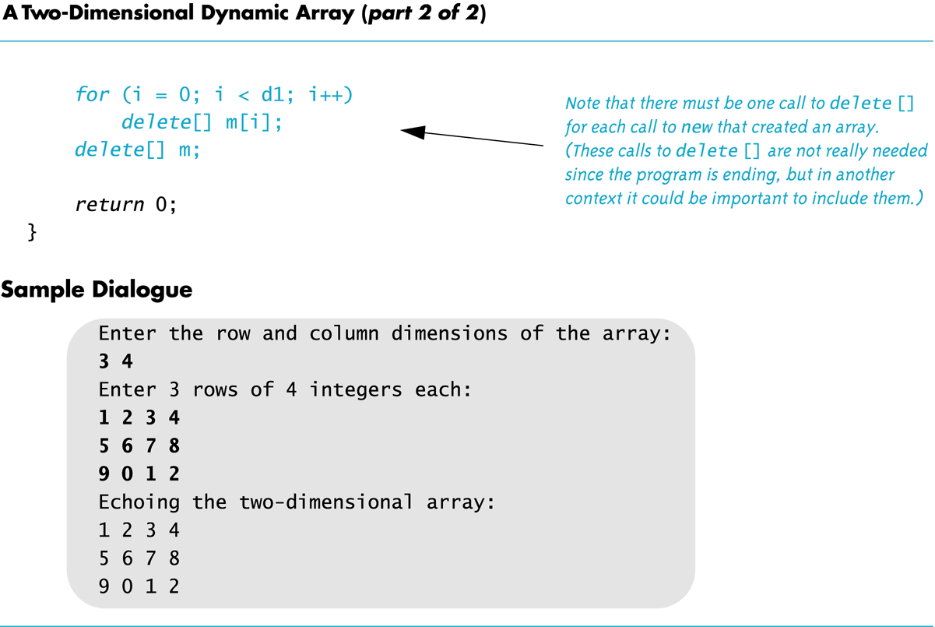
Display 9.6 (2/2)
Back
Next

