Slide 1
Session 12 Pointers
CS 200 – Introduction to Programming

Slide 2
Pointers
A pointer is the memory address of a variable
Memory addresses can be used as names for variables
If a variable is stored in three memory locations, the address of the first can be used as a name for the variable.
When a variable is used as a call-by-reference argument, its address is passed

Slide 3
Pointers Tell Where To Find A Variable
An address used to tell where a variable is stored in memory is a pointer
Pointers "point" to a variable by telling where the variable is located

Slide 4
Declaring Pointers
Pointer variables must be declared to have a pointer type
Example: To declare a pointer variable p that can "point" to a variable of type double: double *p;
The asterisk identifies p as a pointer variable

Slide 5
Multiple Pointer Declarations
To declare multiple pointers in a statement, use the asterisk before each pointer variable
Example: int *p1, *p2, v1, v2; p1 and p2 point to variables of type int v1 and v2 are variables of type int

Slide 6
The address of Operator
The & operator can be used to determine the address of a variable which can be assigned to a pointer variable
Example: p1 = &v1; p1 is now a pointer to v1 v1 can be called v1 or "the variable pointed to by p1"

Slide 7
The Dereferencing Operator
C++ uses the * operator in yet another way with pointers
The phrase "The variable pointed to by p" is translated into C++ as *p
Here the * is the dereferencing operator
p is said to be dereferenced

Slide 8
A Pointer Example
v1 = 0; p1 = &v1; *p1 = 42; cout << v1 << endl; cout << *p1 << endl; output: 42 42
v1 and *p1 now refer to the same variable

Slide 9
Pointer Assignment
The assignment operator = is used to assign the value of one pointer to another
Example: If p1 still points to v1 (previous slide) then p2 = p1; causes *p2, *p1, and v1 all to name the same variable

Slide 10
Caution! Pointer Assignments
Some care is required making assignments to pointer variables
p1= p3; // changes the location that p1 "points" to
*p1 = *p3; // changes the value at the location that // p1 "points" to
Display 9.1

Slide 11
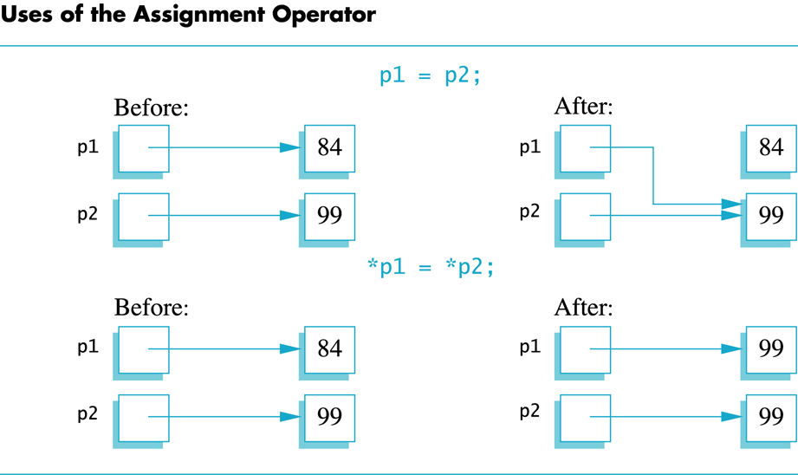
Display 9.1
Back
Next

Slide 12
The new Operator
Using pointers, variables can be manipulated even if there is no identifier for them
To create a pointer to a new "nameless" variable of type int: p1 = new int;
The new variable is referred to as *p1
*p1 can be used anyplace an integer variable can cin >> *p1; *p1 = *p1 + 7;

Slide 13
Dynamic Variables
Variables created using the new operator are called dynamic variables
Dynamic variables are created and destroyed while the program is running
Additional examples of pointers and dynamic variables are shown in An illustration of the code in Display 9.2 is seen in
Display 9.2
Display 9.3

Slide 14
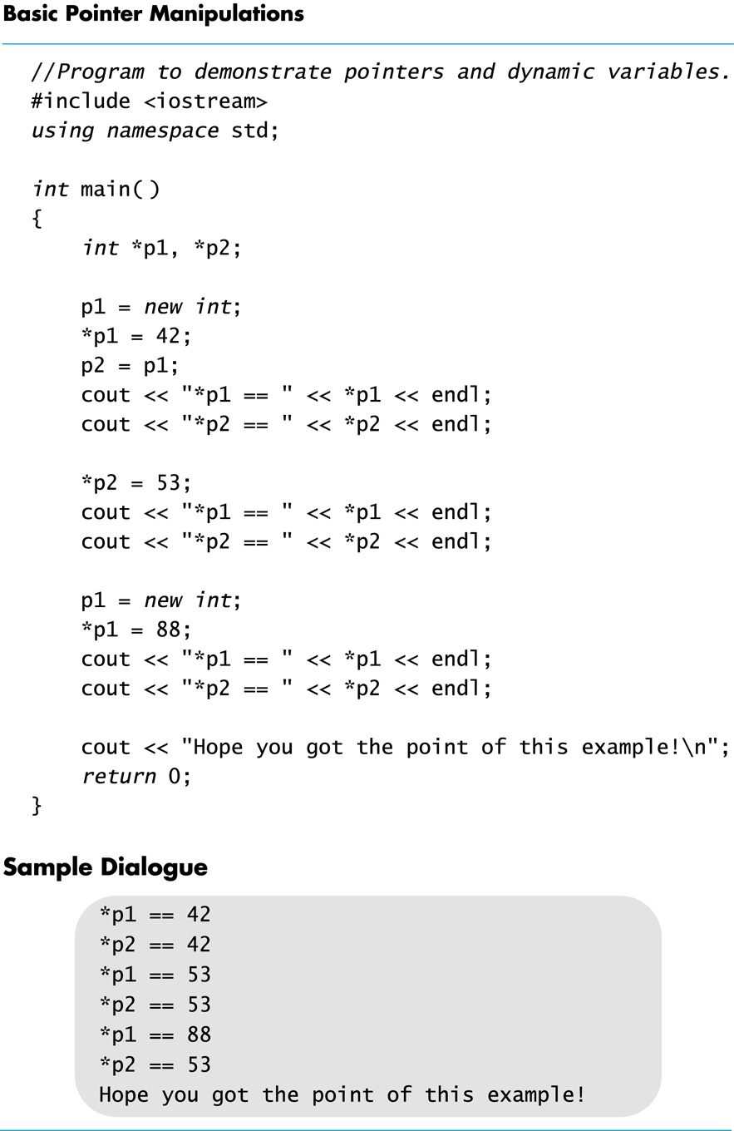
Display 9.2
Back
Next

Slide 15
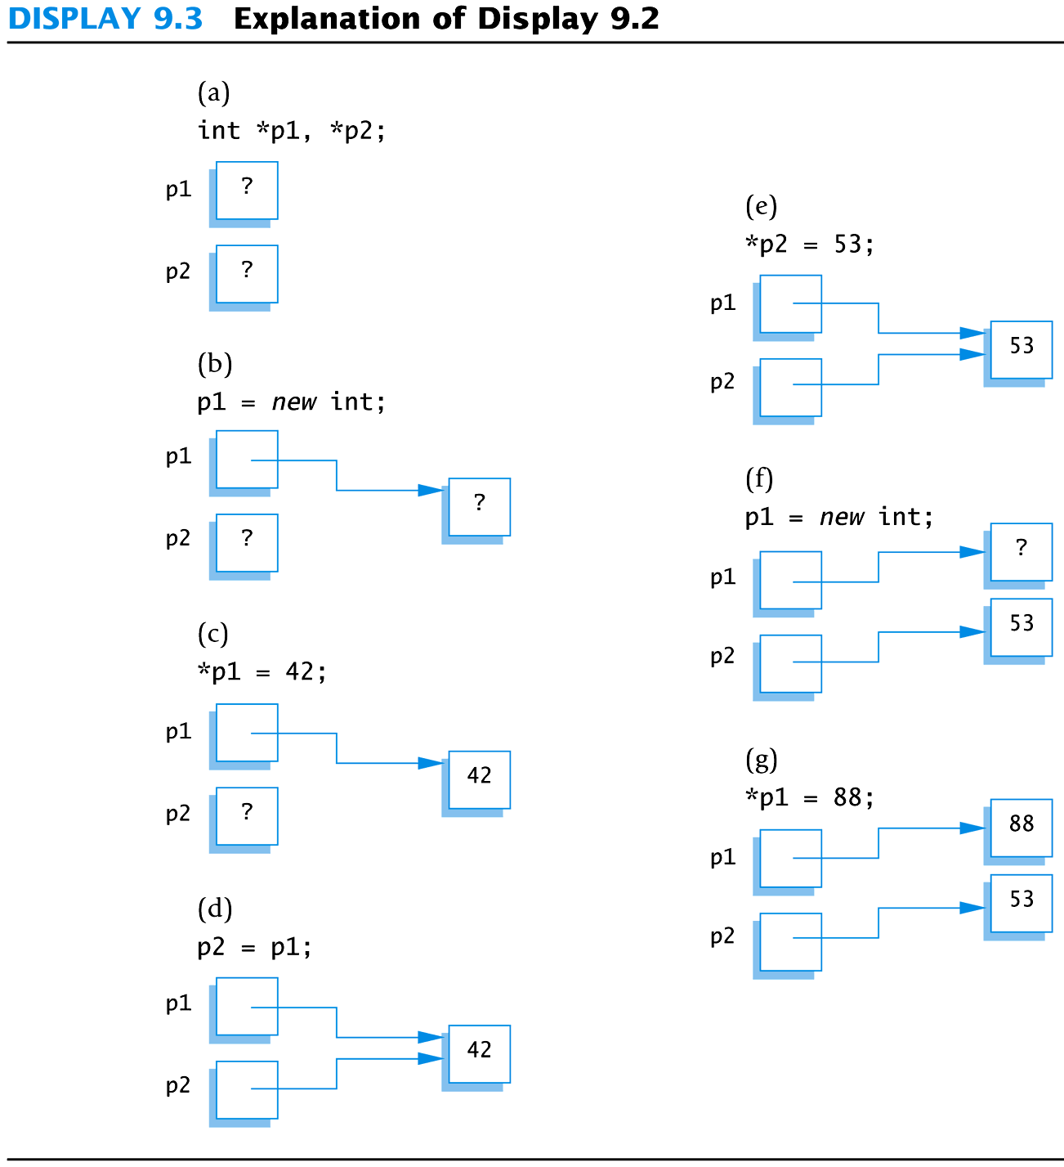
Display 9.3
Back
Next

Slide 16
new and Class Types
Using operator new with class types calls a constructor as well as allocating memory
If MyType is a class type, then MyType *myPtr; // creates a pointer to a // variable of type MyType myPtr = new MyType; // calls the default constructor myPtr = new MyType (32.0, 17); // calls Mytype(double, int);

Slide 17
Basic Memory Management
An area of memory called the freestore is reserved for dynamic variables
New dynamic variables use memory in the freestore
If all of the freestore is used, calls to new will fail
Unneeded memory can be recycled
When variables are no longer needed, they can be deleted and the memory they used is returned to the freestore

Slide 18
The delete Operator
When dynamic variables are no longer needed, delete them to return memory to the freestore
Example: delete p; The value of p is now undefined and the memory used by the variable that p pointed to is back in the freestore

Slide 19
Dangling Pointers
Using delete on a pointer variable destroys the dynamic variable pointed to
If another pointer variable was pointing to the dynamic variable, that variable is also undefined
Undefined pointer variables are called dangling pointers
Dereferencing a dangling pointer (*p) is usually disasterous

Slide 20
Automatic Variables
Variables declared in a function are created by C++ and destroyed when the function ends
These are called automatic variables because their creation and destruction is controlled automatically
The programmer manually controls creation and destruction of pointer variables with operators new and delete

Slide 21
Global Variables
Variables declared outside any function definition are global variables
Global variables are available to all parts of a program
Global variables are not generally used

Slide 22
Type Definitions
A name can be assigned to a type definition, then used to declare variables
The keyword typedef is used to define new type names
Syntax: typedef Known_Type_Definition New_Type_Name;
Known_Type_Definition can be any type

Slide 23
Defining Pointer Types
To avoid mistakes using pointers, define a pointer type name
Example: typedef int* IntPtr; Defines a new type, IntPtr, for pointer variables containing pointers to int variables
IntPtr p; is equivalent to int *p;

Slide 24
Multiple Declarations Again
Using our new pointer type defined as typedef int* IntPtr;
Prevent this error in pointer declaration: int *P1, P2; // Only P1 is a pointer variable
with IntPtr P1, P2; // P1 and P2 are pointer // variables

Slide 25
Pointer Reference Parameters
A second advantage in using typedef to define a pointer type is seen in parameter lists
Example: void sample_function(IntPtr& pointer_var); is less confusing than void sample_function( int*& pointer_var);

Slide 26
Section 9.1 Conclusion
Can you
Declare a pointer variable?
Assign a value to a pointer variable?
Use the new operator to create a new variable in the freestore?
Write a definition for a type called NumberPtr to be a type for pointers to dynamic variables of type int?
Use the NumberPtr type to declare a pointer variable called my_point?

Slide 27
9.2
Dynamic Arrays

Slide 28
Dynamic Arrays
A dynamic array is an array whose size is determined when the program is running, not when you write the program

Slide 29
Pointer Variables and Array Variables
Array variables are actually pointer variables that point to the first indexed variable
Example: int a[10]; typedef int* IntPtr; IntPtr p;
Variables a and p are the same kind of variable
Since a is a pointer variable that points to a[0], p = a; causes p to point to the same location as a

Slide 30
Pointer Variables As Array Variables
Continuing the previous example: Pointer variable p can be used as if it were an array variable
Example: p[0], p[1], …p[9] are all legal ways to use p
Variable a can be used as a pointer variable except the pointer value in a cannot be changed
This is not legal: IntPtr p2; … // p2 is assigned a value a = p2 // attempt to change a
Display 9.4

Slide 31
Creating Dynamic Arrays
Normal arrays require that the programmer determine the size of the array when the program is written
What if the programmer estimates too large?
Memory is wasted
What if the programmer estimates too small?
The program may not work in some situations
Dynamic arrays can be created with just the right size while the program is running

Slide 32
Creating Dynamic Arrays
Dynamic arrays are created using the new operator
Example: To create an array of 10 elements of type double: typedef double* DoublePtr; DoublePtr d; d = new double[10];
d can now be used as if it were an ordinary array!
This could be an integer variable!

Slide 33
Dynamic Arrays (cont.)
Pointer variable d is a pointer to d[0]
When finished with the array, it should be deleted to return memory to the freestore
Example: delete [ ] d;
The brackets tell C++ a dynamic array is being deleted so it must check the size to know how many indexed variables to remove
Forgetting the brackets, is not legal, but would tell the computer to remove only one variable
Display 9.5 (1)
Display 9.5 (2)

Slide 34
Pointer Arithmetic (Optional)
Arithmetic can be performed on the addresses contained in pointers
Using the dynamic array of doubles, d, declared previously, recall that d points to d[0]
The expression d+1 evaluates to the address of d[1] and d+2 evaluates to the address of d[2]
Notice that adding one adds enough bytes for one variable of the type stored in the array

Slide 35
Pointer Arthmetic Operations
You can add and subtract with pointers
The ++ and - - operators can be used
Two pointers of the same type can be subtracted to obtain the number of indexed variables between
The pointers should be in the same array!
This code shows one way to use pointer arithmetic: for (int i = 0; i < array_size; i++) cout << *(d + i) << " " ; // same as cout << d[i] << " " ;

Slide 36
Multidimensional Dynamic Arrays
To create a 3x4 multidimensional dynamic array
View multidimensional arrays as arrays of arrays
First create a one-dimensional dynamic array
Start with a new definition: typedef int* IntArrayPtr;
Now create a dynamic array of pointers named m: IntArrayPtr *m = new IntArrayPtr[3];
For each pointer in m, create a dynamic array of int's
for (int i = 0; i<3; i++) m[i] = new int[4];

Slide 37
A Multidimensial Dynamic Array
The dynamic array created on the previous slide could be visualized like this:
m
IntArrayPtr's
IntArrayPtr *
int's

Slide 38
Deleting Multidimensional Arrays
To delete a multidimensional dynamic array
Each call to new that created an array must have a corresponding call to delete[ ]
Example: To delete the dynamic array created on a previous slide: for ( i = 0; i < 3; i++) delete [ ] m[i]; //delete the arrays of 4 int's delete [ ] m; // delete the array of IntArrayPtr's
Display 9.6 (1)
Display 9.6 (2)

Slide 39
Section 9.2 Conclusion
Can you
Write a definition for pointer variables that will be used to point to dynamic arrays? The array elements are of type char. Call the type CharArray.
Write code to fill array "entry" with 10 numbers typed at the keyboard? int * entry; entry = new int[10];

Slide 40
Chapter 9 -- End

Slide 41
Display 9.1
Back
Next

Slide 42
Display 9.2
Back
Next

Slide 43
Display 9.3
Back
Next

Slide 44
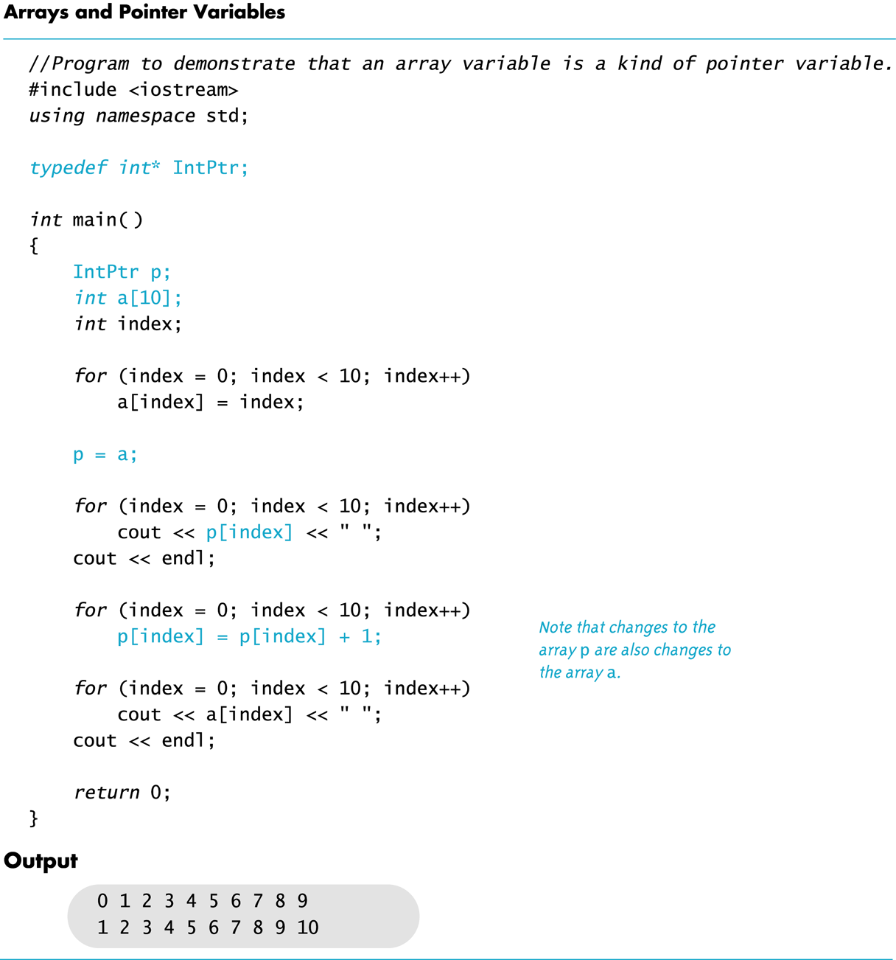
Display 9.4
Back
Next

Slide 45
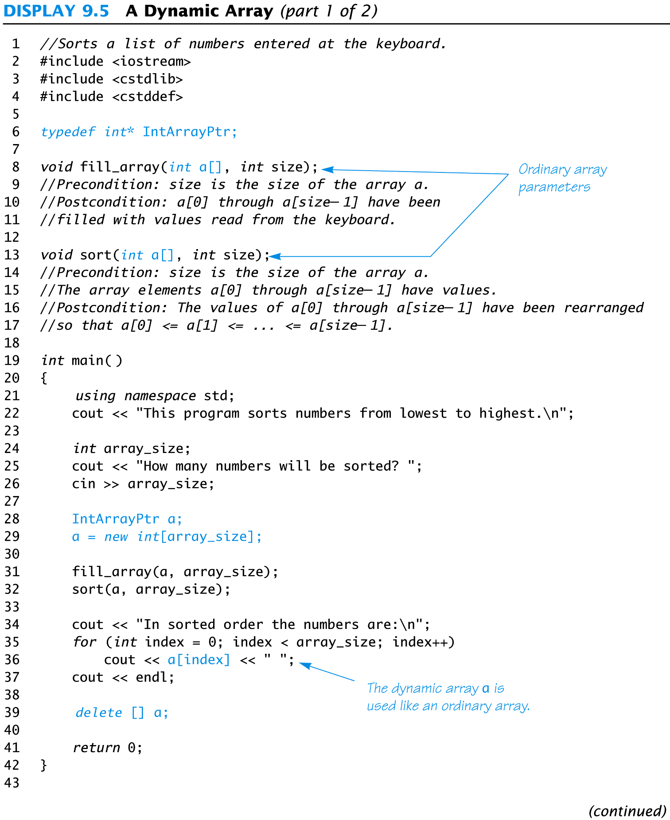
Display 9.5 (1/2)
Back
Next

Slide 46
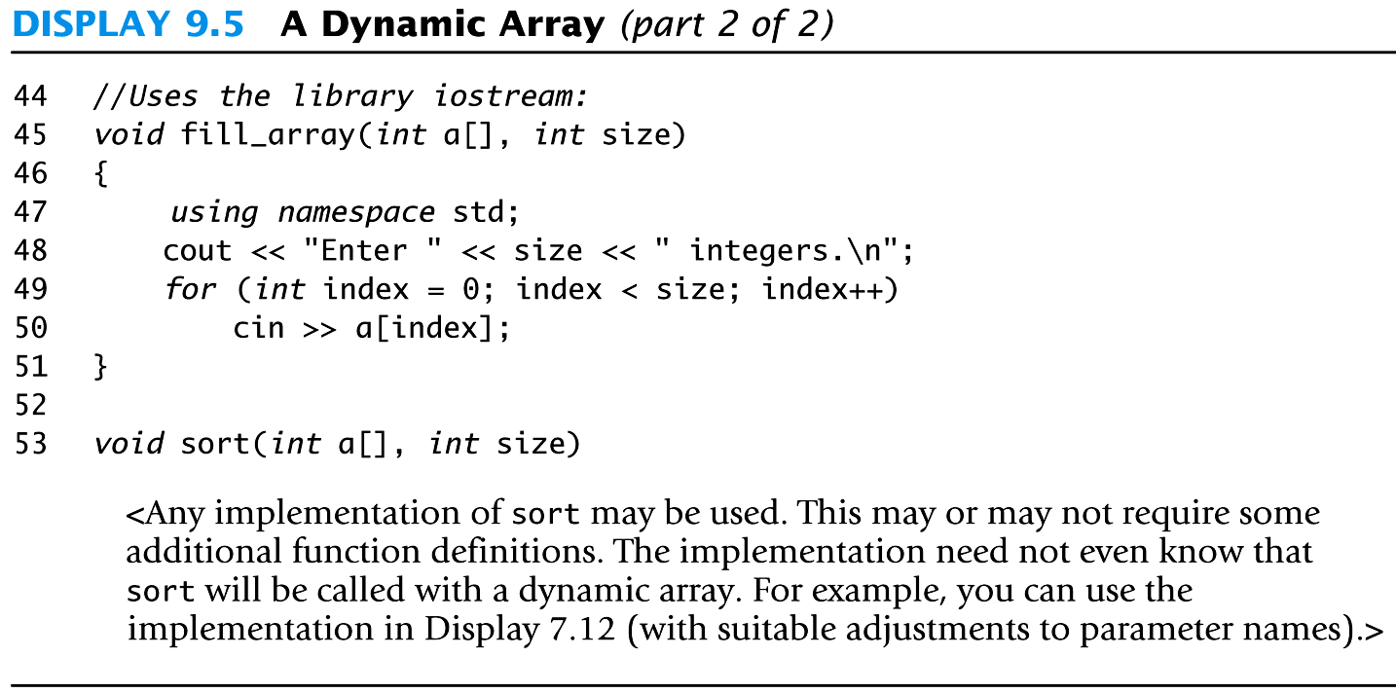
Display 9.5 (2/2)
Back
Next

Slide 47
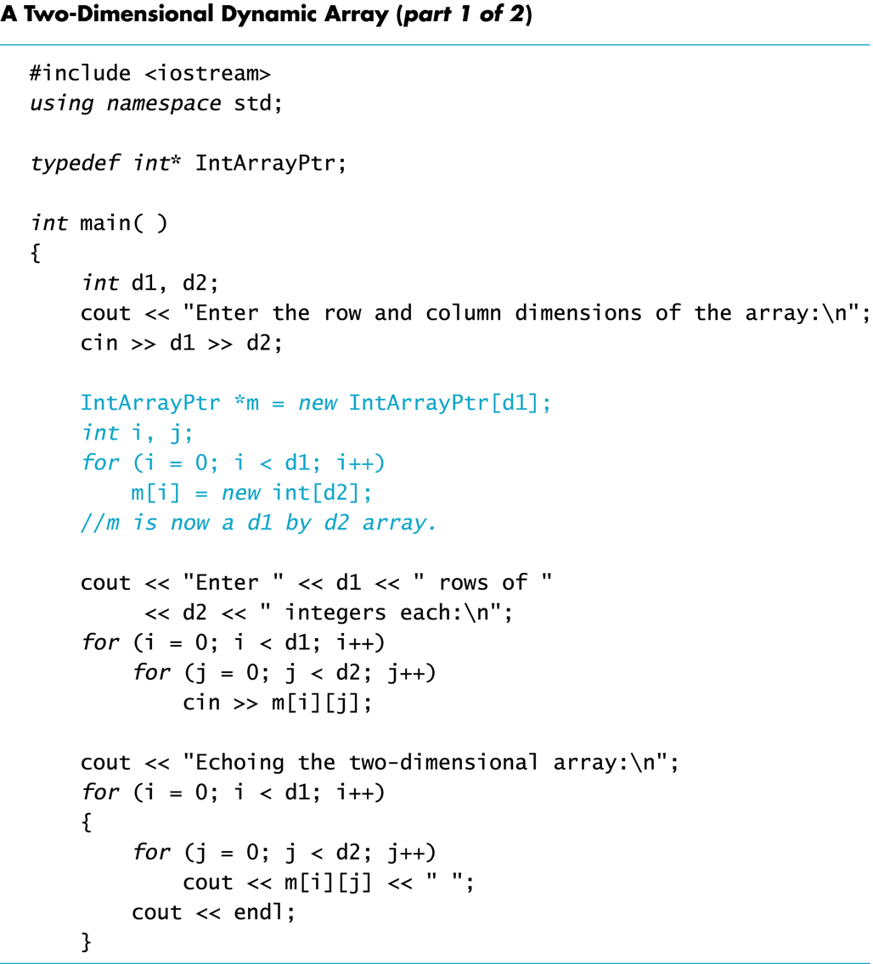
Display 9.6 (1/2)
Back
Next

Slide 48
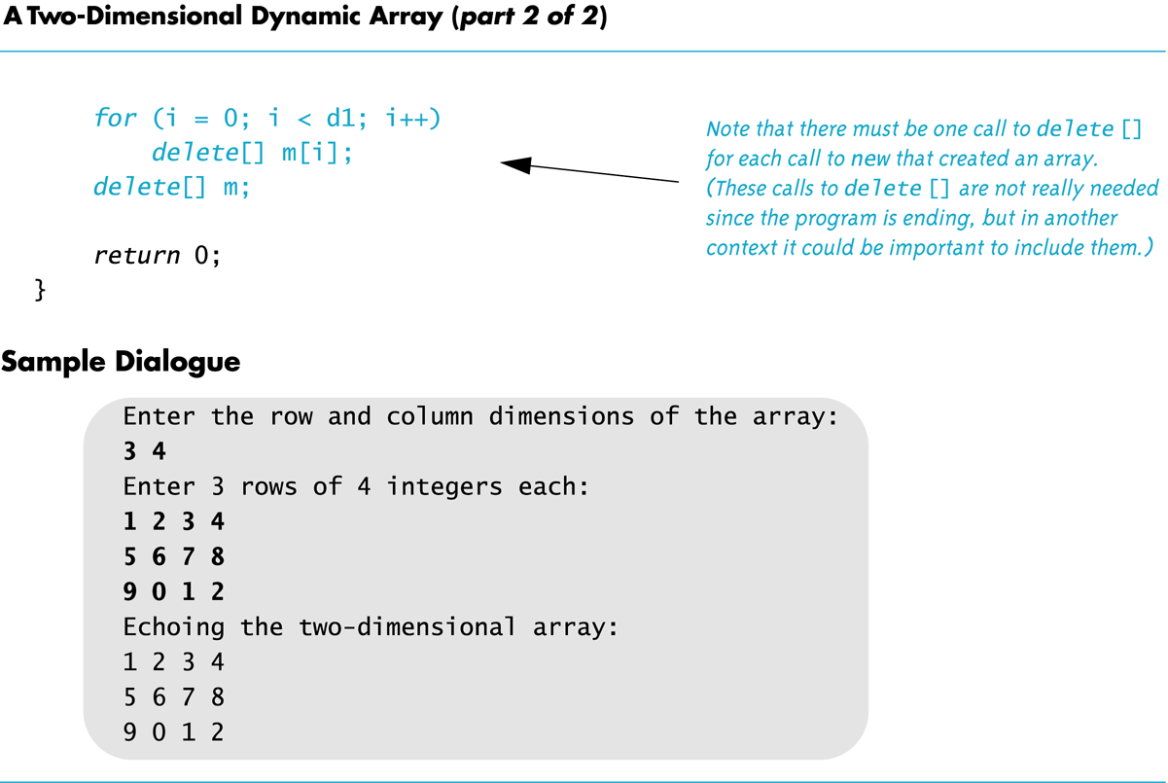
Display 9.6 (2/2)
Back
Next

